Slide 1
University of Portsmouth
Computer Games Technology
CT6GAMAI UP784120

Slide 2
Introduction
This AI project was developed having in mind the idea of a stealth game.
Important stealth games: Assassin's Creed Series
It is considered that the heart of stealth games is represented by a simple game loop between two cognitive senses, sneaking and fleeing. (Wong, 2014, para 2) So, in order for this two to happen the AI will need to be able to move around the map, react to player’s input and change it’s behavior based on different events that happen in the game. The artefact will not only have a hostile AI that will have the role of attacking the player, but crowds will also be implemented.
The hostile AI will be limited in terms of visual and auditory perception. It will be able to see the player only if he is in a certain range and in the FOV and it will react to sounds made by the player.
Rasmussen argues that the state of the art in AI games calls for AI technologies that can support complex, deep and immersive game worlds. He gives example of the Assassin’s Creed series where the number of the non-player characters is growing and the demands of life-like behaviors are increasing. (Rasmussen, 2016, para 9)

Slide 3
FSM
I did choose to use Finite State Machines in order to organise the AI’s behaviors because the AI has to react to different events and inputs based on a certain context. On the other hand, a goal driven approach might have been worked well for an agent that need to satisfy a particular goal that was formed from multiple subgoals. For very simple agents who do not perform lots of tasks FSM are considered to be suffice because the goal driven approach might be a little heavy-handed(Owens ,2014, para 15).
Scriptable objects + polymorphism
Scriptable objects: containers of data
States Action and Decision classes

Slide 4
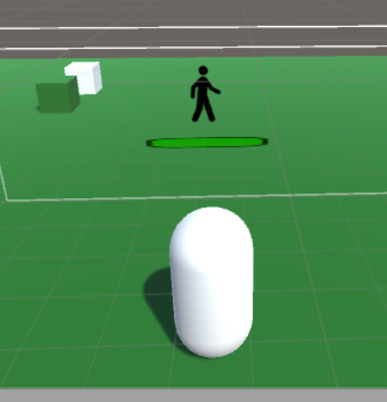

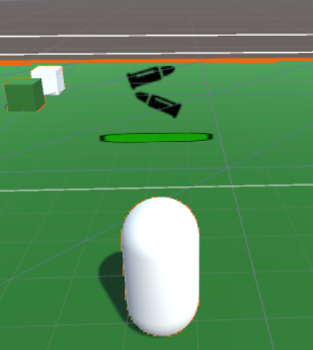


The Hostile AI in the artefact has five main states:
-Patrol : AI patrols between preset waypoints
-Chase Noise: AI Chases to the sound source
-Chase Player : AI chases the player if he is in the view range
-Get Ammo: the AI will go to the closest Ammo pack if the ammo level is low
-Get Health: the AI will go to the closest Health pack if the health level is low
The Crowds AI have only one state: following the leader, the leader being able to patrol between set waypoints as the hostile AI.

Slide 5
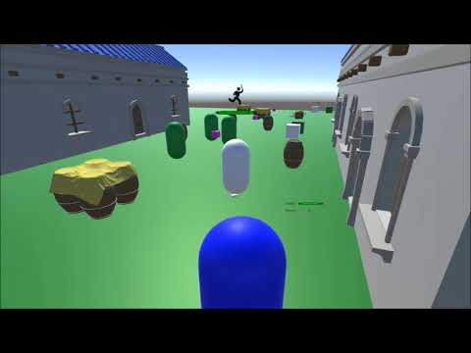

Slide 6
Pathfinding
A*, Djikstra and Breadth First Search are one of the most known pathfinding algorithms. Breadth First Search explores the grid equally in all directions while Djikstra explores the possible path taking into consideration the cost of each move. A* is a combination between Dreadth First Search and Djikstra. Instead of exploring in all directions or exploring all possible paths, A* is a more optimized method for a single destination and also prioritizes paths that lead closer to the final position. (“Introduction to A*, 2014)
A* based on Sebastian Lague Tutorials.
A* needed to be adapted to work with Steering Behaviors.
Heap optimization.
Less waypoints

Slide 7
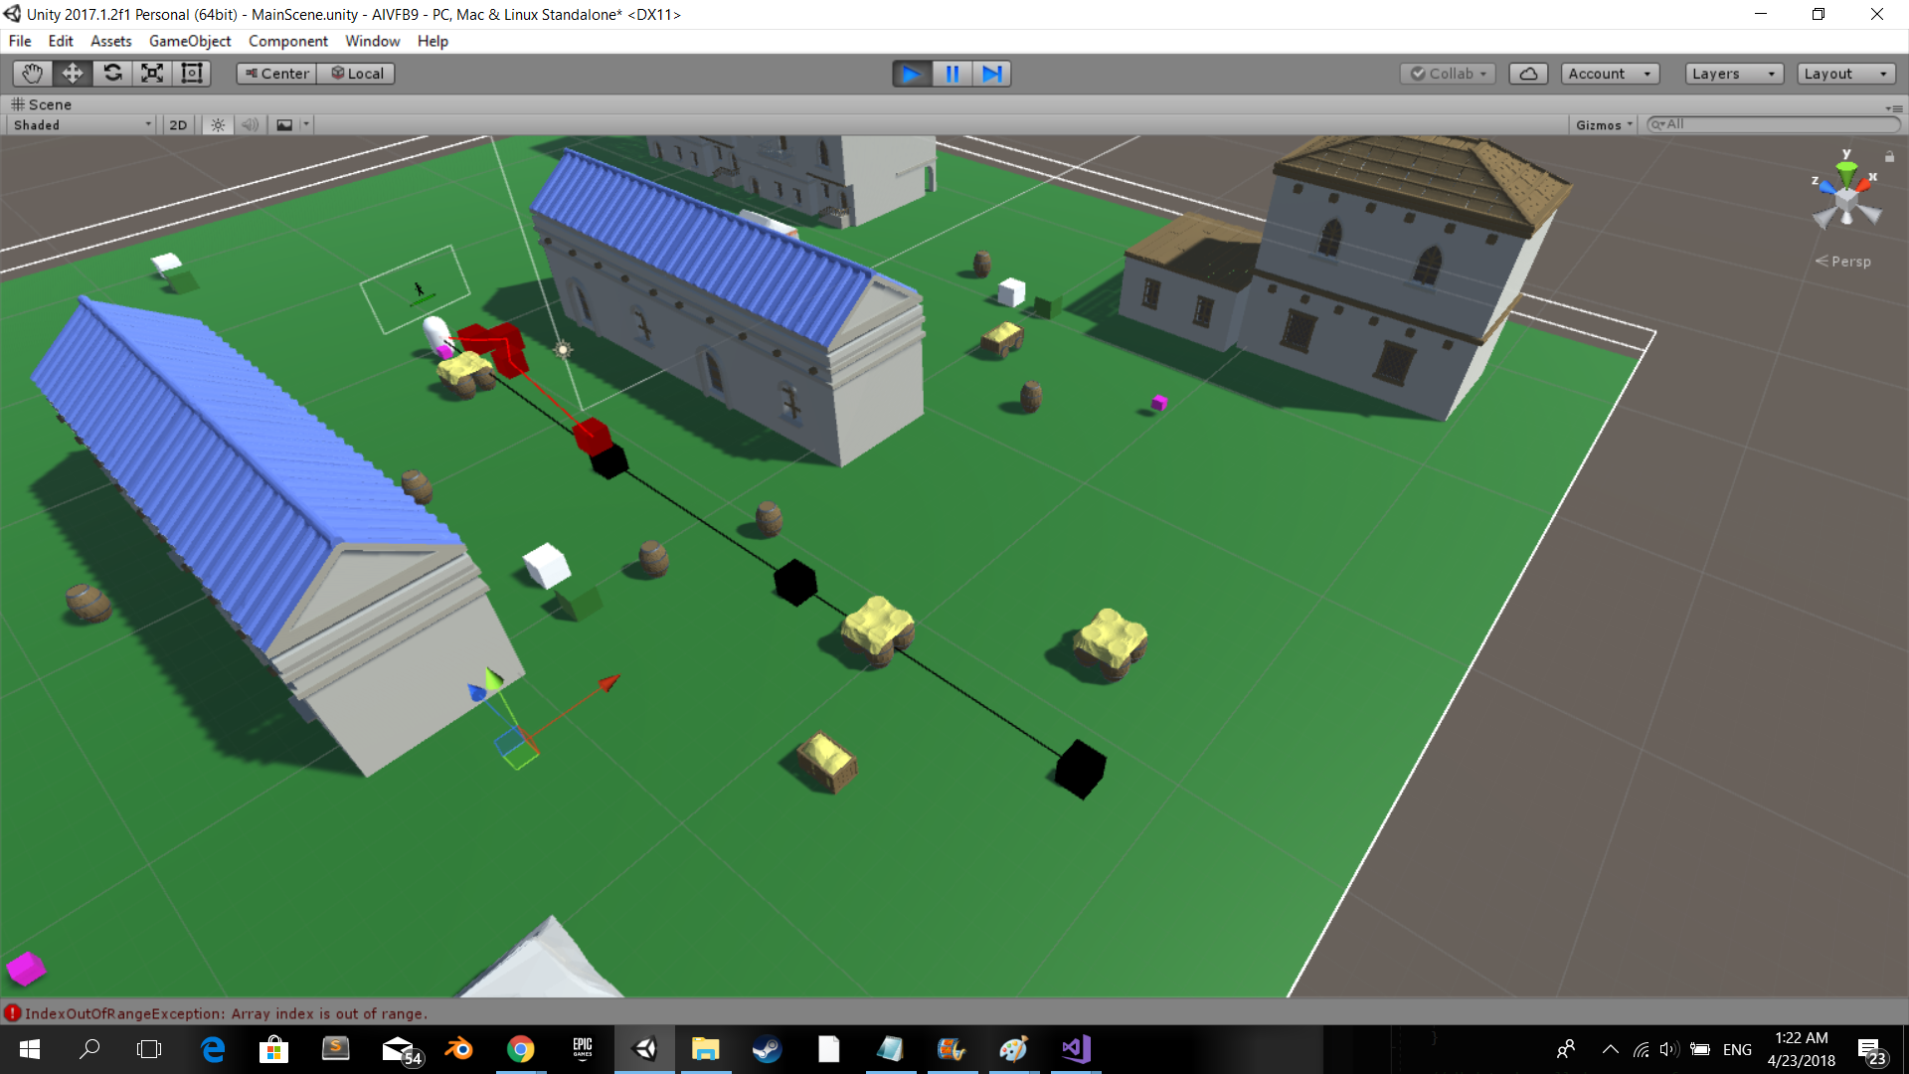
The most important steering behavior that needed to be combined with the A* algorithm is represented by the Path Follow behavior because this allows the player to move around the map. In the artefact the, AI has some predefined waypoints that were called global waypoints. When the AI gets close to a global waypoint it generates a path to the next global waypoint. This path that is created between two global waypoints was called the local path and it is formed from local waypoints.
The Seek steering behavior is used to move the AI between these waypoints because the movement needs to look continuous. When the AI reaches the final global waypoints it resets and moves to the first global waypoint.
Use of arrive behavior when the AI needs to stop.

Slide 8
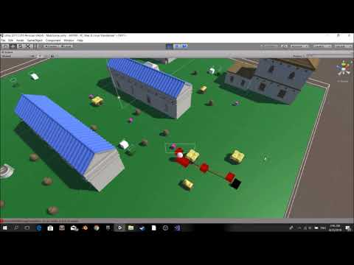

Slide 9
Steering behaviors
Steering behaviors were used in the artefact because they have the role of making autonomous characters move in a realistic way, by using forces that are combined and produce a life-like feeling. (“Understanding Steering Behaviors”, n.d)
All the steering behaviors were implemented but object avoidance. However, in the artefact, only seek, arrive, cohesion, separation, alignment and wall avoidance behaviors are used by characters. The steering behaviors were mainly used on crowds in order to get a realistic group movement.
One of the most important aspect of the steering behaviors is represented by the ability of combining behaviors together. There are three , Weight Truncated Sum, Prioritized Dithering, Weight Truncated Running Sum with Prioritization. In the artefact the Weight Truncated Running Sum with Prioritization was used because it gives a good compromise between speed and accuracy. (Buckland, 2005, p.121)
Cohesion Separation and Alignment - exclude agent
Cohesion - keep crowd together

Slide 10
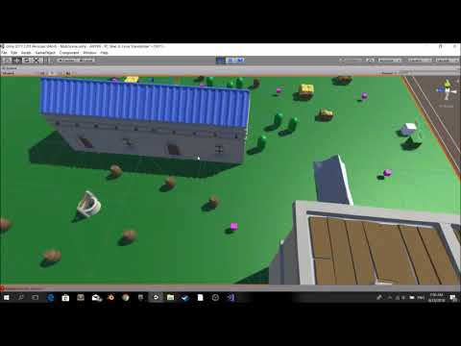

Slide 11
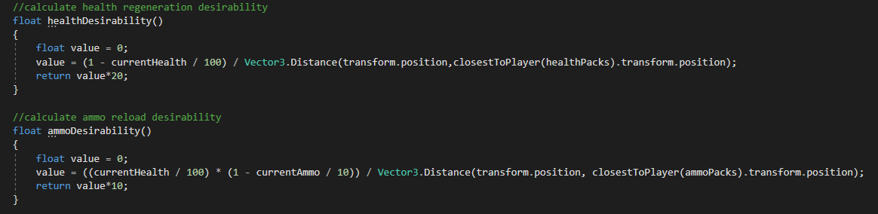
Desirability:
Desirability was implemented in order to make the AI look less repetitive. It is used to decide if the AI wants to reload its weapon or refill its health. In order to integrate desirability I made use of the two formulas that were presented during the lectures.
As a result of this, for example, if the AI is very close to a health pack he will decide to regenerate its health even if the health level is not very low.
In the artefact, desirability creates some form of emergent behavior, but in this case it creates an emergent behavior that is wanted and it is controlled.

Slide 12
Other AI features
Visual sense:
The AI is able to spot the player only if the player is in the FOV. This feature was implemented by calculating the dot product between AI’s position and the player’s position. Than if the player is in front of the player the AI checks if the player is in the FOV limits.

Slide 13
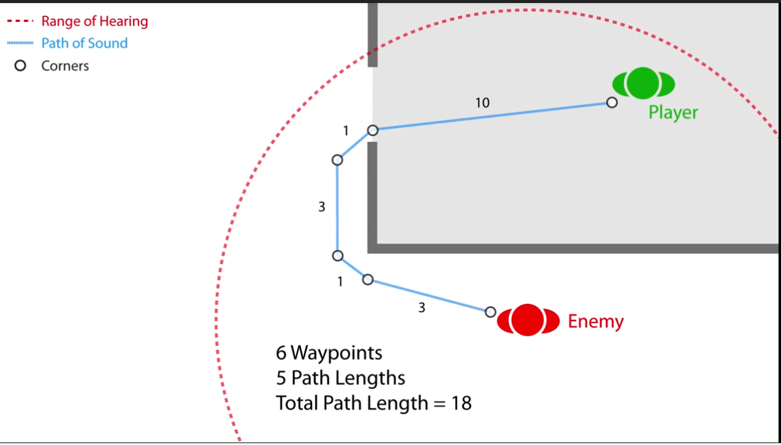
Auditive sense:
The AI is able to hear any noises made by the player and will move towards the noise source.
In order to implement this feature I also made us of the A* algorithm because there can be situations where the real distance between the AI and the player is very small but there might be a wall between them, so the AI shouldn’t hear the noise. By using the A* the AI calculates will calculate the actual path length between the sound source and the AI.

Slide 14
Conclusion
All the desired mechanics have been implemented.
Improvements?
Pathfinding and Steering Behaviors
Used stack-based FSM

