Slide 1
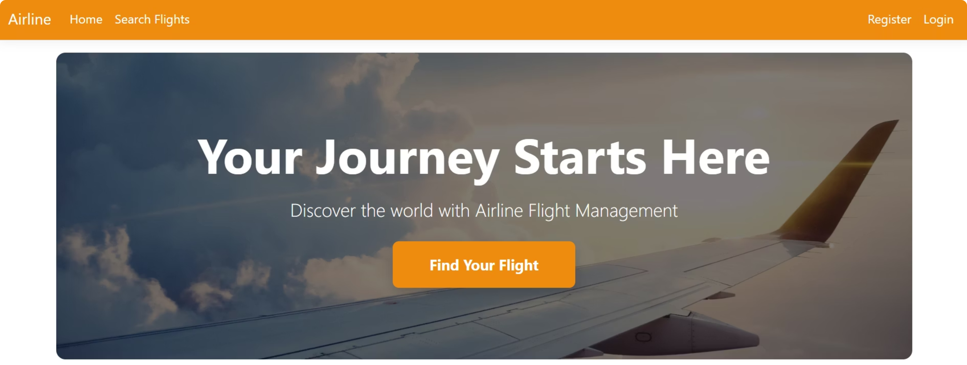
Airline Flight Management Platform
A modern solution for flight search, booking, and reservation management , designed for passengers and built for scale.

Slide 2




Platform Overview
Smart Flight Search
Instant Booking
Search flights by origin, destination, and date. Real-time results with pricing and available classes.
Reserve seats in seconds. Passengers receive instant confirmation with full transaction details.
Passenger Profiles
Admin Analytics
Each user manages their own profile, contact info, and full reservation and payment history.
Administrators access occupancy and revenue reports to monitor performance across all flights.

Slide 3
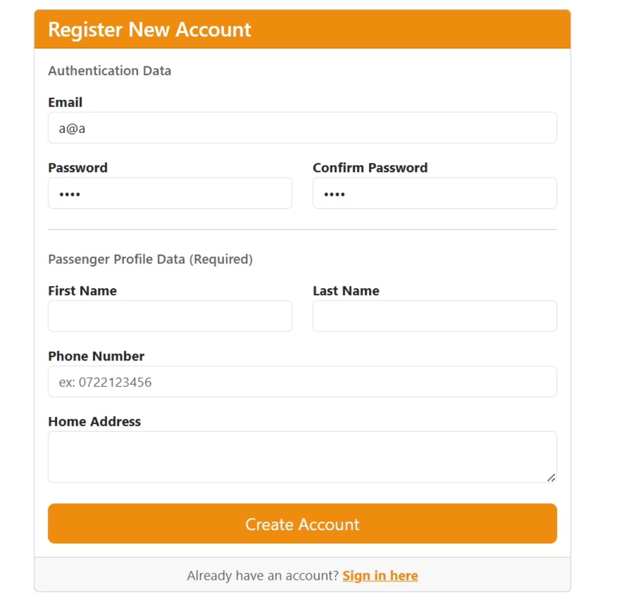

User Experience
Getting Started in Seconds
Registration & Onboarding
New users register with their email and password, and immediately fill in their passenger profile — full name, phone number, and home address. The streamlined form ensures a frictionless onboarding experience.
Already have an account? Sign in directly and pick up where you left off.

Slide 4
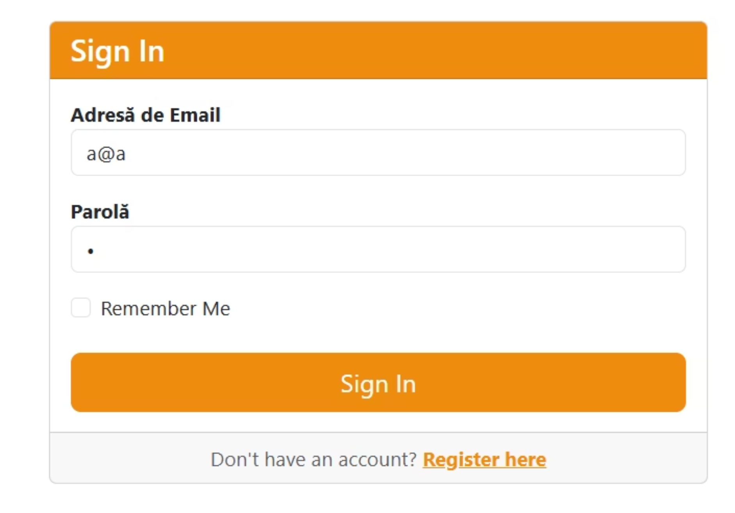
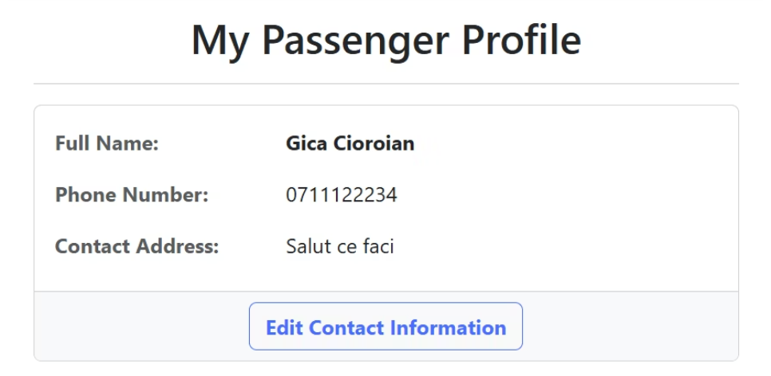
User Experience
Secure Sign-In & Profile Management
Sign In
Returning users authenticate with email and password. A "Remember Me" option keeps sessions active for convenience.
Passenger Profile
Each passenger has a dedicated profile page displaying their personal details. Contact information can be updated at any time through the Edit Contact Information flow.

Slide 5
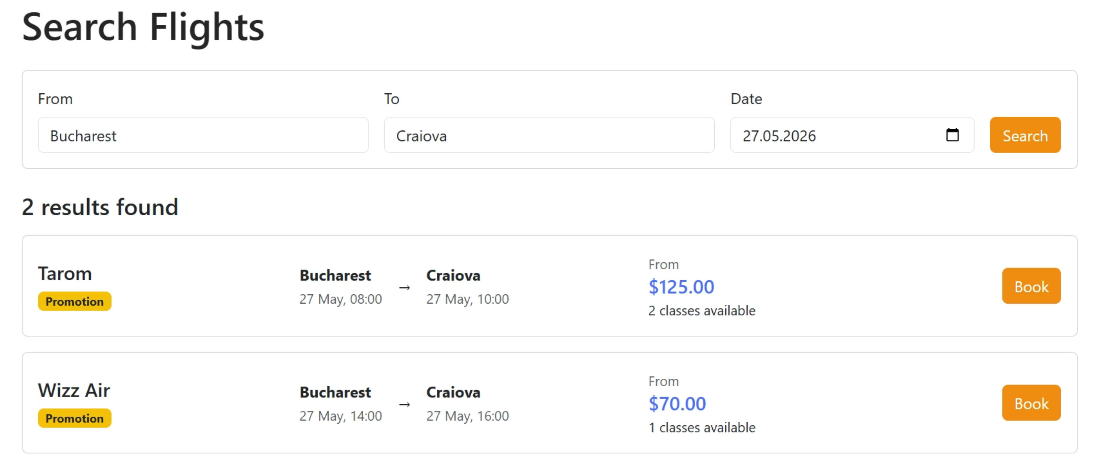
Core Feature
Flight Search — Fast & Intuitive
Users enter their origin, destination, and travel date to instantly retrieve available flights. Results display airline, schedule, available seat classes, and pricing — including promotional fares highlighted in real time. One click takes the passenger straight to booking.

Slide 6
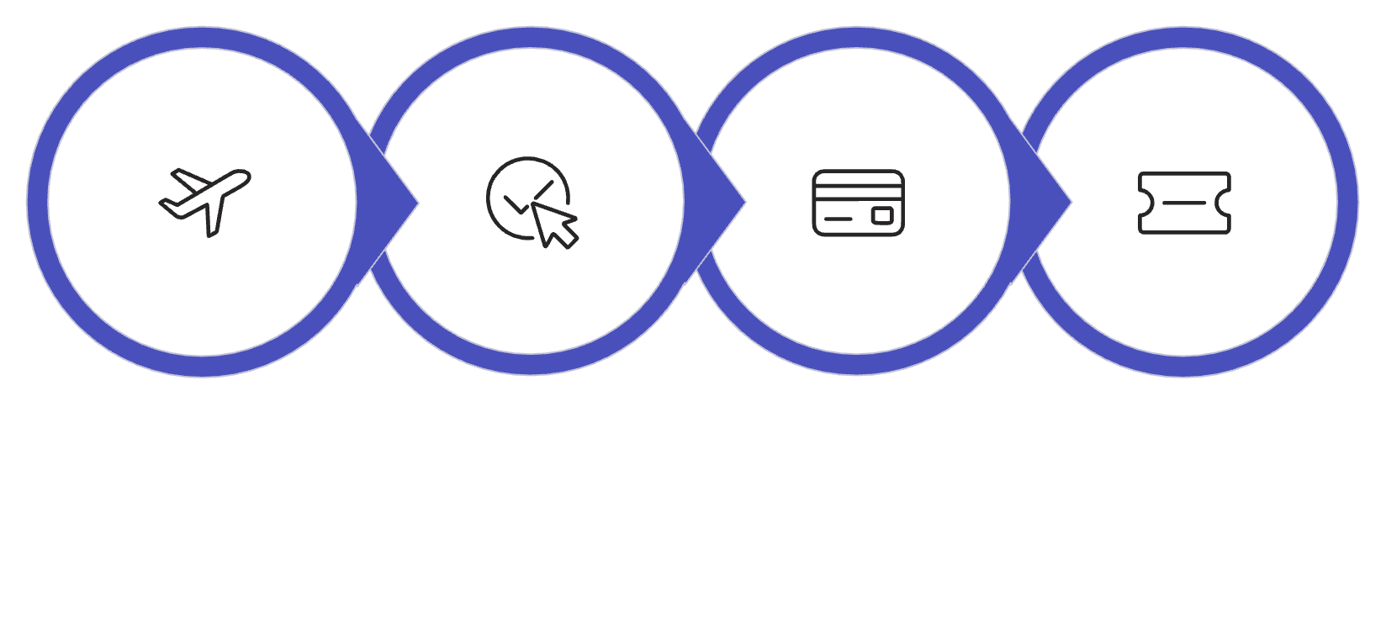
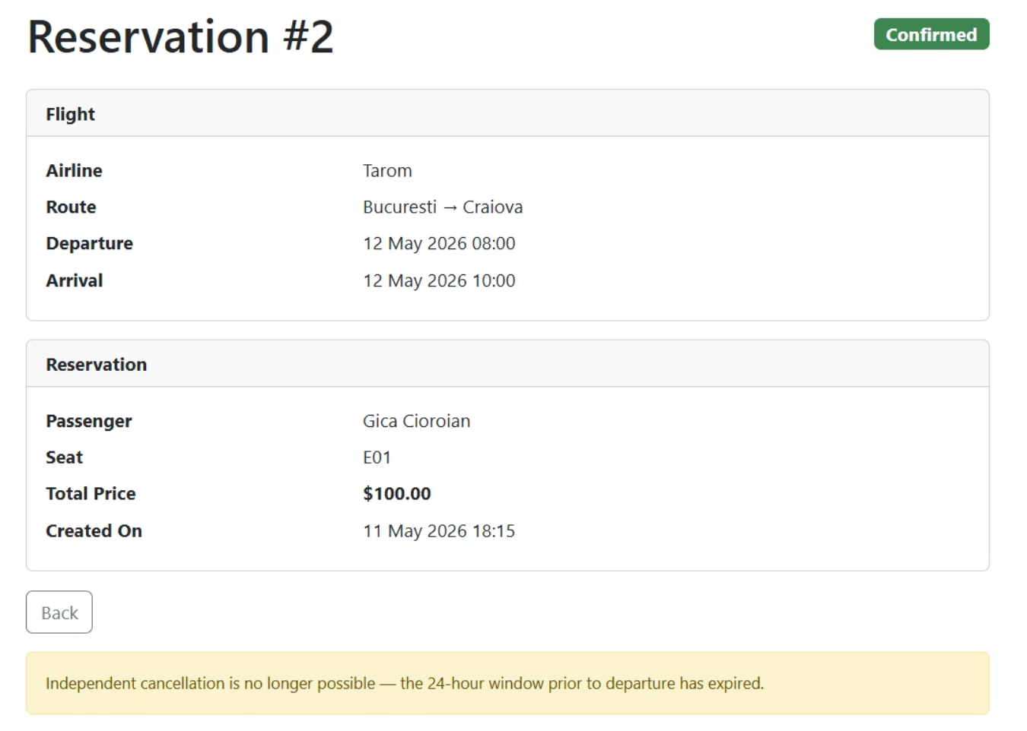
Booking Flow
From Search to Confirmed Seat
Search Flight
Select & Review
Complete Payment
Receive Confirmation
Reservation Details
Each reservation shows the full itinerary — airline, route, departure time, seat number, and class. Passengers can view all active and past bookings from a single, clean interface.

Slide 7
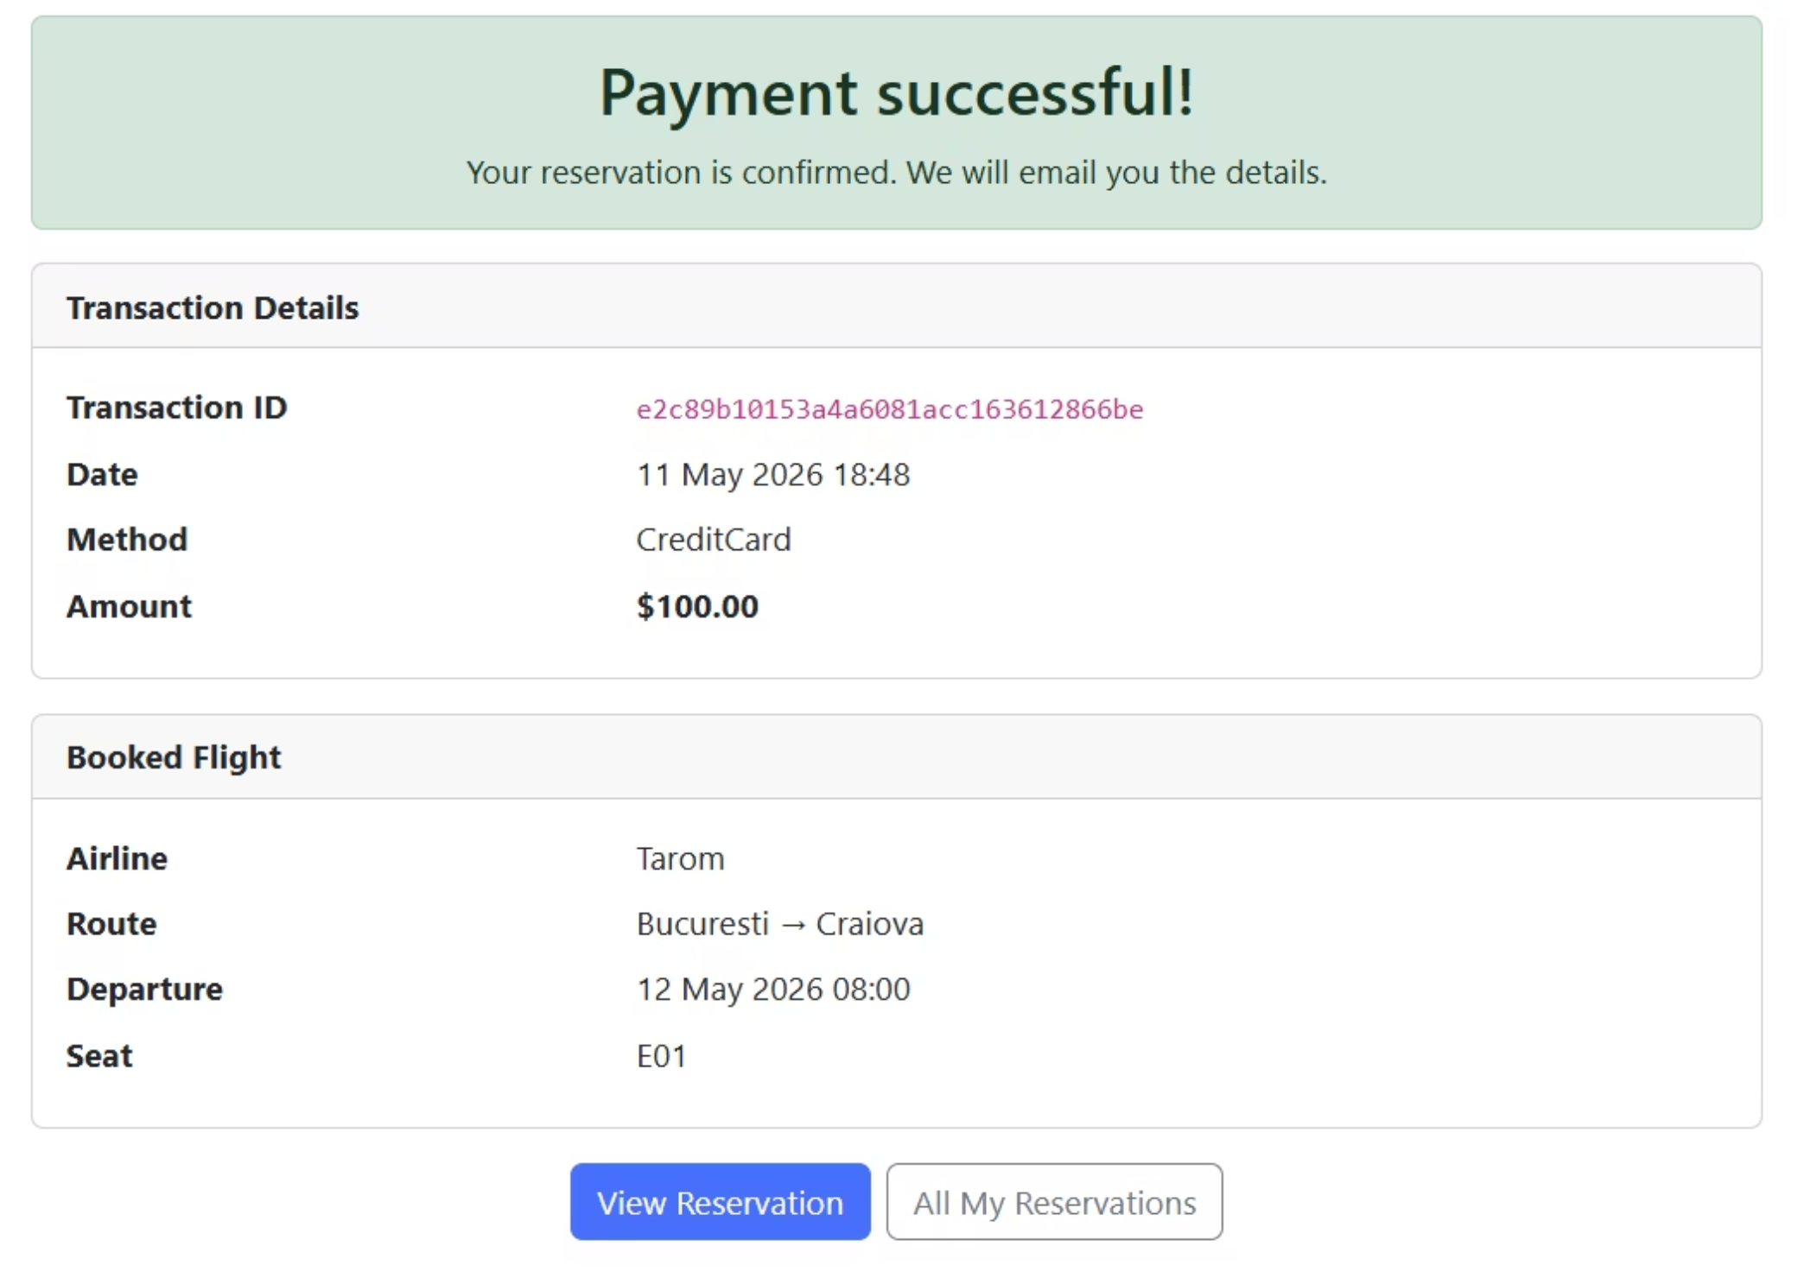
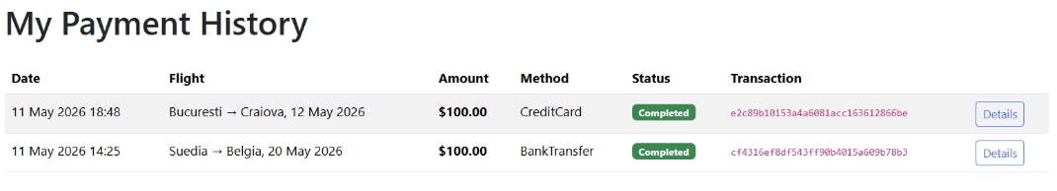
Payments
Seamless Payment & Transaction Tracking
Payment Confirmation
Upon successful payment, passengers receive a detailed confirmation screen with transaction ID, date, method (Credit Card or Bank Transfer), amount, and full flight details.
Payment History
A dedicated My Payment History page lists all past transactions with status indicators, making it easy to track spending and verify completed bookings.

Slide 8
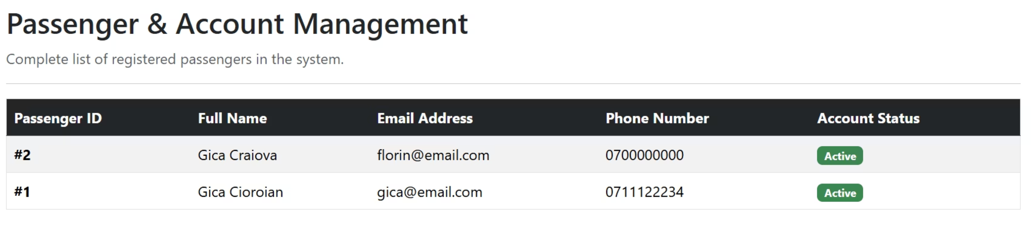
Administration
Passenger & Account Management
Administrators have access to a complete list of registered passengers, including their contact details and account status. The Active status indicator allows quick oversight of the user base, enabling efficient account management at scale.

Slide 9
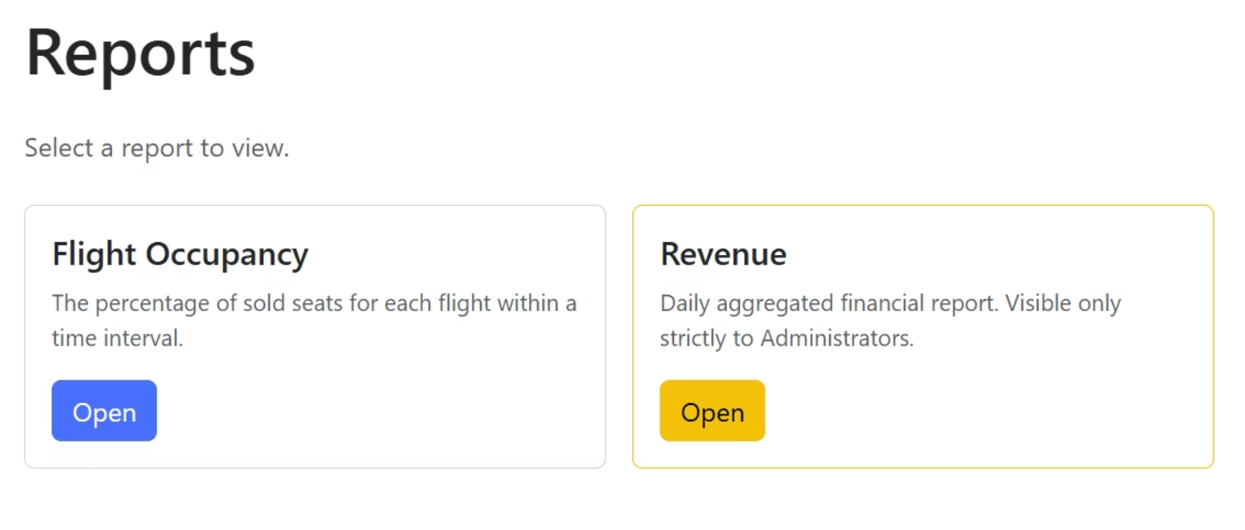
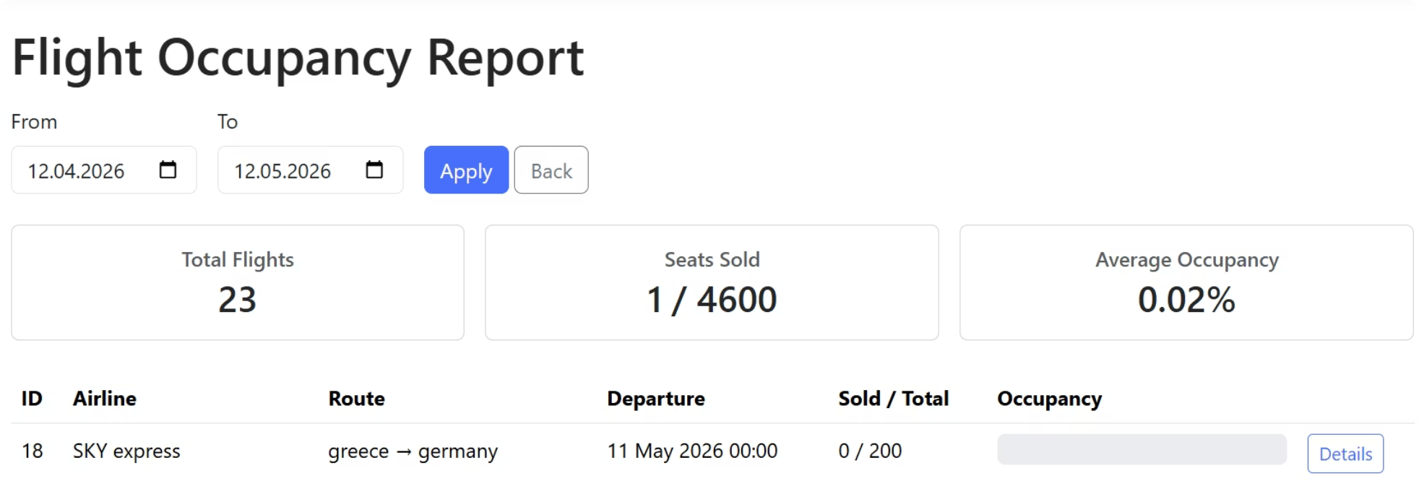
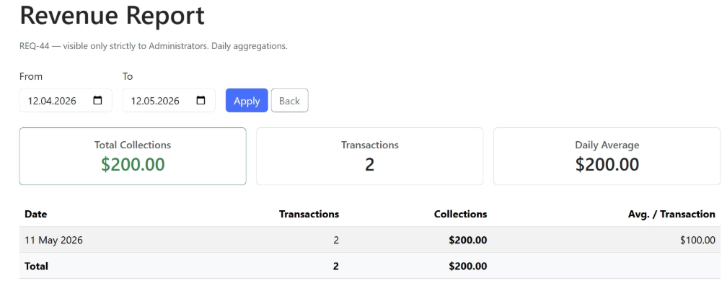
Analytics & Reporting
Data-Driven Insights for Operators
Flight Occupancy Report
Track seat sales per flight within any time interval. Key metrics include total flights, seats sold, and average occupancy rate — helping operators identify underperforming routes.
Revenue Report
A daily aggregated financial report, accessible exclusively to administrators, provides a clear view of revenue trends across the platform.

Slide 10

Why This Platform Stands Out
End-to-End Experience
From search to payment confirmation, every step is covered in one unified platform.
Role-Based Access
Passengers manage their own journeys. Admins oversee operations with powerful reporting tools.
Real-Time Data
Live pricing, promotional fares, and occupancy metrics keep both users and operators fully informed.
Built to Scale
A clean architecture and intuitive UI make this platform ready for growth across multiple airlines and routes.

