Slide 1


Instant Payments Readiness
& Impact Simulator
Developed by Vladyslav Buldenko

Slide 2

Why this project?
Instant Payments are rapidly becoming the dominant payment
method in Germany.
Banks must balance speed, security, and operational workload under
growing system load.
Bundesbank data provides a reliable, real-world foundation to validate
market trends.
A simulation model allows testing “what-if” VoP & Fraud settings that
real datasets don’t include.

Slide 3

Project Goals
Process Bundesbank payment data to understand market trends.
Validate the shift toward Instant Payments and rising system load.
Build a synthetic simulator to test VoP & Fraud thresholds.
Identify the optimal balance between speed, security, and operational workload.

Slide 4
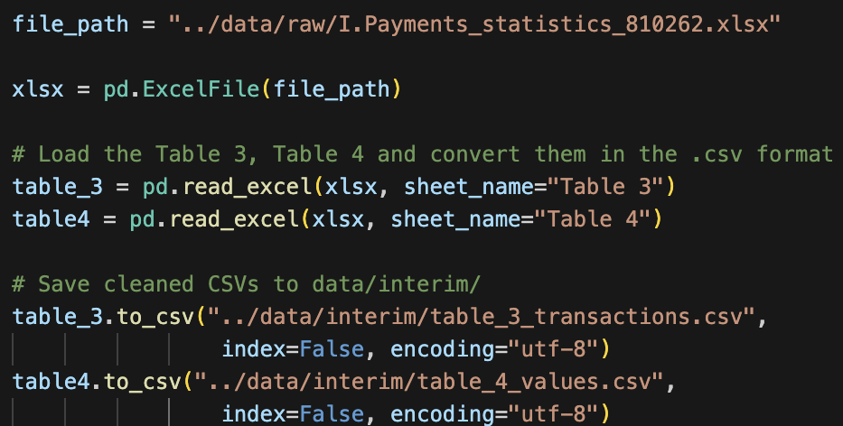
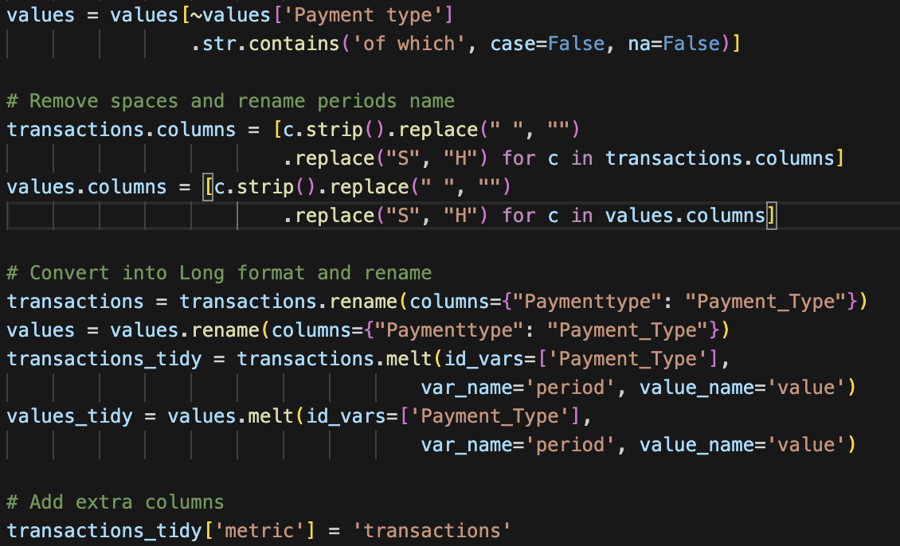

Data Cleaning & Preprocessing
Extract Data
Load Bundesbank Excel dataset.
Extract Table 3a/3b (transactions / values).
Save cleaned CSVs to data/interim/.
2. Clean Data & Create Tidy Dataset
Remove helper rows (“of which”).
Standardize columns (2022 S1→2022H1).
Convert to long (tidy) format with melt().

Slide 5
EDA Goals
Understand the structure and characteristics of payment data.
Identify variability, seasonality, and anomalies in transaction volumes.
Determine key patterns that influence Instant Payments readiness.
Prepare a reliable foundation for further modeling and simulation.

Slide 6
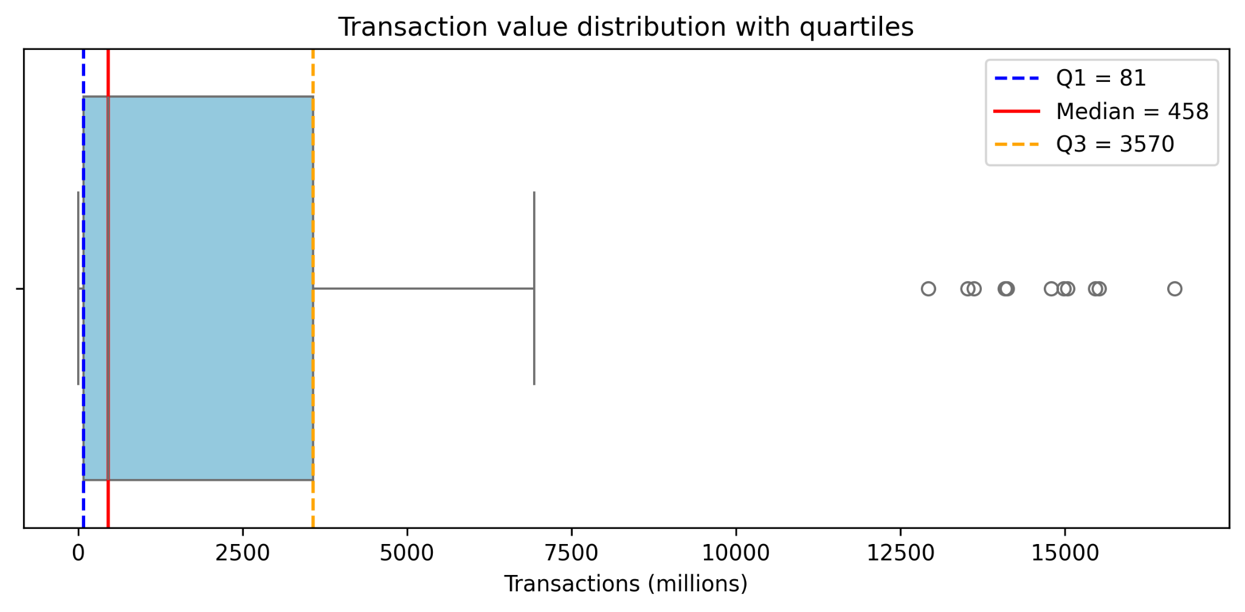
Conclusions:
Distribution is highly right-skewed → a few very large categories dominate volume.
Median is much lower than upper values → strong imbalance in transaction sizes
Several outliers indicate irregular spikes in payment activity.

Slide 7
Hypothesis 1 - Growth of Instant Payments
Are instant payments (SCT Inst) becoming a dominant payment method in Germany?

Slide 8
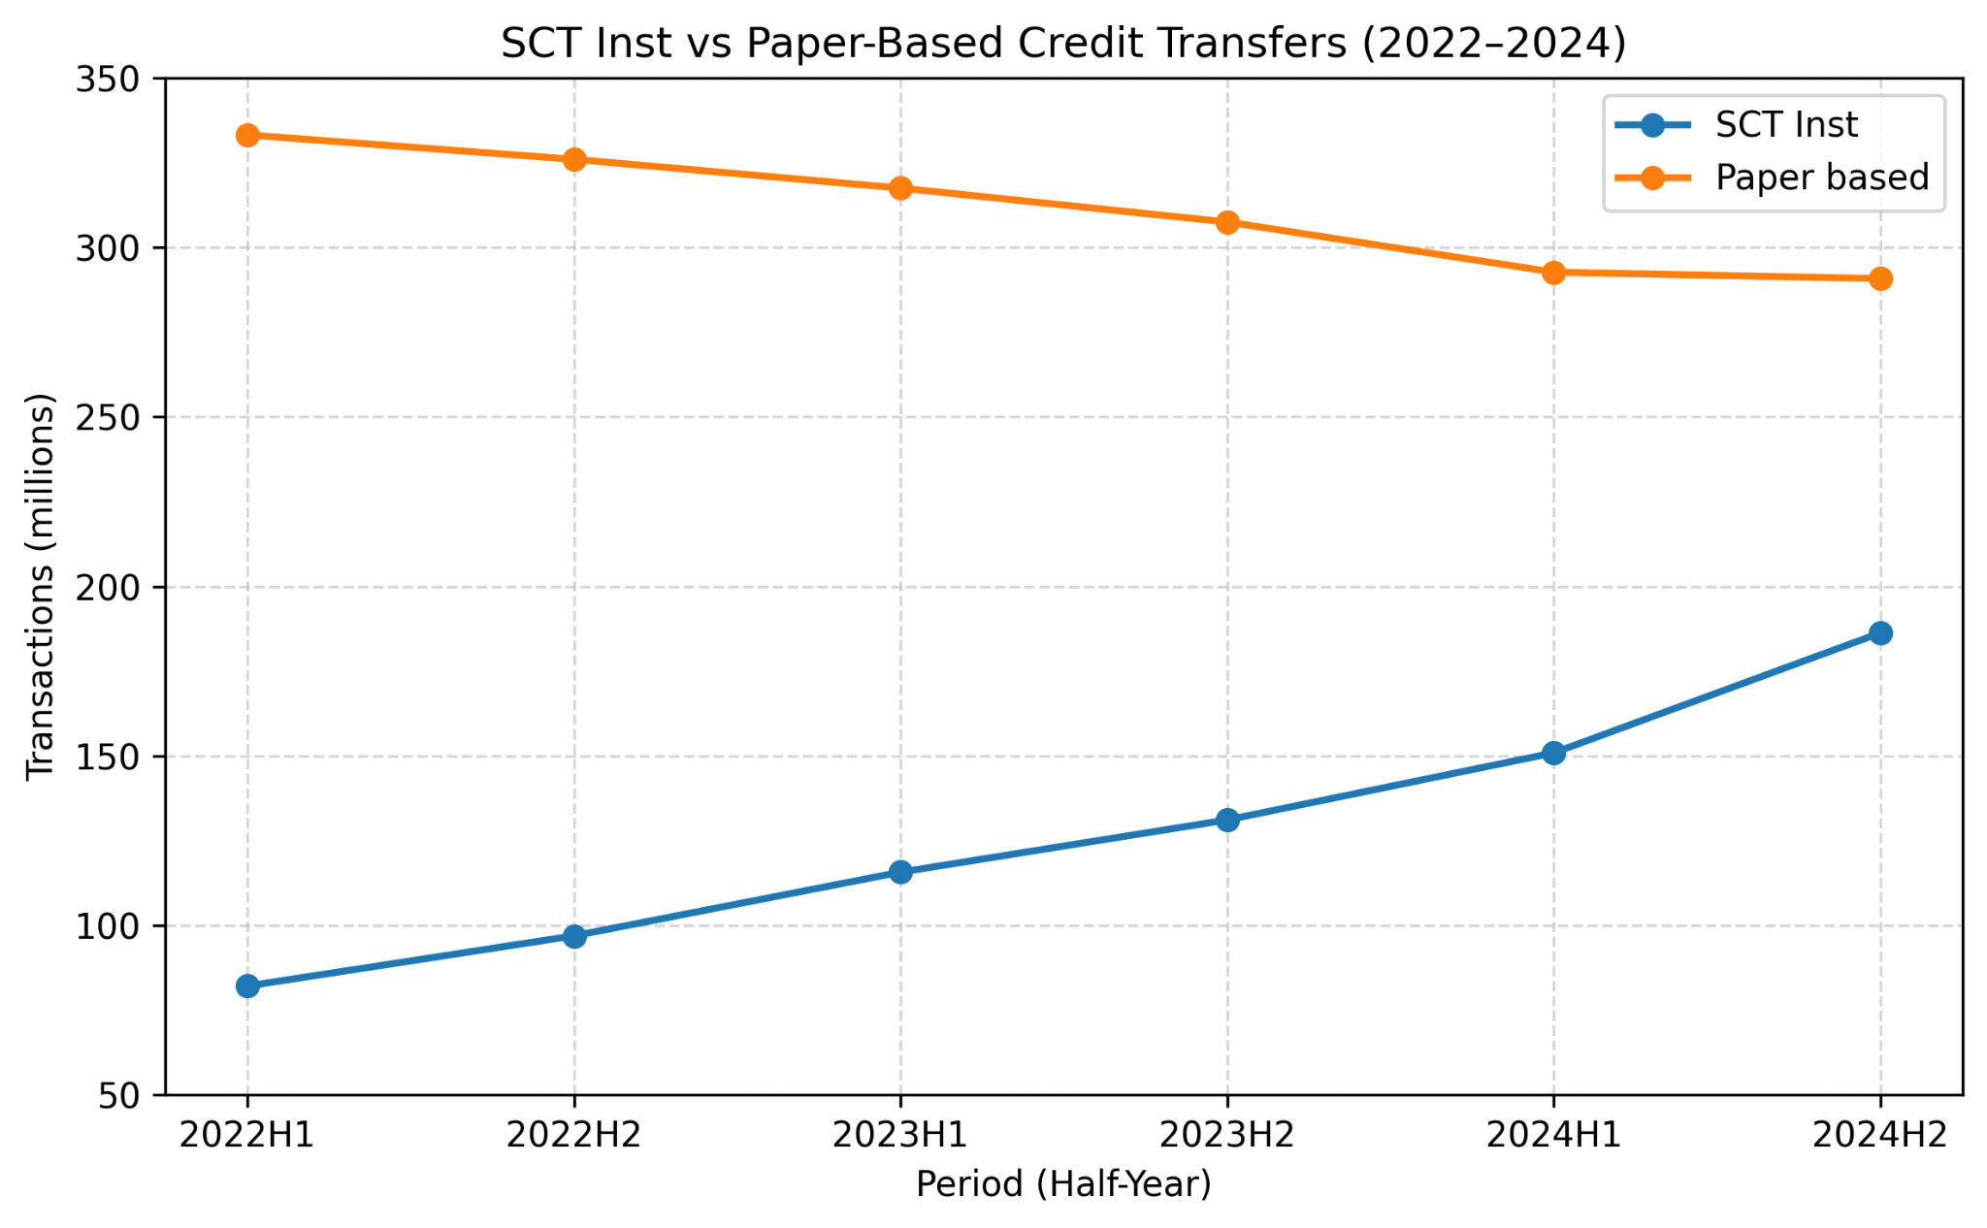


Conclusions:
The volume of SCT Inst increases steadily and the paper-based transfers decreases.
This confirms that Instant payments are gradually replacing traditional paper transfers.
The trend demonstrates a clear digital transformation in the German payment market.

Slide 9
Hypothesis 2 - Electronic payments system load.
Is overall system load increasing as users shift to electronic payments?

Slide 10

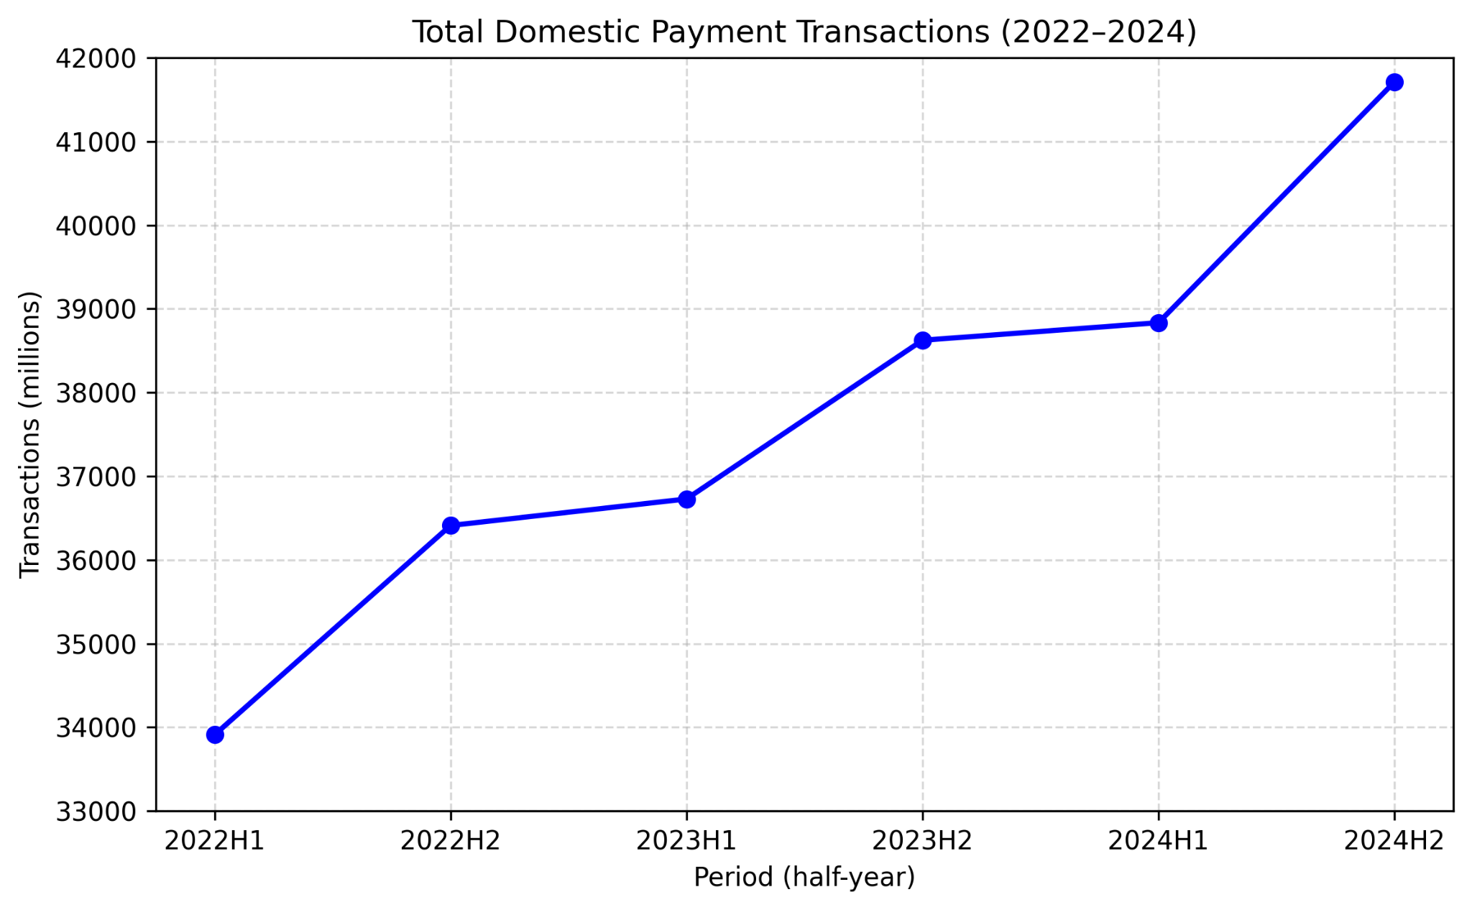
Conclusions:
The number of Domestic transactions increases steadily.
Overall payment activity is growing, indicating a heavier operational load on banking infrastructure.
As electronic and instant payments expand, banks need to ensure that their systems can handle higher transaction volumes and maintain low latency.

Slide 11
Hypothesis 3 - VoP Strictness Impact
How does Verification of Payee (VoP) strictness affect customer experience?

Slide 12
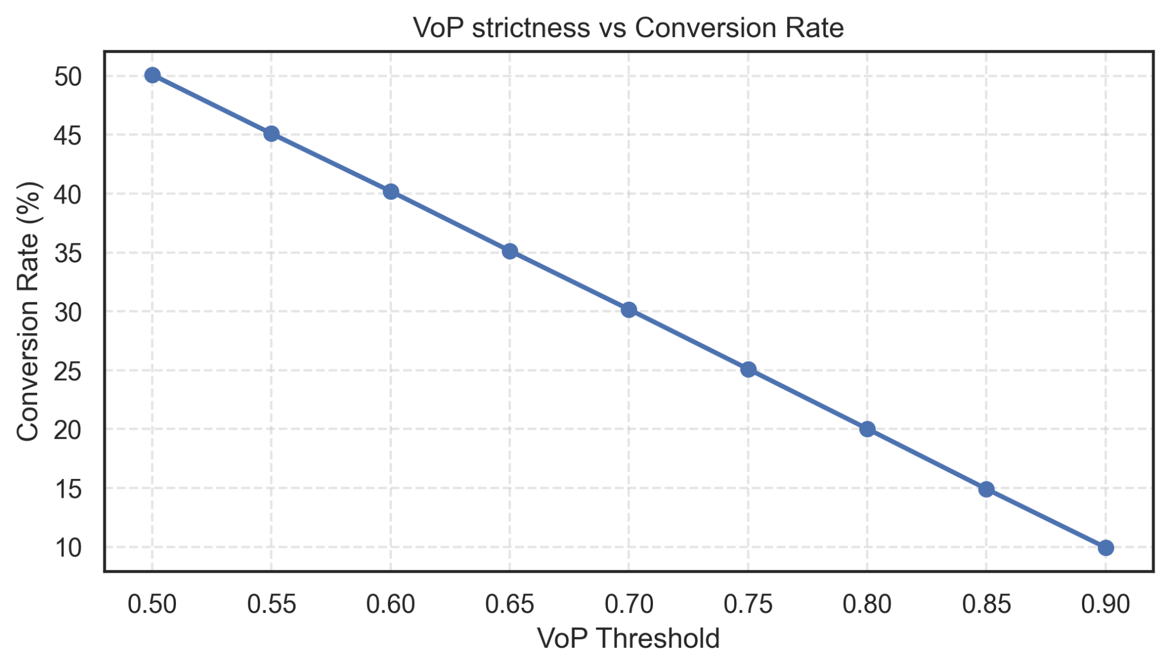
Conclusions:
Higher VoP threshold → fewer transactions pass verification
Conversion Rate decreases as VoP becomes stricter
Too strict VoP harms customer experience and usability

Slide 13
Hypothesis 4 - Risk Exposure & Manual Review Load
How does fraud filter sensitivity influence risk and operations?

Slide 14
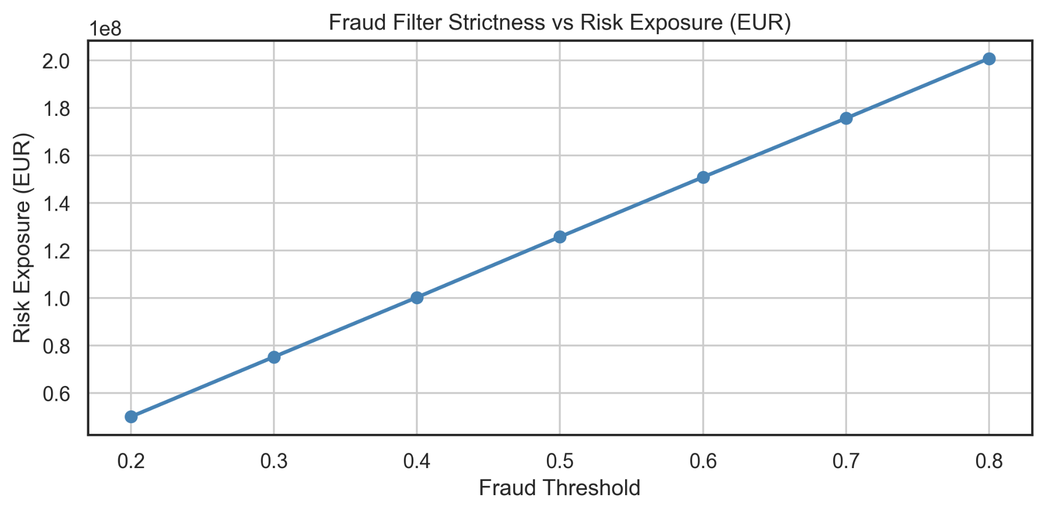
Conclusions:
Lower threshold → less fraud risk, but much higher manual review load.
Higher threshold → fewer reviews, but significantly more fraud slips through.

Slide 15
Difficulties & How I Overcame Them
1. Converting Bundesbank data from PDF to Excel/CSV
Required manual cleaning + reconstruction of column names.
Tables had multi-row headers and merged cells.
Solved: Structured parsing + Tidy transformation (melt)
2. Not realistic KPI formula
Early KPI used only Conversion & Risk.
Needed to integrate 4 metrics: Conversion, Latency, Manual Review, Risk.
Solved: Feature normalization + weighted KPI

Slide 16
Final Result - Optimal Vop x Fraud settings
Balanced settings for speed, security, and operational efficiency.

Slide 17
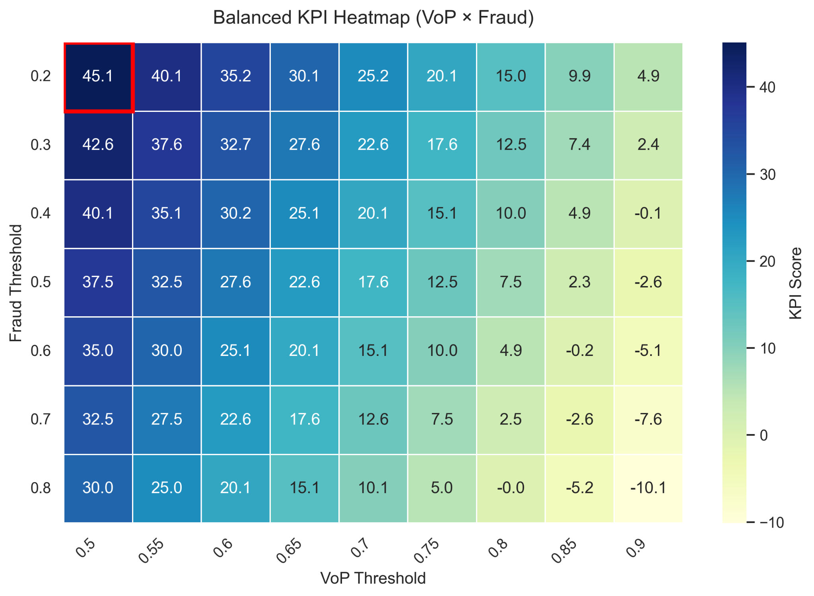

Conclusion: The simulation identifies VoP ≈ 0.80 and Fraud ≈ 0.50 as the optimal balance.

Slide 18
Final Conclusions
Instant payments adoption in Germany is rising — system load is increasing.
VoP and Fraud thresholds create trade-offs between speed, safety, and operations.
Optimal balance found: VoP ≈ 0.80 and Fraud ≈ 0.50.

Slide 19
Future Improvements:
Realistic latency modeling (Queueing Theory).
ML-based fraud model.
Forecasting system load (e.g. 2025–2027).

Slide 20
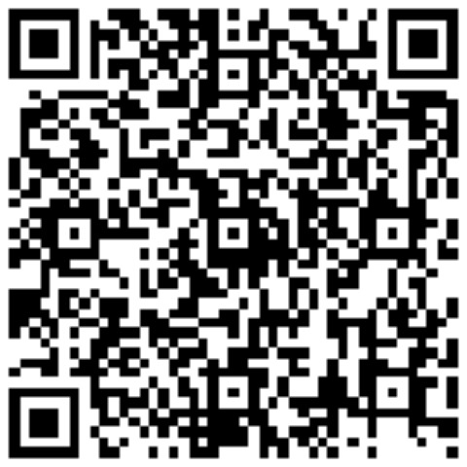
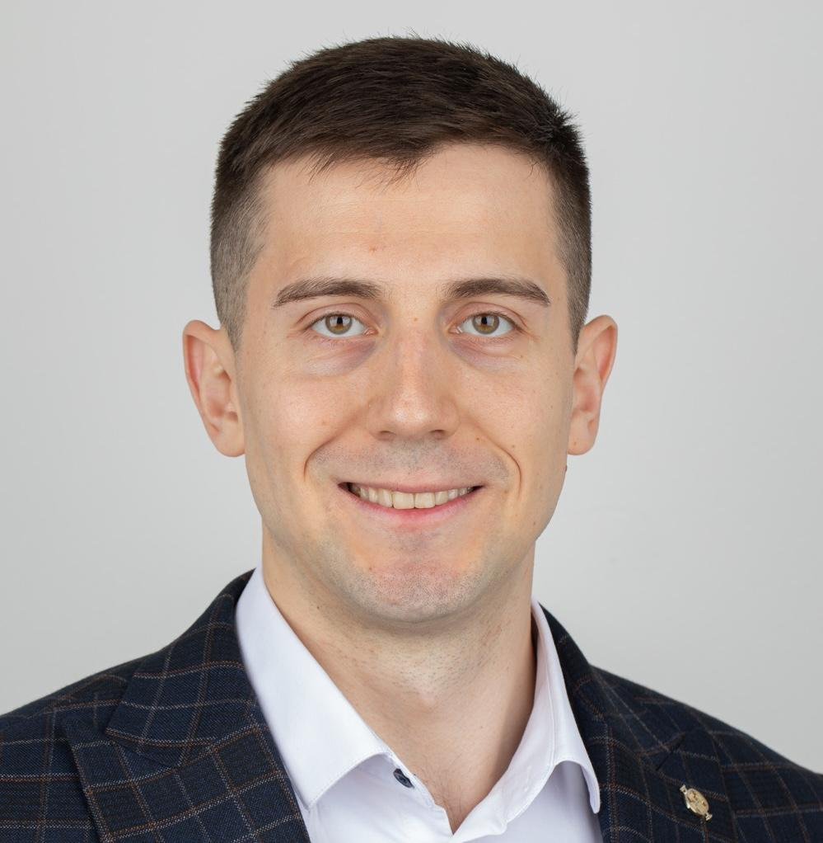
Thanks a lot!
Contact
Vladyslav Buldenko
Student of the Data Analytics course
vlad.buldenko.96@gmail.com

