Slide 1
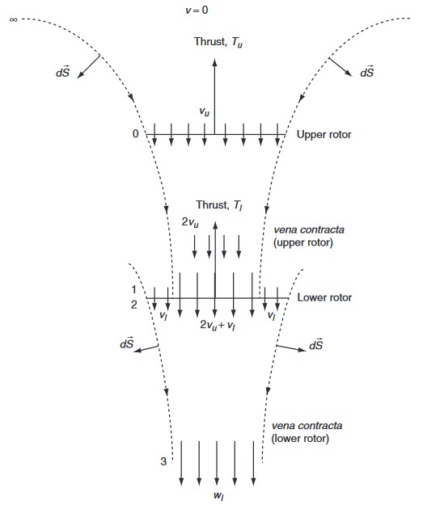

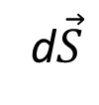
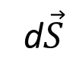

v = 0
Thrust, T_{u}
d$\vec{S}$
d$\vec{S}$
v_{u}
Upper rotor
Thrust, T_{u}
2v_{u}
Lower rotor
v_{i}
v_{i}
d$\vec{S}$
2v_{u}+v_{i}
d$\vec{S}$
w_{l}

