Slide 1



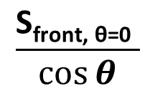
S_{front, θ=0}
S_{top}
$$\text{S}\text{top}{\sin{θ}}$$
$$\vec{v}$$
$$\frac{\text{S}\text{front}\text{, }\text{θ}\text{=0 }}{\cos{θ}}$$
$$θ$$

