Slide 1

university of
Potential-Based Reward Shaping for Planar Pushing
Single-Agent Control vs. Asymmetric Self-Play
VadIftime s3426394
Faculty of Science and Engineering, Artificial Intelligence
University of Groningen
June 2026

Slide 2

1. Introduction & Research

Slide 3

Outline
1. Introduction & Research Questions
5.Evaluation 30 held-out scenes· 20 trials· lsaac vs gym
Background & Related Work reward shaping·curriculum & self-play· push mechanics&SE(2)
Results
7．Discussion
3. Problem Definition & MDP
8. Conclusion & Takeaways
4. Implementation five models:PPO-Baseline, PPO-PBRS, PPO-Curriculum,ASP-dPose, TASP-dPose
3

Slide 4
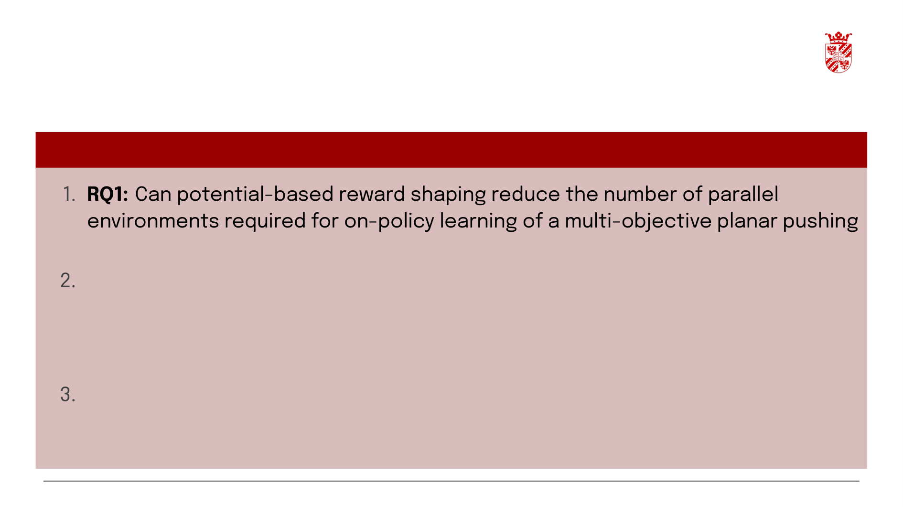
Research Ouestions
Three Research Questions
task on a simulated robotic arm?
RQ2: Given a well-shaped PBRS reward, does modifying the training dynamics - via sequential objective staging or adversarial goal generation - improve final task performance over a direct single-agent approach in a multi-objective planar pushing task on a simulated robotic arm?
RQ3: Does asymmetric self-play enable the learning of individual position and orientation skills in a multi-objective planar pushing task on a simulated robotic arm?
[Ng, Harada & Russell 1999] [Grzes 2017] [Devlin & Kudenko 2012]
4

Slide 5

2. Background & Related Work

Slide 6
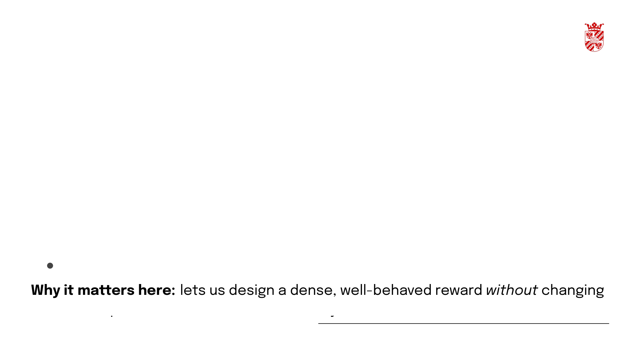
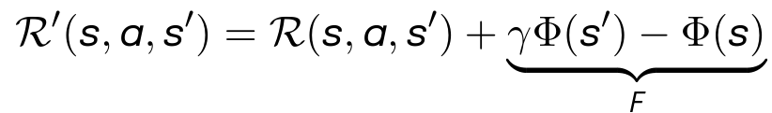
Reward Shaping (PBRS)
Potential-based reward shaping :
Dynamic / arbitrary potentials - basis for our exponential Φ.
the task's optimum - the foundation of every model in this thesis.
[Ng et al. 1999] [Grześ 2017] [Devlin & Kudenko 2012] [Harutyunyan et al. 2015]
6

Slide 7
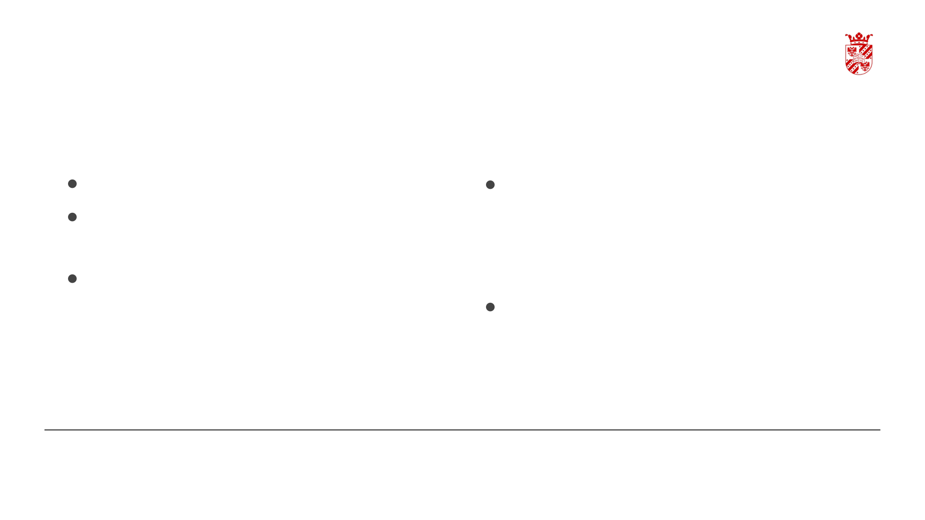
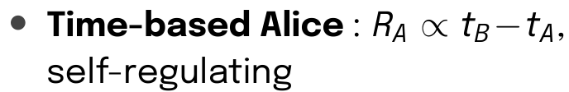
Curriculum & Asymmetric Self-Play
Forced curricula
Automatic (self-play)
• Surveys
AsP: Alice/Bob adversarial game + ABC
Reverse / goal: start near the goal expand outward
Precision: gradually tighten the success tolerance
Regret-based
Our use: a forced 3-phase pos—→rot curriculum (PPO-Curriculum)
Our use: ASP-dPose(outcome) and TASP-dPose (time-based)
[Narvekar et al. 2020] [Portelas et al. 2020] [sukhbaatar et al.2018] [Plappert et al. 2021]
7

Slide 8

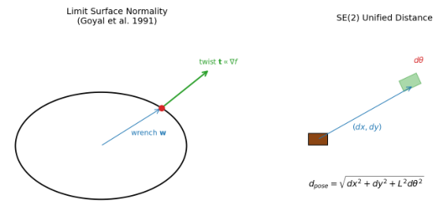
Geometry & Mechanics of Planar Pushing
Push mechanics
Quasi-static pushing: motion set by the friction limit surface.
Limit-surface normality: every push couples translation and rotation.
SE(2) geometry
Unified distance: a single scalar that combines position and orientation error, weighted by the object's physical size L
Equivariant manipulation: exploiting SE(2)/S0(2) symmetry.
8

Slide 9
3. Problem Definition & MDP

Slide 10
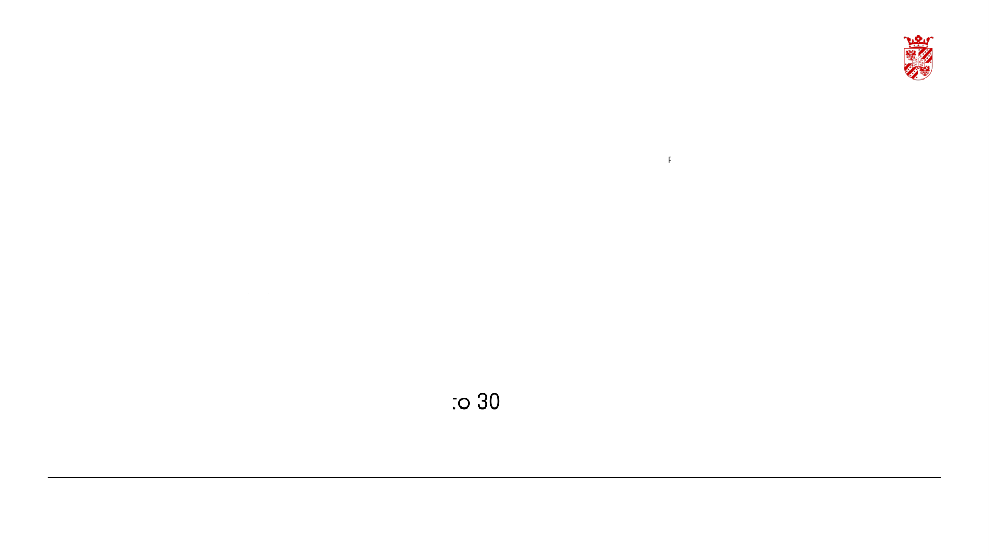
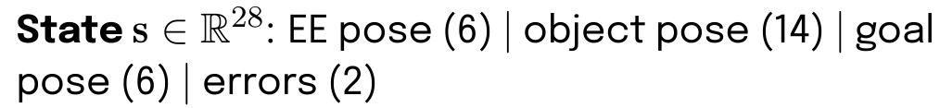
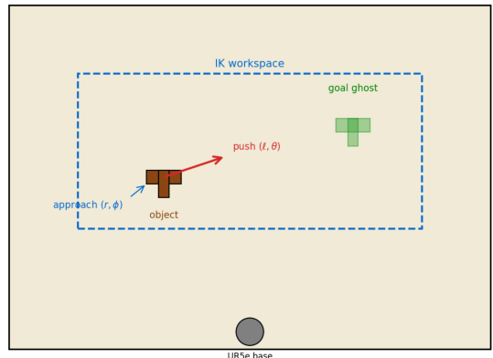
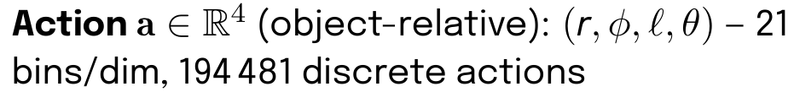
Planar-Pushing MDP - State, Action & Transition
Planar Pushing Task — Object-Relative Action (r, φ, l, θ)
Transition : t ∞ ∇f(w)– limit-surface normality couples every push with rotation
Success: pos < 5 cm and rot < 0.2rad. pushes
Mason 1986][Lynch & Mason 1996][Goyal et al.1991]
10

Slide 11
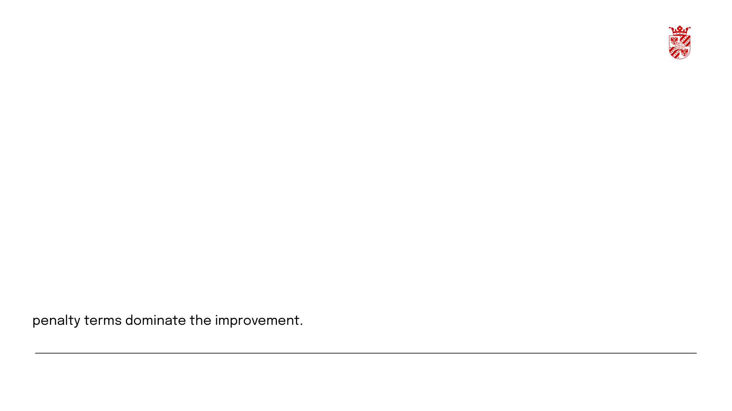
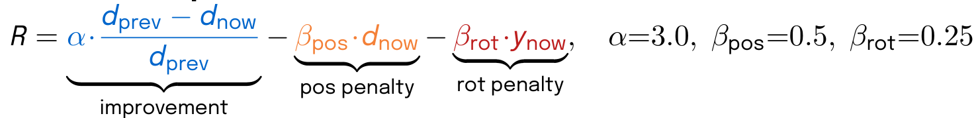
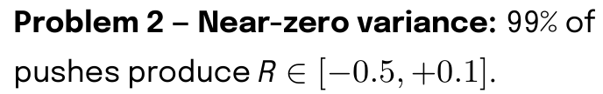
How the Fractional Reward Failed
Fractional improvement formula:
Worked example - pushing toward a goal 30 cm away, 1 cm improvement:
Problem 1 - Negative reward for progress: the
[Ng et al. 1999][Grzes & Kudenko 2009][Schulman et al. 2017]
11

Slide 12
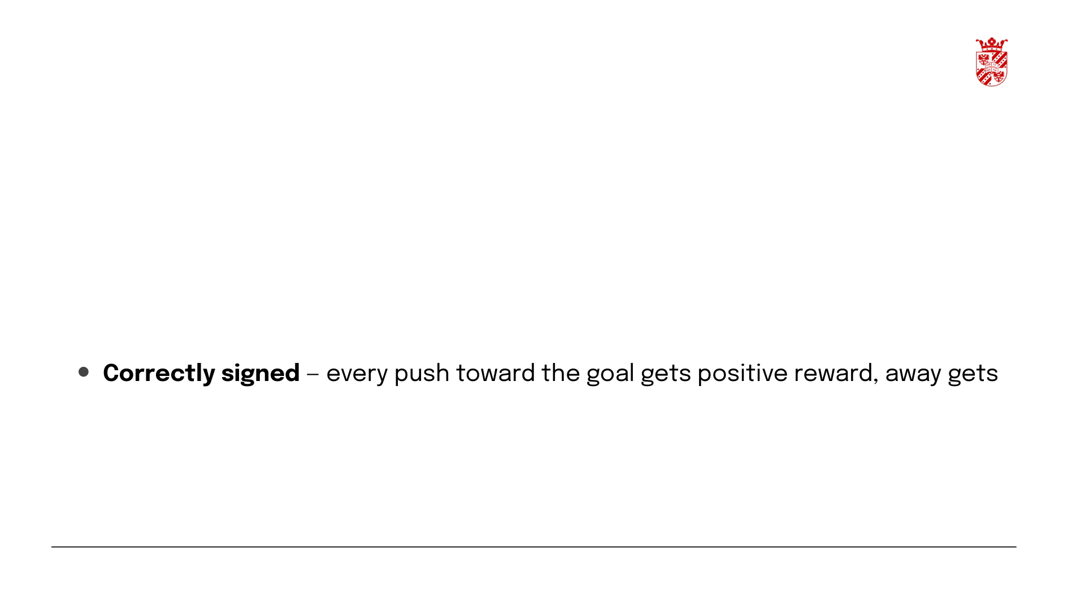
How PBRS Fixes the Reward
Same push, same 1 cm improvement:
Why this matters:
negative
• Policy-invariant – the optimal policy under PBRS is identical to the original task
Ng et al. 1999][Grzes 2017] [Harutyunyan et al. 2015]
12

Slide 13
4. Implementation

Slide 14

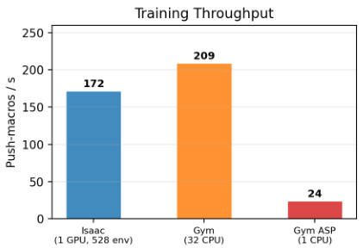
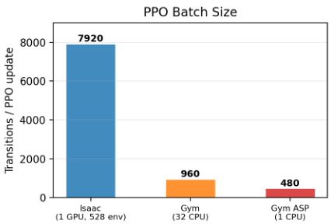
Why Isaac Lab?
1. GPU-batched parallelism — 528 simultaneous environments produce 7,920-sample PPO batches.gym-pusht peaks at 960– 8x smaller. Large batches stabilize the non-stationary self-play gradient.
Isaac vs Gym — Why GPU-Batched Parallelism Matters
2.No extra per-iteration cost - self-play and single-agent run at identical wall-clock (~0.022it/s). The two-agent machinery adds negligible overhead.
Throughput is comparable; batch size is the
differentiator.
14

Slide 15

Why Isaac Lab? - Training demos
15

Slide 16

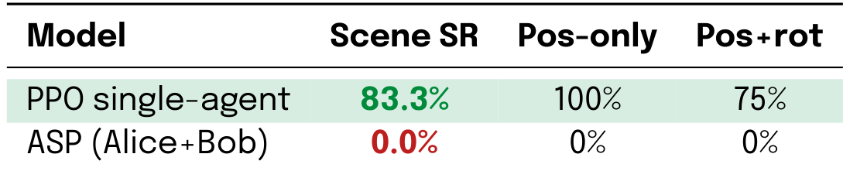
Baseline - Fractional Reward at Scale
Same fractional reward, same PPO+LSTM, same 2,048 envs, same 10oK iter budget:
Same PPO+LSTM, same push primitive, same training budget – only the architecture differs. The adversarial goal distribution, not the reward formula, is the bottleneck. (See Appendix k for training budget comparison.)
[Sukhbaatar et al.2018][Plappert et al.2021]
16

Slide 17

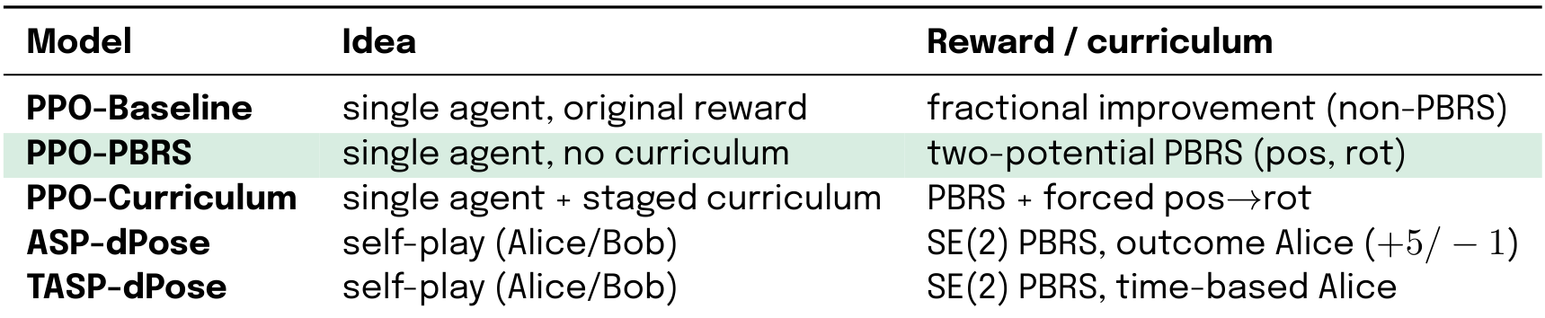
All Models at a Glance
All five models share the same PPO+LSTM backbone and object-relative push primitive.
[Schulman et al. 2017] [Ng et al. 1999][sukhbaatar et al. 2018]
17

Slide 18
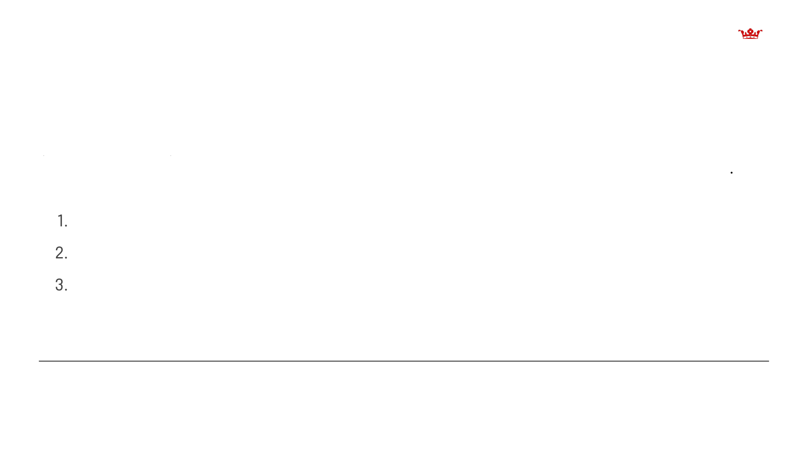
PPO-PBRS – Single-Agent (Recommended Baseliney
Architecture: Single PPO agent, LSTM(28—>256) + MLP[512, 256] trunk, MultiCategorical heac (4 dims X 21 bins). No curriculum, no Alice/Bob, no GoalEncoder.
Training: 528 envs, 15 pushes/rollout, ~3000 iterations ~1.6 days wall-clock (~0.022 it/s) Why it works:
1. Dense, bounded gradient – PBRS fires on every push
2. Fixed goal distribution - stationary random goals; no adversarial shift
3. Single network - one agent, one optimizer; no multi-agent instability
[Ng et al.1999][Grzes 2017][Schulman et al.2017]
18

Slide 19

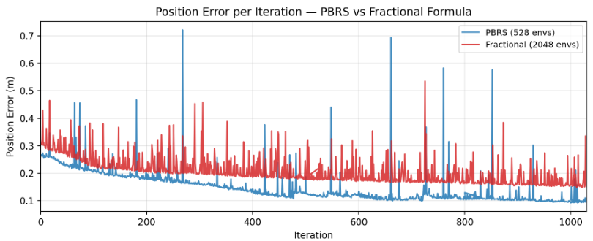
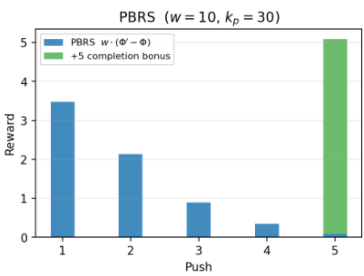
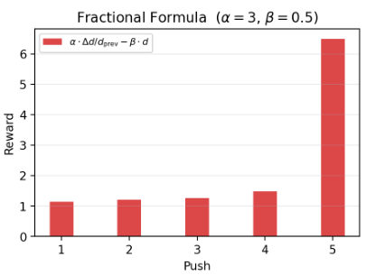
PBRS vs Fractional- Reward Signal Analysis
Simulated 5-Push Episode — PBRS vs Fractional Formula
Per-push reward - Fractional vs PBRS: same
Position error per iteration (TensorBoard): PBRS
5-push episode. Fractional formula: negative or
at 528 envs converges tolower PosErr than
zero for 80% of pushes. PBRS: correctly-signed,
fractionalformula at 2.048 envs - 4× more
bounded on every push.
environment-efficient.
Dense signal on every push, bounded rewards, stable value - PBRS avoids the gradient starvation and critic instability of the old fractional formula.
19

Slide 20
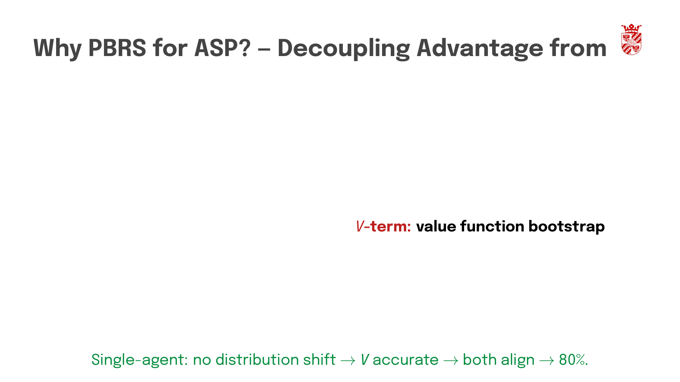
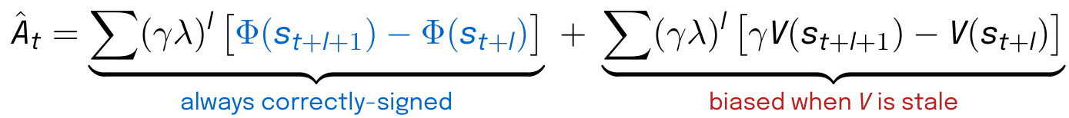
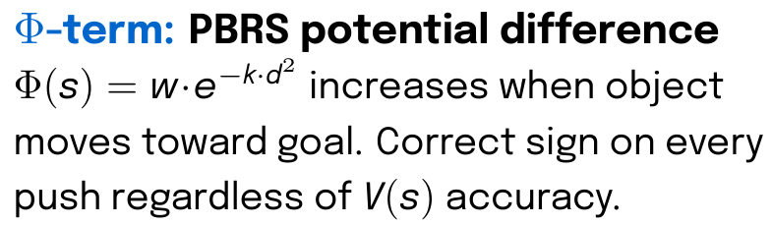
Value
GAE advantage decomposes into two parts:
Under ASP, Alice shifts goal distribution V(s) perpetually stale. GAE bootstraps from wrong values → biased advantage.
Outcome: PBRS lifts ASP 0% 16.7%via the Φ-term - but only partially, because the V-term bias remains.
20

Slide 21

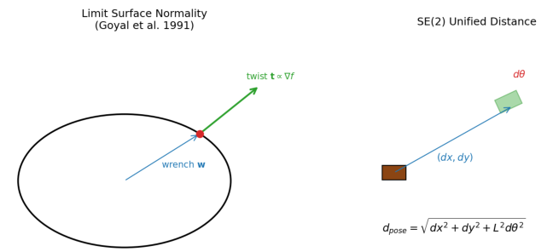
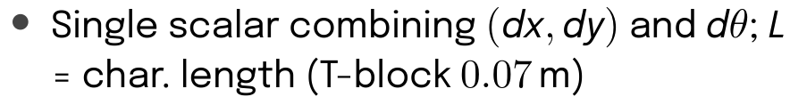
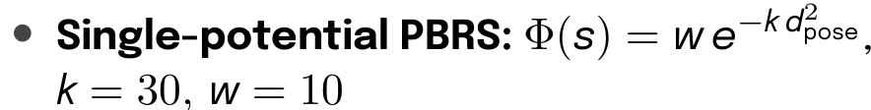
SE(2) Unified Distance – Self-Play Variants
T-block /L = O.O7m (rotation couples to translation)
Eliminates competing pos/rot gradients — aligns reward with the coupled physics
Result: SE(2) does not rescue self-play - ASP-dPose reaches only 6.7% validation SR vs single-agent 80%. The self-play curriculum is the root cause, not the metric.
[Park 1995] [Urain et al. 2023] [Lynch & Mason 1996]
21

Slide 22

PPO-Curriculum — Position—>Rotation Curriculum
Design: Same PPO agent as PPO-PBRS + 3-phase curriculum:
3. Full PBRS (multi-objective)
Narvekar et al. 2020] [Portelas et al. 2020][Florensa et al. 2017]
22

Slide 23

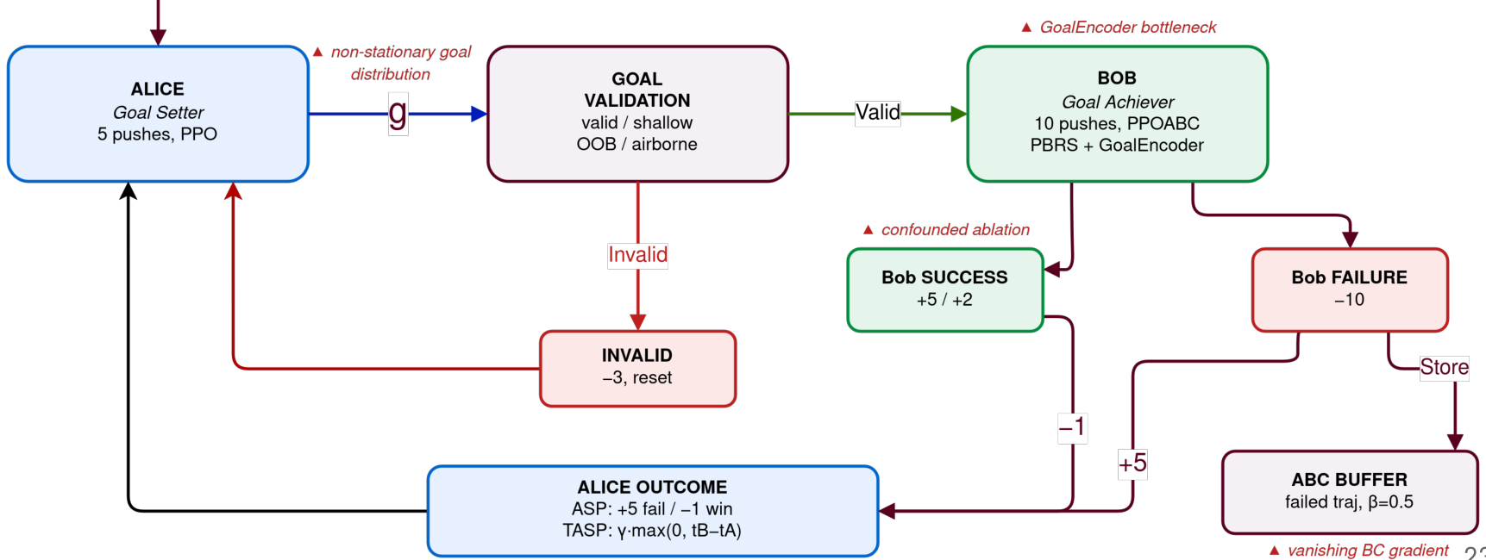
ASP Loop – Alice←→Bob Cycle
Init so

Slide 24
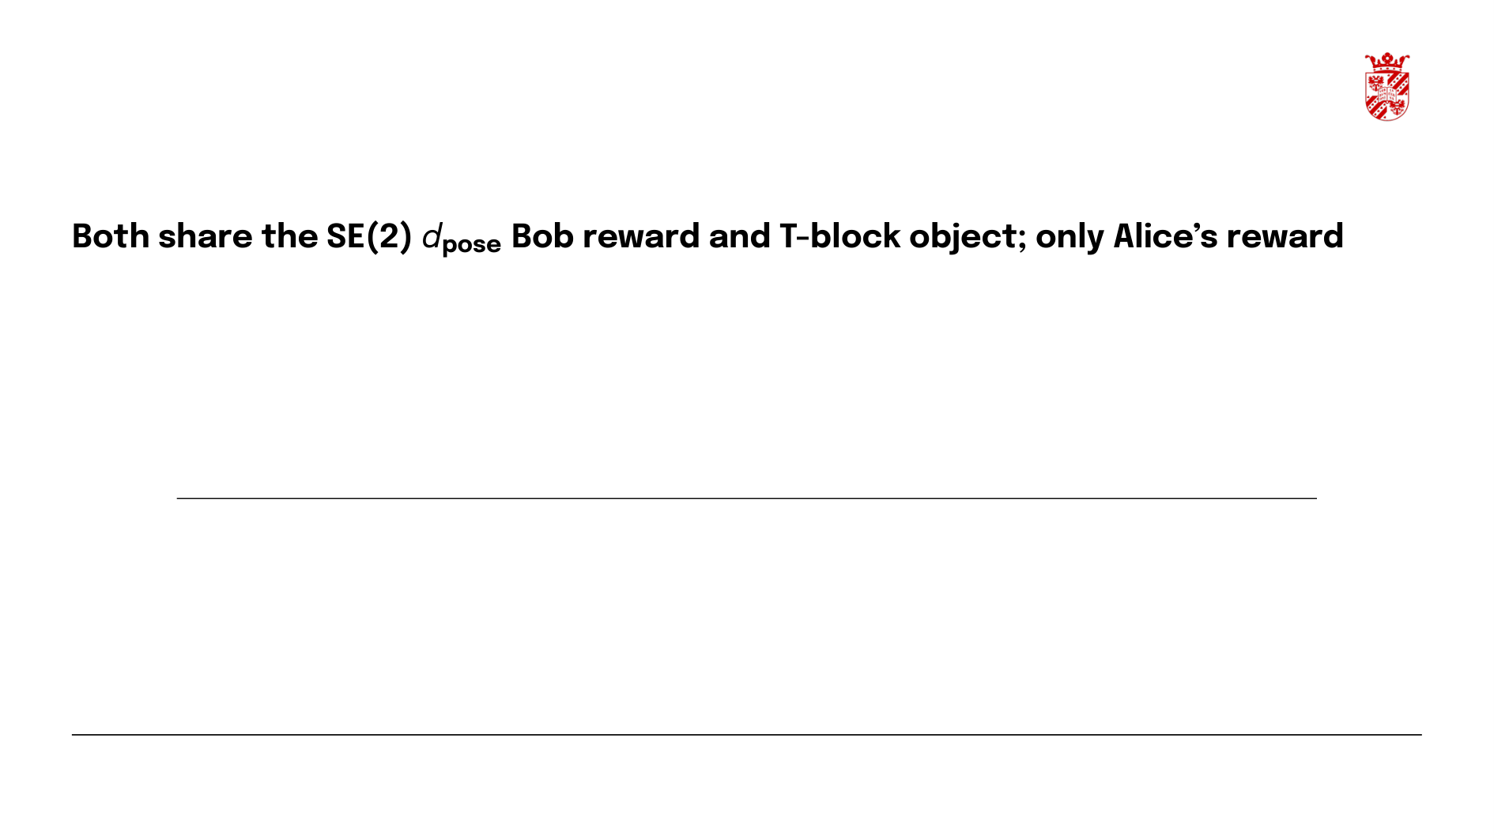
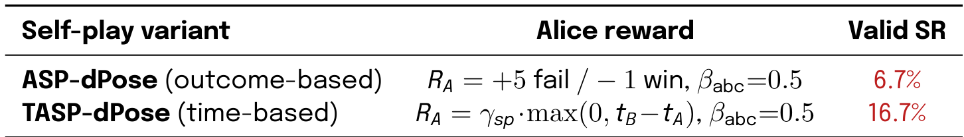
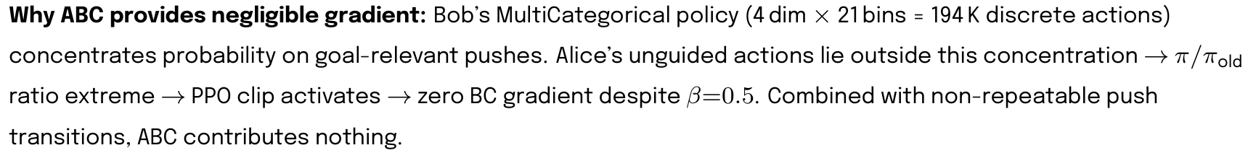
ASP-dPose vsTASP-dPose - Alice Reward
differs.
[Plappert et al. 2021] [Sukhbaatar et al. 2018] [Dennis et al. 2020
24

Slide 25
5.Evaluation

Slide 26

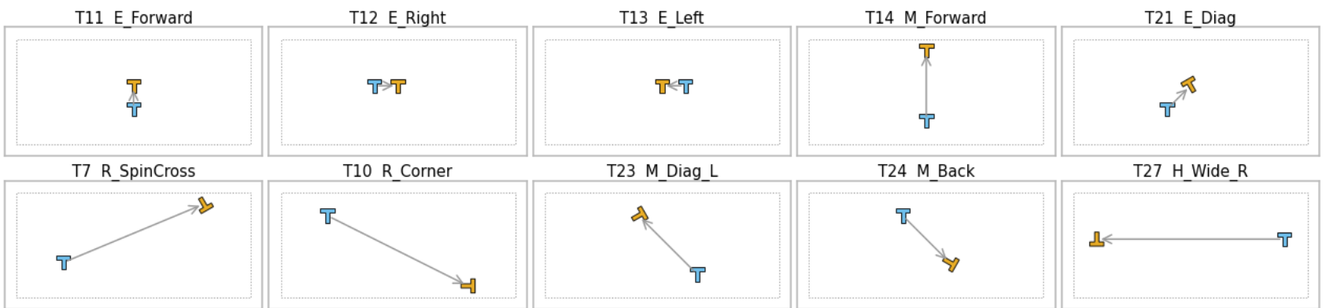
Validation Test Suite – Top 10 Held-Out Scenes
Top row: 5 easiest scenes (3-4 of 4 models pass)| Bottom row: 5 hardest scenes (0 of 4 models pass)
Start pose
Goal pose
T-block start pose > goal pose. Every model is evaluated on an identical 30-scene suite (20 trials × up to 30 pushes per scene).
26

Slide 27


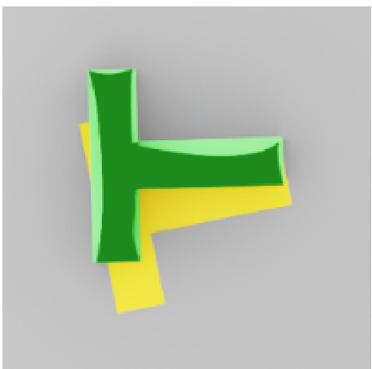
What Does Success Look Like?
Position-only success
Position + Rotation
Success gate:
success
• Object reaches goal pos < 0.05 m AND rot < 0.2 rad
10/30 scenes are pos-only (rotation ungated)
20/30 scenes require both
>1 of 20 trials must pass per scene
27

Slide 28
6. Results

Slide 29

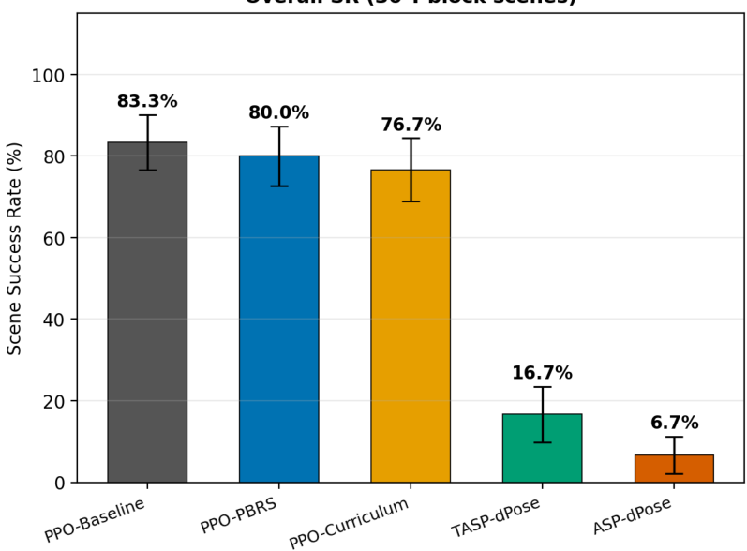
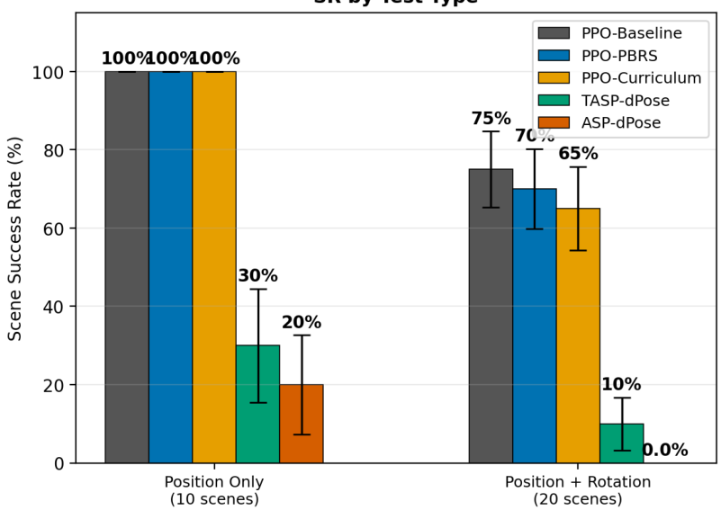
Multi-Model Validation
Multi-Model Validation — 30 T-block Scenes, Best-of-20, 30-Push Budget (Error bars = ±l SE across scenes)
Overall SR (3o T-block scenes)
SR by Test Type
29

Slide 30

PPO-PBRS — Validation Results
30 held-out T-block scenes (20 trials each):
• 80.0% SR (24/30) – pos-only 100%, pos+rot 70%
PosErr 0.032 m, RotErr 0.568 rad (mean over all 30 scenes, incl. failures)
Per-attempt (trial-level) SR 66%; scene SR counts a scene solved if any of its 20 trials passes
[Ng et al. 1999] [Grześ 2017] [Schulman et al. 2017]
30

Slide 31

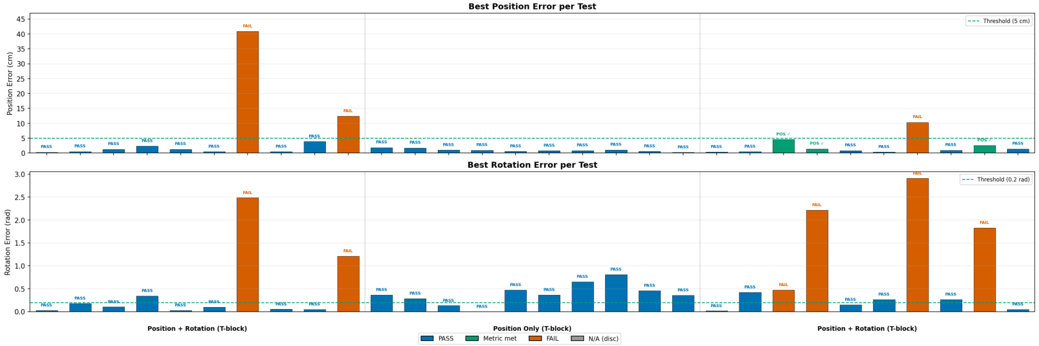
PPO-PBRS - Per-Test Error
24/30 (80.0%) – 100% pos-only, 70% pos+rot. All 6 failures are rotation-limited (large-yaw / spin scenes); 8/10
rotation-dominant scenes solved
31

Slide 32

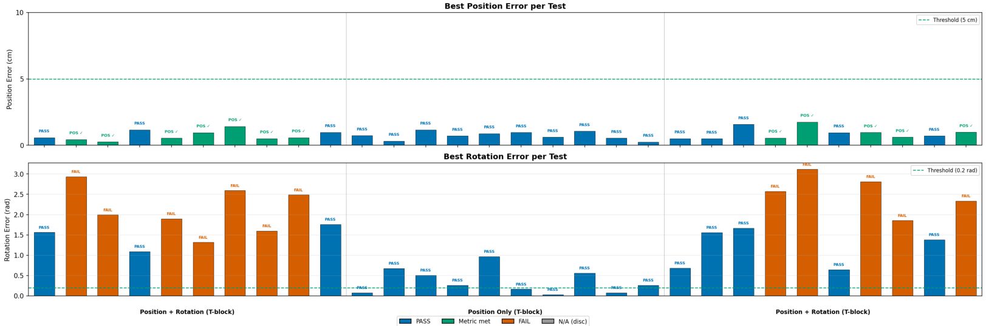
PPO-Curriculum - Per-Test Error
23/30 (76.7%) – same 100% pos-only, 65% pos+rot. Tighter position precision from Phase 1 (0.023 vs 0.032 m), but
marginally worse rotation (0.663 vs 0.568 rad).
32

Slide 33
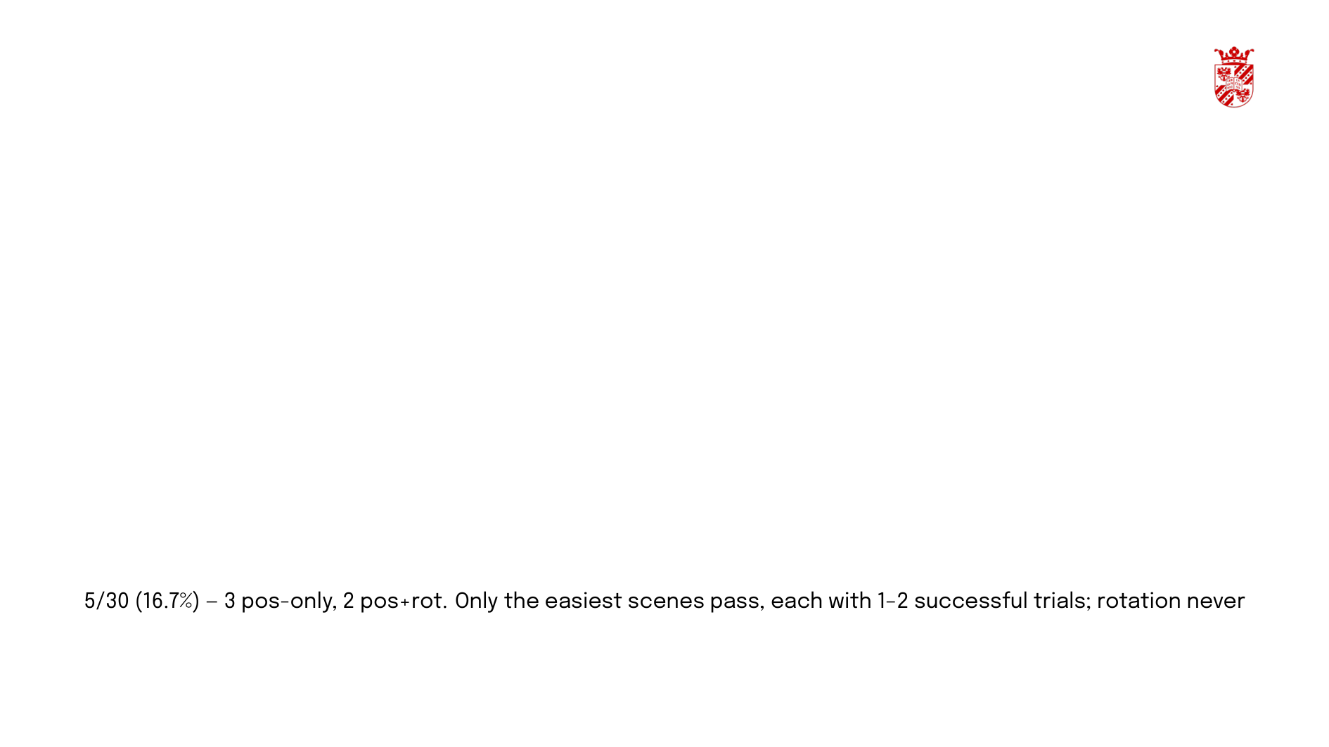
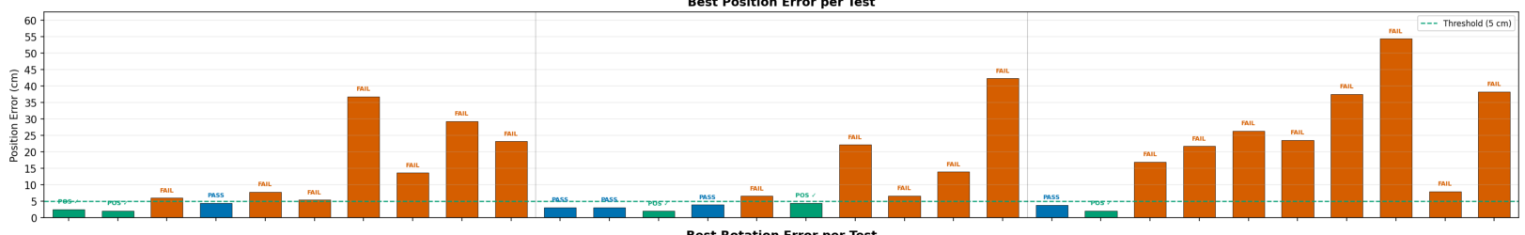
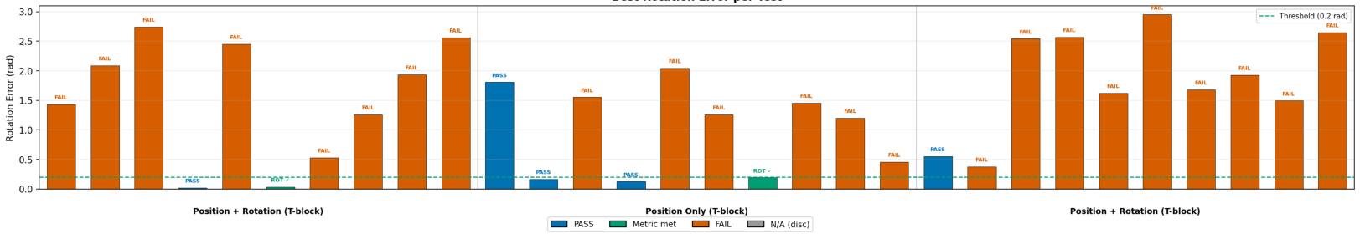
TASP-dPose - Per-Test Error
Best Rotation Error per Test
learned (RotErr 1.457rad).
33

Slide 34

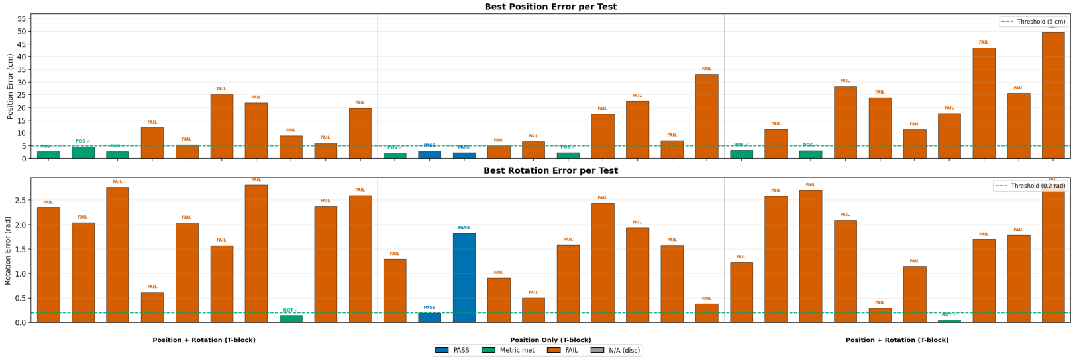
ASP-dPose - Per-Test Error
2/30 (6.7%) – only the two easiest position-only scenes pass. Zero pos+rot success; rotation never learned (RotErr
1.612rad). Outcome-based Alice collapses entirely.
34

Slide 35

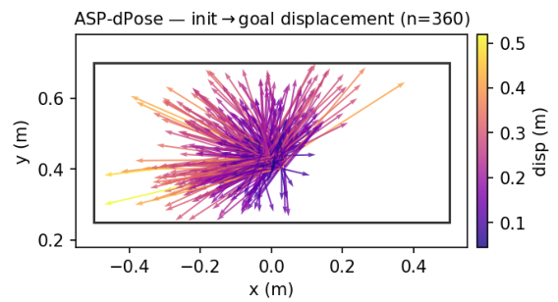
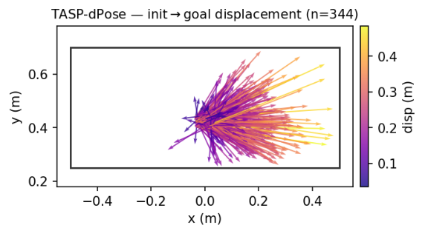
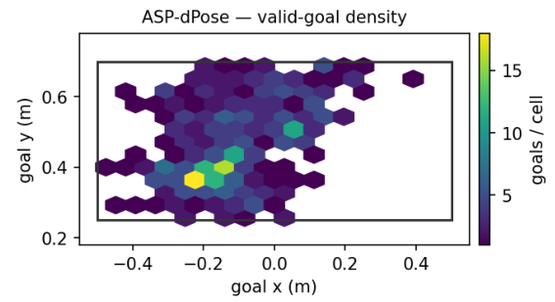
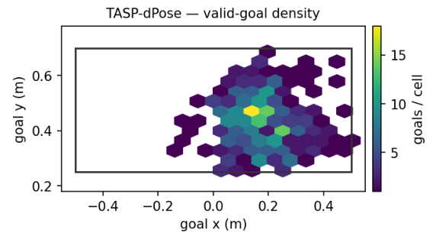
ASP vs TASP training
ASP-dPose (outcome) vs TASP-dPose (time): displacement (top), valid-goal density (bottom). Bob solves few valid goals (3.9% vs 5.5%).
35

Slide 36
PPO-PBRS – Validation Runs (overhead)
36

Slide 37
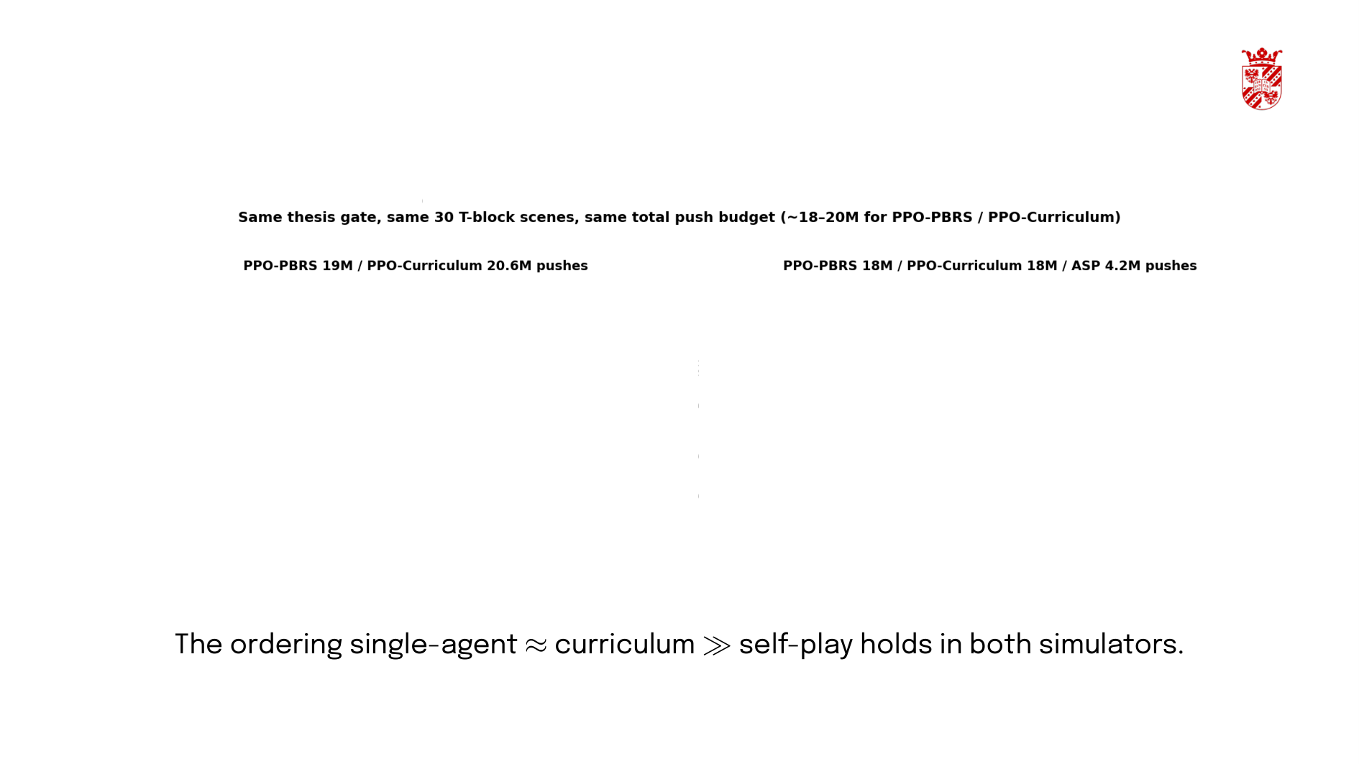
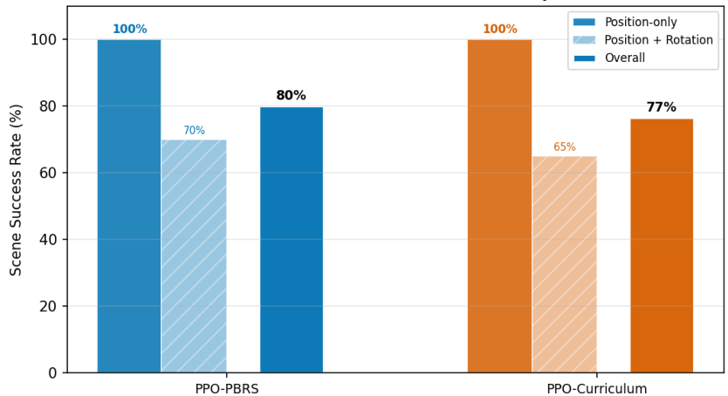
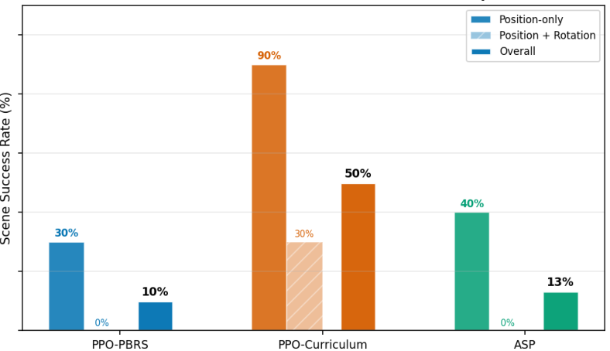
Cross-Environment Validation – Isaac vs Gym
Cross-Environment Validation SR — Isaac Lab vs Gym-pusht HPC
Isaac Lab (528 GPU, batch 7,920)
Gym-pusht HPC (32 CPU, batch 960)
37

Slide 38
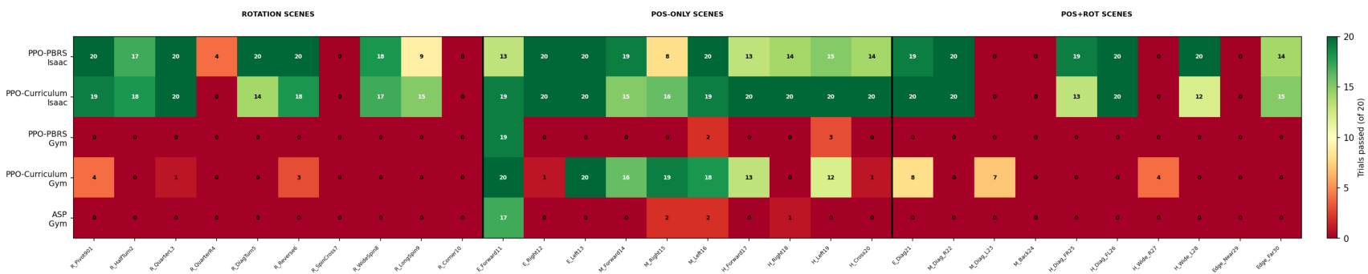
Per-Scene Outcomes – Isaac vs Gym
Per-Scene Trial Success Rate — Isaac vs Gym HPC (30 T-block scenes, 20 trials each) Colour: red=0 trials passed → yellow=10 → green=20
Colour: red (0 trials passed) > yellow (1o) →→ green (all 20). Numbers = successful trials per
scene out of 2o.
38

Slide 39
7. Discussion

Slide 40



ASP Diagnostic - Alice & Bob Training Dynamics
Panel 1 — Alice Goal Validity Rate
Panel 2 — Bob Per-Axis vs Combined Success Rate
budgets. Right: Bob learns position and rotation to ~50% each under PBRS - but the
combined gate caps at ~10%, 2.5 × below the independence product.
40

Slide 41


ASP - The Empirical Result
structural, not a budget artifact
41

Slide 42
8. Conclusion & Takeaways

Slide 43

Conclusion – Environment Efficiency (RQ1)
RQ1 – PBRS reduces parallel-environment requirements
PBRS achieves 80.0% SR at 528 parallel envs - 4× fewer than the fractional reward requires (2,048 envs) for the same performance (83.3%). Dense, correctly-signed, bounded rewards on every push. Policy invariance (Ng et al. 1999) holds with stochastic PhysX.
[Ng et al.1999][Grzes 2017][Harutyunyan et al.2015]
43

Slide 44

Conclusion – Curriculum & Self-Play (RQ2)
RQ2 - Staging adds no value; self-play degrades performance
PBRS(80.0%, n.S.).
Adversarial goal generation: five self-play configurations across three simulators yield stable on-policy learning.
The substitution finding: PBRS substitutes for an explicit curriculum at this batch size - curriculum adds 3.3pp (n.s.). This is regime-dependent: at gym batch 960, curriculum helps (50% vs 10%). Self-play (4.8-11.9 × worse) helps in neither regime. Practical implication: invest in reward design first
Plappert et al. 2021][Sukhbaatar et al. 2018][Narvekar et al. 2020
44

Slide 45

Conclusion – Individual Skills Under Self-Play (RQ3
RQ3 – ASP teaches individual skills it cannot compose
Under PBRS-ASP, Bob learns per-axis position (54%) and rotation (45%) individually - but the combined gate caps at 10%, 2.5x below the independence product (24-25%). Under the original fractional reward, nothing is learned (1.3% per-axis, 0.07% combined). The adversarial
Plappert et al. 2021] [Sukhbaatar et al. 2018] [Schulman et al. 2017]
45

Slide 46

Computational Overhead – Self-Play Is Not Slower
Controlled measurement (same machine, same 528 envs, same cuRobo IK + physics):
PPO-PBRS (single-agent) vs the self-play variants run at ∼1.0 × per-iteration wall-clock (~0.022 it/s for both). The 2-agent machinery (Alice + Bob, GoalEncoder, ABC, historical pool) adds no measurable per-iteration overhead - the shared cuRobo IK + PhysX contact step dominates the cost.
Key result:
Self-play is not slower per iteration - it simply does not learn
(two networks, non-stationary objective, ABC), not throughput
same compute
Plappert et al. 2021][Schulman et al. 2017]
46

Slide 47

Limitations & Future Work
equilibrium.
→ Zero-sum game theory (Letcher 2019) may stabilise symmetric self-play; test penalty only on non-catastrophe ends.
Combined pos+rot gate is the universal bottleneck - joint gate rarely fires under self-play (0-10% pos+rot)
→ Relaxed success gate or partial credit per objective to provide gradient toward both.
3. Single-seed validation - training SR variance across 5 chains (BestSR 0.081-0.110) → Re-evaluate checkpoints across 5 seeds for validation confidence intervals.
batch 7,920; curriculum helps at batch 960.
threshold.
[Letcher et al.2019][Dennis et al. 2020] [Schulman et al.2017]
47

Slide 48

universityof
Thank You - Questions?
VladIftime s3426394
Faculty of Science and Engineering, Artificial Intelligence
University of Groningen
June 2026

Slide 49

Appendix Outline
• A. Push Mechanics – Limit Surface & Characteristic Length L
B. Training curves for all PBRS models (Success Rate, Reward, Loss)
D. Validation scene descriptions (30 test cases)
E. cuRobo IK pipeline and workspace configuration
•F. Observation space specifications (all model variants)
G. Per-test error bars - PPO-PBRS vs PPO-Curriculum head-to-head and all-model comparison (95% binomial Cls)
H. P82 Curriculum Trigger Bug - why the original trigger never fired
I. BobPenalty Fail-Fast Equilibrium - degeneracy mechanism
• J. Confounded Ablation Disaggregation – 7-axis variation table
• K. Training Budget Comparison – envs, iterations, push-macros
L. Validation Protocol - scene set, trials, disclosed limitations
49

Slide 50


PBRS - The Shaping Theorem
Ng et al.:
Our potential functions (PPO-PBRS / PPO-Curriculum):
[Ng, Harada & Russell 1999][Grzes 2017] [Devlin & Kudenko 2012]
50

Slide 51

PBRS – Why It's the Right Choice
1. Markovian – depends only on s, s', not history.
2. Bounded - exponential potentials prevent reward explosions from PhysX contact spikes.
reward hacking.
4. No constant drain - F=O when stationary; no penalty for hesitation or deliberation.
Key consequence: you can replace any ad-hoc reward with a potential-based one policy optimisation are decoupled.
[Ng, Harada & Russell 1999][Grzes 2017] [Harutyunyan et al. 2015]
51

Slide 52



PPO-PBRS - Training Dynamics
Left: PPO-PBRS (blue) steadily improves training success rate over 30oo iterations.
PPO-Curriculum (orange) follows a similar trajectory but converges slightly lower. Self-play
variants remain near baseline throughout. Right: Stable value function - no explosion. Initial
V≈ 0.057with gain= 0.01.
[Schulman et al.2017][Ng et al.1999]
52

Slide 53



PPO-Curricuum vs PPO-PBRS
[Narvekar et al. 2020][Portelas et al. 2020][Florensa et al. 2017]
53

Slide 54


Self-Play – Validation Comparison
Key findings:
Time-based self-play (TASP-dPose)is 2.5x better than outcome-based (ASP-dPose), but still 4.8 × below single-agent PPO-PBRS
No self-play variant achieves pos+rot SR above 10% - the combined gate remains the bottleneck
Self-play complexity provides no benefit
[Plappert et al. 2021] [sukhbaatar et al. 2018][Dennis et al. 2020]
54

Slide 55


Rotation Error
55

Slide 56


Appendix A – Push Mechanics: Limit Surface & L
Limit surface normality: t ∞ f(w) – twist is normal to the surface, so every push couples translation and rotation.
(Goyal et al. 1991)
SE(2) Unified Distance
Characteristic length L (radius of gyration):
T-blockL = O.07m- an off-centre push couples translation and rotation
L is a physical constant, not a hyperparameter
The T-block rotates under an off-centre push (coupled SE(2) motion)
[Goyal et al.1991] [Howe &Cutkosky1996][Mason 1986]
56

Slide 57




Appendix B – Training Curves (All PBRS Models)
Success Rate
Mean Reward
Value Loss
57

Slide 58






Appendix C – PBRS Theory Analysis
Potential Landscape
Gradient Comparison
PBRS vs Fractional Formula
Cosine Angular Distance c(s) = (1 — cos(θ* − θ))/2
58

Slide 59


Appendix G – Per-Test Error Bars (95% Binomial Cls
Distance to Target per Test
Top: PPO-PBRS (blue) vs PPO-Curriculum (orange) head-to-head - per-scene trial-level SR from 20 trials. Overlapping Cls on most scenes.
Bottom: All 4 models - the self-play variants are near-zero on all but the easiest scenes. Green labels: position-only tests. Purple labels: position+rotation tests.
59

Slide 60

Appendix H – P82 Curriculum Trigger Bug
metric.
Broken trigger (original):
If mean(per-push PosErr)< 0.08 m for ALL 50 consecutive iterations activate Phase 2
Why unreachable:
Per-push PosErr is measured after every push, including early ones far from a freshly randomized goal (0.1-0.45 m away)
The iteration-mean has a structural floor well above O.08 m - even the best model's validation PosErris 0.202 m
•50-iteration AND gate: one noisy iteration resets the streak
60

Slide 61


Appendix I– BobPenalty Fail-Fast Equilibrium
Why it creates a degenerate equilibrium:
Mechanism:
10 pushes and fail"(—20.0)
2. Since failing is easier than succeeding in contact-rich physics, the policy collapses to immediate failure

Slide 62


Appendix J – Confounded Ablation Disaggregation
Implication: the 4.8 ×x SR gap cannot be attributed to any single Iever.
But this is a single 1-axis experiment within a 7-axis package change
• We present “self-play as implemented,” not “the curriculum mechanism in isolation”
62
[See thesis 86 3 for disagoregation analvsis]

Slide 63


Appendix K - Training Budget Comparison
direct architectural comparison.
Caveats:
PPO-Baseline at 2,048 envs received ~129 x more push-macros than PBRS models
a fraction of the total push budget63

Slide 64

Appendix L - Validation Protocol
All models evaluated under an identical protocol:
(E_*/M_*/H_*), 10 combinedposition+rotation
Trials: 20 independent trials per scene (best-of-20); a scene is "solved" if any trial meets the gate
Success gate: pos_err < 0.05 m and rot_err < 0.2 rad at trial termination
• Push budget: up to 30 pushes per trial (training uses 5-15)
Scene SR vs Trial SR: scene SR counts scenes where >1/20 trials pass; trial SR counts individual tria success rate
Disclosed limitations:
Training SR variance exists across 5 chains (PPO-PBRS BestSR 0.081-0.110) but validation Cs are singe-mode.64
64

