Slide 1

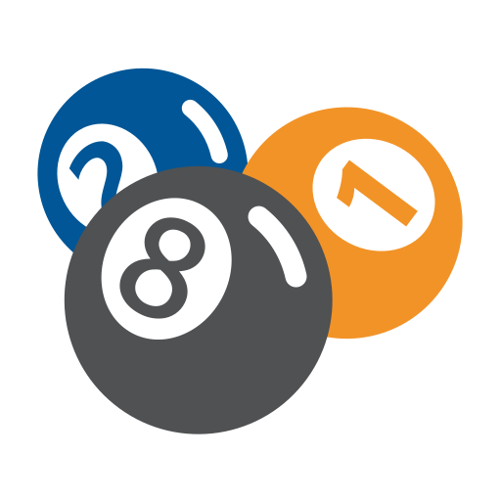
Pool Game
Performer: Lieus Vladyslav
Mentor: Grebenovich Julia

Slide 2



Purposes and Tasks
Purposes of this work is to find the right algorithms for realization of software part of the Pool Game. At the very beginning the player has one main ball, (white one), 6 regular balls in a pyramid form and a cue. There are two players, both have 3 hearts and 5 attempts in the first round. If one of them rolled a white ball into a hole, current player will lose a heart. Each next round both players' attempts decreasing by one, but not less than 3, than game restarts with 5 attempts for both. Switch to the next round happens in case of: one of the players lost all of his hearts or both of them lost all their attempts or all the balls are in the holes.
Tasks are: find the right algorithms of objects spawn, correct physics of collisions and checks for hearts, attempts and players’ scores, build a block diagram of how game works in general, realization of software product according to all conditions.

Slide 3





Main algorithms
Main algorithms of the game is: game objects spawn and updating, following the mouse cursor by cue for aiming, and collisions calculations and of course round endings checks.
Spawning and updating objects: drawing an .png images in a special position at the moment.
Following the mouse cursor for aiming: we use a general high school math ta calculate the angle, on which we’ll turn our cue.
Collisions: using special formulas for 2D objects, we made an vector velocities for objects when its collided.
Round endings: use all the check according to our game rules, if one of them is true, we go to the next round.

Slide 4

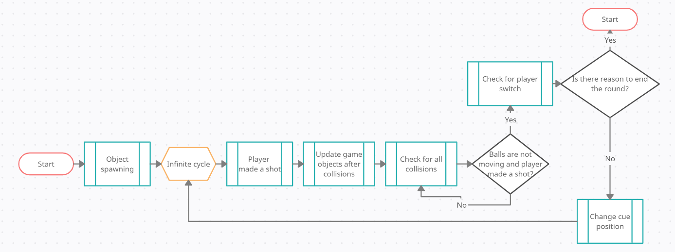
How game works
The game is on infinite cycle while the page is not closed, but it’s refreshing itself in the end of the round, if there are reasons for that, by respawning the objects and return everything like at the very beginning but with less amount of attempts next round. Or also user can fully restart it by pressing F5. Lets made an block diagram of how it works in general to easy understanding without details.

Slide 5


Logic of software product
For better realization of this software product was chosen a JavaScript. This programming language is better in action with user on the web page. And because this language is not strictly typed, it’s easier to do some of the algorithms and checks in our game, also it gives an opportunity to keep the game into an infinite cycle just by calling its beginning in the HTML document.
Game has 4 main classes which contains all game objects and 5 which provide main game logic.
Main classes: player – contains two global variables: currentPlayer and secondPlayer, which contains all their properties; ball – contains some of calculation constants and all balls collisions; sctick – contain an cue object and check when player make a shot and control cue position; canvas – we can say that its our field, this class draw all the objects.
Logic classes: assets – helps canvas download all the images and check balls by colors; colors – contains all balls’ colors; game – that’s where we start the game; gameWorld – contains an every physical game objects an render it each frame, also checks for player switch; gamePolicy – provide scoring, round ending and tells who is a winner, reset everything each next round.

Slide 6

Final Result

