Slide 1
gas meter Block diagram Reference design
Vlad Manole

Slide 2
Wireless Transmission
Power
Cellular IoT
Zigbee
Flow Sensor
LDO
Battery Monitoring
BLE
LORA
Buck/Boost
MCU16/32
Security Module
Flash
Battery
RTC
Wired Transmission
Flow Control
CAN
UART
Temper Protection
Alert
Position Sense
Segment
MaxTouch
Motor Driver
Valve

Slide 3

Simple Implementation
3x AA Batteries
Power (B1 Connector)
LCD Segment Display
Multi-Output MEMS OSC. DSC613
MCU
PIC24FJ512GL406
Or
ATSAM22G18A
Ultrasonic Flow Converter TDC-GP22
Ultrasonic Transducers
SPI
LDO MCP1711
UART
M-BUS Transceiver BL15721B

Slide 4
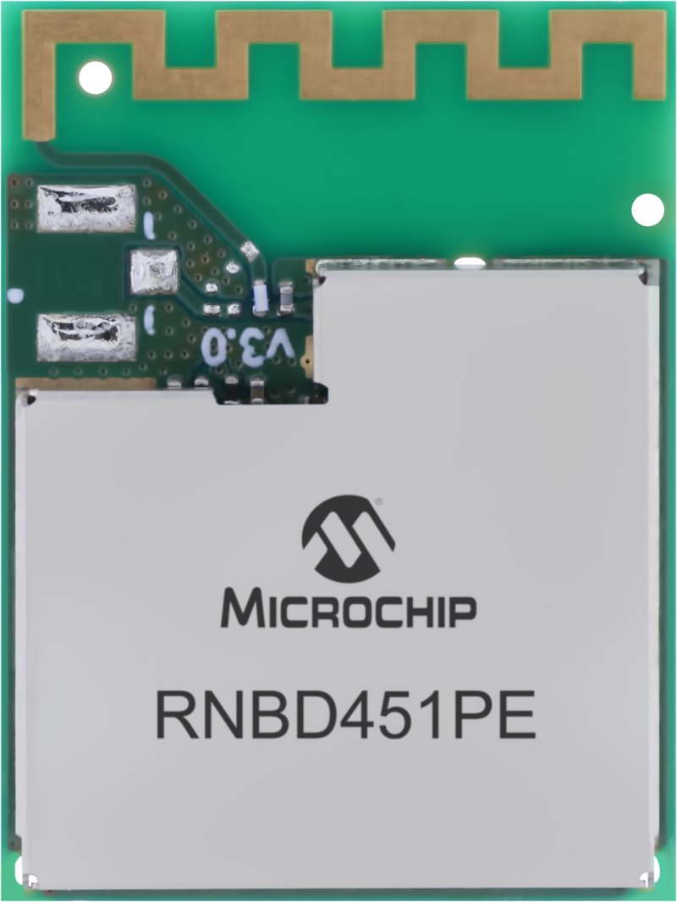
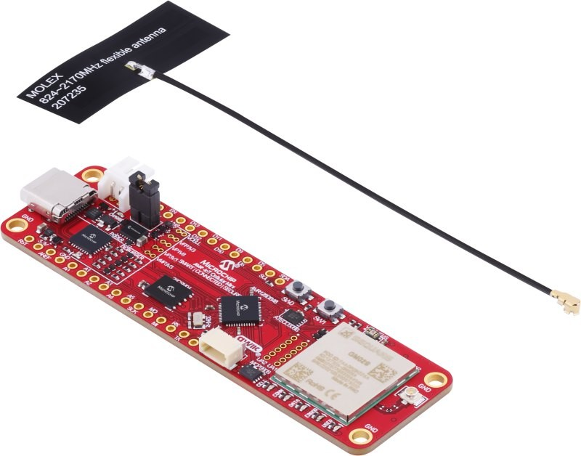
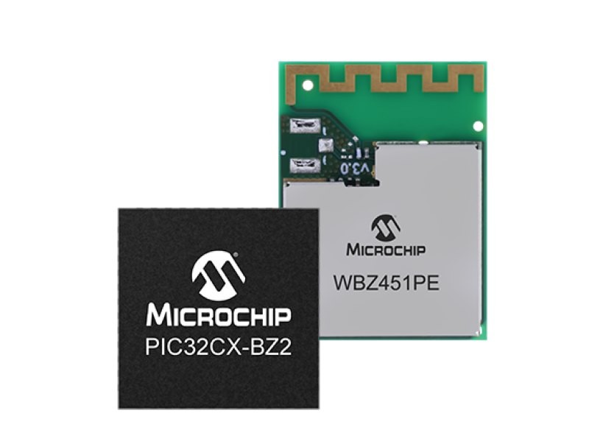
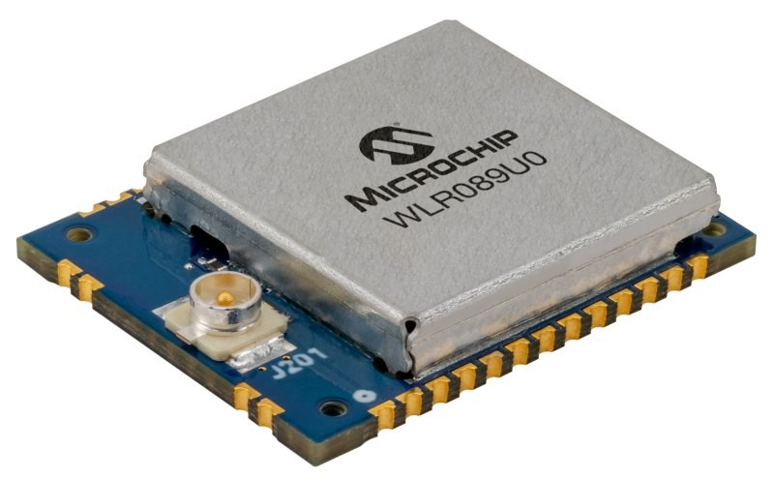
Wireless Transmission Solutions
Cellular IoT
Zigbee
Bluetooth/BLE
LORA
Press on the product image in order to be redirected.

Slide 5
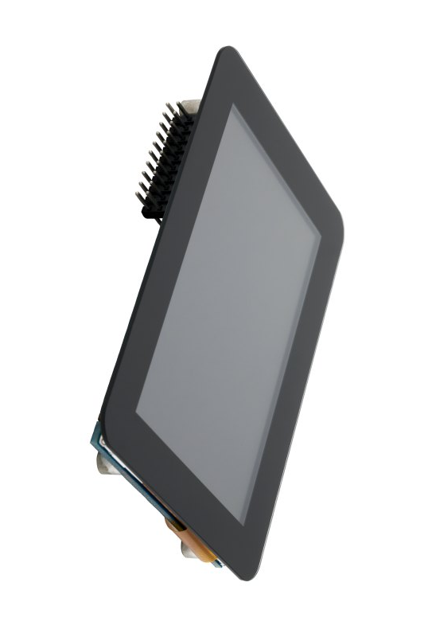
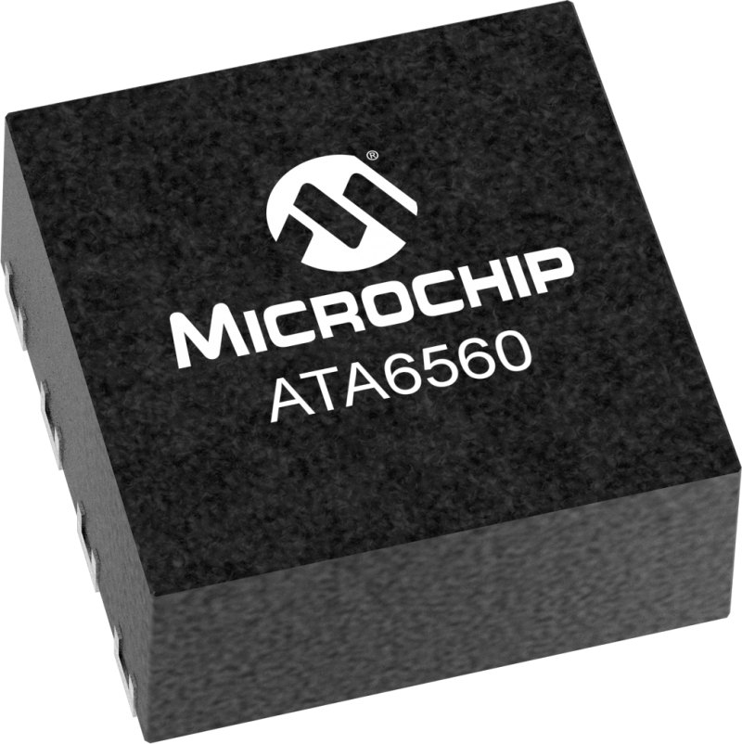
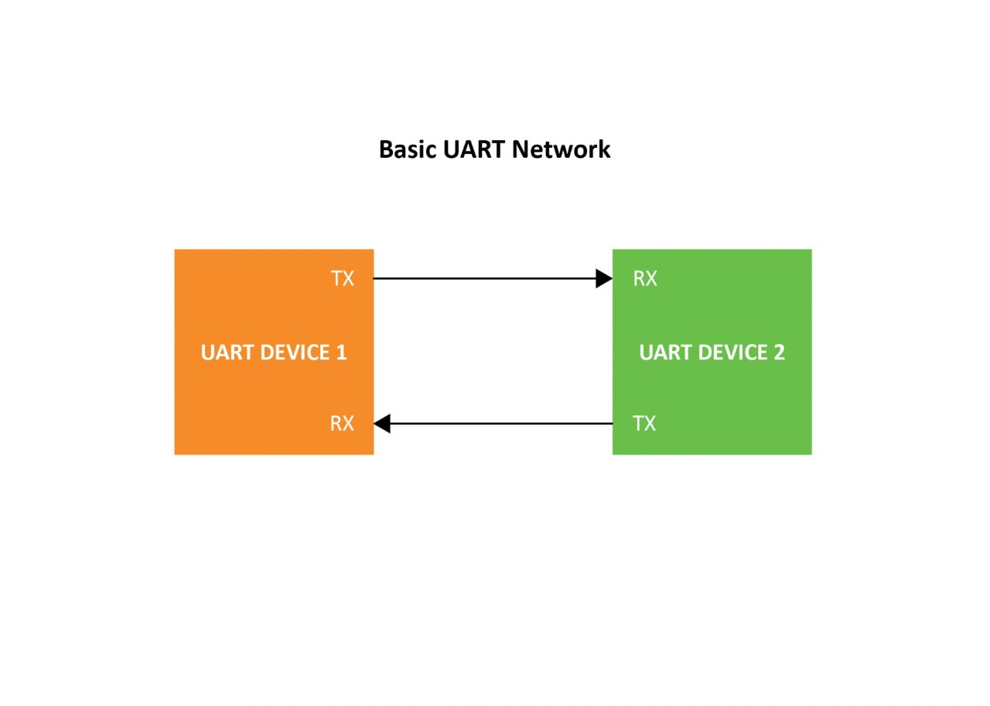
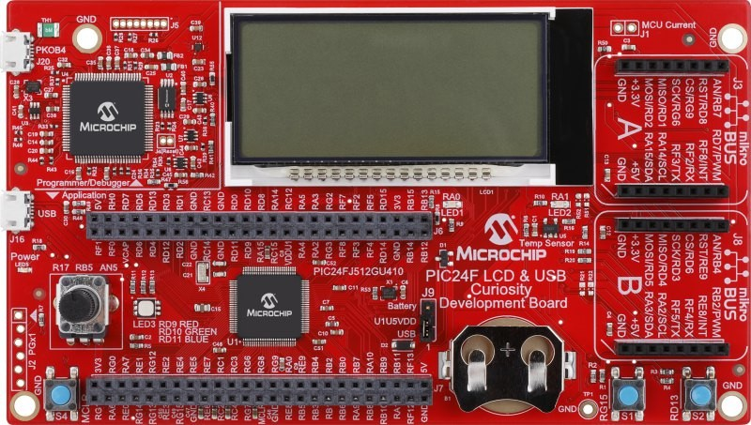
Wired Transmission Solutions
CAN and CAN FD
UART/EUSART
Segment
MaxTouch
Press on the product image in order to be redirected.

Slide 6
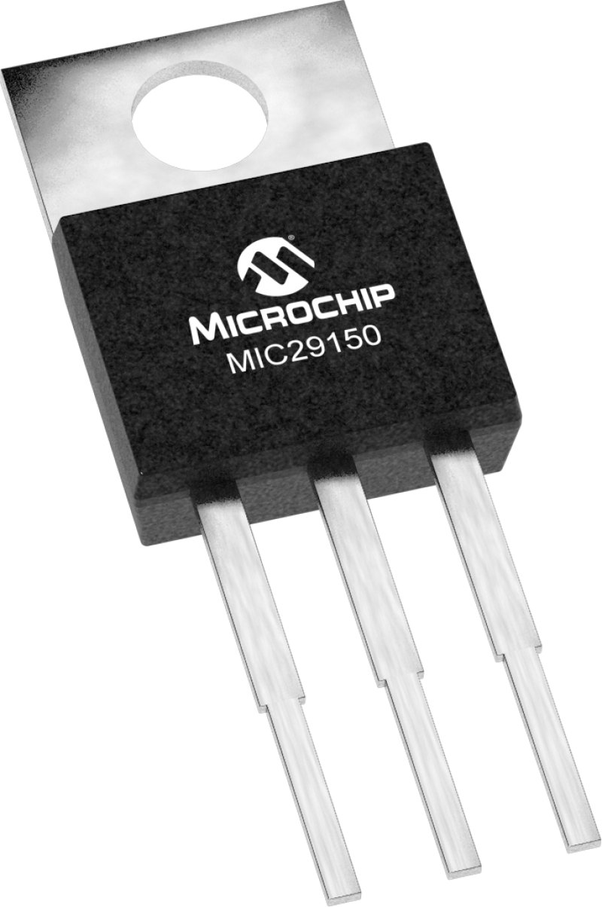

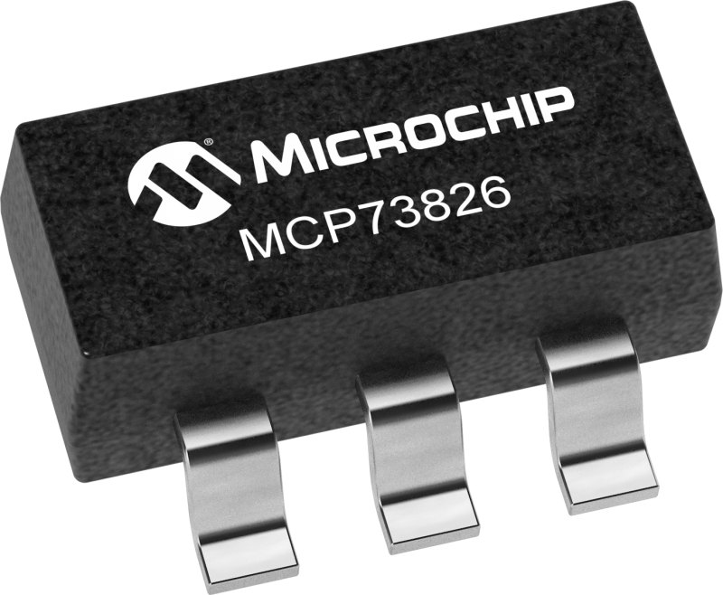
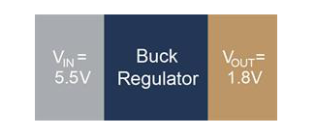
Power Solutions
LDO
Buck Convertor
Boost Convertor
Battery Monitoring
Press on the product image in order to be redirected.

Slide 7
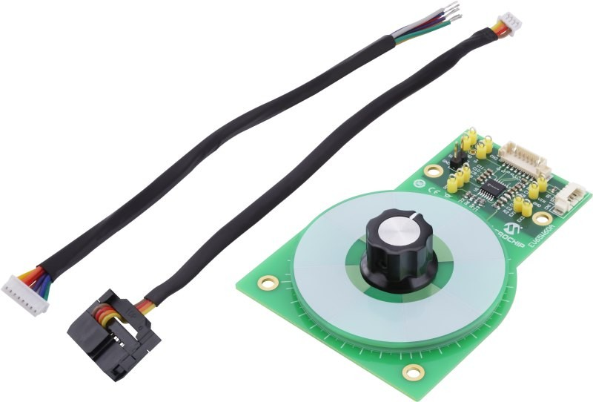

Flow Control
Inductive Position Sensor
Motor Driver
Press on the product image in order to be redirected.

Slide 8

Security
Find out more here:
https://www.microchip.com/en-us/products/security

Slide 9
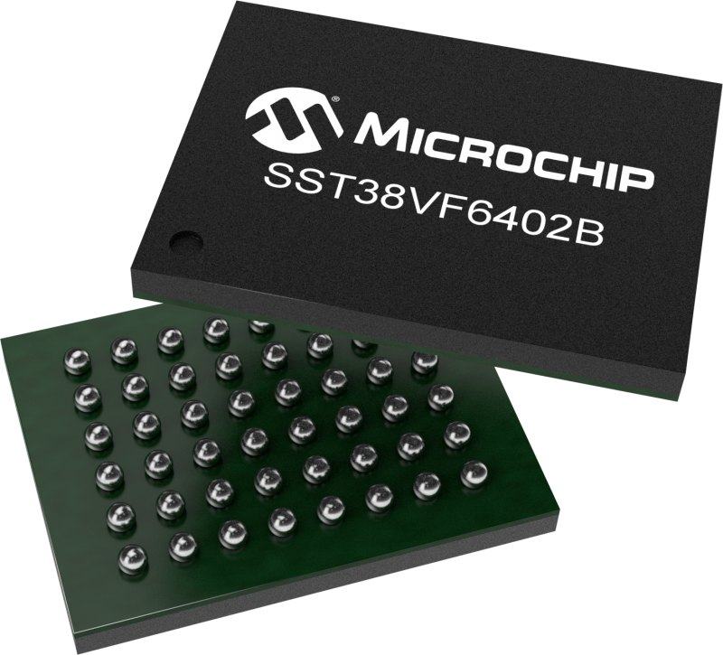
Flash
Find out more here:
https://www.microchip.com/en-us/products/memory/serial-and-parallel-flash

