Slide 1
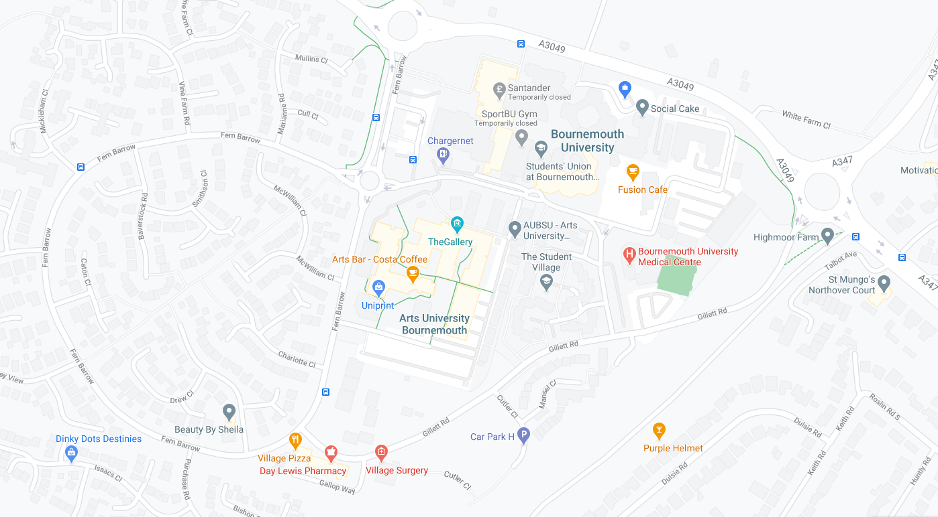
Maps with MPG
Our idea!
A special pugly production by the Moonshiners

Slide 2
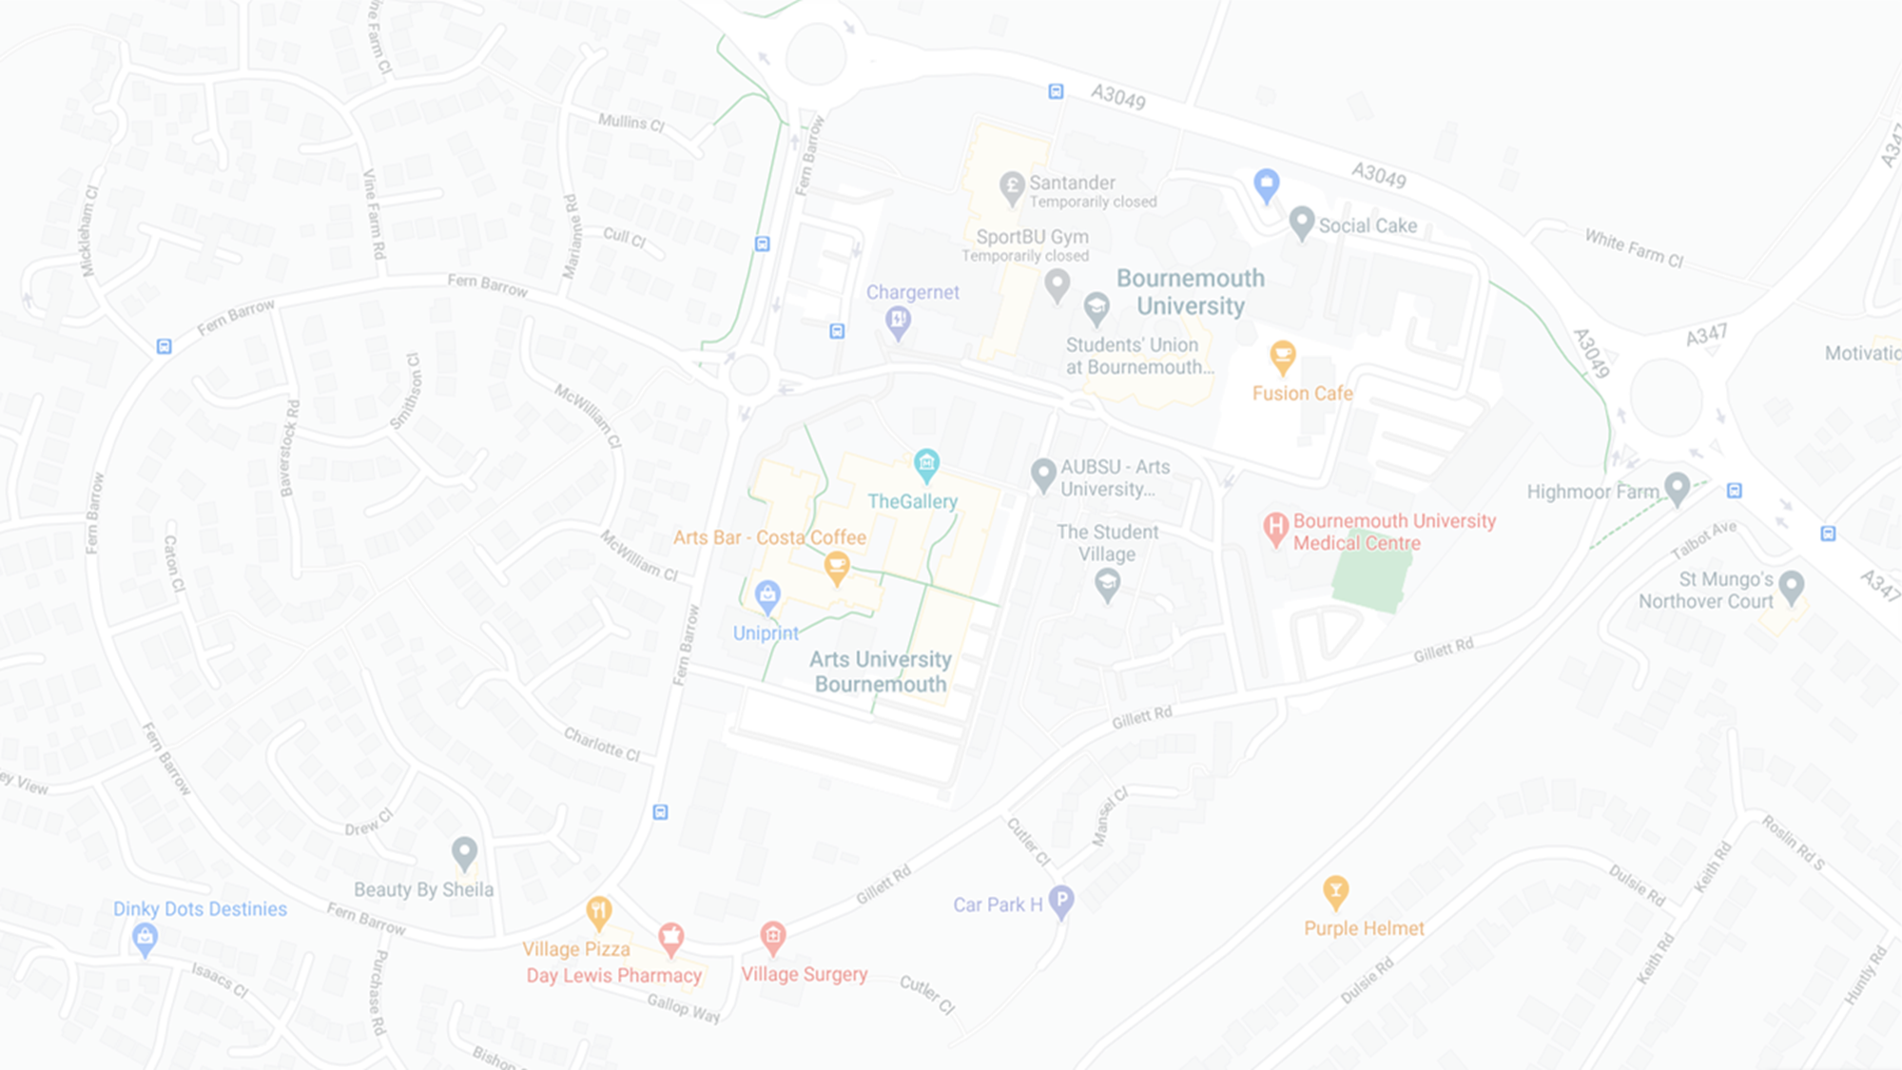
The concept ….
Google Maps has no way to calculate routes based on the efficiency of the vehicle, only on the efficiency of the roads (fastest route, shortest route, types of roads)
Wouldn’t it be great if you could choose a route that would save you money?
It would be like having a smart meter for your car, telling you if you were spending more than you needed to.

Slide 3
But why would we want maps to do this? Surely it isn’t hard to work out?
Working out which route is cheapest by yourself is really hard, because you need to know:
How many miles per gallon (MPG) your car can do
How congested the roads are on different routes – start-stop journeys waste a lot of fuel
How hilly the roads are – going uphill is way more expensive than downhill.

Slide 4
Google Maps already knows most of these things!
The only thing that Google Maps doesn’t know is how efficient your car is.
It already knows how busy the roads are and how quickly traffic is moving
It already knows elevation and so knows if there are steep hills
You would just need to use the data differently.

Slide 5
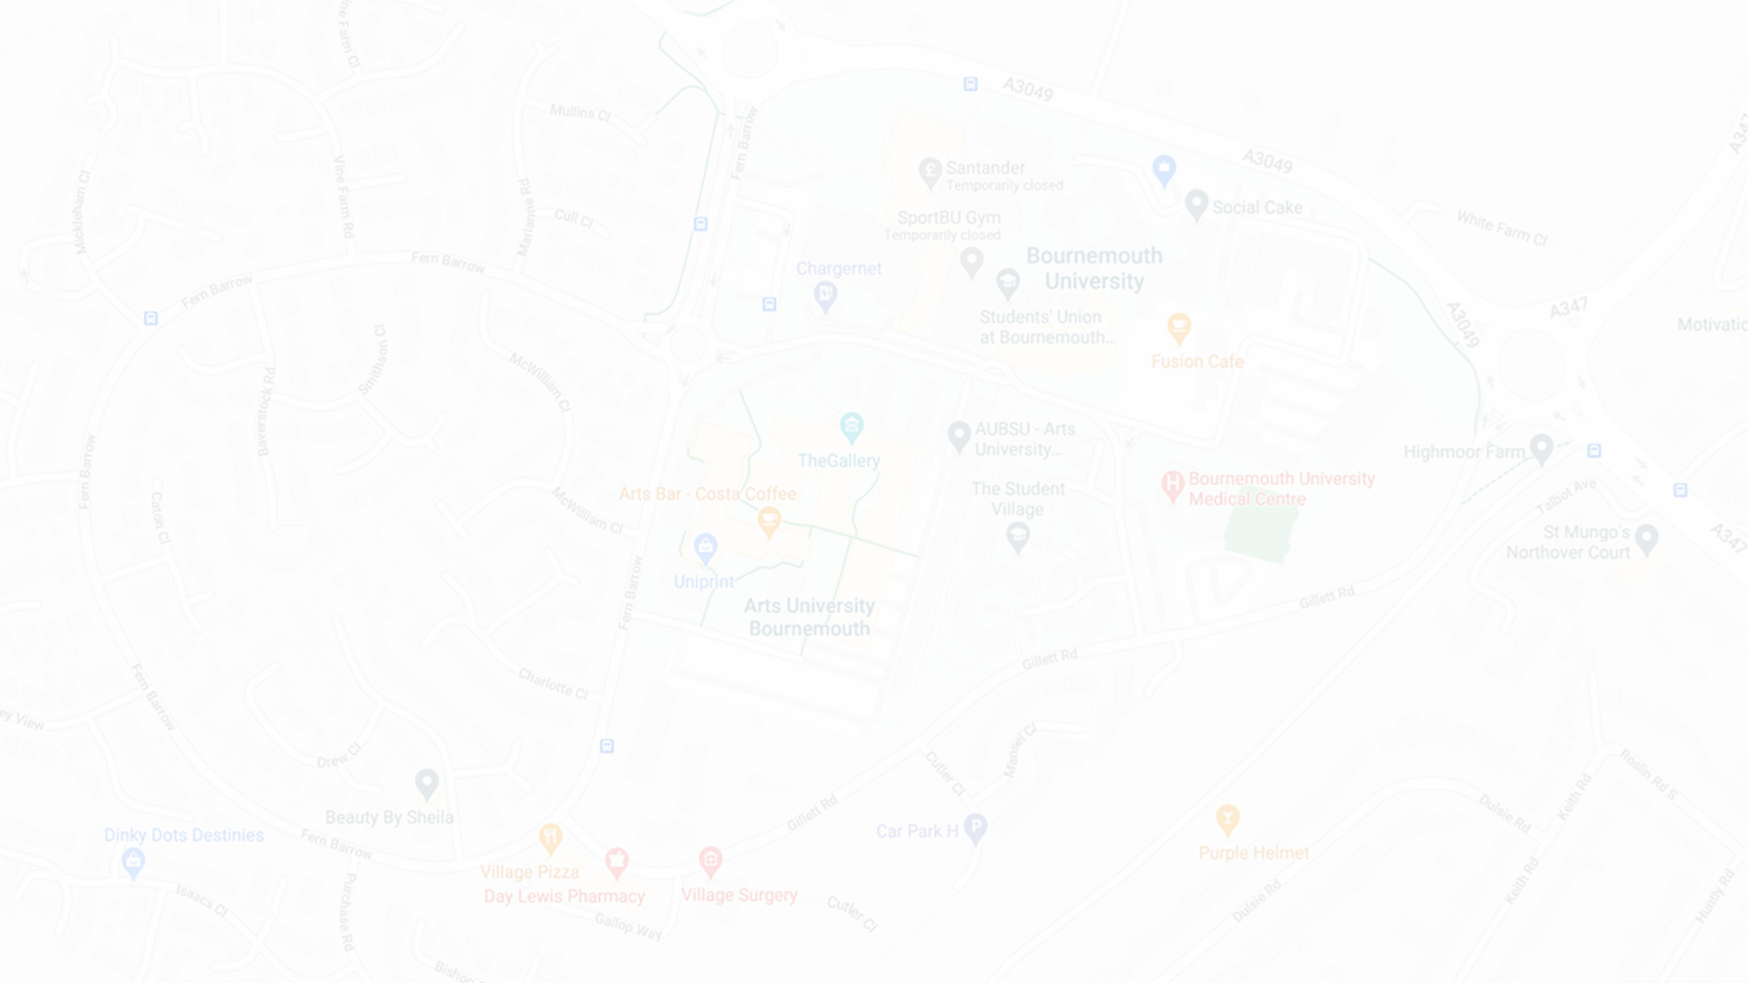
What would be the benefits of looking at mapping data this way instead?
The user saves money by choosing more fuel efficient routes
Google Maps would route to avoid congestion more aggressively, which would reduce congestion in hotspots
And
Less fuel used means less pollution
Less congestion mean less pollution
Everybody wins!

Slide 6
What we did …
We looked at how you could get vehicle data into Google Maps and how this could be handled.
There are vehicle databases available with vehicle registration numbers and MPG stats.
So you could have a user put in their vehicle registration number and Google Maps would have the data it needed to work out how efficient that car would be on any given trip

Slide 7
What we did …
We looked at how you could integrate vehicle registration entry and choosing the most efficient route within the existing Google Maps app.
Vehicle registration entry could be included in the settings of the app, so users would only need to enter this once whilst they remained signed in, or they could easily change details if they were using a different vehicle.
Adding the option of the most efficient route would sit well alongside the existing setting for fastest and shortest routes.

Slide 8
What we did …
We looked at the coding that would be needed.
We worked on the Google Developers mapping APIs and started to see how it works.
We looked at the calculations that need to be done in order to calculate the most efficient routes, using Urban, Extra-Urban and Combined MPG figures.
We made a UI in Adobe XD to see how the new settings would fit in with the existing UI.

Slide 9
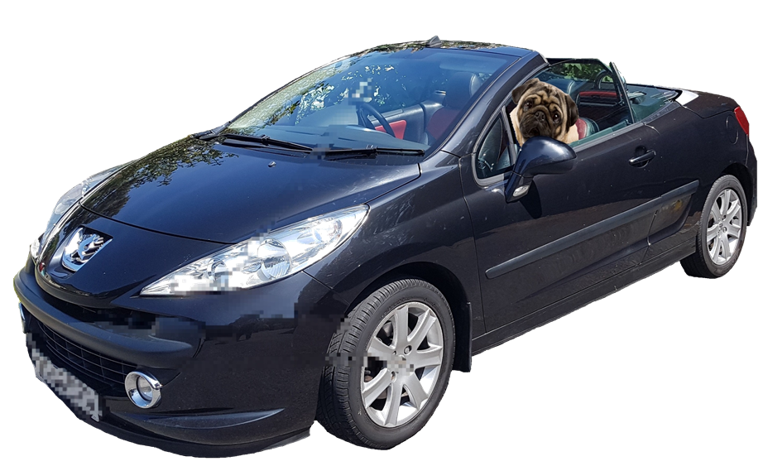
What we found …
We didn’t have time to completely re-engineer Google Maps in the time we had but …
We are sure from our work that it is possible to do and that the resources are there to make the changes without needing to compile vehicle stat lists from scratch
We really think that this is a useful project and that it would be used
Working in a team was really fun
And lastly ….
Pugs in Pugs are awesome!

