Slide 1
Monkey Business
By Marius Virciu & Vlad Sarbu

Slide 2
What we set out to make:
1. Efficient Time Management:
- A self-organizing task app can help users prioritize and schedule tasks based on deadlines, importance, or other criteria. This enables efficient time management by ensuring that crucial tasks are addressed first, aiming to reduce procrastination and improve overall productivity. (in theory)
2. Adaptability to Changing Priorities:
- A self-organizing task app that can automatically adjust task priorities or reorganize schedules in response to changing circumstances allows users to keep better track of their responsibilities.
3. Reduced Mental Load:
- Keeping track of multiple tasks and deadlines can be mentally draining. A self-organizing task app can handle the organizational stuff, freeing up mental space for creative thinking and focused work. This can contribute to reduced stress and better overall mental health.

Slide 3
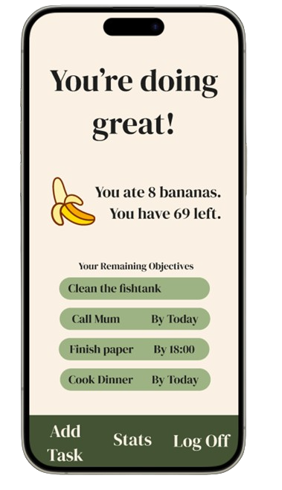
What functionalities we planned:
The ability to create task and evaluate them in bananas.
The ability to add deadlines to tasks.
A statistic overview of your productivity over time.

Slide 4
What tech we decided to use:
For frontend we decided to use React Native for its popularity and plethora of tutorials.
For backend we ended up using Express.js as it is known for its simplicity and minimalism
We settled on SQLite for our database as it is best suited for a small sized app.

Slide 5
Thank you! <3

