Slide 1
Social Helper

Slide 2
DONE
Team
Design
Conceptual Model
taxonomy
ontology
Open source Tools
REST API
Business Logic
Use Apache Jena
Use Fuseki
Integration
Robert Petrov
Vlad Cristea
Vlad Tudose

Slide 3
Motivation
Donator Management
Donation Management
Resource Management
Inventory Management = { collection of pair resource and quantity }
Location Management
Warehouse Management

Slide 4
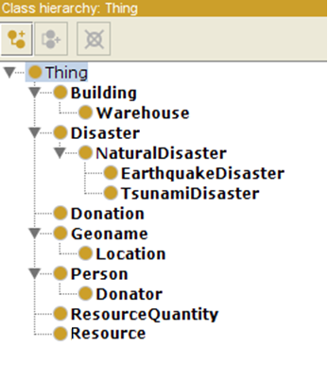
Conceptual Model - Taxonomy
Building
Geoname
Disaster
Warehouse
Location
Natural Disaster
Thing
Person
Tsunami
Earthquake
Donation
Donator

Slide 5
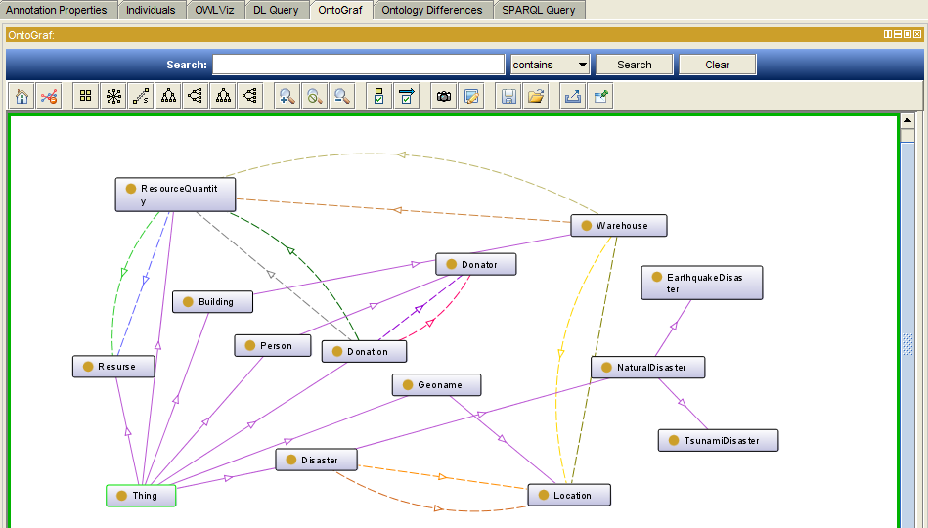
Conceptual Model - Ontology

Slide 6
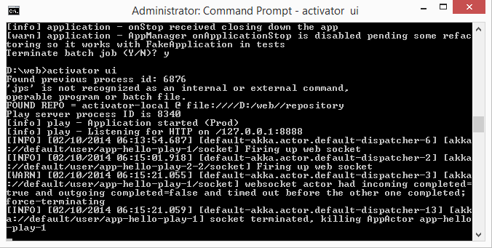
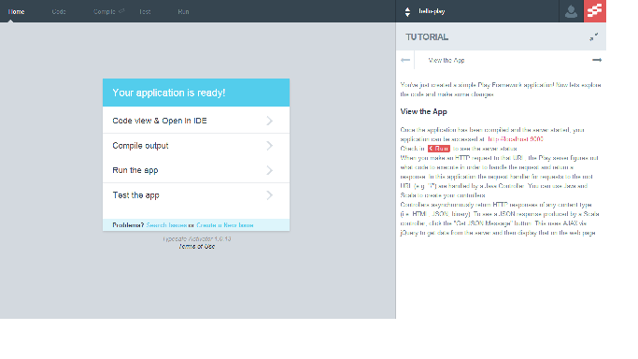
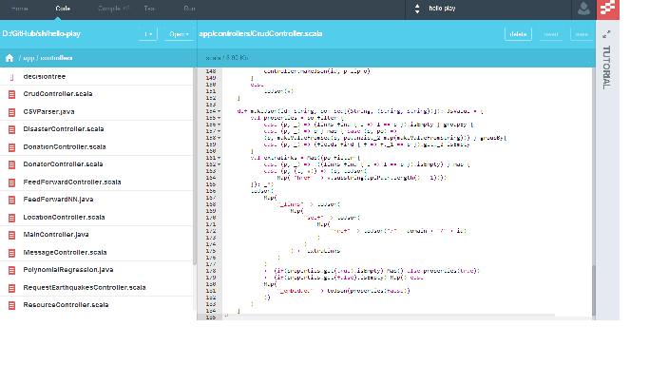
TYPESAFE ACTIVATOR

Slide 7
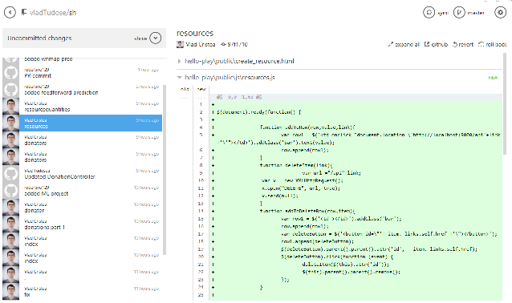

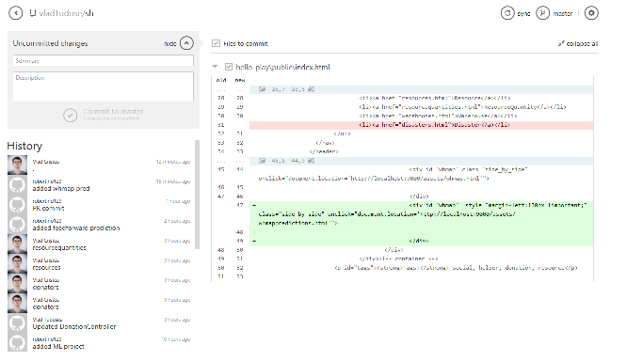
Source control

Slide 8
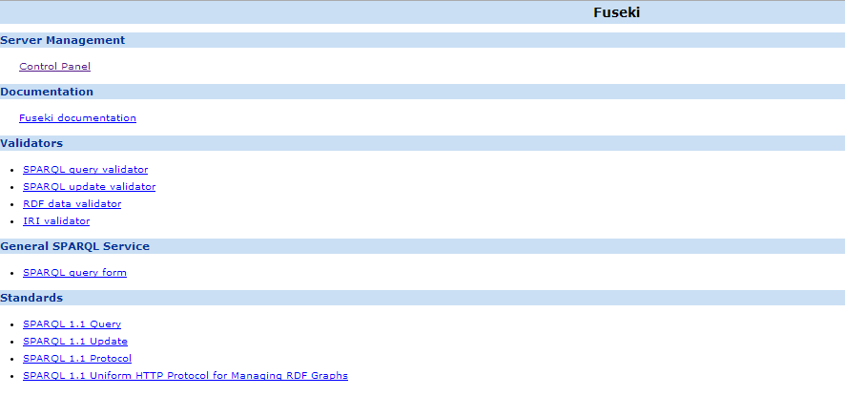
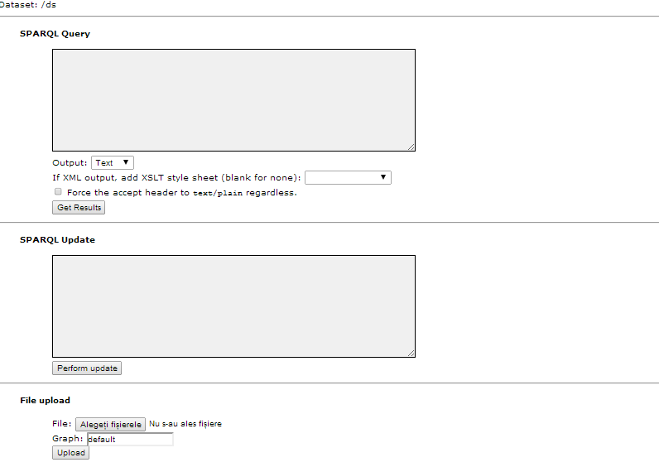
FUSEKI

Slide 9
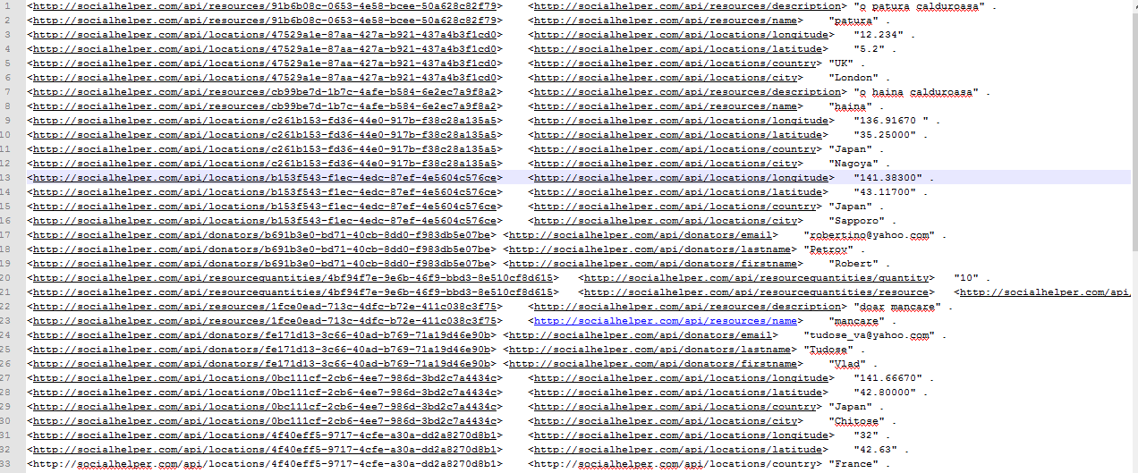
TTL

Slide 10
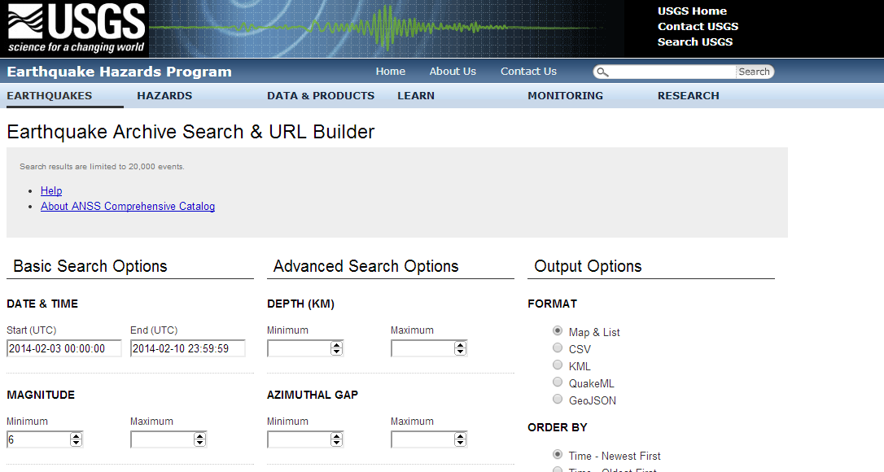
DATASOURCE
http://earthquake.usgs.gov/earthquakes/search/

Slide 11
MACHINE LEARNING
Time Series Prediction

Slide 12
Open Source Tools
Server: TypesafeActivator
Programming languages : Scala, Java
Ontology editor : Protégé
Source Control : GitHub
Apache Jena => semantic web
Apache Fuseki => SPARQL Server

Slide 13
demo

