Slide 1


2026
Corporate
capabilities
Custom software built around your operation.
PRODUCT
DATA + AI
OPERATIONS
GOVERNANCE
Rochester, New York · usatii.com
Notes:
[Sources]
- https://www.usatii.com/
- USATII Media approved logo asset (client brand asset)
- AI-generated shareholder meeting photograph (OpenAI ImageGen, project asset)

Slide 2

CORPORATE CAPABILITIES
00
WHAT WE DO
We build systems
that power operations.
For the last half-decade, Usatii has helped businesses build operations software and bring critical workflows in-house.
ONE
Learn
Ship
Operating
partner
Document the current process with your team.
Put working software in front of users.
02
USATII.COM
Notes:
[Sources]
- https://www.usatii.com/
- https://www.usatii.com/software

Slide 3
01
Products
Customer and employee applications
What we build
Integrations
02
Connections between existing systems
Core systems for daily operations.
03
Automation
Approvals, routing, and alerts
04
Data
Reporting and decision support
05
Operations
Project, asset, and workforce tools
06
Revenue
Lead and customer workflows
07
Governance
Access control and audit records
08
Visibility
03
Current status and exceptions
Notes:
[Sources]
- USATII Media capability statement (client-supplied source)
- USATII Media approved logo asset (client brand asset)

Slide 4
PRODUCT + SOFTWARE
01
PRODUCT AND INTERNAL SOFTWARE
Software designed for
your operation.
CUSTOM APPLICATIONS
INTERNAL SYSTEMS
Customer-facing products
Operations software
We build portals, forms, quoting tools, and responsive web applications.
We build tools for scheduling, inventory, service work, and project tracking.
Production stack
Modern web applications backed by Python and SQL.
Deployed in containers with authentication and role-based access.
We can also work within a client-required stack.
04
USATII.COM
Notes:
[Sources]
- USATII Media capability statement (client-supplied source)

Slide 5
WORKFLOW + OPERATIONS
02
OPERATIONAL AUTOMATION
Every task has an owner,
a status, and a record.
We automate repeatable handoffs while keeping approvals and exceptions visible to the people responsible for them.
01
Route
Send work to the right person based on clear rules.
02
Track
Show current status, due dates, and blocked work.
03
Record
Keep approval history and supporting evidence together.
CALL WORKFLOWS
Turn calls into assigned follow-up with a transcript, summary, and due date.
05
USATII.COM
Notes:
[Sources]
- USATII Media capability statement (client-supplied source)

Slide 6
DATA + AI
03
DATA AND DECISION INFRASTRUCTURE
Use company data
in everyday decisions.
Bring records from forms, business systems, documents, and calls into one usable data model.
DATA
01
Collect and organize
02
Find
Search documents and retrieve the supporting source.
03
Review
Use AI for a first pass, then route uncertain results to a person.
Fits your model policy
We can use your approved provider or deploy an open-weight model.
06
USATII.COM
Notes:
[Sources]
- USATII Media capability statement (client-supplied source)

Slide 7
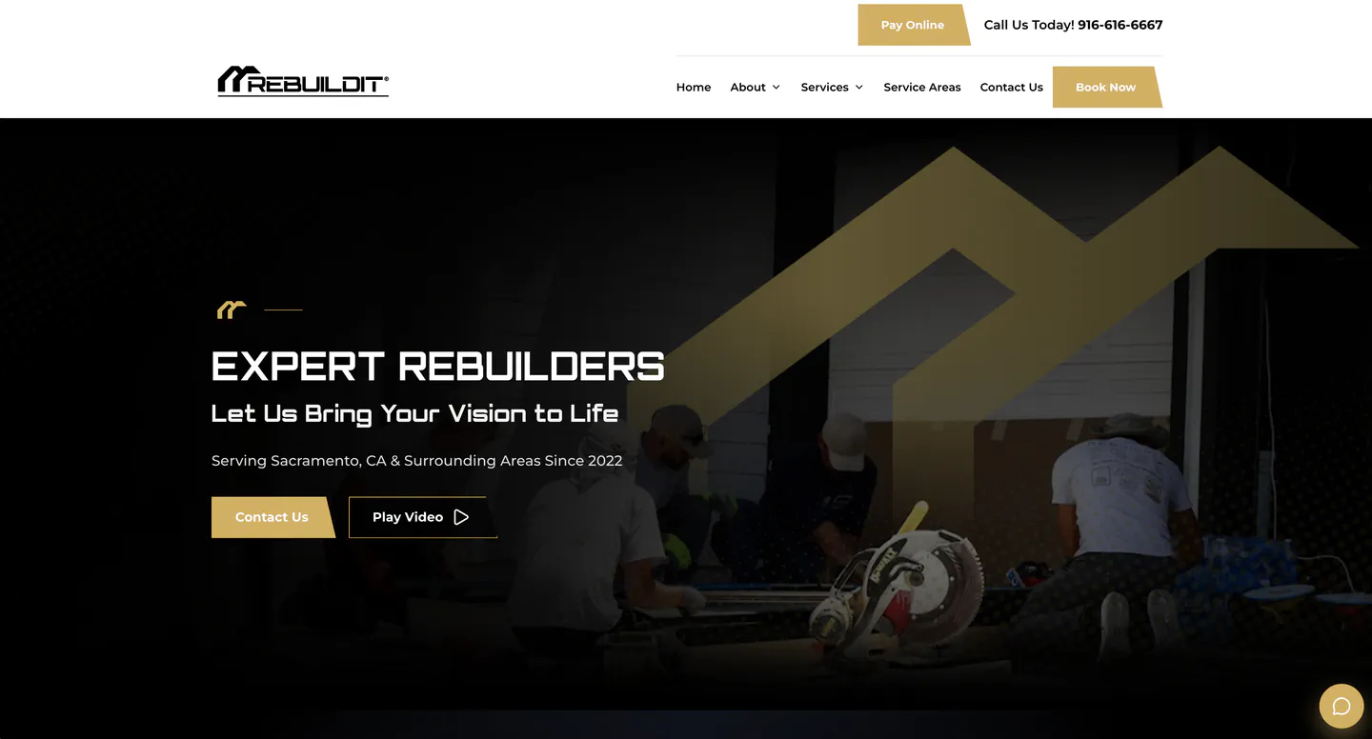
SELECTED WORK
04
REBUILDIT INC.
One system for office
and field work.
CONSTRUCTION OPERATING SYSTEM
Work is tracked from the first inquiry through the active project. The same workspace supports the back office.
REBUILDITINC.COM
07
USATII.COM
Notes:
[Sources]
- https://www.usatii.com/
- https://www.usatii.com/software
- https://www.rebuilditinc.com/
- REBUILDIT INC. website image from client repository

Slide 8
PLATFORM + CONTROL
05
CLOUD, INTEGRATIONS, AND GOVERNANCE
Run critical systems
on a controlled foundation.
SECURITY
CONTROLS
Cloud deployment
Deploy to the cloud environment your team is prepared to operate.
Sign-in controls
Role-based access
Restricted records
Backups
Audit logs
System integration
Connect current software through supported APIs and controlled data transfers.
We document these controls so they can be reviewed and maintained.
Management visibility
Show current status, blocked work, and items that need attention.
08
USATII.COM
Notes:
[Sources]
- USATII Media capability statement (client-supplied source)

Slide 9
ENGAGEMENT MODEL
06
FORWARD-DEPLOYED DELIVERY
Prove one workflow
in 30 days.
01
Operational review
Choose the workflow, users, records, access rules, and success measure.
02
30-day pilot
Put a working version into use with a small group and collect direct feedback.
03
Ongoing delivery
Improve the pilot and add the next workflow when the first one is stable.
09
USATII.COM
Notes:
[Sources]
- USATII Media capability statement (client-supplied source)

Slide 10
10
Which workflow is
slowing your team down?
We will scope a pilot and put it into use with your team.
VLAD USATII
VLAD@USATII.COM
USATII.COM
Managing Member
701-864-0782
Rochester, NY
VAU SOLUTIONS, LLC d/b/a USATII MEDIA
Notes:
[Sources]
- USATII Media capability statement (client-supplied source)
- USATII Media approved logo asset (client brand asset)

