Slide 1
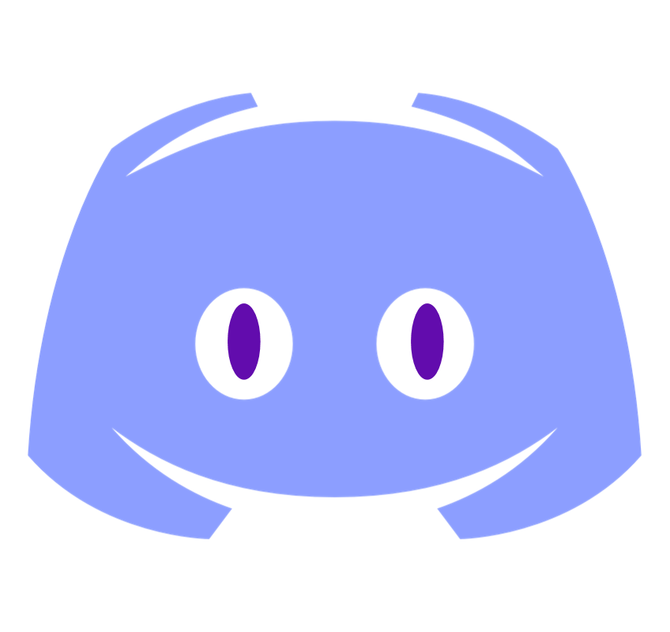
DisBotify

Slide 2
What is it?

Slide 3
Web application where you can configure your own Discord Bot
without a single line of code!

Slide 4
How does it work?

Slide 5
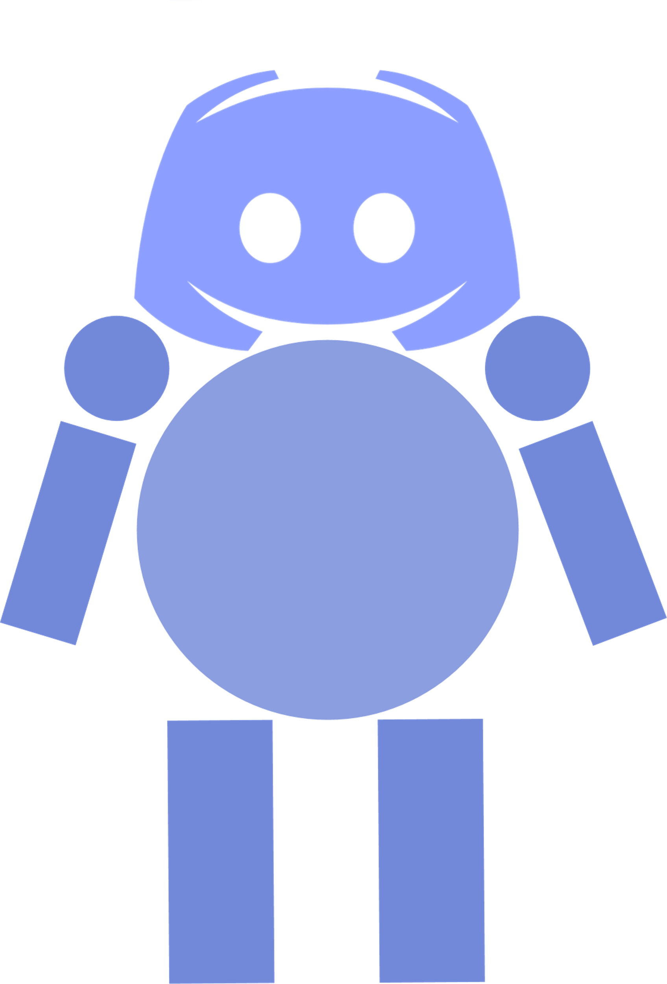
USER
UI
BOT'S TOKEN
FEATURES
Backend
GENERATES
USER'S SERVER

Slide 6
Scalability...

Slide 7
Scalability
Bot generator
Admin responsability
Simulating a real user
1
3
5
2
4
6
Small features
Schedueling
Assistant / Comrade

Slide 8
Why DisBotify?

Slide 9
1. Intuitive design 2. Easy to use 3. Instant result 4. Simple to scale

Slide 10
Thank you!
THIS PROJECT WAS
BROUGHT TO LIFE BY:
CLAUDIU MARIAN LĂBUȘ
RADU IONESCU
VLAD MIHAI OLĂERIU

