Slide 1
Can Machine Translation
preserve language patterns?
Computer Science Department, University of Bucharest, Romania
Vlad Olăeriu - group 507
Radu Ionescu - group 508
Toma Nadu - group 508

Slide 2
Introduction 1
Q: preserve style and nuance ?
Focus: preservation :
Opinion
Reporting
Satire
Approach: classification task

Slide 3
Introduction 2
Source: English (SemEval2023)
Targets: French, German, Spanish, Polish, Russian.
Translation Model: M2M100 (Meta)
Classification Model: XLM-RoBERTa

Slide 4
Introduction 3
Overview:
English -> Target languages
Fine-tune classifier for l:languages
  res vs baseline

Slide 5
Dataset
SemEval 2023 Task 3, Subtask 1 - news article classification:
  opinion
  satire
  reporting
Only used the English dataset
Topics: politics, economy

Slide 6
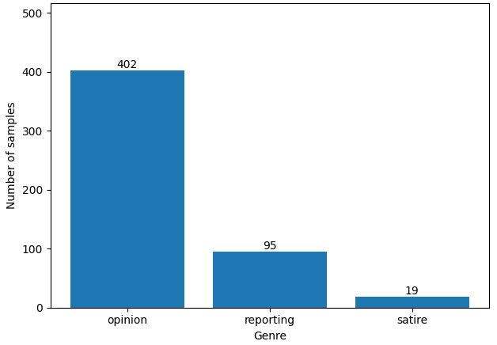
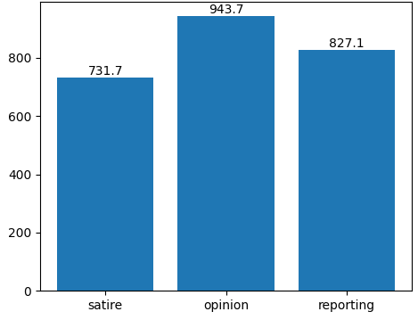
Dataset
Figure 1. Class distribution of samples
Figure 2. Class distribution in terms of average words per sample

Slide 7
Environment
Initial: free Google Colab + Kaggle
timeout / resource limit
vast.ai
rented RTX 5090
Repo: here

Slide 8
Environment 2
tools:
python 3.12
Hugging Face
PyTorch
Scikit-learn
Pandas & Seaborn

Slide 9
Translation Model
Model: M2M-100 418M
Multilingual Encoder-Decoder
M2M family: first many-to-many models without English intermediate
100 languages
Language indicators to specify source and target languages (__en__, __fr__)

Slide 10
Translation Model
Language | COMET
French | 0.3829
German | 0.4156
Spanish | 0.4213
Polish | 0.4514
Russian | 0.4504
Table 1. COMET Scores

Slide 11
Classification Model
Judge - xlm-roberta-large
560 million parameters
Why:
unified brain: single (vocabulary+vector space)

Slide 12
Results
Language | Precision | Recall | F1
English | 0.7395 | 0.7700 | 0.7407
French | 0.8023 | 0.7063 | 0.7172
German | 0.7684 | 0.7607 | 0.7257
Spanish | 0.7984 | 0.6671 | 0.6510
Polish | 0.8175 | 0.8174 | 0.8135
Russian | 0.8285 | 0.7999 | 0.7820
Table 2. Macro-Averaged Metrics

Slide 13
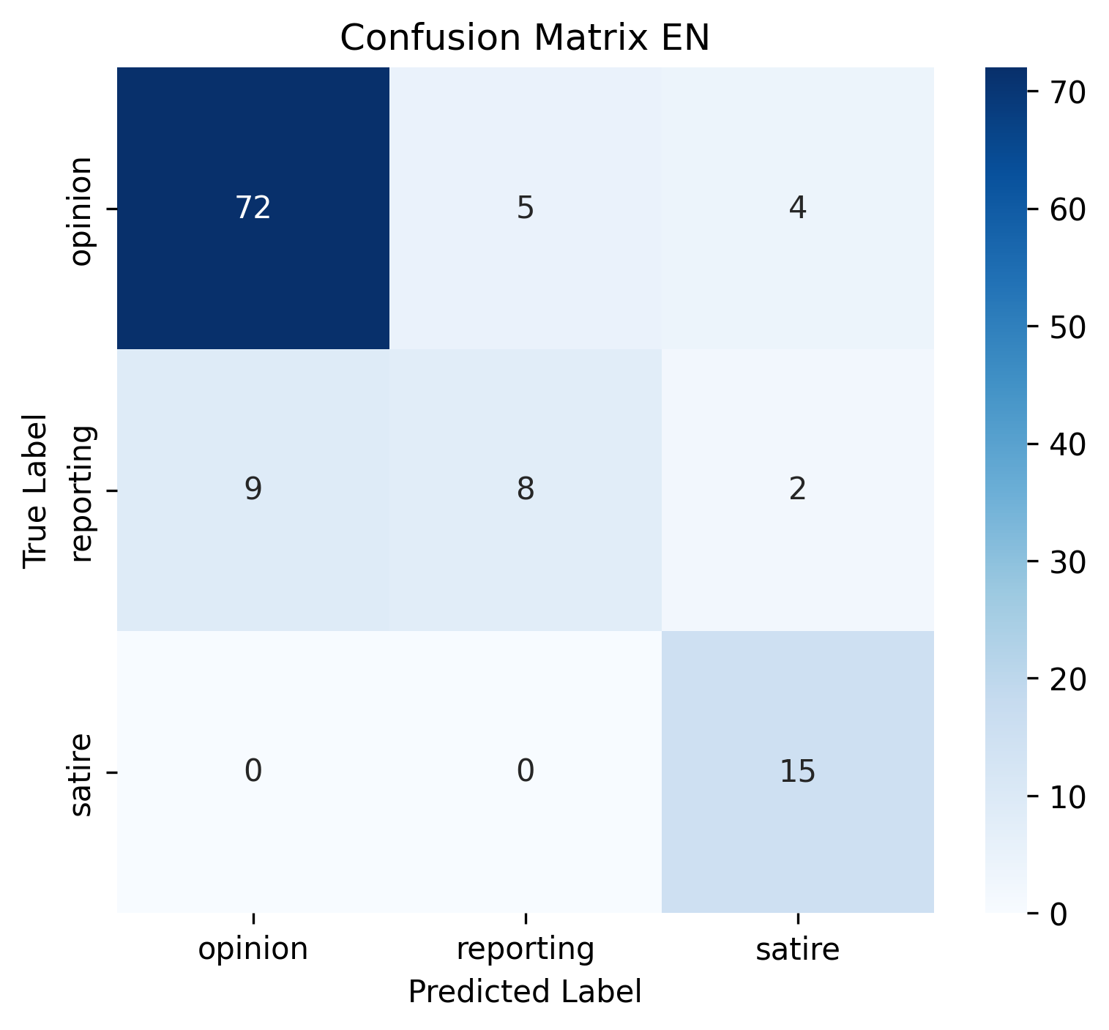

Results
Figure 3. Confusion Matrix for EN
Figure 4. Confusion Matrix for PL

Slide 14
Limitations
Dataset is unbalanced -> possible classifier bias
Limited hardware -> limited model -> small context window -> subdividing samples into sentences & Low Scalability to Long Text
Difficult to find “off-the-shelf” SMT and older NMT models (convolutional)

Slide 15
Conclusions
Language patterns were preserved, moreover we seen some significant improvement for Slavic languages (Polish and Russian)
Language pattern preservation was correlated with better translations

Slide 16
Future Work
Analysis of language preservation for different MT model architectures: PB-SMT, RB-MT, NMT with RNNs, CNNs
Rerun the experiment on a better dataset
Compare language preservation from other source languages, not only English

Slide 17
Thank you!

