Slide 1
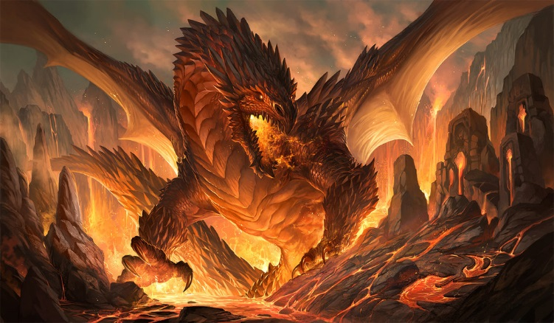

MNEMENTH

Slide 2
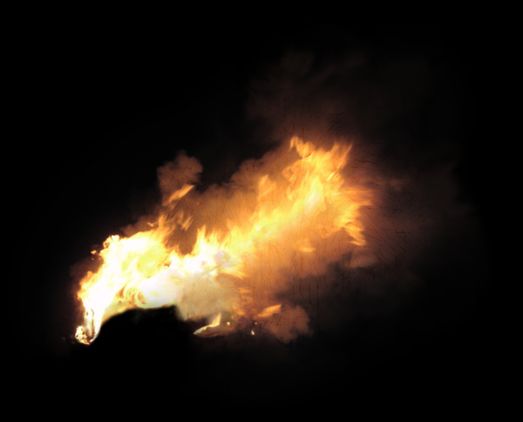
TEAM CONTRIBUTIONS
TEAM MEMBER | CONTRIBUTION
Magdalena Kirova | Menu
Mario Diankov | Health
Dido Viktorov | Enemies
Emilian Markov | Game Loop
Nikola Donev | Background
Vladi Nikolov | Soundtrack
Georgi Dimitrov | Physics
Todor Damianov | Battleground
https://github.com/VladYY/Mnementh_Team_Project/graphs/contributors

Slide 3

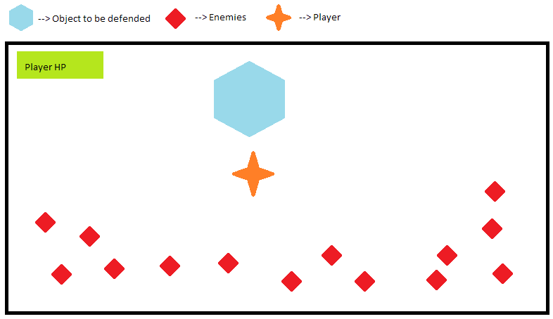
Basic dynamic of the game
The player (a bronze dragon named Mnementh) have the task to protect the dragon cave (the object that must be defended) and avoid his own death.
Each time the dragon hit directly an enemy, losing 5% of his total health, but of course the enemy dies – you can’t hit a dragon like this. When an enemy reach the cave, it disappear in the deep darkness and takes 10% of dragon’s total health.
Every next wave is bigger and bigger. You must slay all enemies you can. Protect the cave! Protect the treasure in it!

