Slide 1
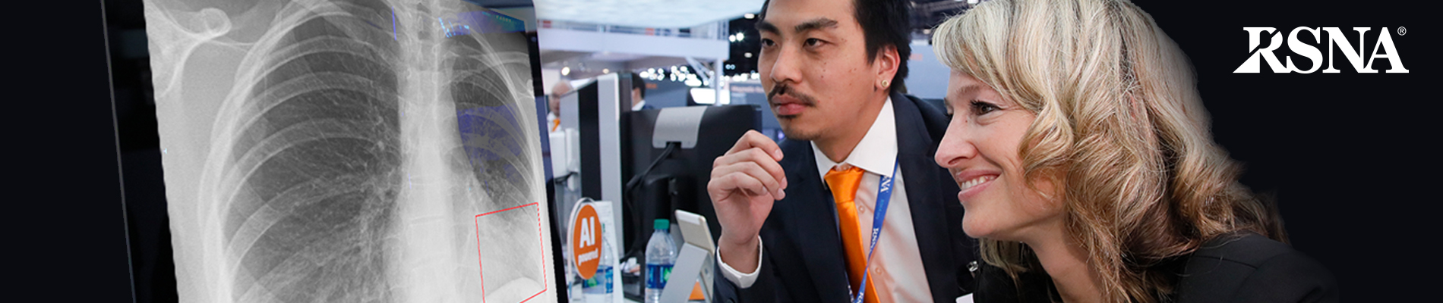
RSNA Pneumonia Detection Challenge
Notes:
thoughts

Slide 2
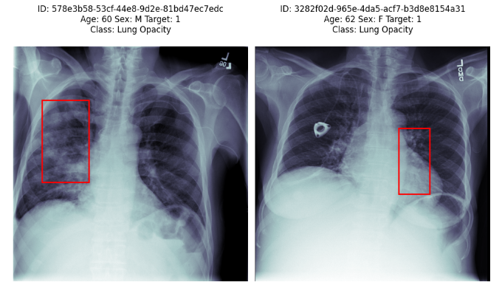

Slide 3
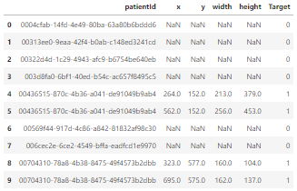
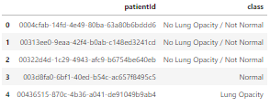

Slide 4
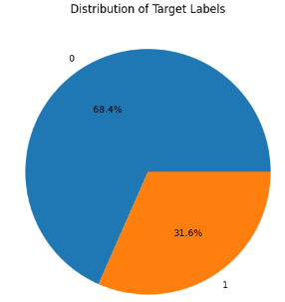
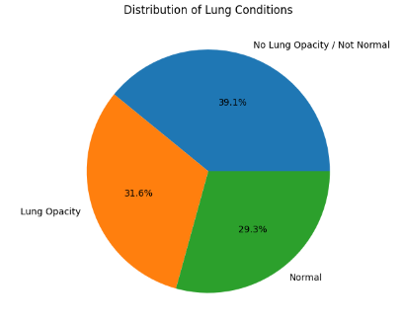
Distributions of classes

Slide 5
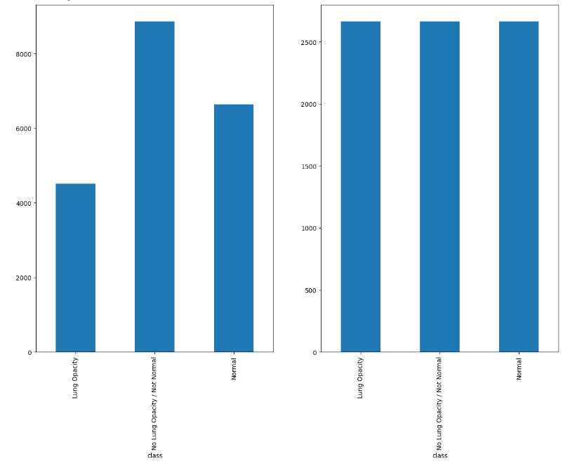

Slide 6
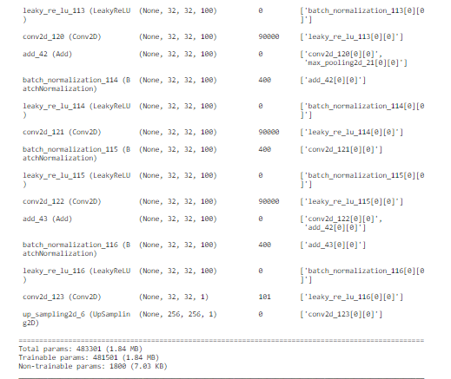
Model Structure
Notes:
Here is the breakdown of this model
1. Initial Convolution Layer: The model starts with a standard 2D convolution layer (Conv2D) that processes the input image.
1. Downsampling and Residual Blocks: The model then alternates between downsampling layers and a series of residual blocks, repeated num_downsampling_layers times.
Each downsampling layer consists of Batch Normalization, LeakyReLU activation, a 1x1 Conv2D layer for channel adjustment, and a MaxPooling layer to reduce the spatial dimensions by half. This process effectively compresses the input, focusing on the most important features while reducing computation for deeper layers.
Each residual block further processes the data using two sets of Batch Normalization, LeakyReLU activation, and 3x3 Conv2D layers.
The output of the second Conv2D layer is added to the original input of the residual block (a shortcut connection), which helps in mitigating the vanishing gradient problem and allows deeper models to be trained effectively.
1. After the downsampling and residual blocks, the model applies another set of Batch Normalization and LeakyReLU. An UpSampling2D layer then upscales the output back to the original input size. The factor for upsampling is 2 ** num_downsampling_layers, reversing the spatial dimension reduction done by the MaxPooling layers.

Slide 7
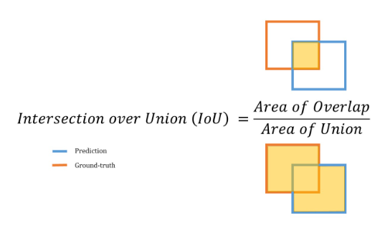
What Metrics to use?

Slide 8
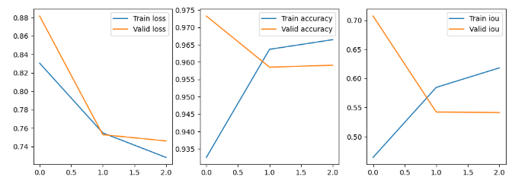
Metrics during training

Slide 9
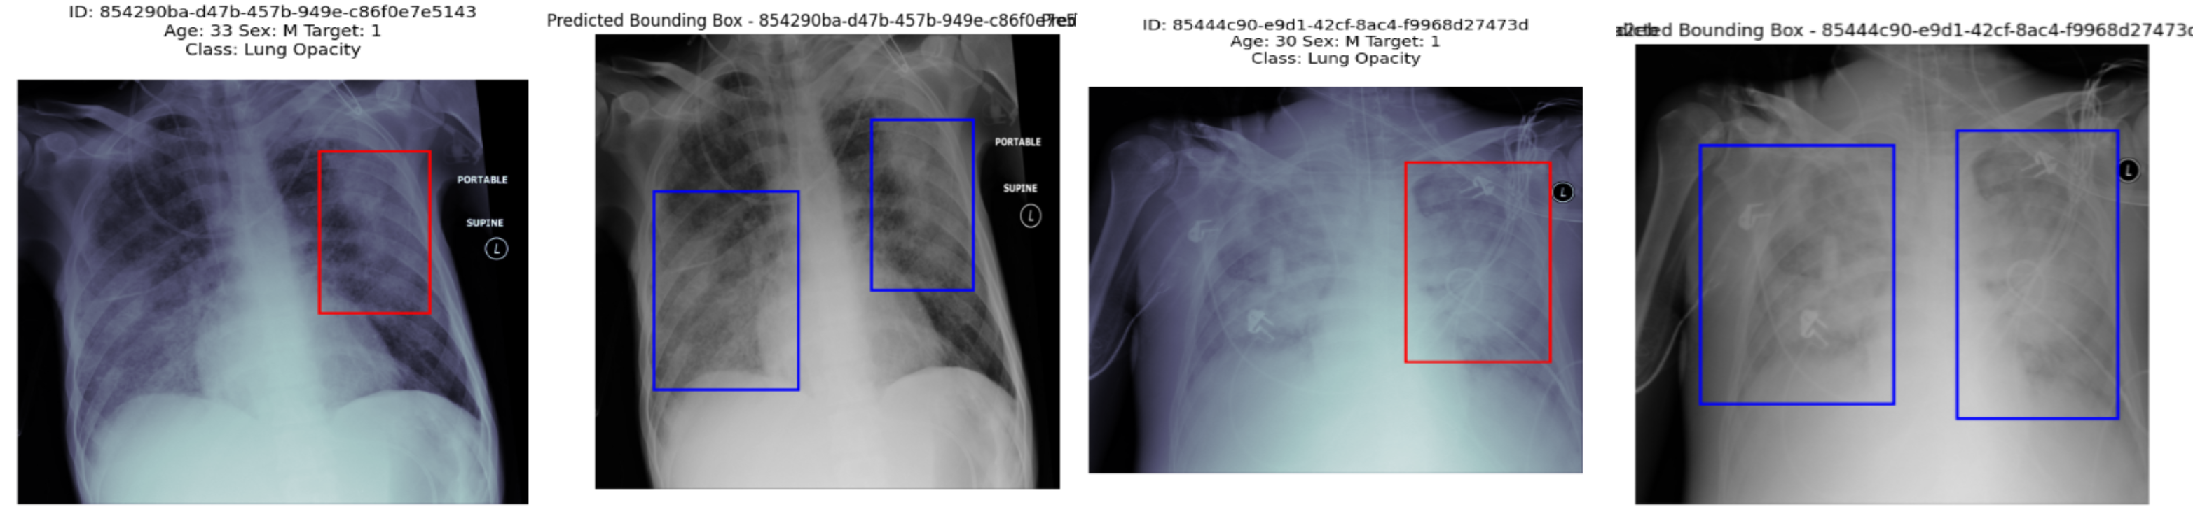
Predictions

Slide 10
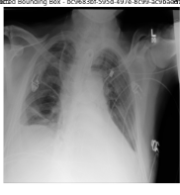
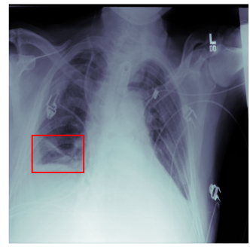

Slide 11
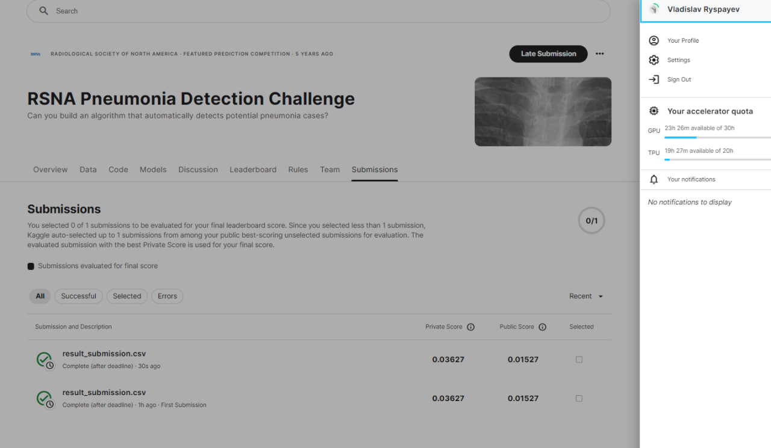

Slide 12
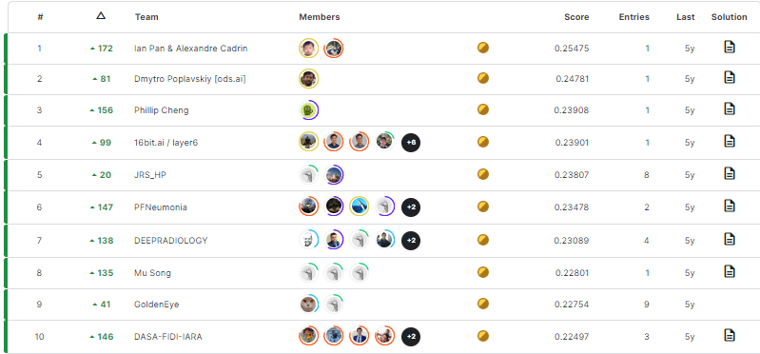
Interpretation of the results

Slide 13
YOLO ? Mask R-CNN, and so on.
Some thoughts

