Slide 1

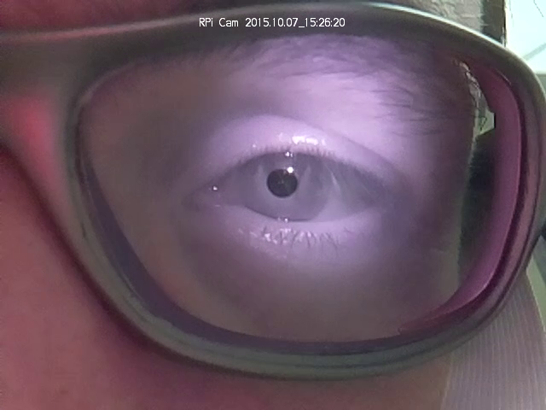
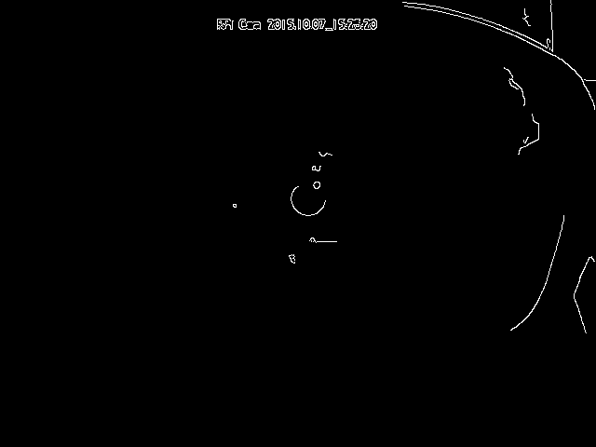
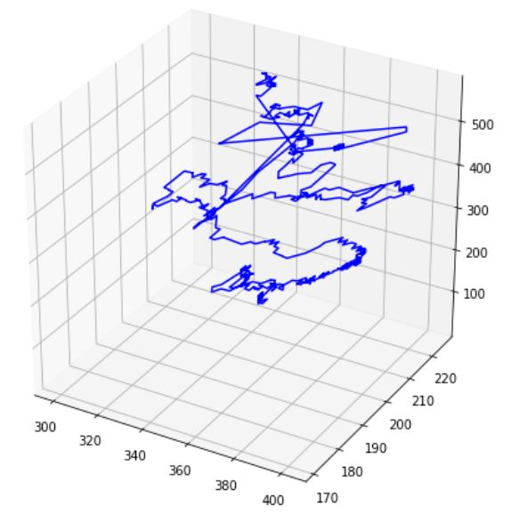
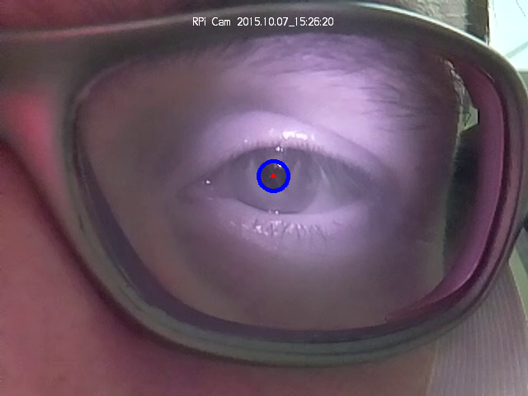
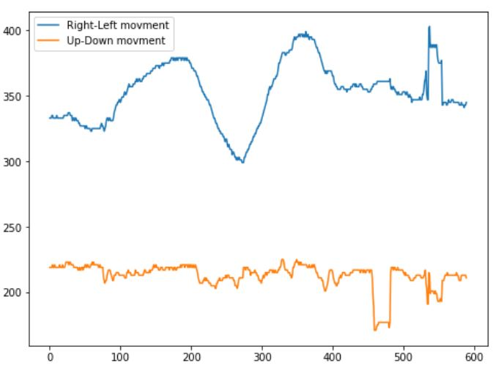
Computer vision 2020 | Eye tracking Student: Vladislav Goteiner
Dr. Jonathan Rubin
Photos from different stages of the processing of the video:
Overview
Written in Python 3.6 using jupyter notebook.
The goal: to track the movment of the eye and show how the eye moves as a function of time.
Feature detectors used:
- Canny edge detector
- Hough Transform (Circle)
Steps:
Turning each frame into gray scale and blurring the image.
Running Canny edge detector on the smoothened image.
Running Hough Circles algorithm on the image using the edges we received.
Manually deciding which circles fit our needs. In this case we want to focus on the center of the eye.
Drawing the circles on the original frame.
The 3D representation of the location of the eye as a function of time:
The 2D representation of the eye movement:
Blue line represents the movement along the x axis
The orange line represents the movement along the y axis

