Slide 1
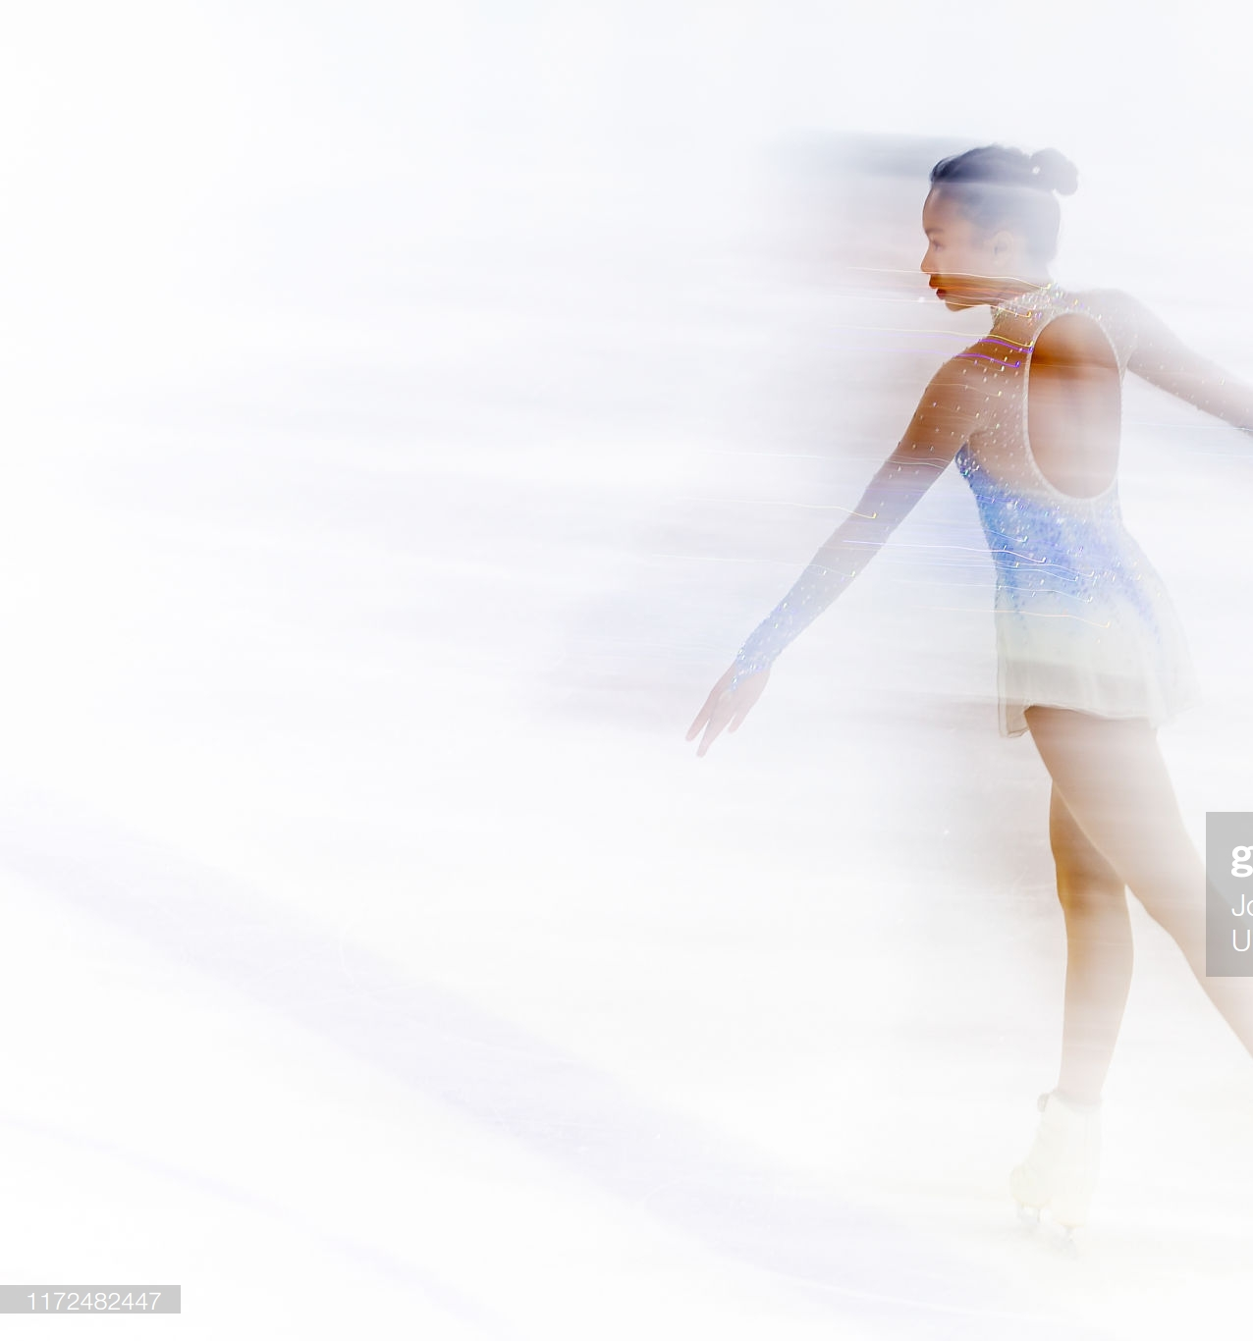
Figure Skating
Video
Classification
by Elena Golubeva and Vladislav Goteiner

Slide 2
01
ABOUT THE PROJECT
02
PROCESS
03
MODEL STRUCTURE
04
CODE EXAMPLE
05
FINAL RESULTS

Slide 3
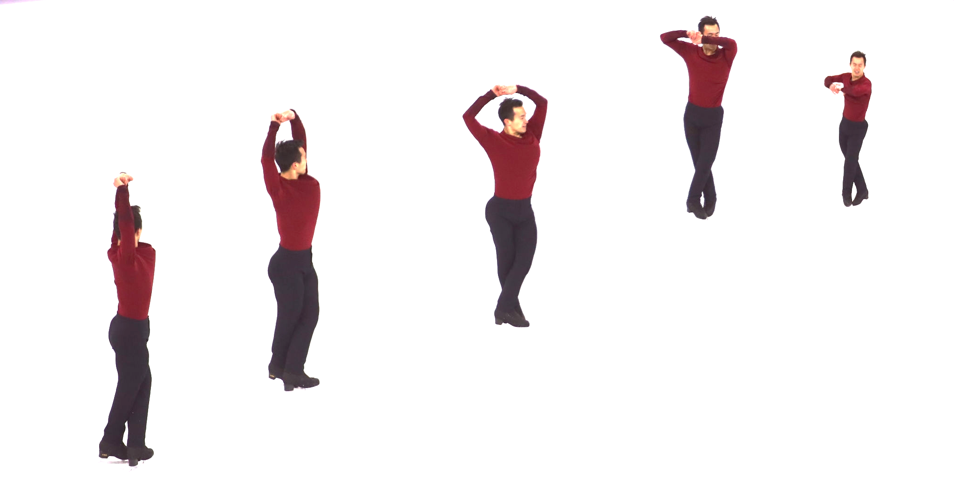
01
FIGURE SKATING
JUMP CLASSIFICATION
About the project:
Tell what kind of jump is on the given video. What score would figure skater get for his element execution.

Slide 4
01
FIGURE SKATING
JUMP CLASSIFICATION
Expectations:
To classify element with over 85% accuracy. Give a score based on similar element executions that we learned.
Flip - 23.6/25

Slide 5
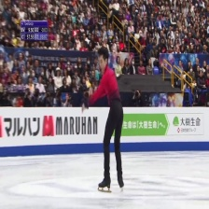
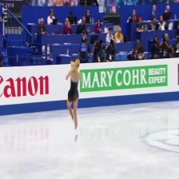
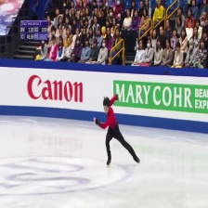
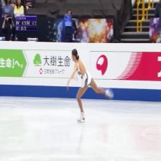
01
FIGURE SKATING
JUMP CLASSIFICATION
Obstacles:
Examples from different classes has very little differences.

Slide 6
02
CREATE MODEL
PREPARE TEST DATA
TRAIN ON THE MODEL
RESULT DISPLAY

Slide 7
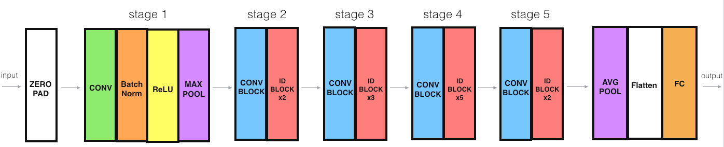
03
AveragePooling2D
ResNet50
Flatten
Relu x2
Dropout
Softmax

Slide 8
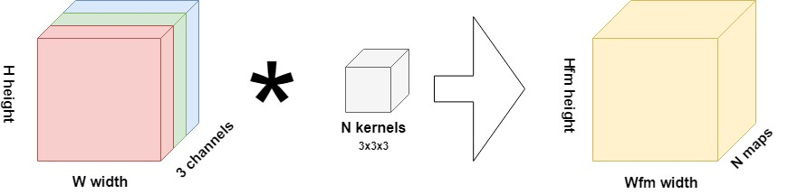
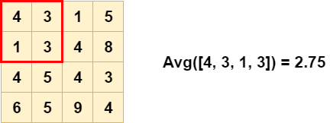
03
AveragePooling2D
ResNet50
Flatten
Relu x2
Dropout
Softmax

Slide 9
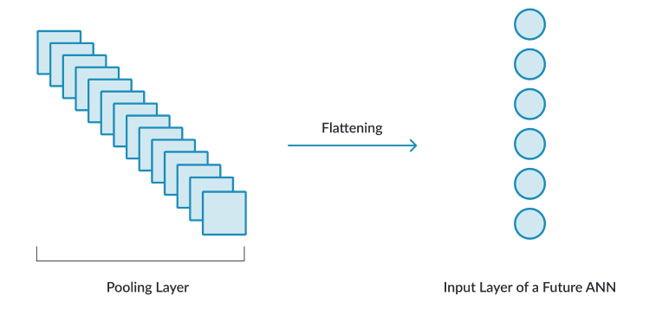
03
AveragePooling2D
ResNet50
Flatten
Relu x2
Dropout
Softmax

Slide 10
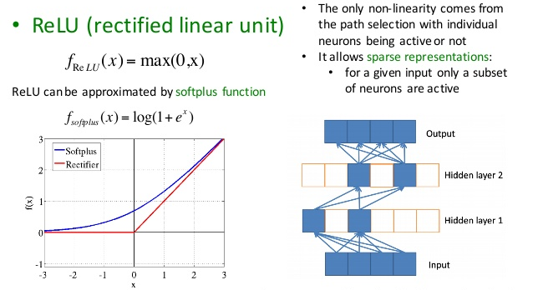
03
AveragePooling2D
ResNet50
Flatten
Relu x2
Dropout
Softmax

Slide 11
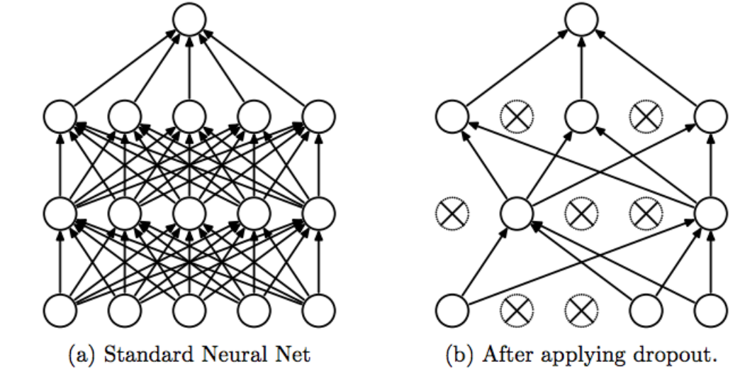
03
AveragePooling2D
ResNet50
Flatten
Relu x2
Dropout
Softmax

Slide 12
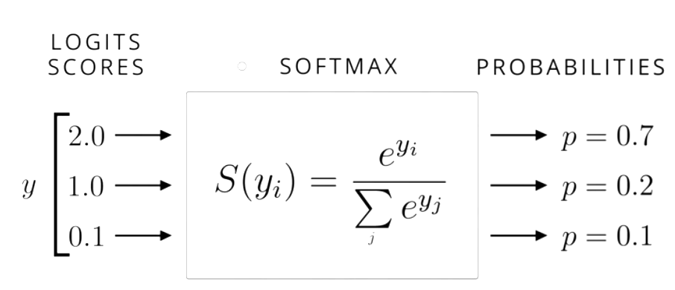
03
AveragePooling2D
ResNet50
Flatten
Relu x2
Dropout
Softmax

Slide 13
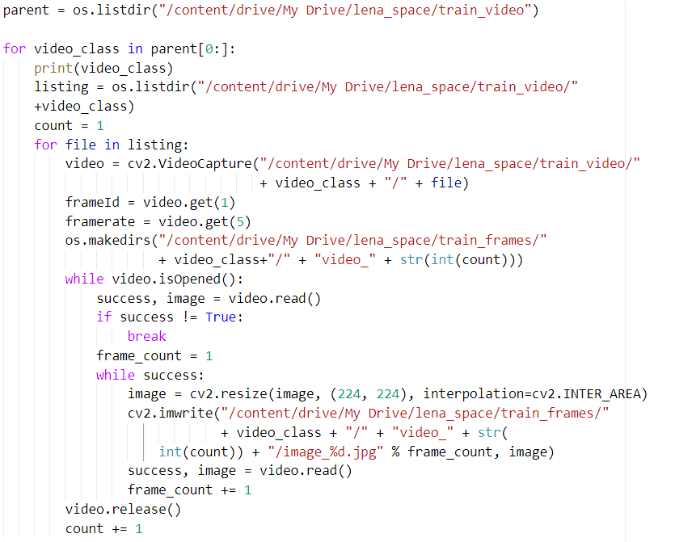
04

Slide 14
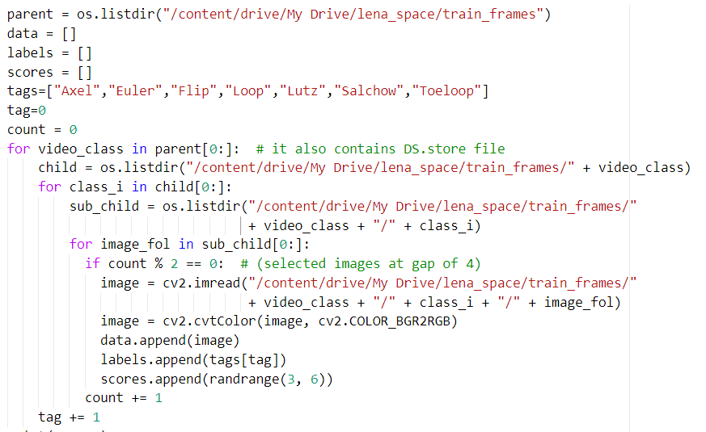
04

Slide 15
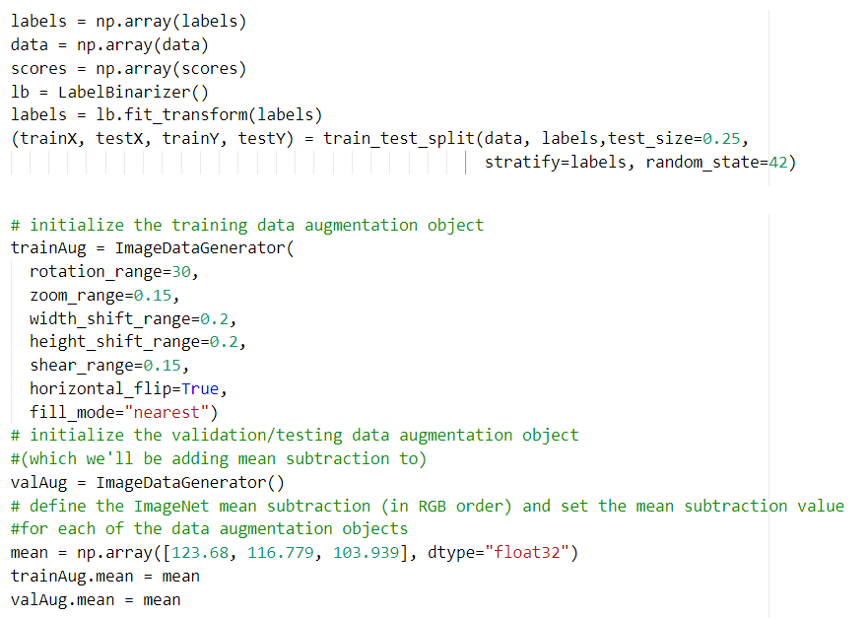
04

Slide 16
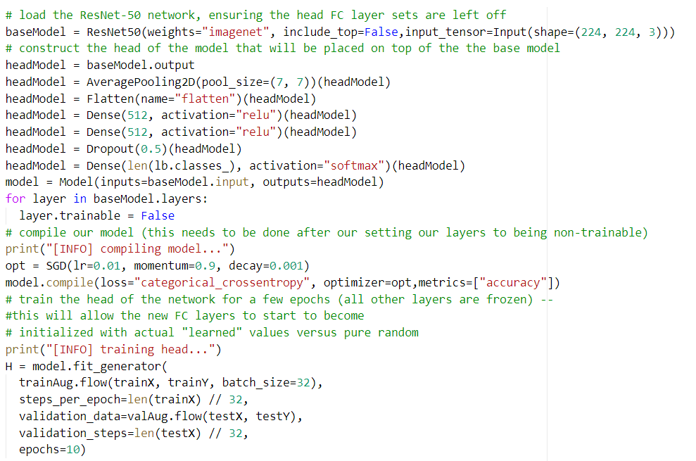
04

Slide 17
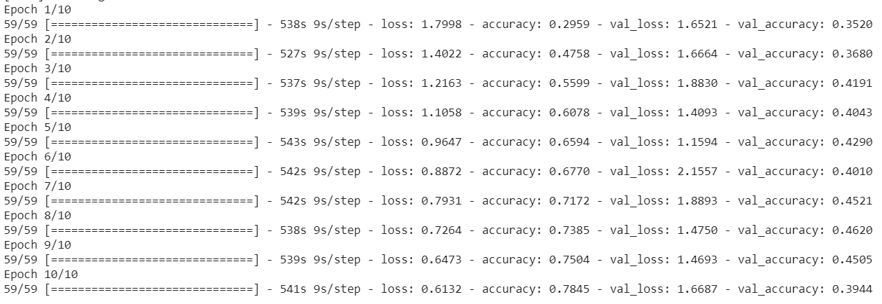
04

Slide 18
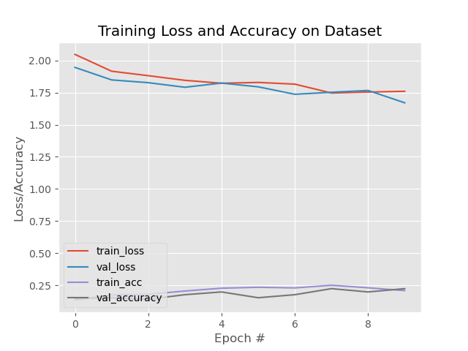
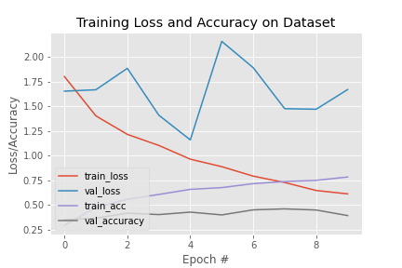
04

Slide 19
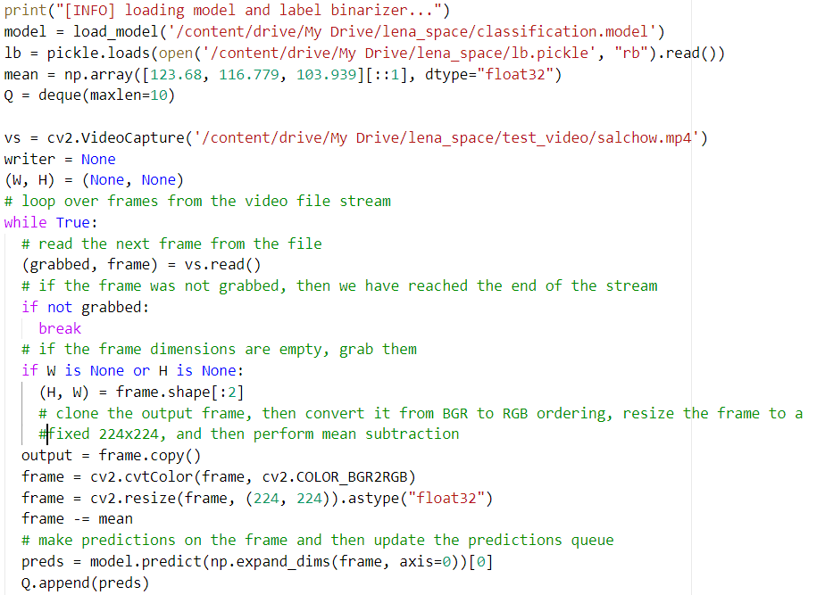
04

Slide 20
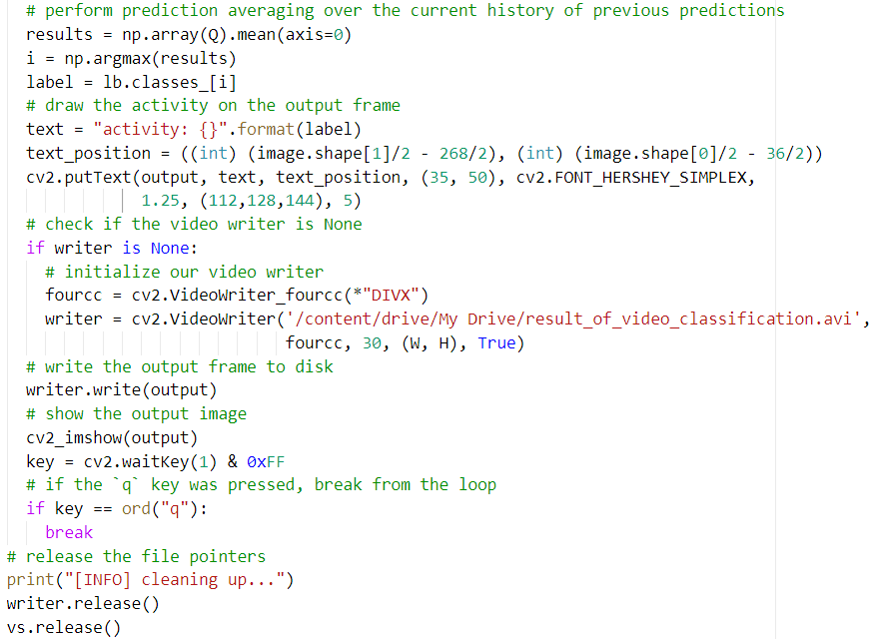
04

Slide 21
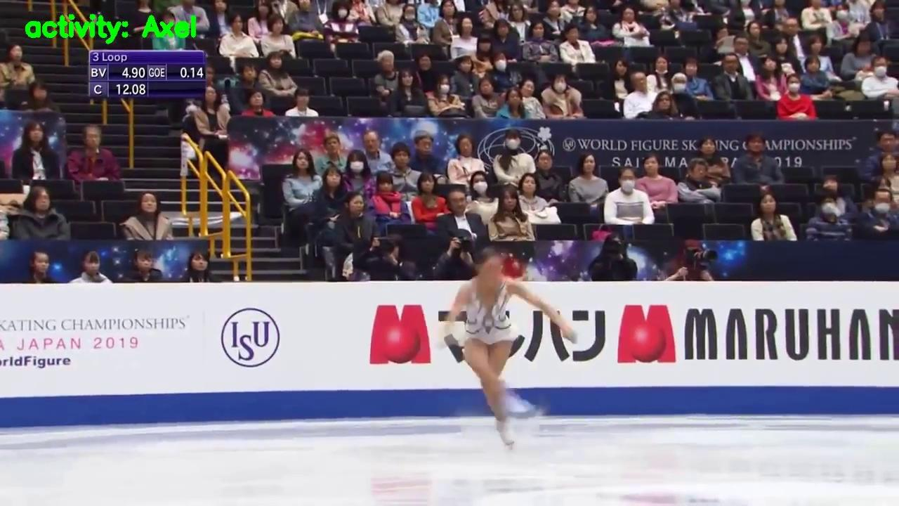
05

