Slide 1

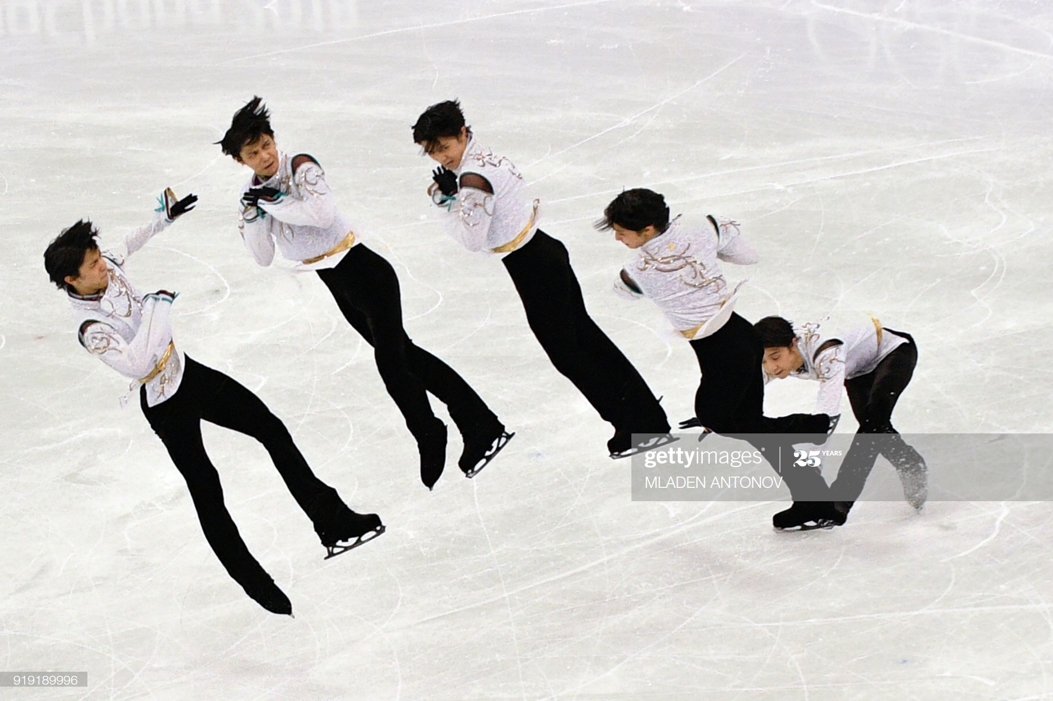
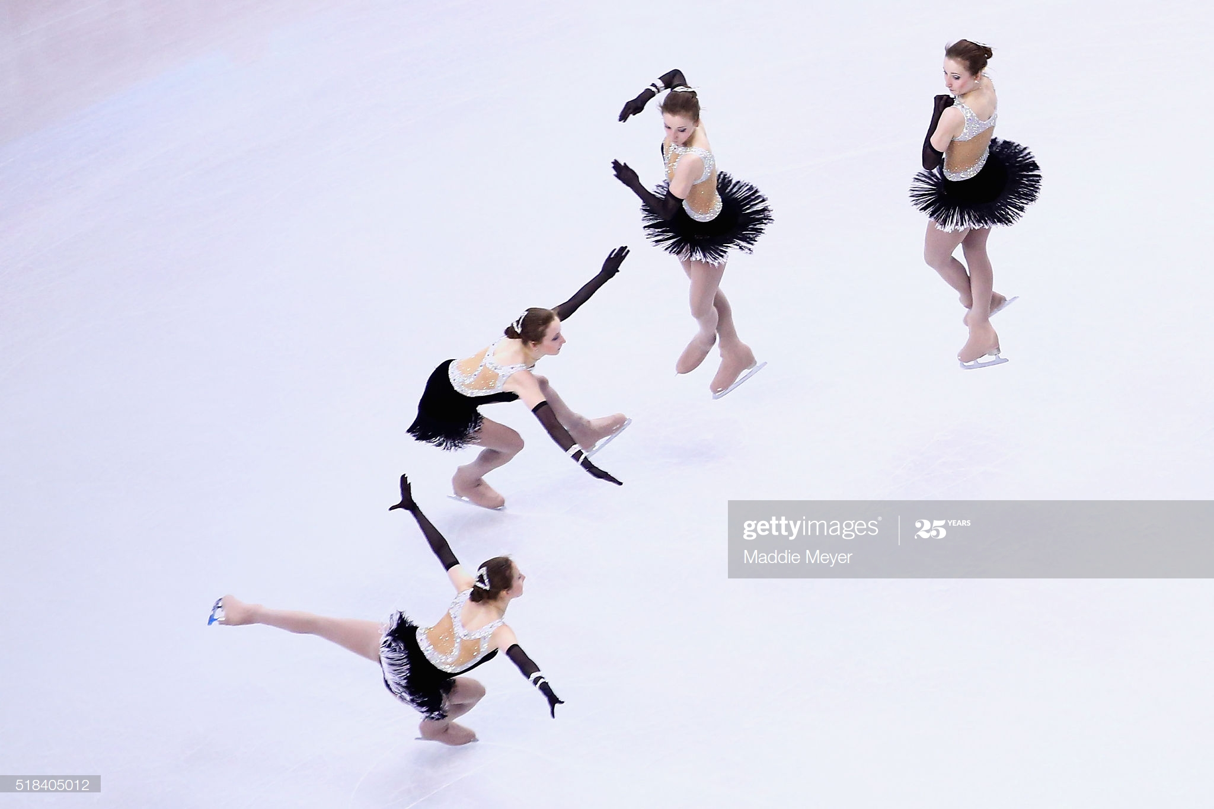
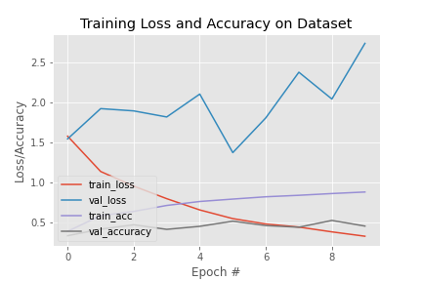
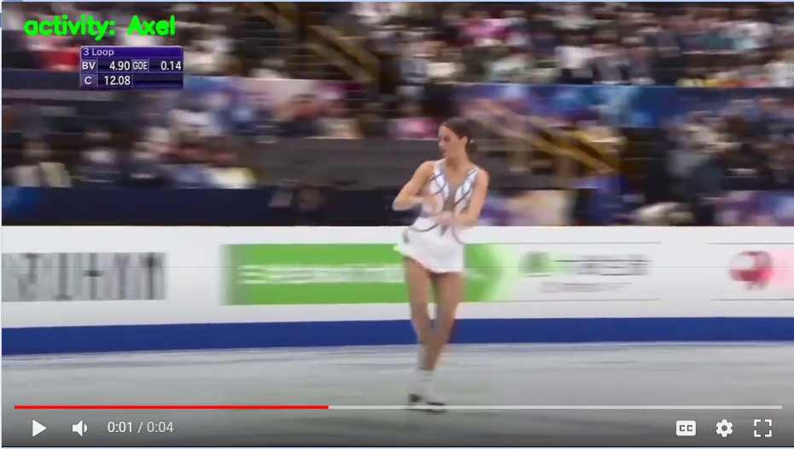
Deep Learning | Figure Skating Video Classification by Elena Golubeva, Vladislav Goteiner
Ph.D. Theodor Lazebnik
Video classification of figure skating jumps is created to learn how well can AI recognize and distinguish apart very similar looking actions.
Classifying data that has little differences is a challenge today. We saw that element recognition is easier and more accurate when they are very different in shape, color, sizes.
We used ConvNets object position detection algorithm and CNN for video classification, and Class-Agnostic Counting algorithm for detecting repeating element to give a real life score to our classified data.
We succeeded to get classification accuracy of over 80% with only 20% of our data set. We expect to get accuracy over 90% when learning on all the data set we made.
Results are shown on the original file:
With this project we want to implement our idea of helping figure skaters to
improve one of the elements - jumps. As for this project we only present results on random video from real competition, but we hope that in the future this project will be used as an application for live jump detection, classification and scoring.

