Slide 1

HOW WILL HOUSING MARKET AFFECT THE UNEMPLOYMENT RATE
data mining and machine learning final project
Vladi Kruk & Ram Sarfian
GitHub

Slide 2


Research questions:
Can we predict how will housing market affect the unemployment rate
What pattern can we observe and what conclusions can we learn from them?

Slide 3




Project Lifecycle
Obtain Data
The very first step of a data science project is straightforward. We obtain the data that we need from available data sources
Cleaning data
The second step is to look at every one of your columns to make sure your data is homogeneous and clean
Explore Data
Once your data is ready to be used, and right before you jump into Machine Learning, you will have to examine the data
Model Data
The data set connects to an algorithm, and the algorithm leverages sophisticated mathematical modeling to develop predictions

Slide 4
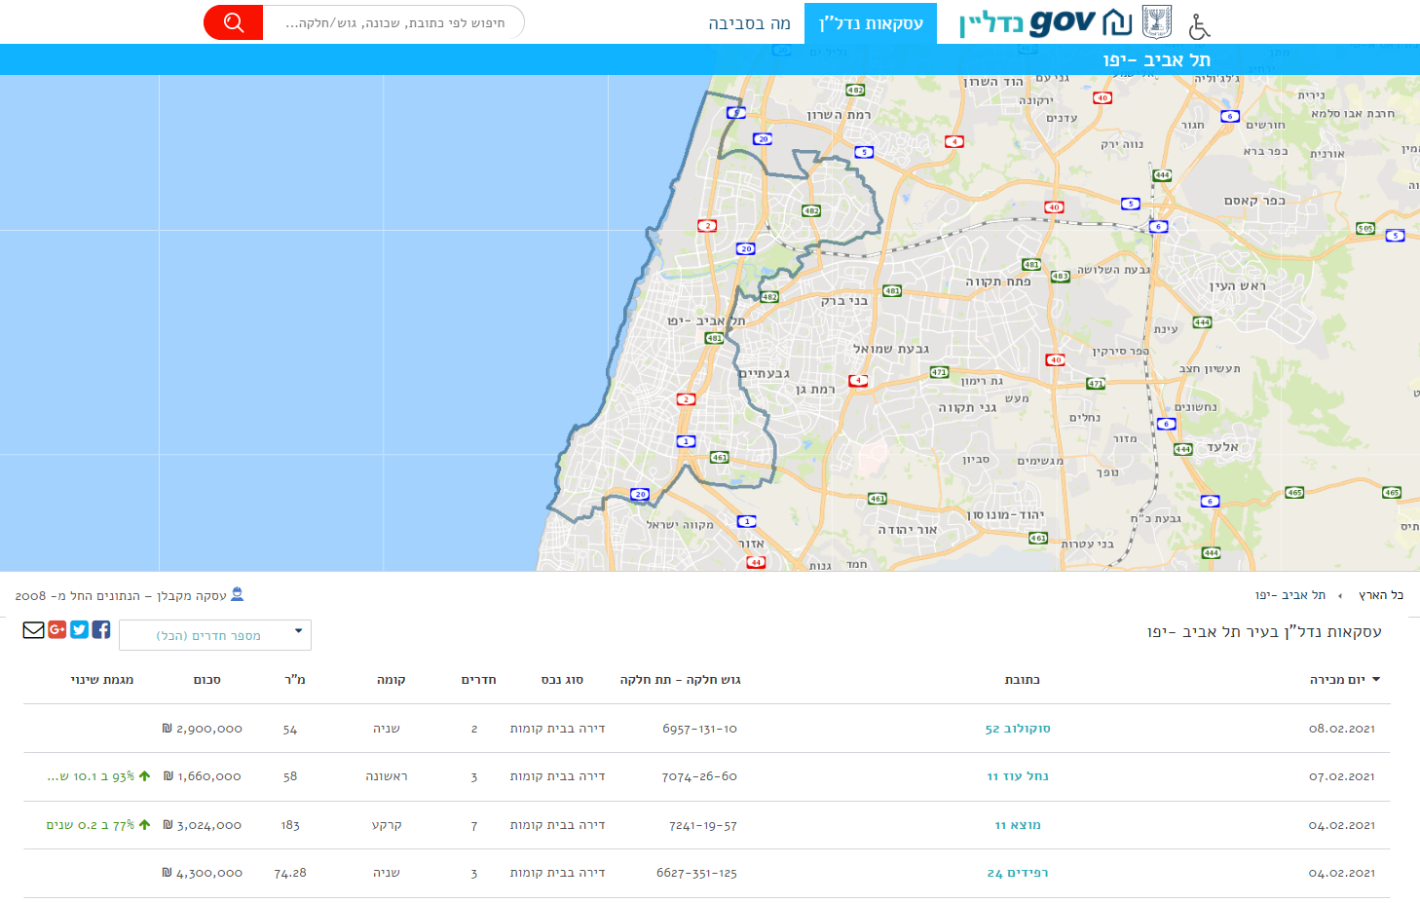
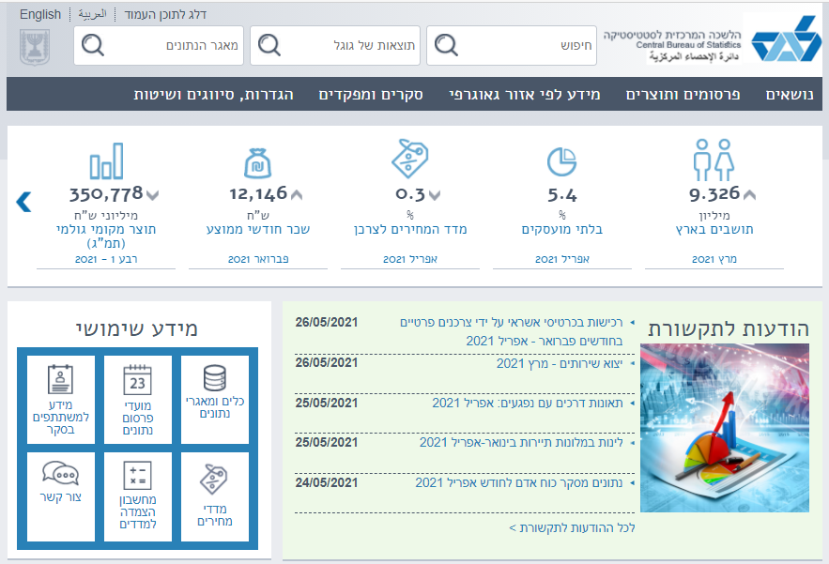
Data Resources
Model Data
Explore Data
Cleaning data
Obtain Data
Data Scraping Sources
Nadlan Website
Additional resources
Central Bureau of Statistics

Slide 5
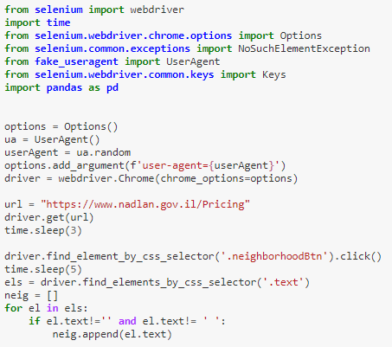
Scraping – Nadlan Website
Model Data
Explore Data
Cleaning data
Obtain Data
Web Scraping using Selenium
The Selenium API uses the WebDriver protocol to control a web browser, like Chrome. The browser can run either locally or remotely.
we faced obstacles that could not be overcome with traditional methods.
We decided to abandon our traditional methods and look at a possible tool for browser-based scraping. This would work differently than normal – instead of going directly to a page, downloading the parse tree, and pulling out data elements, we would instead “act like a human” and use a browser to get to the page we needed, and then scrape the data.

Slide 6
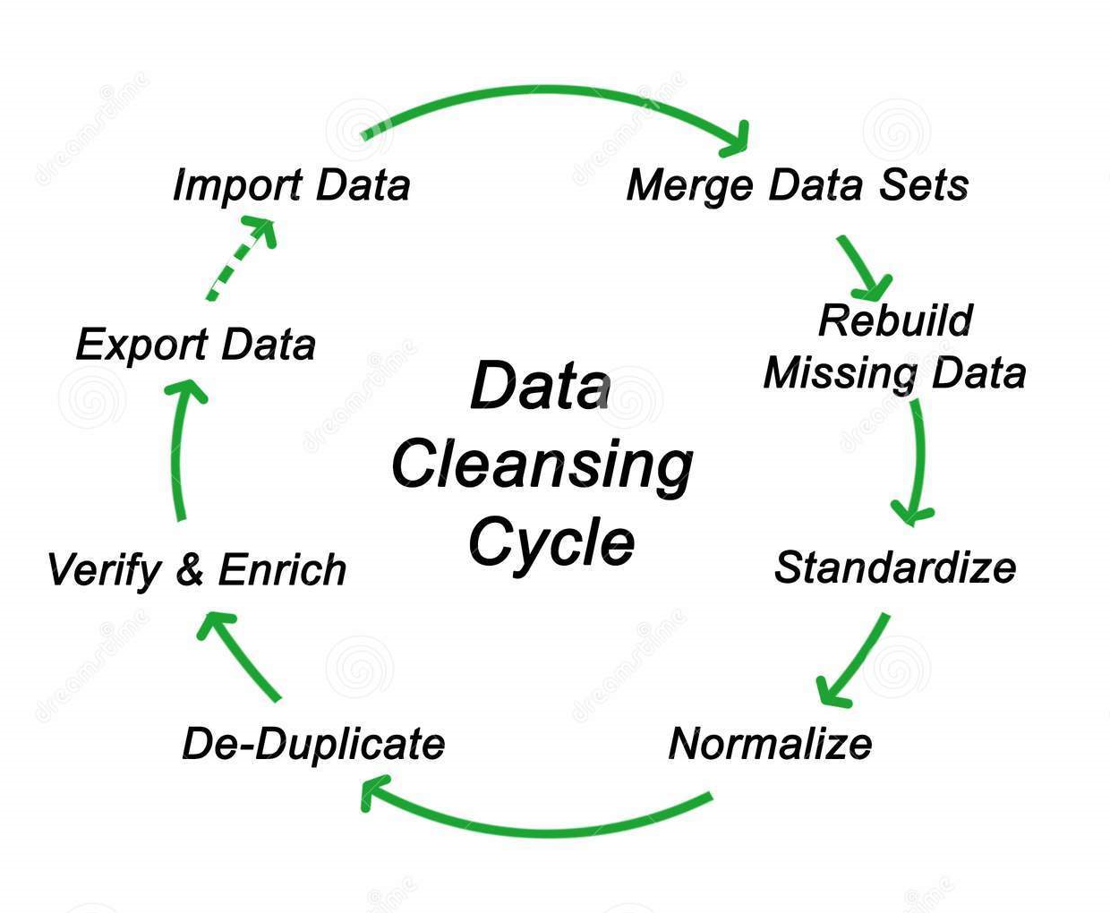
Cleaning Data
Model Data
Explore Data
Cleaning data
Obtain Data
Random whitespaces within the data content
Remove blank data - Numbers getting
converted to text on exporting
Treatment of duplicates
Same data in different cases
Spelling errors in text data

Slide 7


Cleaning data - Handle missing data
Model Data
Explore Data
Cleaning data
Obtain Data
We Couldn’t ignore missing data because many algorithms will not accept missing values. We had a couple of ways to deal with missing data. Neither is optimal, but both could be considered.
As a first option, we could drop observations that have missing values, but doing this will drop or lose information.
As a second option, We could input missing values based on other observations.
As a third option, missing completely at random (MCAR) values are randomly drawn from the sample, independent of other variables.

Slide 8
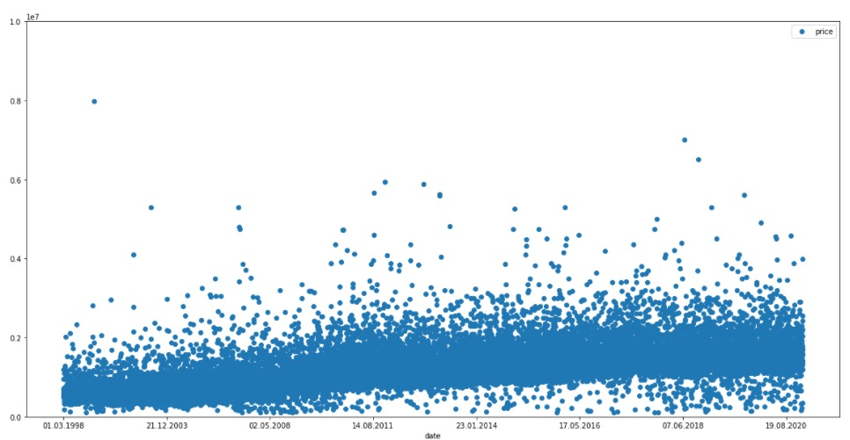
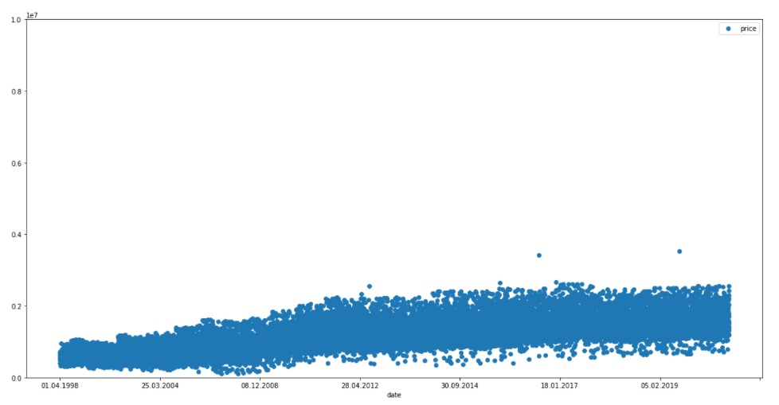
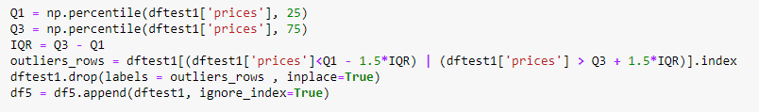
Cleaning Data - Outliers
Model Data
Explore Data
Cleaning data
Obtain Data
One of the best ways to identify outliers data is by using charts. When plotting a chart the analyst can clearly see that something different exists. Here are some examples that illustrate the view of outliers with graphics.

Slide 9
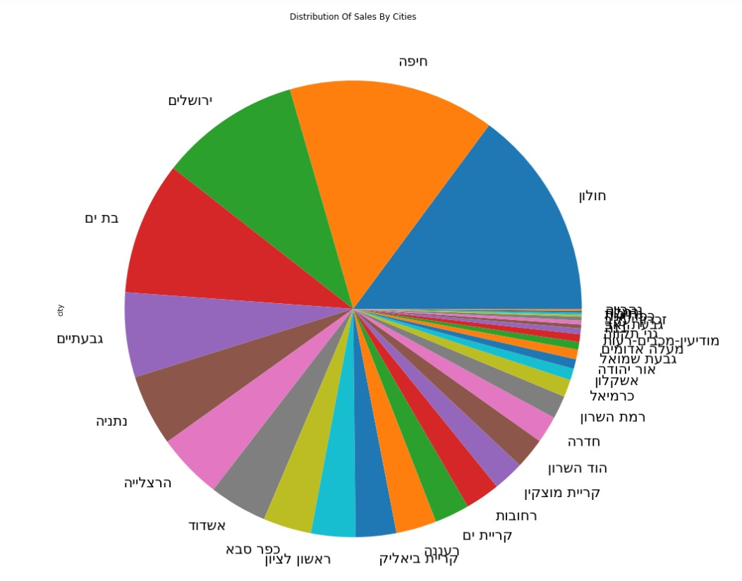
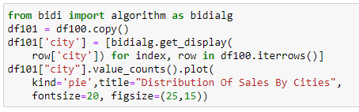
Explore Data - Visualization
Model Data
Explore Data
Cleaning data
Obtain Data
“Pandas” library doesn’t work well with Hebrew text.
We found a library that can deal with this problem and now every word looks as expected.

Slide 10
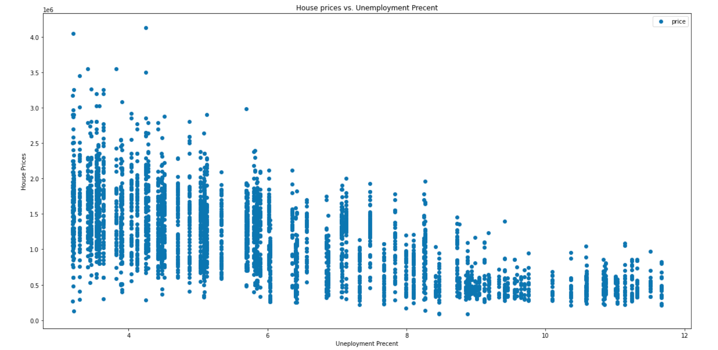
Explore Data - Visualization
Model Data
Explore Data
Cleaning data
Obtain Data
As we can understand from the graph, there is direct correlation between house prices and the unemployment precent

Slide 11
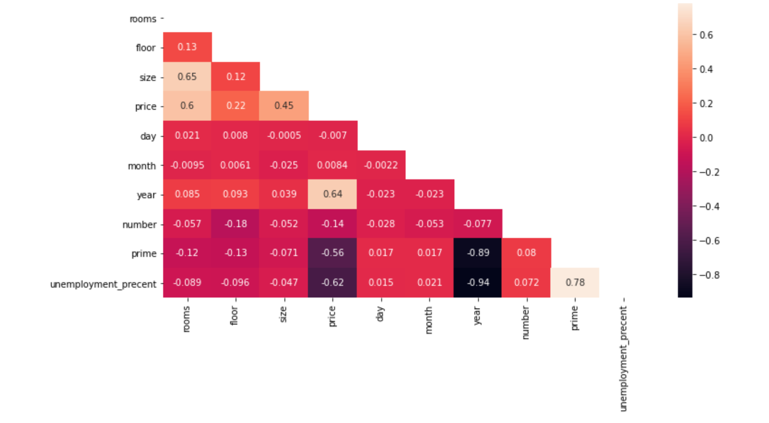
Explore Data - Visualization
Model Data
Explore Data
Cleaning data
Obtain Data
We can learn from this graph about the correlations between every column in our data source.

Slide 12

Model Data – Machine Learning
Model Data
Explore Data
Cleaning data
Obtain Data

Slide 13
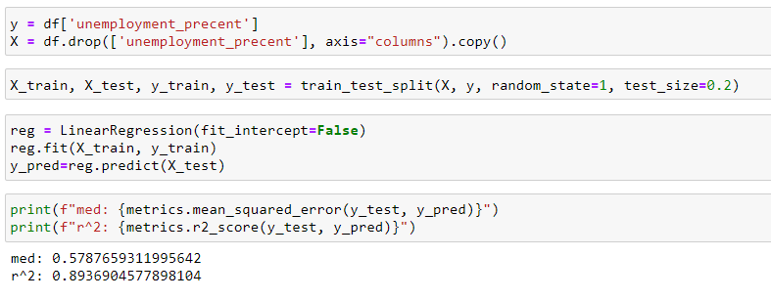
Model Data – Linear Regression
Model Data
Explore Data
Cleaning data
Obtain Data
Linear regression algorithms show a linear relationship between a dependent variable, y, and one or more independent variables, x, how the value of the dependent variable, y changes according to the value of the independent variable, x.
We were able to train a model that predicts the unemployment precent based on other parameters like house prices, prime, location, etc.

Slide 14
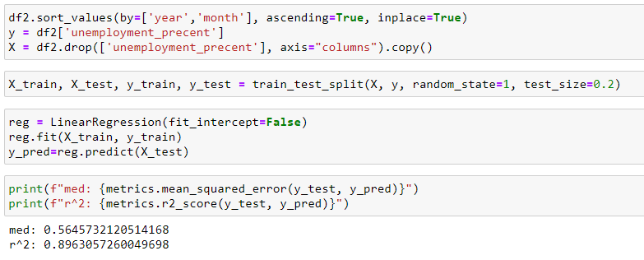
Model Data – Linear Regression
Model Data
Explore Data
Cleaning data
Obtain Data

Slide 15
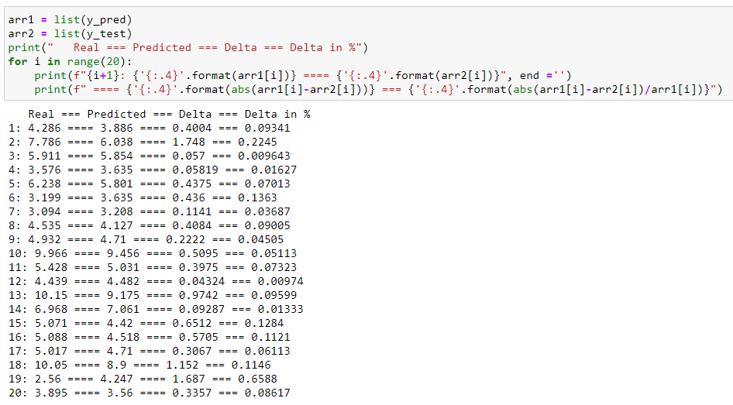
Model Data – Linear Regression
Model Data
Explore Data
Cleaning data
Obtain Data

Slide 16
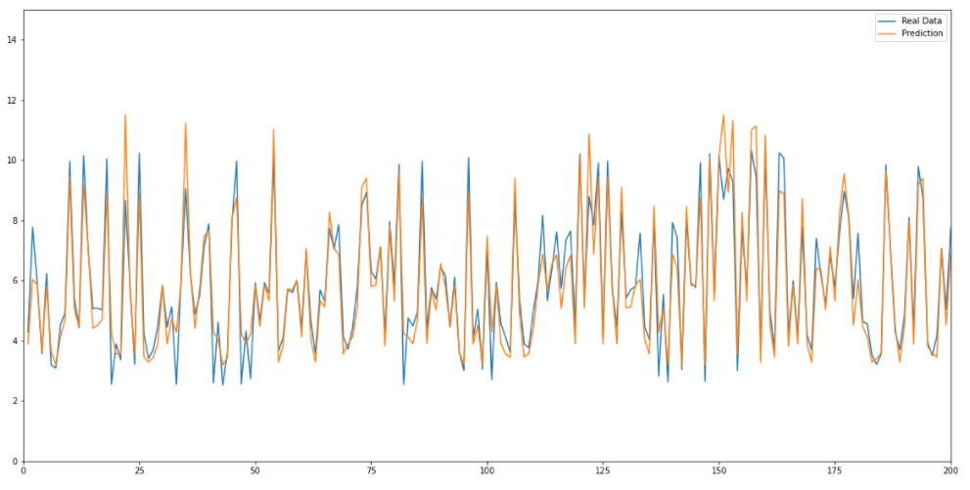
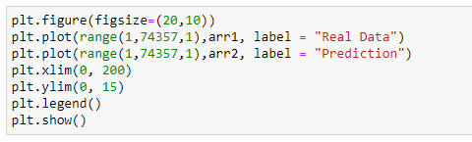
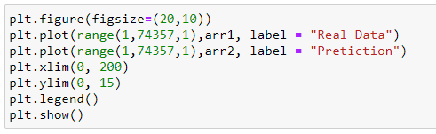
Model Data – Linear Regression
Model Data
Explore Data
Cleaning data
Obtain Data

Slide 17
The End
Model Data
Explore Data
Cleaning data
Obtain Data

