Slide 1


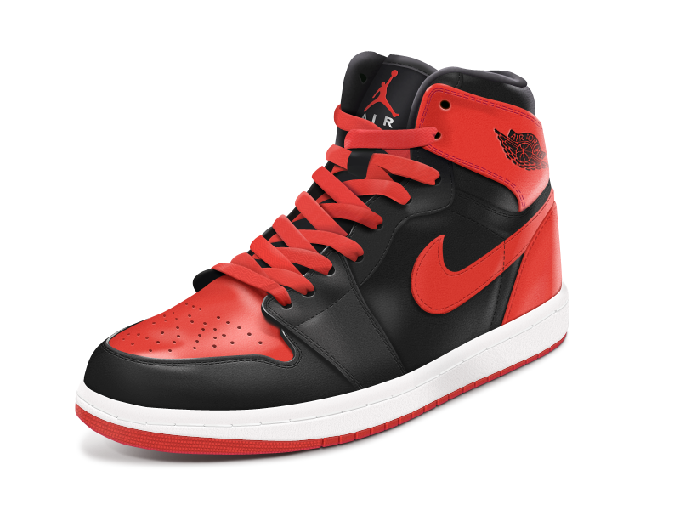
AIR
sturdykicks.
Alexandru Brinzei
Vladoiu Stefan
Mares Petre
Lita Stefan

Slide 2
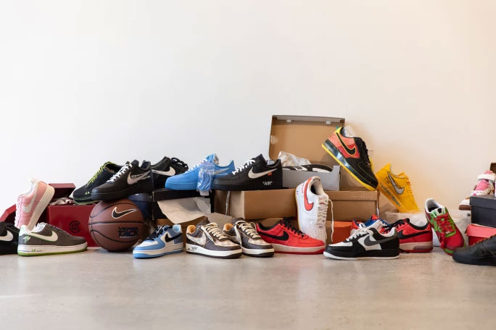
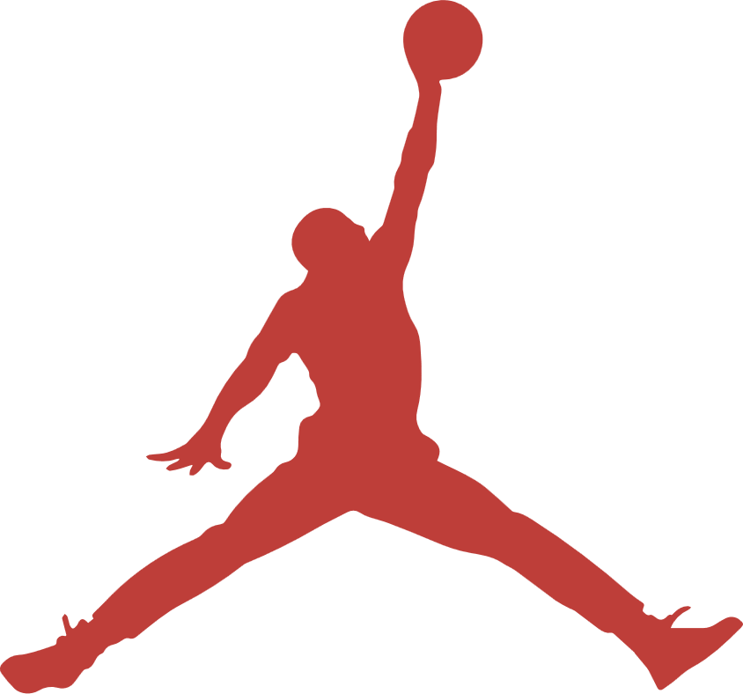
02
Introduction
of our store
Sturdykicks is an online sneaker store that specializes in reselling Nike sneakers. The store has a wide range of sneakers, including limited edition releases and hard-to-find models.
Sturdykicks is known for its commitment to quality and authenticity. All sneakers sold by the store are guaranteed to be 100% authentic, and customers can shop with confidence knowing they are getting the real deal.
sturdykicks.

Slide 3
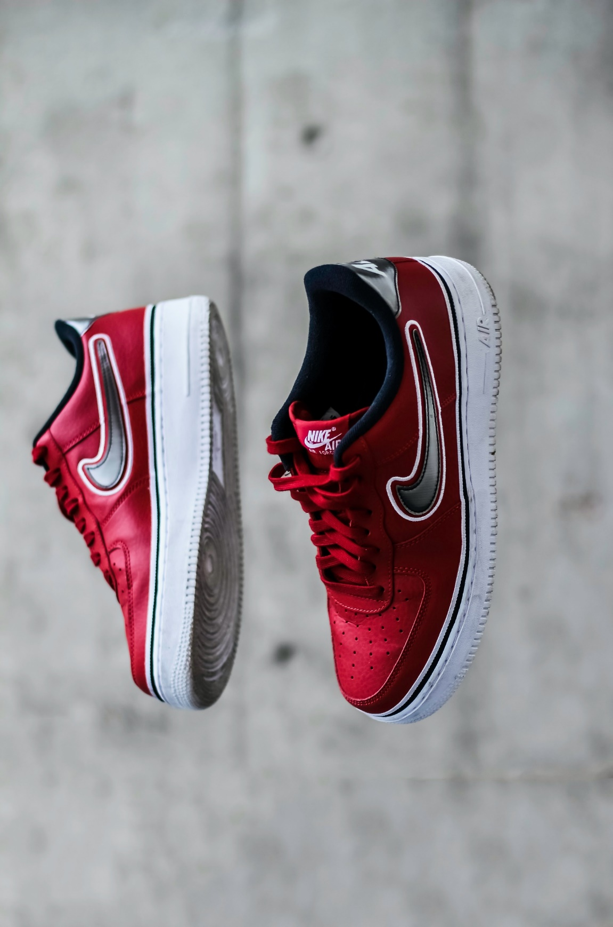
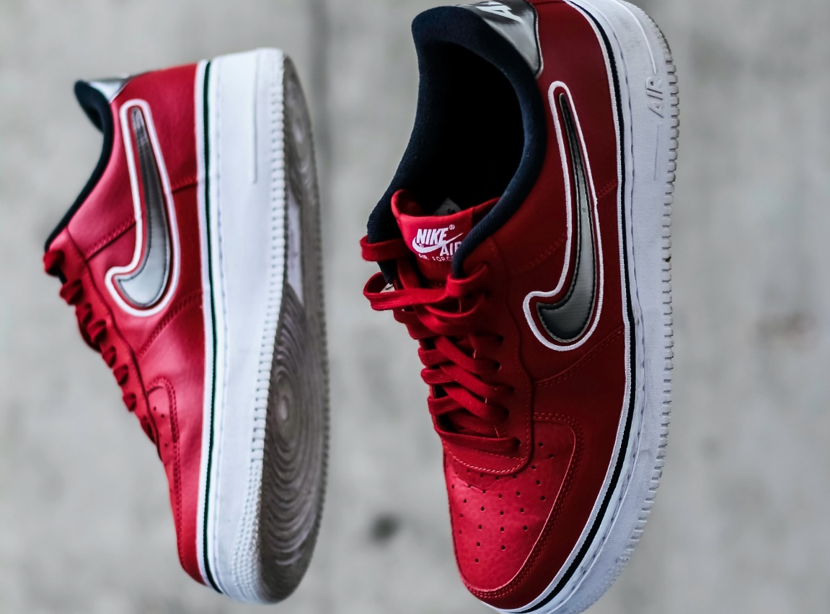
03
About our
sneakers
Shopping at Sturdykicks is a seamless experience. The website is easy to navigate and features detailed product descriptions and high-quality images of each sneaker. Customers can filter their search results by size, color, and price to find exactly what they're looking for.

Slide 4
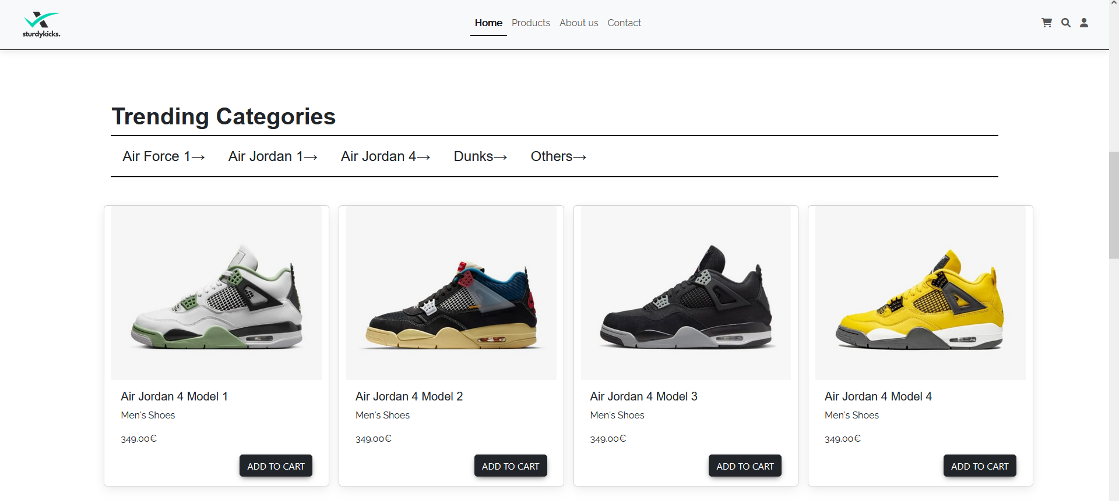
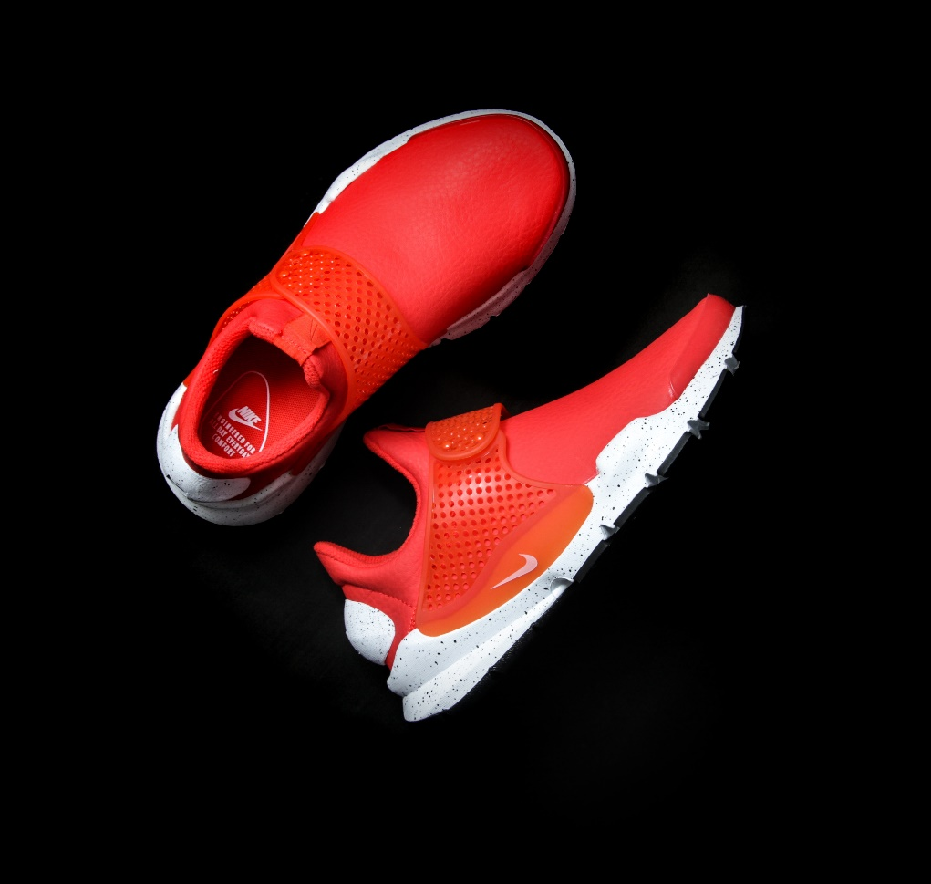
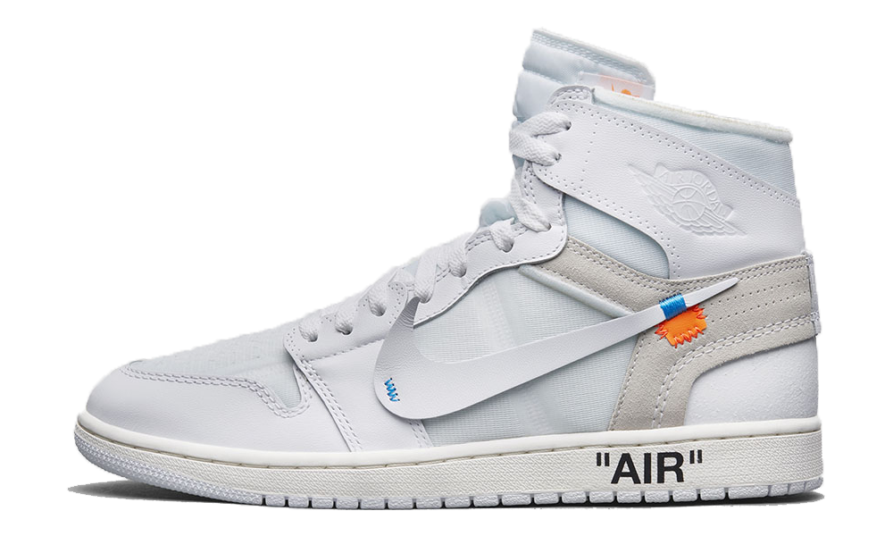
The Website
04
Our website has a sleek and User-Friendly design, offering a visually appealing and intuitive interface for effortless navigation. By clicking on a certain sneaker category, the sneakers in stock from that category pop up.

Slide 5
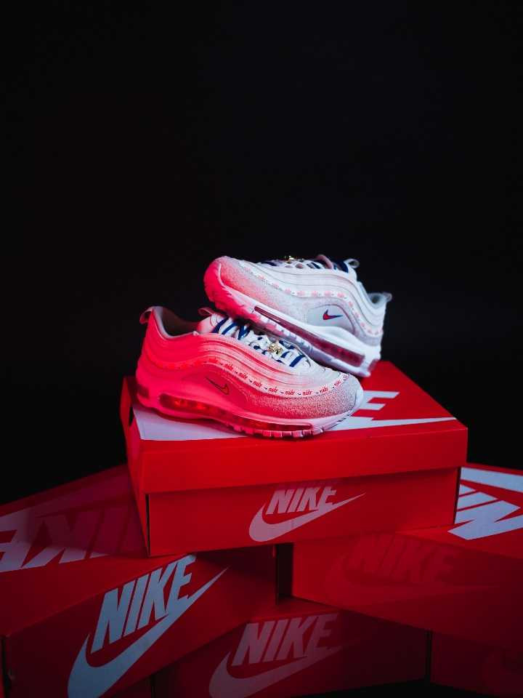
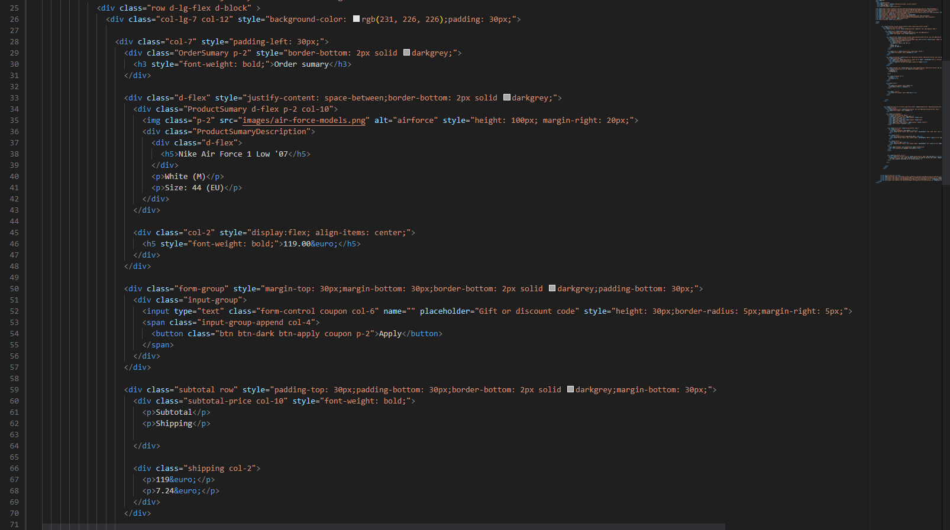
The coding
#1: HTML
05
Programming the website was done simultaneously in three parts: the main HTML, the CSS and the JavaScript functions. All of the participants worked hard in hopes of creating a masterful web page.
The HTML consists of three sections: the landing page, the check-out and the product page.

Slide 6
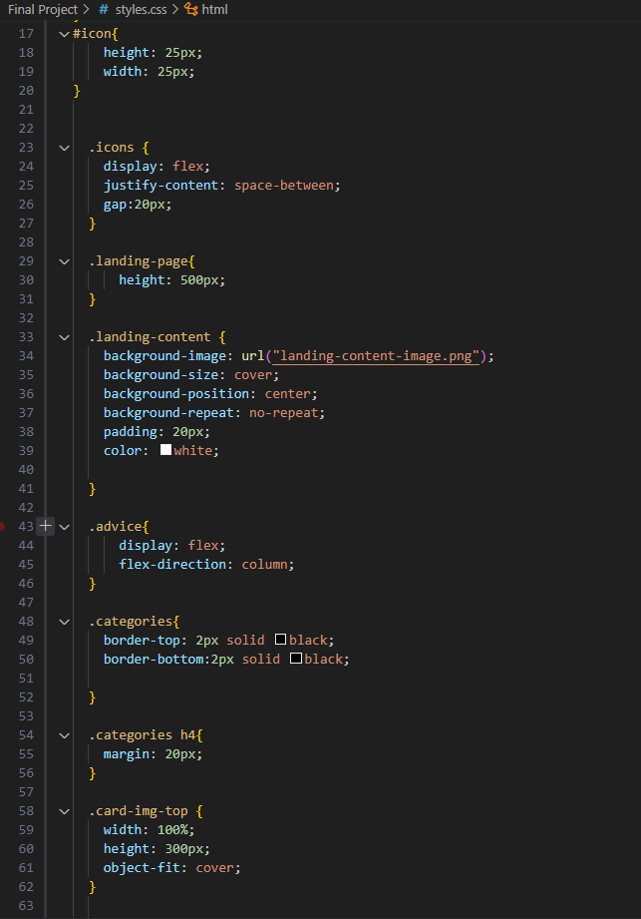
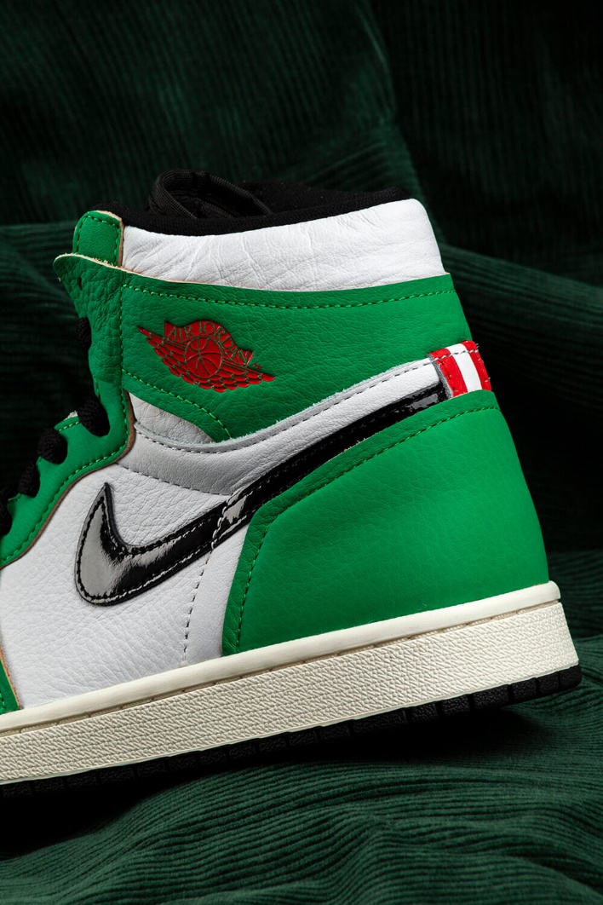
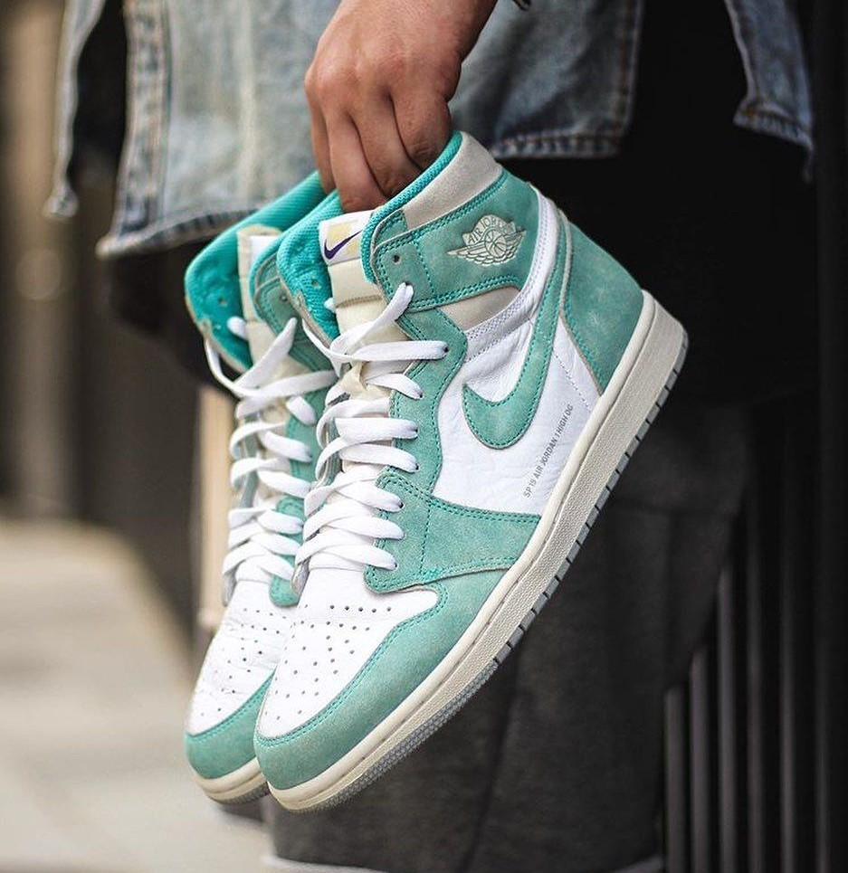
The coding
06
#2: CSS
The CSS is the aesthetic and visual aspects of the website, including pictures, icons etc.

Slide 7
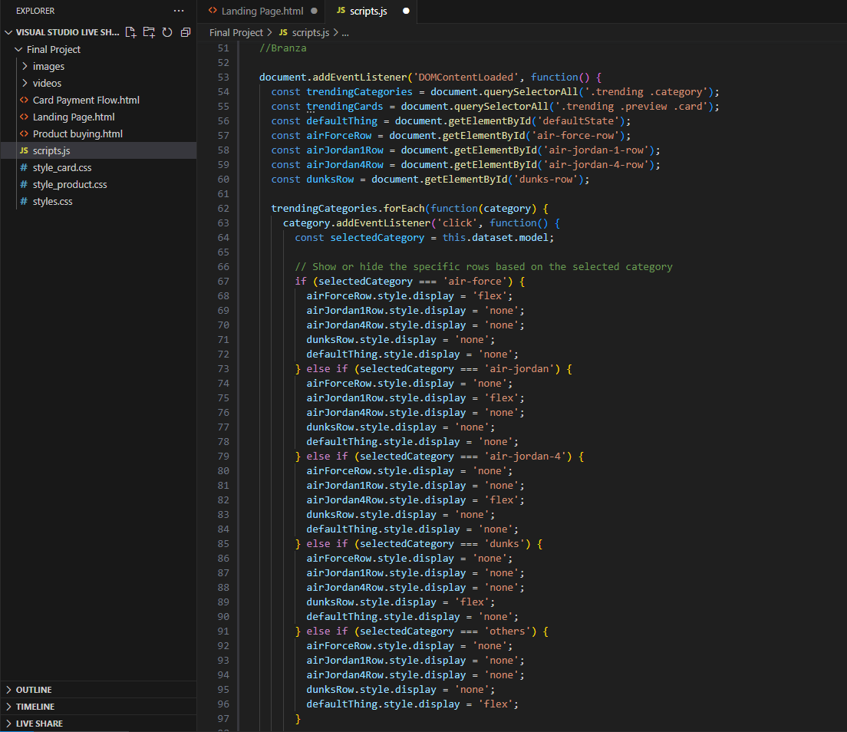
The coding
07
#3: JavaScript
The JavaScript represents the functionality of every button or link in the website, being fundamental for the making of any web page.

Slide 8


How to clean
shoes?
08
Sturdykicks not only sells sneakers but also provides valuable information on how to care for them. The store's website features a section on sneaker care tips, including advice on how to clean and maintain different types of sneakers.

Slide 9
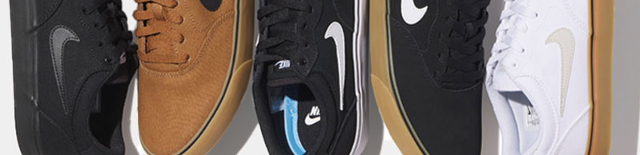
Conclusion
09
Sturdykicks is a top-notch online sneaker store that offers a wide range of Nike sneakers, including limited edition releases. The store's commitment to authenticity and quality sets it apart from other resellers, and its excellent customer service ensures a seamless shopping experience.
Whether you're a serious sneaker collector or just looking for a stylish and comfortable pair of kicks, Sturdykicks has something for everyone.

Slide 10
Thank you!
Thank you!

