Slide 1

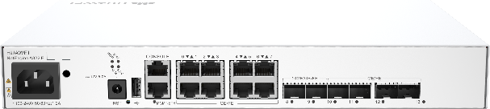
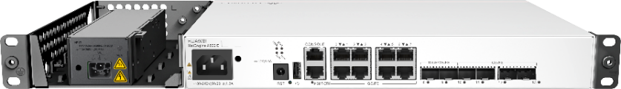
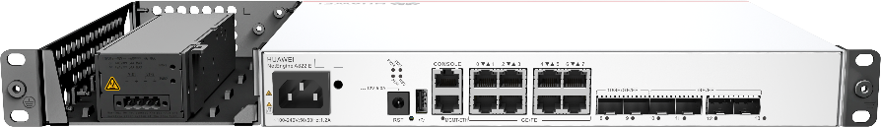
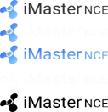




NetEngine A822 E
1U IPv6+ 10 Gigabit Access Router
Overview
HUAWEI NetEngine A822 E is an integrated access router oriented to the 5G and cloud era. It is mainly used in government commissions and bureaus, MAN access in villages and towns, financial outlets, railway stations, and enterprise branches. The details are as follows:
The NetEngine A822 E is 1 U high and 220 mm deep. It provides 14 service ports, such as GE and FE ports, to meet the requirements for traffic growth and diversified service access in the cloud era. Network slicing is supported. Multiple types of services can be carried on one network, simplifying network layers.
NetEngine A822 E supports SRv6 smart connections. SRv6 provides massive consecutive addresses and rich scalability based on IPv6. SRv6 enables automatic cross-domain connections and minute-level service provisioning, implementing cloud-based network scheduling and one-hop access to the cloud. SRv6 can identify applications and tenants and implement intelligent scheduling such as latency and bandwidth based on customer requirements to ensure service SLAs. The number of network protocols is reduced from 10+ to 2, simplifying network O&M.
The NetEngine A822 E supports intelligent O&M by introducing automation and intelligent technologies. Based on the iMaster NCE and iFit technologies, the NetEngine A822 E accurately detects network SLAs in real time, provides real-time service quality visualization, and supports minute-level fault locating.
The NetEngine A822 E integrates multiple functions, simplifies the network structure, provides various service types, reliable service quality, and intelligent O&M. The NetEngine A822 E leads the IP WAN to an intelligent network with autonomous driving, and continuously drives the business success of enterprise customers.
GE/GE
10GE/GE/FE
GE/FE
NetEngine A822 E (AC)
NetEngine A822 E (双AC)
Application Scenario
NetEngine A822 E (AC+DC)
Campus office
Production
in the park
Campus Assets
A822 E
Industry slicing private network
1

Slide 2
Product Highlights
Compact and large capacity
IPv6+ fully supported
Flexible deployment
Size: 300 mm deep cabinet, 1 U high
Capacity: 20 Gbit/s
SRv6 Ready, Simplified Network
Network slicing, one network for multiple purposes
iFIT, with-flow detection
Supports mobile phone deployment and remote deployment
1 U high, can be placed on a desktop, wall, or cabinet
Flexible switching between MPLS and SRv6 modes
Product Specifications
Property | Description
Interface Type | 2*10GE + 4*GE/FE (optical) + 8*GE/FE (electrical)
Main control board | Securing the box-shaped structure
Service Slot | Securing the box-shaped structure
Power supply | Single AC, dual AC, single AC+single DC
Dimensions (W x D x H) | 320 mm x 220 mm x 43.6 mm (1U)
Typical power consumption | 33.2 W
Heat Dissipation Mode | Natural heat dissipation
Long-term operating temperature | -5°C - 55°C
Voltage Range | AC: 100 V-240 V DC: ±48 V/+24 V to 12 V power
Product Features
Features | Description
Ethernet Layer 2 Protocol | STP/RSTP, MSTP, Layer 2 protocol transparent transmission, BPDU, and LACP
Ethernet service | VLAN, Bridge Domain, QinQ
Route selection | RIP, RIPng, OSPF, OSPFv3, IS-IS, IS-ISv6, BGP, BGPv6, static routing
IPv4 protocol | ICMP, IP, TCP, UDP, Socket (TCP/UDP/RAW IP) ARP, Static DNS, DNS Client DHCP、DHCP Relay、DHCP Server、DHCP Client Ping, Tracert, NQA
2

Slide 3
Features | Description
IPv4 protocol | IP policy-based routing Flow-based forwarding next hop IP policy-based routing load balancing IPv4 load balancing is supported.
IPv6 Protocol | IPv6(ND), Path MTU (PMTU) TCP6, Ping IPv6 Tracert IPv6, Socket IPv6 DHCPv6 Relay, Static IPv6 DNS Policy-based routing
MPLS | LDP, MPLS TE, SR MPLS
L2VPN | PWE3/VLL, VPLS, EVPN
L3VPN | CE routers can access L3VPN through L3 interfaces. Supports static routes between CEs and PEs, between BGP, RIP, OSPF, and IS-IS. Inter-AS VPN, including RFC 2547bis option A, RFC 2547bis option B, and RFC 2547bis option C
SRv6 | SRv6 BE, SRv6 TE Policy, Flex-Algo, G-SRv6, SRv6 network slicing, and anti-microloop
Value-added service | NAT/CGN, IPsec, Xsec
O&M | IFIT, NQA, TWAMP, BFD, Telemetry VRRP, Ethernet OAM, and bit-error-triggered protection switching
QoS | QPPB, DiffServ, level-3 HQoS, redirection, ACL, and policy-based routing
Other | AAA, RADIUS, SSH, SNMP v3, and system logs
3

Slide 4
Compliance
Project | Description
Compliance | EMC ANSI C63.4 AS/NZSPR 32 CISPR 24 CISPR 32 EN 55024 EN 55032 ETSI EN 300 386 FCC CFR47 Part 15 Subpart B ICES-003 Issue 6 ICES-GEN Issue 1 IEC 61000-3-2 IEC 61000-3-3 IEC 61000-4-11 IEC 61000-4-2 IEC 61000-4-29 IEC 61000-4-3 IEC 61000-4-4 IEC 61000-4-5 IEC 61000-4-6 IEC 61000-6-2 IEC 61000-6-4 VCCI-CISPR 32 Environment ETSI EN 300 019-1-1 ETSI EN 300 019-1-2 ETSI EN 300 019-1-3 ETSI EN 300 753 ETSI EN 300 019-2-1 ETSI EN 300 019-2-2
4

Slide 5
Project | Description
 | ETSI EN 300 019-2-3 IEC 60068-2-1 IEC 60068-2-2 IEC 60068-2-14 IEC 60068-2-27 IEC 60068-2-30 IEC 60068-2-31 GB/T 2423.26-2008 IEC 60068-2-39 IEC 60068-2-64 ISTA 2A ISO 7779 Security. IEC/EN/UL/CSA 60950-1 IEC/EN 62368-1 Environmental protection 2011/65/EU & (EU)2015/863 (EU RoHS) Regulation (EC) No.1907/2006 (REACH) 2012/19/EU (WEEE) 2006/66/EC and 2013/56/EU on batteries and accumulators
With regard to the physical dimensions provided in the table, the width (W) does not consider the mounting ears.
Temperature and humidity are measured 1.5 meters above the ground and 0.4 meters in front of the cabinet. There is no protection plate on the front or rear side of the cabinet.
"Short-term" means that the continuous working time does not exceed 96 hours and the accumulated working time does not exceed 15 days per year. If the working time exceeds any of these values, it is considered "long-term".
Software upgrade path
Access to Software upgrade path Obtain the VRP software version or patch.
5

Slide 6
More information
For more information about NetEngine A800 E-Series Routers, visit https://e.huawei.com or contact us by:
Global service hotline : https://e.huawei.com/cn/service-hotline
Log in to Huawei enterprise technical support website : https://support.huawei.com/enterprise/
Customer service email : support_e@huawei.com
Copyright © Huawei Technologies Co., Ltd. 2025. All Rights Reserved. Without the written permission of the Company, no unit or individual shall excerpt or copy part or all of the contents of this document without authorization, and shall not disseminate it in any form. Trademarks and Notices and other Huawei trademarks are trademarks of Huawei Technologies Co., Ltd. All other trademarks or registered trademarks mentioned in this document are the property of their respective owners. Attention. The products, services, or features you purchase are subject to Huawei's commercial contracts and clauses. All or part of the products, services, or features described in this document may not be within your purchase scope or usage scope. Unless otherwise specified in the contract, Huawei makes no express or implied representation or warranty in this document. This document may be updated irregularly due to product version upgrade or other reasons. Unless otherwise agreed, this document is intended as a guide, and all statements, information, and recommendations in this document do not constitute a warranty of any kind, express or implied. | Huawei Technologies Co., Ltd. Address: Huawei Headquarters Office Building, Bantian, Longgang District, Shenzhen, 518129 Website:www.huawei.com
6

