Slide 1
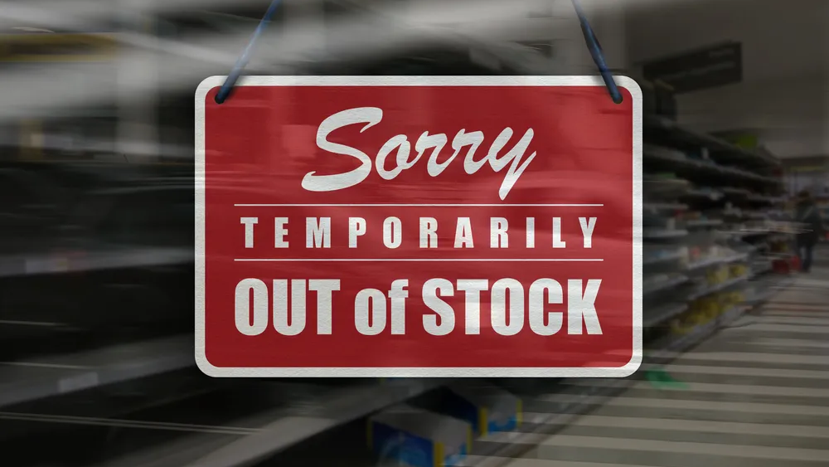
Notes:
Restaurants, whether small or large chains, face a critical challenge: unpredictable supply shortages that disrupt operations and lead to missed revenue opportunities. Today, many businesses still rely on Excel for supply data—resulting in delayed insights and reactive decision-making. This inefficiency not only affects inventory management but also has a ripple effect on sales and customer satisfaction. Our goal is to flip this script and solve the shortage dilemma from the ground up

Slide 2
The AI-Driven Agent
AI Predicts Supply Behavior
Prevents Shortages Before They Happen
Intelligent Alternative Suggestions
Notes:
“Imagine an AI agent that not only forecasts when supplies are running low but also predicts how each good behaves over time. Our solution uses historical and real-time Excel data to proactively alert restaurants before they hit a shortage. Moreover, when traditional restocking routes aren’t available, it intelligently suggests alternative suppliers, ensuring that every restaurant never runs out of essential goods.”

Slide 3
Seamless Integration & Customization
Excel Today, SAP & More Tomorrow
Integration with Custom Supply Systems
Balanced Sponsored Supplier Recommendations
Notes:
While our proof-of-concept starts with Excel data – the industry standard – our roadmap is clear: direct integration with SAP ERP and other major supply chain systems used by large restaurant chains. We also introduce a unique twist: a promotion model where suppliers can be featured as long as it remains balanced and beneficial to the user. This seamless integration and customization ensure that our solution is both immediately feasible and scalable for future enhancements.

Slide 4
Business Impact & Feasibility
Boost Operational Efficiency
Enhance Sales & Customer Experience
Secure, Scalable & Feasible Implementation
Notes:
Our concept doesn’t just stop at preventing shortages. By optimizing inventory management, we create an environment where restaurants operate more efficiently, indirectly boosting sales and improving customer experiences. The solution is designed with security in mind—especially important for the German market—and its feasibility is underpinned by a robust roadmap. With our approach, practical business value is delivered from day one, while also laying a solid foundation for future digital transformation and cloud integration.

Slide 5
Boom: We Solved the Problem
From Chaos to Control
Future-Proof & Secure Supply Chains
Clear Roadmap to Digital Transformation
Notes:
In conclusion, we began by identifying the acute problem of unpredictable supply chain management in the restaurant industry. With our AI agent, restaurants can move from chaos to control—ensuring that shortages are anticipated and alternative, cost-effective suppliers are always available. Our concept, secure by design and ready to evolve from Excel to full SAP integration, addresses both current needs and future opportunities. We’ve not only solved the problem but provided a clear, actionable roadmap for digital transformation that resonates with every stakeholder from operational teams to IT and security experts.

