Slide 1
Predicting Per Capita Neighborhood Crime Rates
Vladimir Khin
Michael Krzysko

Slide 2
Data Summary
Overview
The Communities and Crime Data Set collected 122 socioeconomic and law enforcement features to analyze their relationship with the rate of neighborhood violent crime per 100K Population.
This dataset may be useful for local leaders to understand which variables may be associated with violent crimes in their communities.
Data
N = 1,944 individual counties in the United States were observed.
P = 100 numeric features (22 features removed from dataset due to many missing values)
According to the authors : "All numeric data was normalized in the original dataset into a decimal range 0.00-1.00 using an Unsupervised, equal-interval binning method."
No categorical features are present in the dataset.

Slide 3
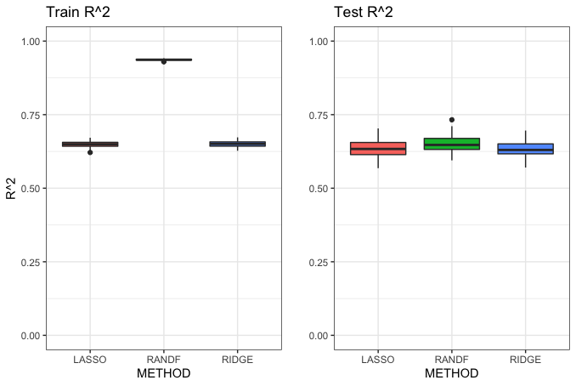
Train + Test R² Boxplots All three models perform similarly in Test R², while Random Forest seems to overfit on the training set, leading to a significantly higher Train R².

Slide 4
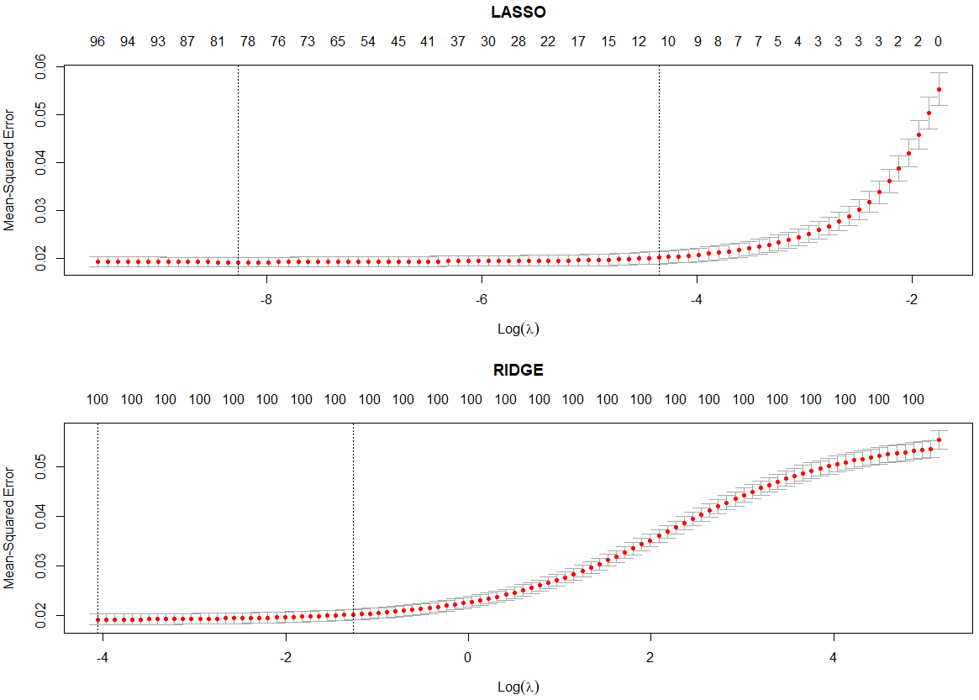
10-Fold Cross-Validation Curves Lasso clamps to 11 features when using lambda.1se while Ridge uses all 100 features as expected.

Slide 5
R² Confidence Interval Comparisons
We observed the Random Forest model to have the largest upper bound in the 90% confidence interval for the Test R² however no particular model performs significantly better than the others with respect to Test R².
The regularization methods performed faster than the random forest, with Ridge Regression performing the fastest (including 10-fold cross-validation and final fit).
In this case, the least efficient model is Random Forest, which takes significantly longer to fit with no improvement on Test R². We recommend using Lasso Regression, as its interpretability is higher (due to fewer non-zero features) while fitting in similar time and producing similar results to Ridge Regression.
​ | Test R2 90% Confidence Interval | Iteration Fit Time (median seconds)​ | Overall Fit Time (MM:SS)​
Lasso​ | (0.59, 0.69) | 0.63​ | 01:07​
Ridge​ | (0.59, 0.68) | 0.45​ | 00:52​
Random Forest​ | (0.60, 0.70) | 1.12​ | 01:54​
Note: random forest was fit with 40 trees as we observed the R2 level out at that point.​

Slide 6
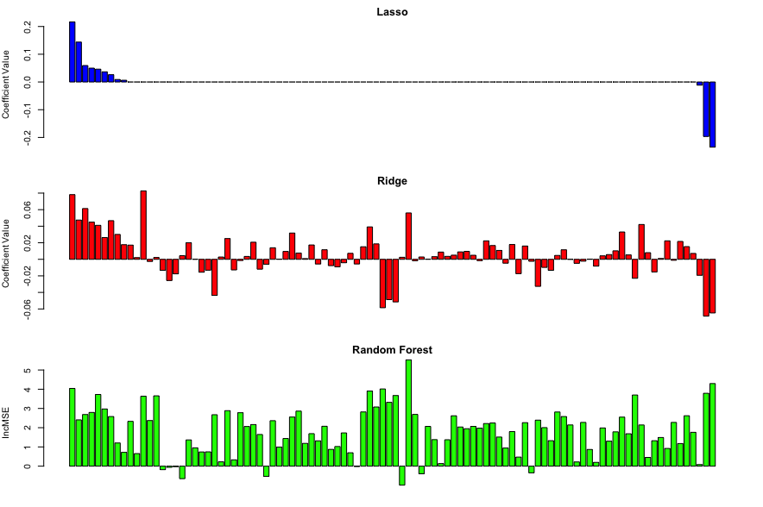
Variable Importance All three models identify similar variables as being important indicators of per capita neighborhood crime. This would explain our similar Test R² results, as the models are largely similar.
Most Important Variables | Lasso | Ridge | Random Forest
 | PctKids2Par (-) | racepctblack (+) | NumIlleg
 | PctIlleg (+) | PctIlleg (+) | PctKids2Par
 | racepctwhite (-) | racepctwhite(-) | PctIlleg

Slide 7
Conclusions
For Test R², there was no clear best model after fitting 100 iterations of the training data.
For timing, Ridge Regression fit the fastest using 10-fold CV while still performing as well as the other methods in capturing the variability of the response.
For interpretability, we saw that Lasso Regression fit with only 11 predictors in its model and performed similarly to the other methods for the Test R².
We suggest the Lasso regression model for the previous reason to achieve a more parsimonious model that would be easier to interpret than the other two.

