Slide 1
Predicting Future Customer Purchase Behavior
Michael Krzysko
Vladimir Khin

Slide 2
Data Summary
Overview
The Santander data set contains 200 anonymized columns of customer profile and historical behavior data, all of which are used to predict a whether the customer will purchase a specific Santander product in the future
Data is anonymized at source due to proprietary nature
Predicting future customer spending is vital for an organization to optimize budgets and efficiently target marketing outreach
Data
4,000 customers (randomly sampled from 200,000 records)
200 customer financial features (anonymized by source - i.e. named "var_1")
364 positive records; 3,636 negative records (~10% positive response)
Models fit to minimize misclassification error, weighted due to data imbalance

Slide 3
Model Comparisons
Ridge regression has the highest median test AUC of 0.819, while Random Forest has the lowest at 0.701. Lasso and Elastic Net regressions perform slightly worse than Ridge at 0.807 and 0.809, respectively.
Lasso regression has the fastest overall fit time (of all 50 cross-validated models) with a time of 05:07. Elastic Net is marginally slower, while Ridge and Random Forest are each significantly slower.
 | Median Test AUC | Overall Fit Time (MM:SS) | Iteration Fit Time (median seconds)
Lasso | 0.807 | 05:07 | 6.27
Elastic Net | 0.809 | 05:19 | 6.56
Ridge | 0.819 | 08:11 | 10.11
Random Forest | 0.701 | 11:07 | 13.46

Slide 4
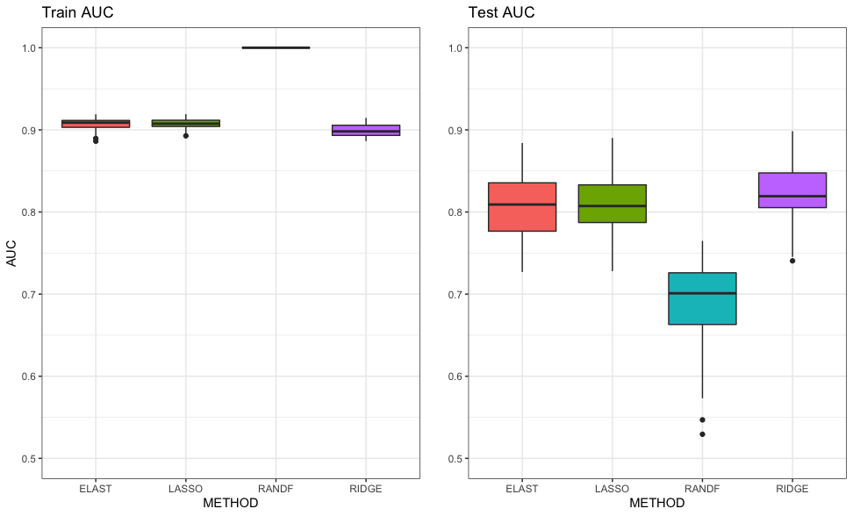
Train + Test AUC Boxplots All three regression models perform similarly in Test AUC, while Random Forest seems to overfit on the training set, leading to lower Test AUC.

Slide 5
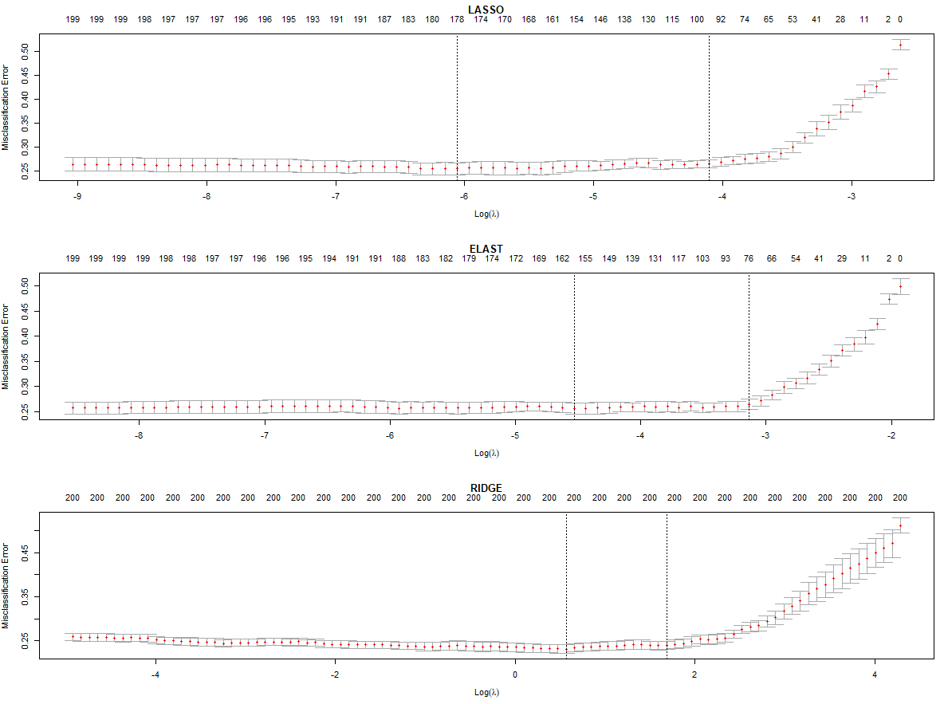
10-Fold Cross-Validation Curves

Slide 6
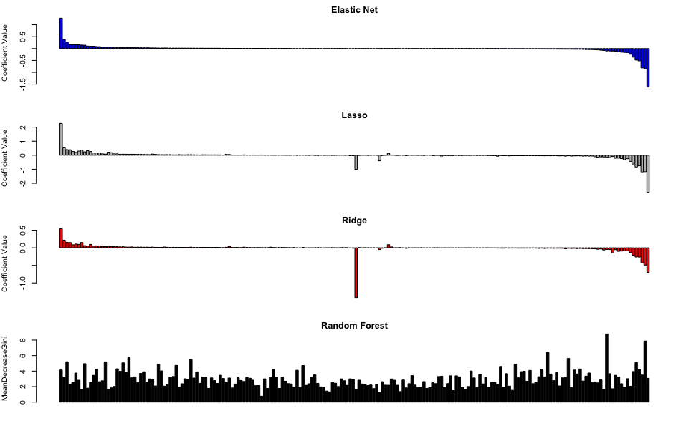
Coefficient Comparisons Lasso and Ridge put more emphasis on variables that Elastic Net considers unimportant, however all three only focus on a small subset of the 200 predictors. Random Forest considers most variables when predicting the outcome.
Most Important Variables | Elastic Net | Lasso | Ridge | Random Forest
 | var_108 (-) | var_108 (-) | var_68 (-) | var_81
 | var_91 (+) | var_91 (+) | var_108 (-) | var_12
 | var_12 (-) | var_148 (-) | var_91 (+) | var_139

Slide 7
Conclusions
While Ridge produced the highest AUC, we conclude that the best model for this data is either Lasso or Elastic Net regression.
The Lasso and Elastic Net models' median test AUC is only marginally worse than the Ridge model while their fit time is significantly faster.
The three Logisitic regression models each identify similar variables as the most important, however each has its own perspective on the coefficient's weight
If data was not anonymous, we would use domain expertise to discern which model's important variables are the most logical/applicable to our outcome
Random Forest should not be considered to fit this data based on these results because it not only performs the worst when considering the test data, it is also the most computationally expensive model to fit.

