Slide 1
Asymptotic Analysis

Slide 2
Analysis of Algorithms
Analysis of Algorithms is the determination of the amount of time, storage and/or other resources necessary to execute them.
Analyzing algorithms is called Asymptotic Analysis.
Asymptotic Analysis evaluate the performance of an algorithm.

Slide 3
Time complexity
Time complexity of an algorithm quantifies the amount of time taken by an algorithm.
We can have three cases to analyze an algorithm:
Worst Case.
Average Case.
Best Case.

Slide 4
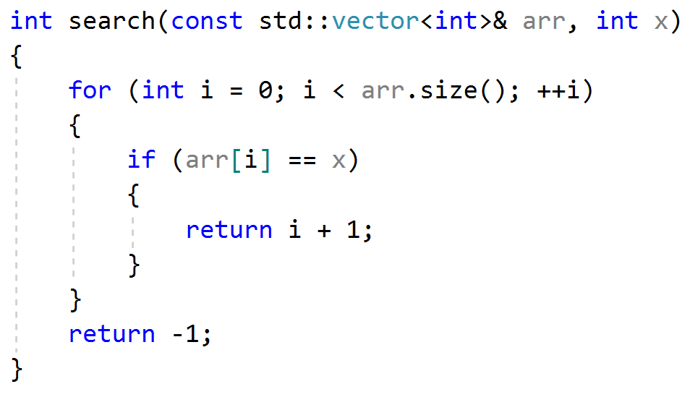
Time complexity
Assume the below algorithm using C++ code:

Slide 5
Time complexity Worst Case Analysis
In the worst case analysis, we calculate upper bound on running time of an algorithm.

Slide 6
Time complexity Worst Case Analysis
The case that causes maximum number of operations to be executed.
For Linear Search, the worst case happens when the element to be searched is not present in array (example: search for number 8)․
2 | 3 | 5 | 4 | 1 | 7 | 6

Slide 7
Time complexity Worst Case Analysis
When x is not present, the search() functions compares it with the elements of arr one by one.

Slide 8
Time complexity Worst Case Analysis
Time complexity of linear search would be O(n).

Slide 9
Time complexity Average Case Analysis
We take all possible inputs and calculate computing time for all of the inputs.

Slide 10
Time complexity Best Case Analysis
Calculate lower bound on running time of an algorithm.

Slide 11
Time complexity Best Case Analysis
Time complexity in the best case of linear search would be O(1).

Slide 12
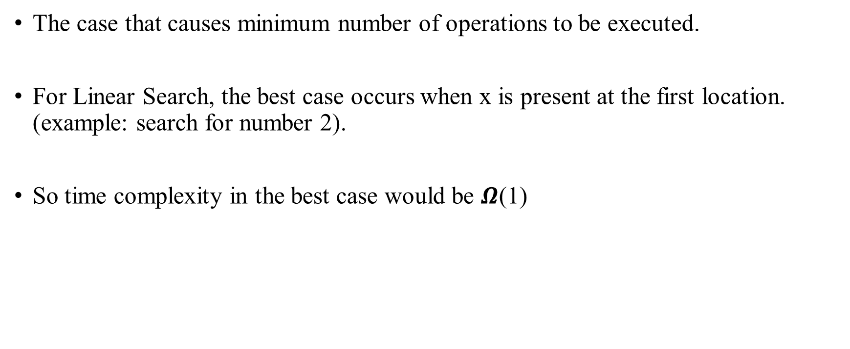
Time complexity Best Case Analysis
The case that causes minimum number of operations to be executed.
For Linear Search, the best case occurs when x is present at the first location. (example: search for number 2).
So time complexity in the best case would be $Ω$(1)
2 | 3 | 5 | 4 | 1 | 7 | 6

Slide 13
Time complexity
Most of the times, we do worst case analysis to analyze algorithms.
The average case analysis is not easy to do in most of the practical cases and it is rarely done.
The best case analysis is bogus. Guaranteeing a lower bound on an algorithm doesn’t provide any information.

Slide 14
Asymptotic Notations
Big-O Notation: is an Asymptotic Notation for the upper bound.
Ω Notation (omega notation): is an Asymptotic Notation for the lower bound.
Θ Notation (theta notation): is an Asymptotic Notation for both the lower and the upper bounds.

Slide 15
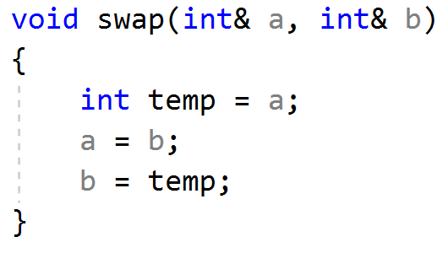
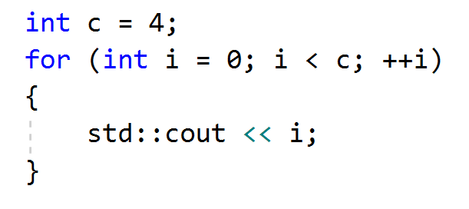
Big-O Notation O(1)
Time complexity of a function (or set of statements) is considered as O(1) if it doesn’t contain loop, recursion and call to any other non-constant time function. For example swap() function has O(1) time complexity.
A loop or recursion that runs a constant number of times is also considered as O(1). For example the following loop is O(1).

Slide 16
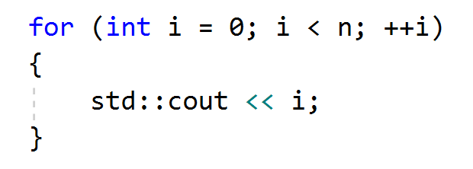
Big-O Notation O(n)
Time Complexity of a loop is considered as O(n) if the loop variables is incremented / decremented by a constant amount.
For example the following loop statements have O(n) time complexity.

Slide 17
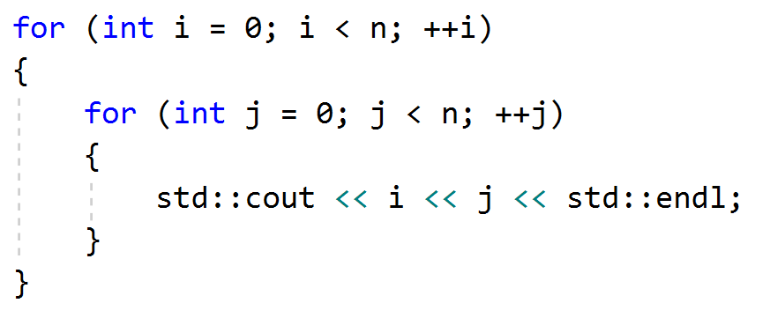
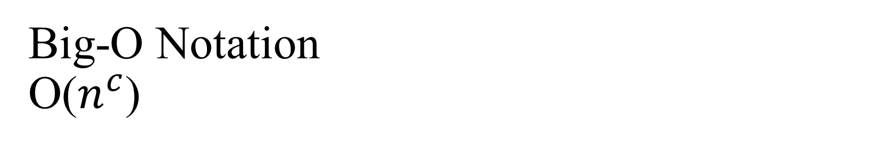
Big-O Notation O($n^{c}$)
Time complexity of nested loops is equal to the number of times the innermost statement is executed.
For example the following loop statements have O(n²) time complexity.

Slide 18
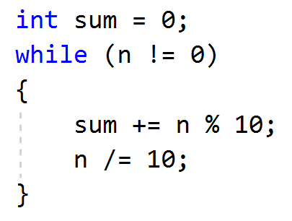
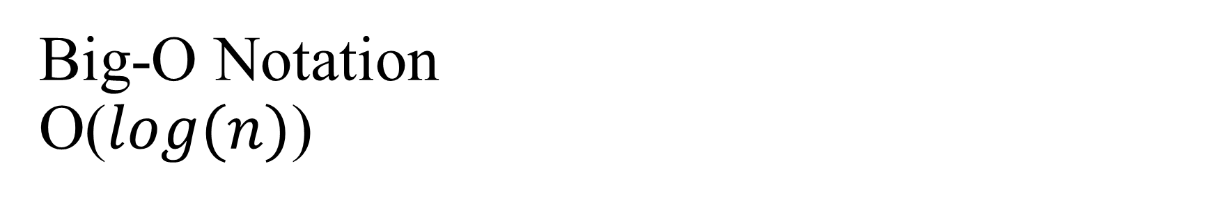
Big-O Notation O($log(n)$)
Time complexity of a loop is considered as O(log(n)) if the loop variables are divided / multiplied by a constant amount.

Slide 19
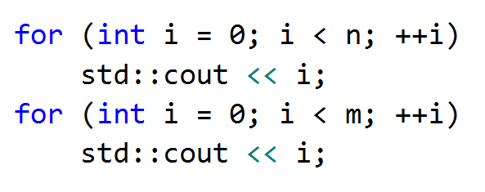
Big-O Notation
How to combine time complexities of consecutive loops?
Time complexity of above code is O(n) + O(m) which can also be written as O(n+m) or O(max(n, m)).

Slide 20
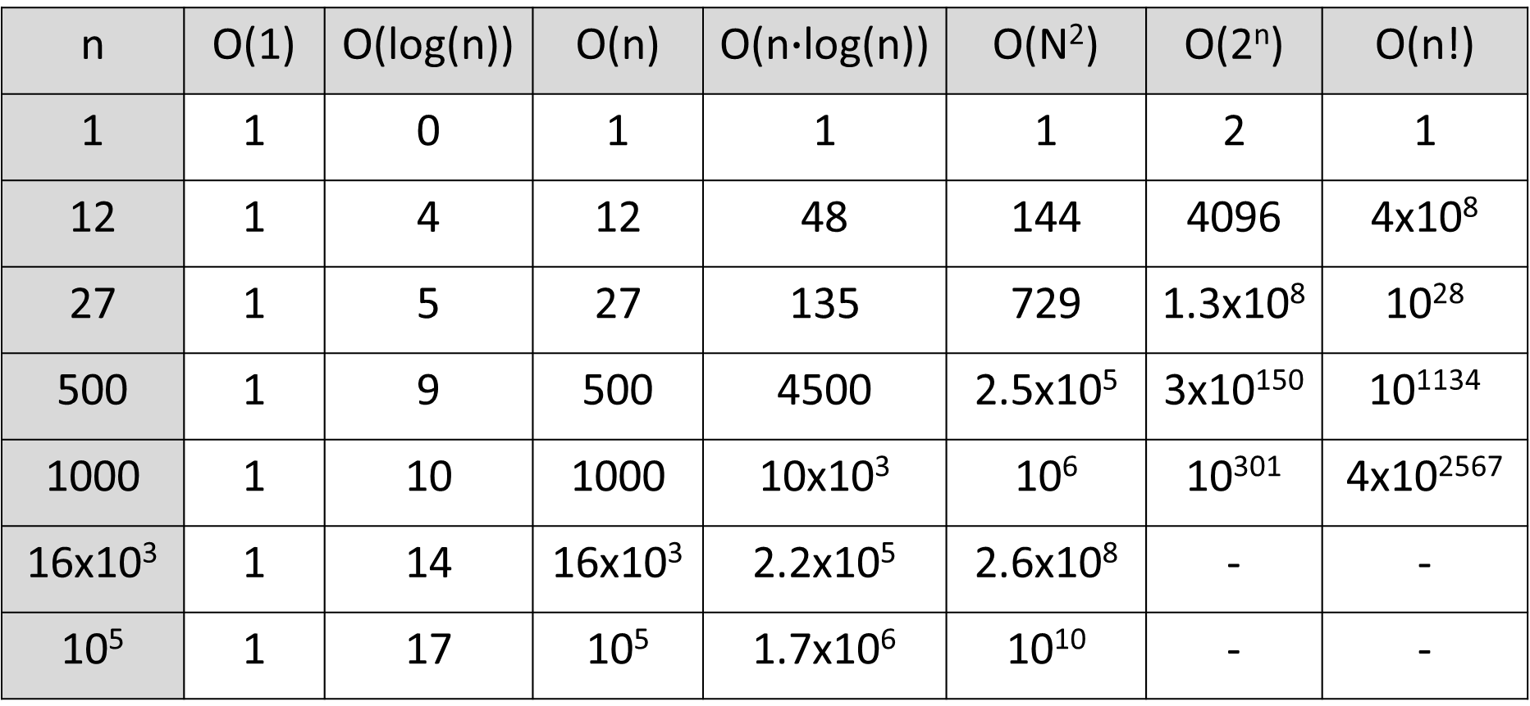
Big-O Notation. Growth Orders
n | O(1) | O(log(n)) | O(n) | O(n$∙$log(n)) | O(N²) | O(2^{n}) | O(n!)
1 | 1 | 0 | 1 | 1 | 1 | 2 | 1
12 | 1 | 4 | 12 | 48 | 144 | 4096 | 4x10⁸
27 | 1 | 5 | 27 | 135 | 729 | 1.3x10⁸ | 10²⁸
500 | 1 | 9 | 500 | 4500 | 2.5x10⁵ | 3x10¹⁵⁰ | 10¹¹³⁴
1000 | 1 | 10 | 1000 | 10x10³ | 10⁶ | 10³⁰¹ | 4x10²⁵⁶⁷
16x10³ | 1 | 14 | 16x10³ | 2.2x10⁵ | 2.6x10⁸ | - | -
10⁵ | 1 | 17 | 10⁵ | 1.7x10⁶ | 10¹⁰ | - | -

Slide 21
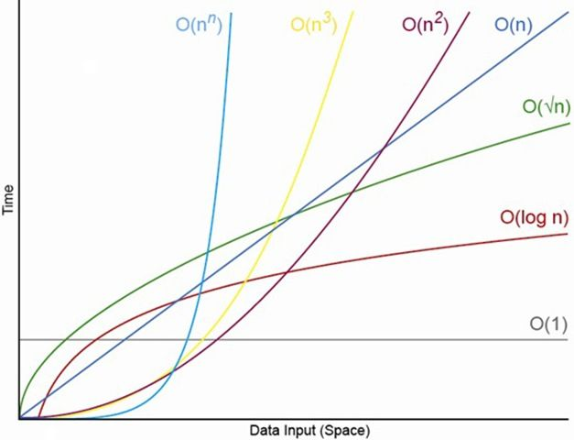
Big-O Notation. Growth Orders

Slide 22
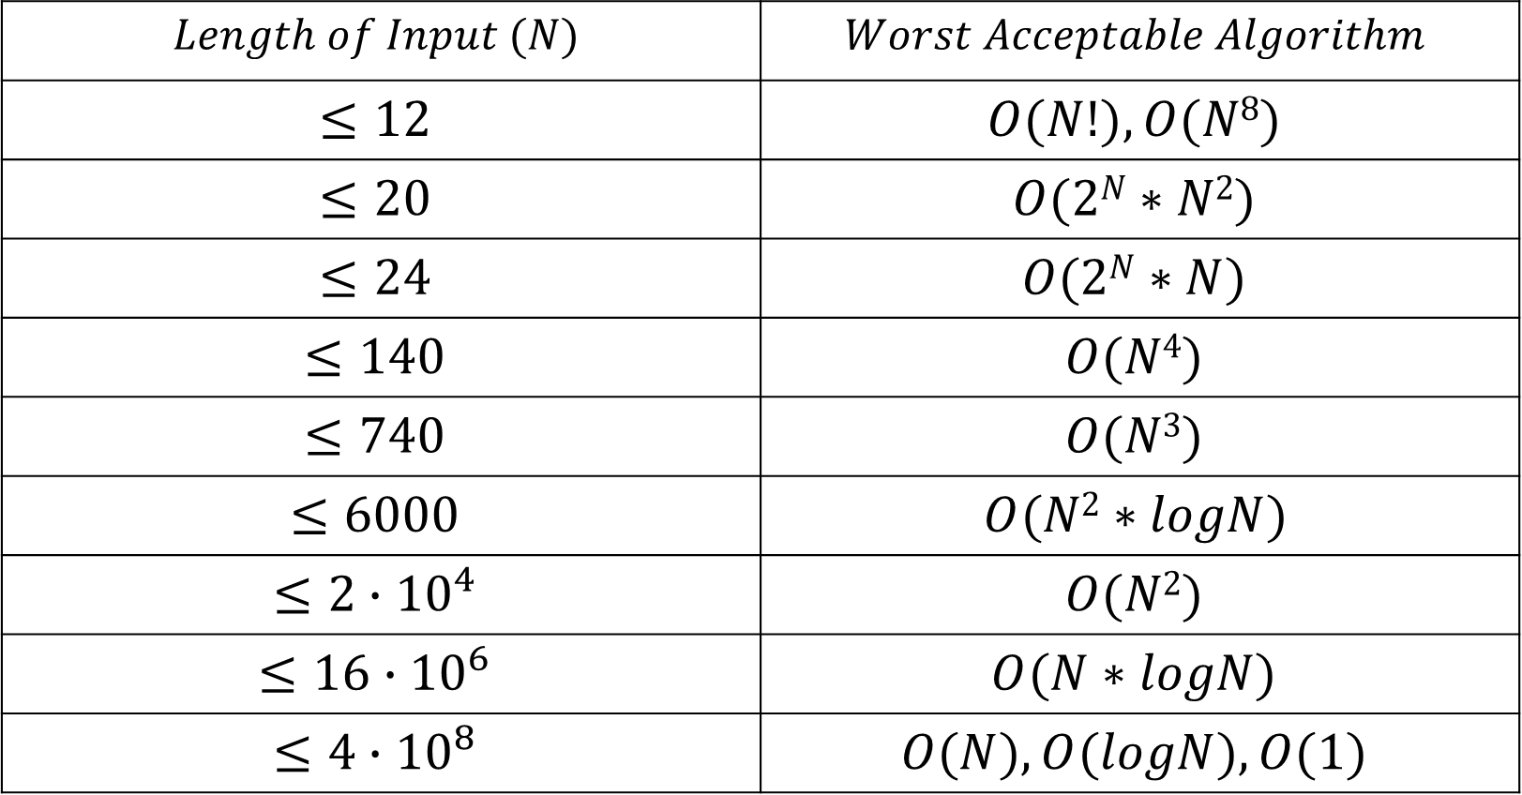
Big-O Notation. Growth Orders
$$Length of Input (N)$$ | $$Worst Acceptable Algorithm$$
$$≤12$$ | $$O(N!),O(N8)$$
$$≤20$$ | $$O(2N∗N2)$$
$$≤24$$ | $$O(2N∗N)$$
$$≤140$$ | $$O(N4)$$
$$≤740$$ | $$O(N3)$$
$$≤6000$$ | $$O(N2∗logN)$$
$$≤2∙{10}^{4}$$ | $$O(N2)$$
$$≤16∙{10}^{6}$$ | $$O(N∗logN)$$
$$≤4∙{10}^{8}$$ | $$O(N),O(logN),O(1)$$

Slide 23
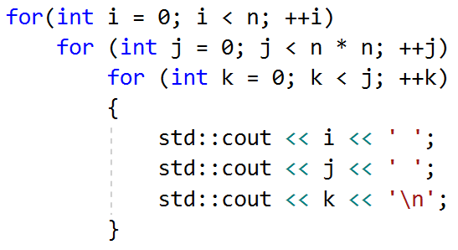
Big-O Notation
What is this code complexity?

Slide 24

Big-O Notation
What is this code complexity?
Time complexity of above code is O($n^{5}$).

Slide 25
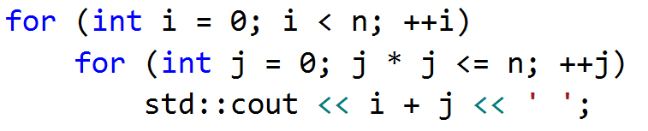
Big-O Notation
What is this code complexity?

Slide 26

Big-O Notation
What is this code complexity?
Time complexity of above code is O($n ∙\sqrt{n}$).

