Slide 1
Data structure in RAW_Data file
Each raw trace is in the following format:
Batch NAME -> Recording DATE -> Mouse NAME -> Raw traces (.rhd)
For example: we want to locate the recording used for analysis for mouse M2
Batch5_A -> 11/20 -> M2 -> 3 files with extension .rhd
Except Batch 4 (first batch and done manually)
In order to find dates/mice used for analysis, please use Excel file: Mice and days used

Slide 2
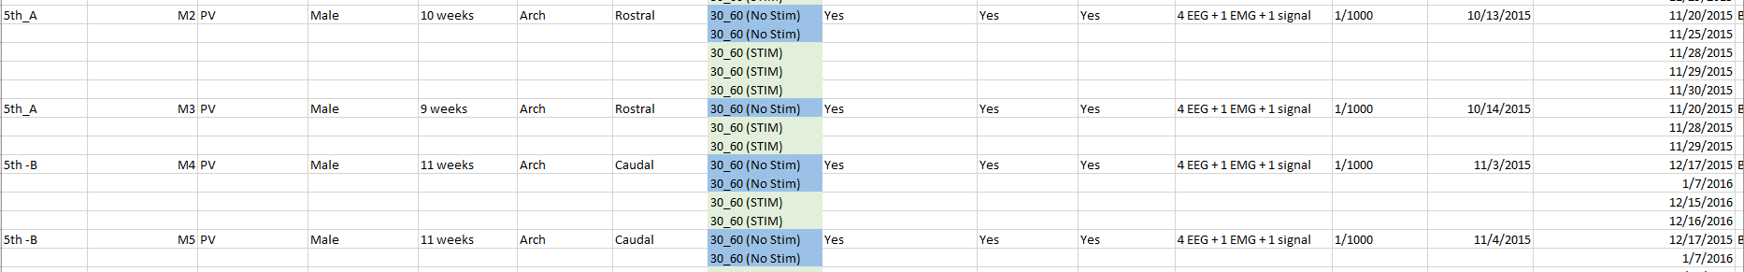
Mice and days used
Please open excel file: Mice and days used
The data used for analysis is mentioned in the spreadsheet: Mice

Slide 3
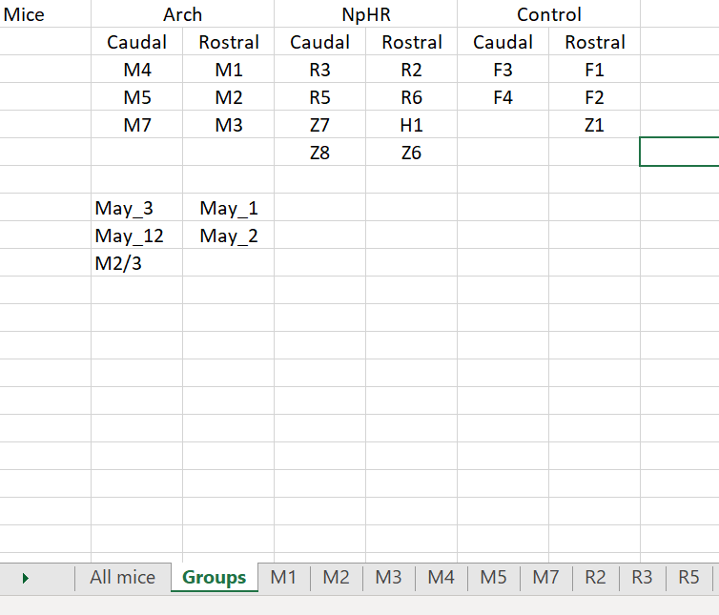
I have created spreadsheet Groups, which portrays the belongings
of all mice to each group.
Animals in red square (Batch 4 - May_3 and ext) are from the first batch
Data from these animals were only used for the creation of EEG data figures
(Figure 5C and Supplementary Figure 2e and 3e)
Stimulation pattern on these animals were done manually,
And these animals cannot be used for sleep behavior scoring (no EMG signal)

Slide 4
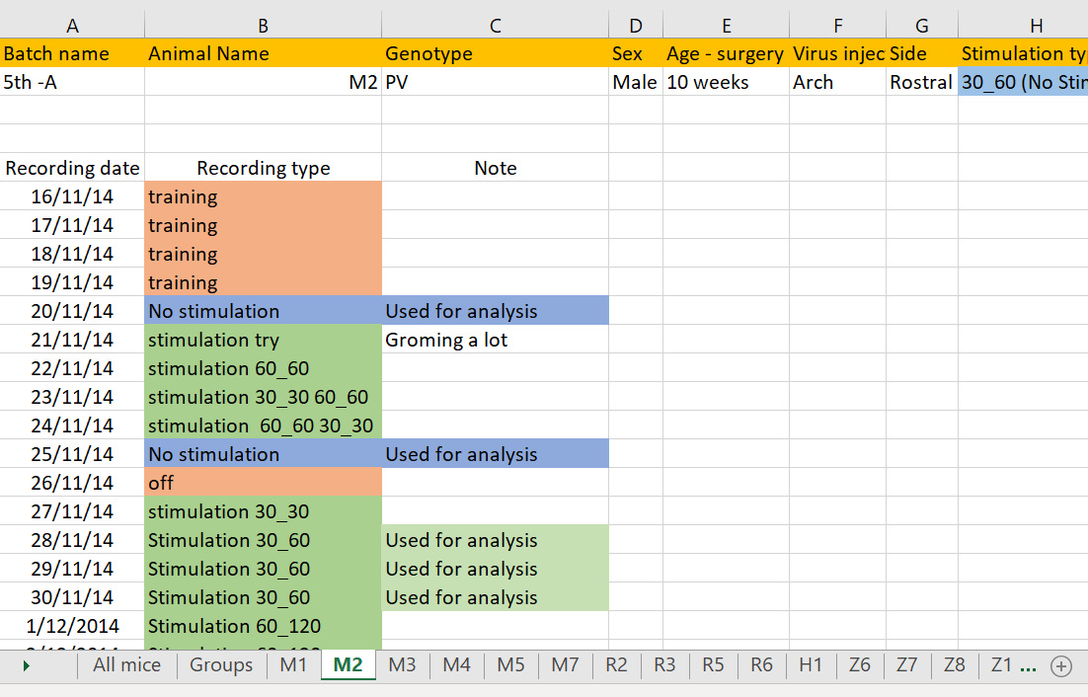
Stimulation pattern 30_60 (30 on and 60 off) or 30_90 were included in the analysis. Other stimulations were not analyzed.
Animal was included in the analysis if it showed at least 10 minutes of sleep on that day.

Slide 5
Data structure
So, by exploring file Mice and days used and RAW_DATA direction:
(Batch NAME -> Recording DATE -> Mouse NAME -> Raw traces (.rhd)
It is possible to find all raw data.
In the next part I am going to explain each figure creation step by step, so it would be
possible to recreate the same figure with given data.

Slide 6
Figure explanation
For simplicity, I have created file for each figure: Codes. It contains Matlab codes used to process the data,
figure creation and stats.
Additionally, I have created Processed_Data_byFigure folder. It contains processed data in matlab format
used for statistical analysis and figure creation.
2 Excel folders contain similar information in Processed data_Fig2ef and Dat_Fig_3_Fig7
Before the data explanation, I am going to explain how I converted the .rhd file (raw data - intan) to matlab file

Slide 7


Matlab file conversion
File_conversion file contain several codes, which are used to convert data from .rhd ext to .m
Figures -> File_conversion -> Codes -> read_Intant_RHD2000_file
Press read_Intant_RHD2000_file, choose the data you want to convert and get
Output: board_adc_data (light On/Off array) and amplifier_data (5 EEG/EMG channels).
The problem is that single raw data file contains only 1 hour of recording. Additionally, the recording failed and stopped in
some cases due to Intan software failures. If recording lasted several hours, we have several recording files, which we
combined into one after conversion to .m file. We did not include small files (less than 5-10 minutes recordings).
This way it was simpler and less time consuming
So, I converted files into .m file first and than I manually combined all files (board_adc_data / amplifier_data) into
Single file. Please see example in the next slide

Slide 8
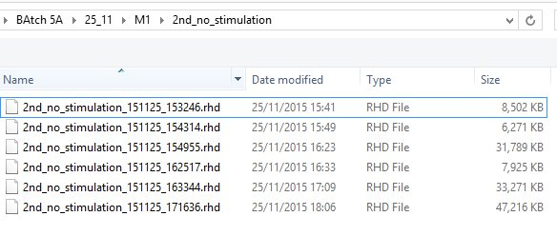

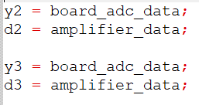

Matlab file conversion - Example
For example, data from Batch5 > 25_11 > M1 > 2nd stimulation
I have excluded small data (less than 10.000 KB)
And combined 3 files which are left into 1
First: I convert 1st file into .m file using read_Intant_RHD2000_file
Second: I name board_adc_data / amplifier_data
With simple y1/d1 (manually)
By using ext.m code
Next, I convert/rename 2nd file and same way 3rd file.
After, I combine all 3 files into single file using same code in ext.m
Output = is DD2 – (light on/off arrays) Y2 = 5 channels from EEG/EMG

Slide 9
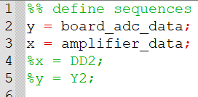
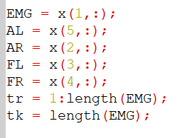
Matlab file conversion - Example
Input to most analysis is following:
converted DD2/Y2 or board_adc_data/amplifier_data (sometimes only single
File was recorded during session)
Board_adc_data (y) – single string (off = 0 / on = 3) - signal
Amplifier_data (x) contain 5 strings (channels)
1st – EMG (recoding from muscle)
2nd – AR (EEG channel from Auditory right)
3rd – FL (EEG channel from Frontal left)
4th – FR (EEG channel from Frontal right)
5th – AL (EEG channel from Auditory left)
EMG channel was used for sleep scoring. In few data EMG was missing, and FR channel was used to sleep score. All data was visually inspected before included in the sleeping data.
FR channel (3rd) was used mostly for analysis in EEG. If FR was missing FL was used for analysis.
Important to note! Some animals did not have 5 channels and code was adjusted to 3-4 channels. See Mice and days used.xls file contain info about the number of channels during recordings

Slide 10
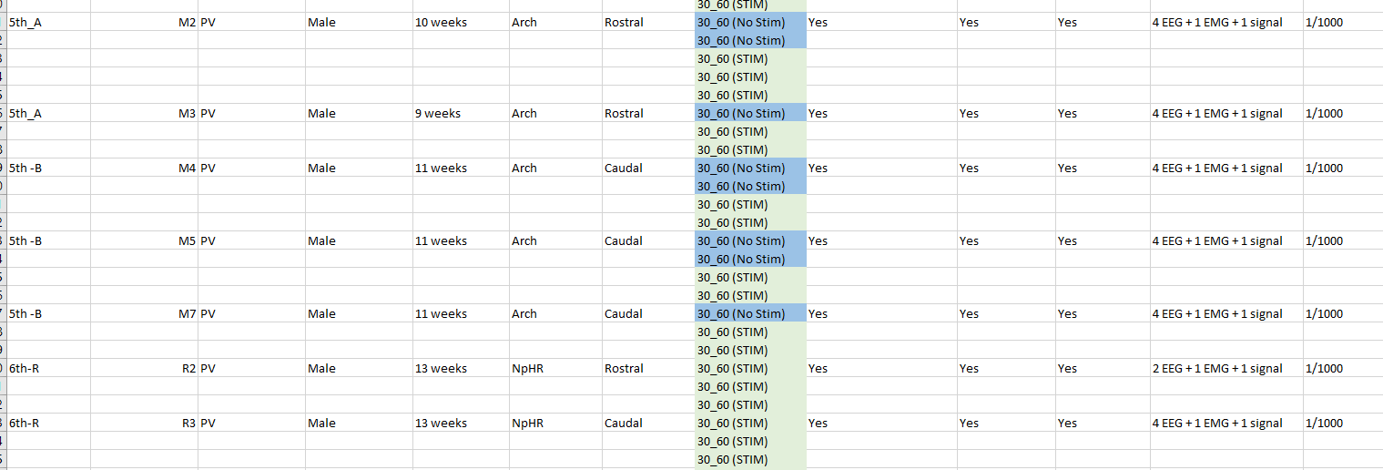
Mice and days used.xls
Example showing number of channels recorded from animals (in red)

Slide 11
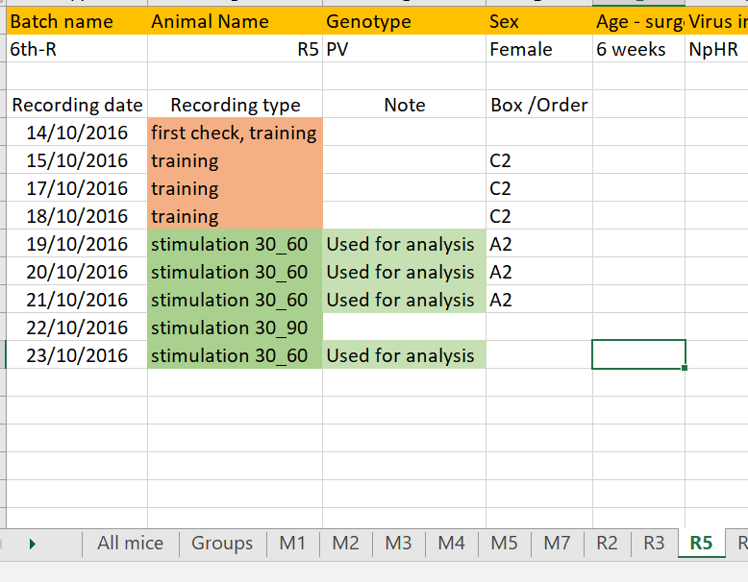

Mice and days used.xls
Additionally, Control and NpHR containing animals were recorded at the same time in two different boxes (A and C).
So, Amplifier_data (x) could contain up to 10 channels (5 channels from one animal and 5 channels from different animal)
Sometimes it was 8 or 9 channels as one of the animals did not have one or two channels). In order to understand which
channels belong to animal of interest (1-5 or 6-10) you can use Mice and days used.xls single animal data. For example:
Animal R5 was recorded in box A (Number 2 mean 2nd order of recording – not important), had only 3 EEG channels, No
EMG channel.
So, for Animal R5 in Amplifier_data (x) we will use only channels 1-3. Channels 4-8 belong to different animal.

Slide 12
Figures folder
Once we know how to convert data, now we can start with each figure explanation
For simplicity, I have created file for each figure.
Codes_processed data _ folders contain processed data and codes in matlab format
used for statistical analysis and figure creation.
2 Excel folders contain similar information in Processed data_Fig2ef and Dat_Fig_3_Fig7
https://github.com/Vladimir8585/TRN-project - contains following folders:
Codes_only (matlab)
Explanation_data.pw
Mice and Days used.xl
Processed data_Fig2ef.xl
Processed data _Fig3_Fig7.xl
To large for github to keep and available per request:
Raw_data (.rhd format)
Codes_processed data (matlab format)
Processed data (matlab format)

Slide 13
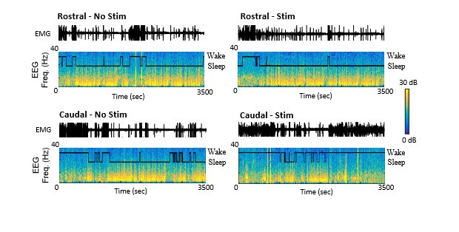
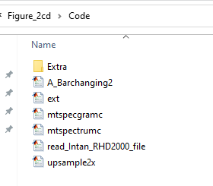
Figure_2cd
Input: DD2/Y2 or board_adc_data/amplifier_data
Codes used: A_Barchanging2.m
Figure portrays two single recording from caudal and
rostral mice with and without stimulation.
A_Barchanging2.m (code explanation)
calculate spectogram 30-150
calculate spectogramms 0-30
EMG band filter 60-200 Hz
Sleep scoring using 5 second window
Calculates delta and theta power for 5 second window
Calculate REM and SWS traces
Collecting sleep/wake only traces during stimulation (30_60) or (120_60)
Portray sleep/wake only traces (figure 2) and sleep scoring results (figure1) // for Figure 2_cd construction we are using only these two figures

Slide 14
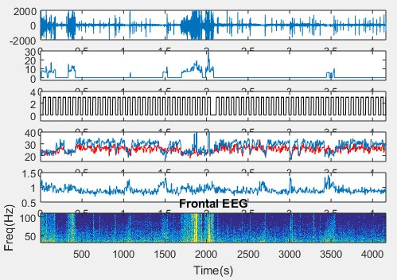
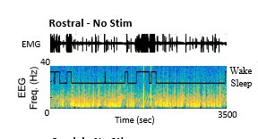
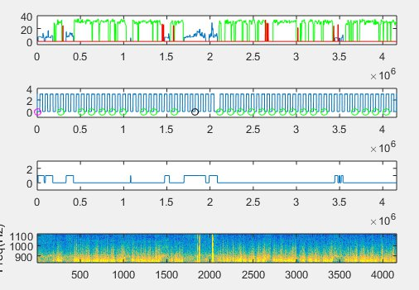
Figure_2cd - Example
EMG
Sleep scorring trace
Spectrogram

Slide 15
Figure_2cd
Animals used for figure construction
Batch NAME -> Recording DATE -> Mouse NAME -> Raw traces (.rhd)
Batch5_A -> 25/11 -> M1
Batch5_A -> 29/11 -> M1
Batch5_B -> 18/12 -> M7
Batch5_B -> 22/11 -> M7

Slide 16
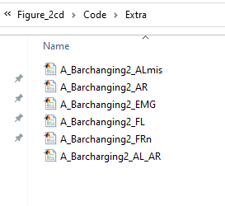
A_Barchanging2.m
Important to note!
Input for code A_Barchanging2.m is DD2/Y2 or board_adc_data/amplifier_data.
You might remember that these data consist of 5 channels for most of the mice (2 auditory channels, 2 frontal channels and 1 EMG channel. But in some of the mice few channels were missing, therefore I had to modify A_Barchanging2.m code for these mice. I also have included these modified codes in file
For Figure_2CD as Extra. For example, A_Barchanging2_Almis – used if AL (auditory left) channel was missing and ext.

Slide 17
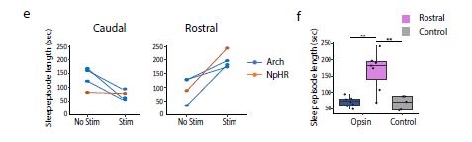
Figure 2_ef
Input: DD2/Y2 or board_adc_data/amplifier_data
Action: Calculation of the sleep episodes length (in seconds)
during stimulation.
Codes used: A_Barchanging2.m ,
AA_Barscorr3_ext30 and AA_Scorr_A (1st section)
AA_Barscorr3_ext30 and AA_Scorr_A (1st section) are addition codes to the A_Barchanging2.m, but it was modified for collection of the traces were animal spent 30 seconds in one state (slept) before stimulation and changed state (woke up) during 60 or 80 seconds after stimulation
AA_Scorr_A is very simple code which using sleep scoring vector (Scorr) from AA_Barscorr3_ext30 to quantify
REM sleep (not included in the analysis) and calculate sleep episode length (P_time) in seconds

Slide 18
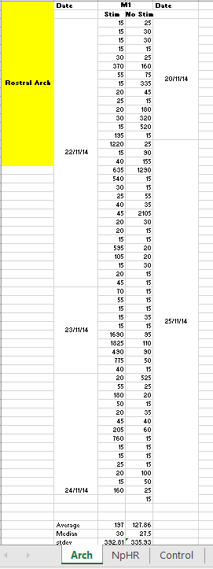
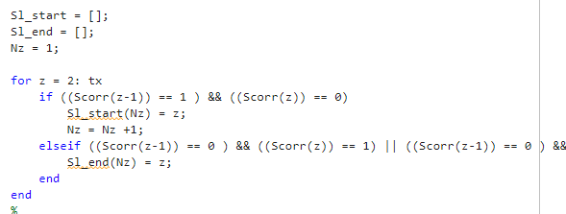
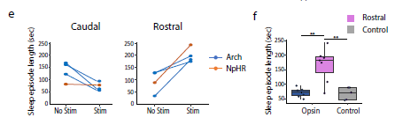

Figure 2_ef
A_Barchanging2.m
AA_Barscorr3_ext30
Processed data_Fig2ef
AA_Scorr_A (1st section)

Slide 19
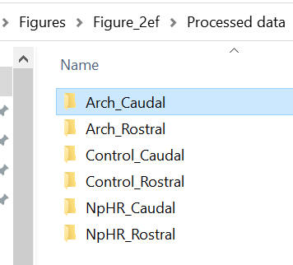
Figure 2_ef
Firstly, I calculated P_time (sleep episode length) for each animal and then combined in groups (Caudal Arch, Rostral Arch ext. All data used for calculation is mentioned in Processed data_Fig2ef .xls
spreadsheet. Processed data for calculation can be found in processed data folder.
Arch groups contain Control (No_Stim) and Stimulation data.
If you need processed data for each mouse and date, you can find it on folder :
Processed_Data> Xbeh>Arch(or other)>Caudal (or Rostral)>Mouse_name>Rem>Sum>P_time

Slide 20
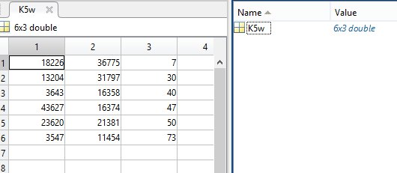
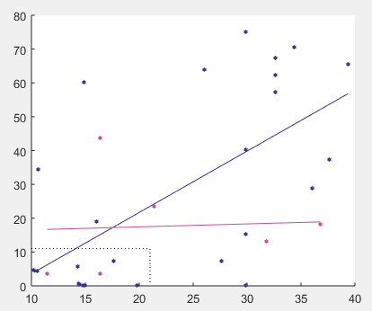
Figure 3
Input: DD2/Y2 or board_adc_data/amplifier_data
Action: Collects time periods before going to sleep and the latency (time between stimulation and wake up)
Codes used: AA_Barscorr3 and AA_Barscorr3_ext.m . Once again AA_Barscorr3 is modified version of the
A_Barchanging2.m code and was used to collected some traces of interest (like 20 second of wake before stimulation
and went to sleep during 80 second after stimulation and ext). AA_Barscorr3_ext.m used (Scorr_sig3 matrix derived from
AA_Barscorr3) to collect time periods (latency and sleep period before stimulation) for figure construction - K5w.
K5w (see processed data) contained 3 columns containing info for: latency, time slept before stimulation,
order of stimulation (see example figure below)
Latency
Latency
Slept
Before
stim
Order
Of Stim
Slept Before stim

Slide 21
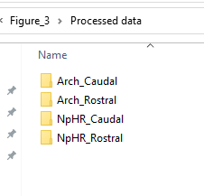
Figure 3
Code: AA_ScatterX was used to construct figures from processed data (K5w)
Processed data was grouped in Codes_Processed data folder
If you wish to see data for each mouse, you can find it on folder I gave you in summer:
Processed data>Z_Beh>Arch (or other group)>Caudal (rostral) > Mouse_name>Sum>Stim(control)>N>an>K5w

Slide 22
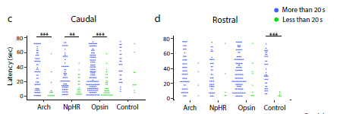
Figure 4cd
Input: DD2/Y2 or board_adc_data/amplifier_data
Action: Collects the latency (time period between the light stimulation start and wake up) See figure 4a
Codes used: AA_Barscorr2. Once again AA_Barscorr2 was modified from A_Barchanging2.m code and was used to
collect traces where animal woke up after stimulation. So, AA_Barscorr2 also provides us with following variables used
for analysis:
K30 – latency (seconds), time period between stimulation and wake up if animal slept at least 10 seconds before stimulation
K30f – same latency, only animal slept at least 20 seconds before stimulation
Kp30f – if you see Kp, that means that animal did not wake up during stimulation (80 seconds after stimulation)
, but we still counted number of non wake traces to calculate the ratio for figure 4g.

Slide 23
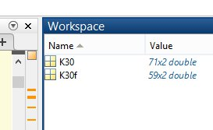
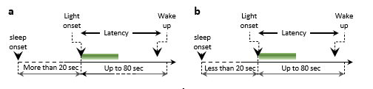
Figure 4cd
K30 – latency (seconds), time period between stimulation and wake up if animal slept at least 10 seconds before stimulation
K30f – same latency, only animal slept at least 20 seconds before stimulation
K30 and K30f had mostly overlapping numbers. If animals slept more than 20 seconds before stimulation, than it would
sleep 10 seconds before stimulation too. For example below, you could see that K30 contain 71 latencies as K30f (20 seconds)
contain only 59 latencies. If we minus 59 from 71 (using ismember function in matlab), we can find 12 latencies, produced,
when animal slept less than 20 seconds, but more 10 seconds. So, K30f gives us latencies produced if animal slept More than
20 seconds, whereas K30-K30f provides us with latencies, where animal slept less than 20 seconds.
K30f
K30-K30f

Slide 24
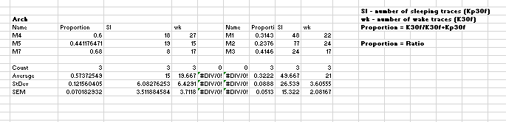
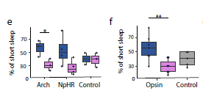
Figure 4ef
For figure 4g and 4h we use the same data
Kp30f – number of traces when animal did not wake up during stimulation (80 seconds after stimulation)
K30f – number of traces when animal woke up during stimulation ( we count latencies)
% of short sleep episodes = K30f/K30f+kp30f. Caudal animals which were stimulated even after 20 seconds
of sleep still showed fragmented sleep.
If you wish to see data for each mouse, you can find it on folder I gave you in summer:
Processed_data_XBeh>Arch (or other group)>Caudal (rostral) > Mouse_name>Sum>Stim(control)>
>30_60>an (an2)>K30

Slide 25
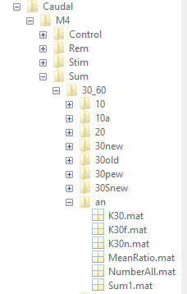
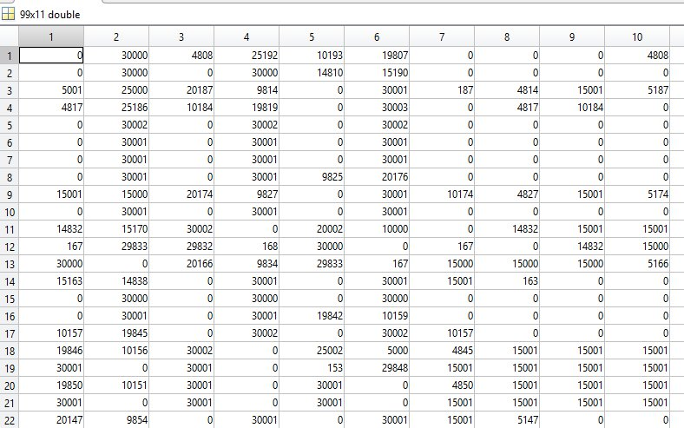
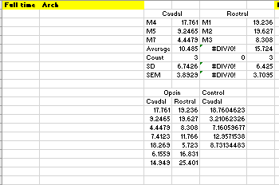
Figure 4g
Input: DD2/Y2 or board_adc_data/amplifier_data
Code: AA_Barscorr2 – was also used to collect sleep length during each light stimulation (30 seconds)
Firstly, I have calculated mean for each animal and than combined in a single figure (see below)
If you wish to see data for each mouse, you can find it on folder I gave you in summer:
Processed_Data>XBeh>Arch (or another group)>Caudal (rostral) > Mouse_name>Sum>Stim(control)>
>30_60> an > NumberAll (1st column)
Processed data_Fig3_Fig7.xls
Mean for M4

Slide 26
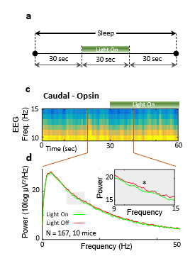
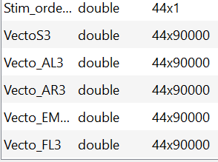
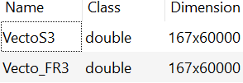
Figure 5
Input: DD2/Y2 or board_adc_data/amplifier_data
Action: Idea was to collect the traces from deep sleep (see figure 5a). In order to get included
animal had to sleep 30 seconds before stimulation and 30 seconds after (90 seconds all together).
Codes used: Main code for traces collections was A_Barchanging2.m. It scored and collected deep sleep traces with right stimulation (30_60). I collected traces for each animal (See Results_2xls)
Input: Xrow x 90000 (vectors for each channel (see below)
After collection, I got rid of noisy traces which were > 800 (microV)
Codes used: A_Barplotting30_60
After I combined all vectors from all animals manually.
Frontal right channel was used only for analysis. All processed data is in
Processed Data folder.
Light On/Off
EEG from Frontal right channel

Slide 27
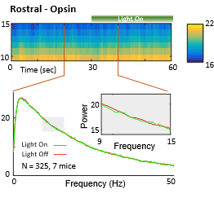
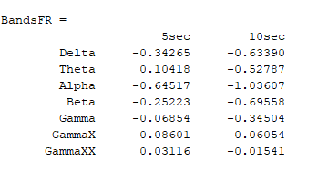
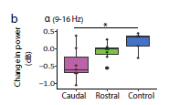
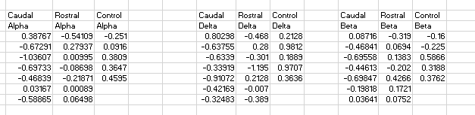
Explanation figure 5
Action: Change in power/spectrogram and spectrum and stats
Code: AA_Barscorr3 – sleep score and collection of the traces
Code: A_Bartrimm10_AL_AR – reducing traces to 10 seconds
Code: A_Spectro2_Picture / A_Spectro2m – creating figures
Code: A_Spectro_Ttest – stats for Paired T test
Action: Access pre-processed data (AA_Barscorr3):
Analysis>Batch>Animal>Stim30_60>Sum or Sumtrim load (collected traces)
Code: AA_adding_one_stats2 (1 section only): collection of the Db difference before and after stimulation 10 sec
BandsFR will be printed
Processed data_Fig3_Fig7.xls

Slide 28
Figure 5
Action: In order to get 20 seconds traces, which I used for analysis of 10 seconds before
And 10 seconds during stimulation, I used code: A_Bartrimm10.
Action: To create the figure of the summary spectrogram (60 seconds) and summary spectrum of
10 seconds before and 10 seconds after were used following codes: A_Spectro2_Picture and A_Spectro_Picture2
Code: A_Spectro_Ttest was used to for T stats
Lastly, for summary where I calculated change in power in Db (see 5b), I used code: AA_adding_one_stats2
It calculates power difference 10 seconds before stimulation and during for each trace and get average. You might
Need to trim the traces for 20 seconds before. I modified code manually sometimes
It for each animal and used for figure and stats
Processed data_Fig3_Fig7.xls

Slide 29
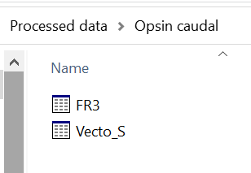
Figure 5
Traces of deep sleep for each animal can be found using following route:
Codes processed data>Figure5>Processed data>Virus(control)>Caudal(rostral)> Mice>>Sum
(might be 90 seconds vector or trimmed for 60 seconds)
Summated traces for caudal and rostral can be found in the processed data folder.
EEG data for Frontal right channel
Light On/Off channel

Slide 30
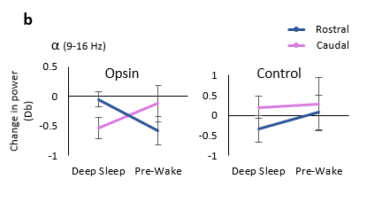
Figure 6b
Action: Once again for the figure 6b,
We need to compare Db difference caused by the light stimulation
Over 10 seconds in summary traces. Summary traces for Deep_sleep
Can be found in folder figure_5 > processed data. And Pre_wake sleep
Summary data can be found in figure_6 > processed data.
Code to use: AA_adding_one_stats2: collection of the Db difference
Pre_wake sleep - sleep which ceased 80 seconds after stimulation. These traces were collected
Using AA_Barscorr2 (modified A_Barchanging2.m)

Slide 31
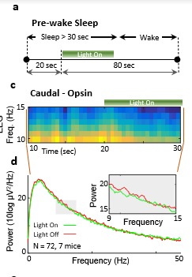
Figure 6cd
Pre_wake sleep - sleep which ceased 80 seconds after stimulation.
Input: DD2/Y2 or board_adc_data/amplifier_data
These traces were collected using AA_Barscorr2 (modified A_Barchanging2.m). Similar way (as deep sleep traces) they were filtered from noise using AA_Barplotting_beh2.
For trimming, plotting and stats were used same codes as for deep sleep:
A_Spectro2_Picture
A_Spectro_Picture2
A_Spectro_Ttest
Summary data can be found in figure_6 > processed data.
If you wish to see data for each mouse:
Processed data>XBeh>Arch (or another group)>Caudal (rostral) > Mouse_name>Sum or Stim(control)>30_60> 30Snew>30f

Slide 32
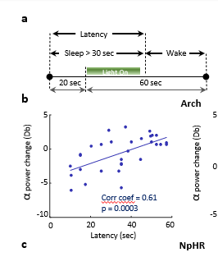
Figure 7
Input: DD2/Y2 or board_adc_data/amplifier_data
For construction of the correlation, we used :
Traces collected using code AA_Barscorr2 were used to collect Db difference
10 second before and 10 seconds after stimulation. Code: AA_adding_one_stats2
2) Latencies collected by AA_Barscorr2 (30f – latencies)
Latencies (30f) and raw traces of FR EEG can be found in processed data folded (figure 7)
Code: AA_Scatter3 was used for the construction of the correlation figure
If you wish to see data for each mouse:
Processed data>XBeh>Arch (or another group)>Caudal (rostral) > Mouse_name>Sum or Stim(control)>30_60> 30pnew>K30f and FR

