Slide 1

GLAMs Working With Wikidata
Vladimir Alexiev, Ontotext
Content Provider Workshop, Athens, 18 May 2015

Slide 2
Content
  Purpose
  Difficulty adding Articles to Wikipedia
  GLAM-Wiki Collaboration
  Adding an Alias to Wikipedia
  Adding Multilingual Aliases to Wikidata
  Uploading Photos to Commons
  Adding an Item to Wikidata
  Bulk Commons Upload
  Bulk Wikidata Item Creation
  Coreferencing Thesauri

Slide 3
Purpose
Europeana Food and Drink (EFD) will classify cultural objects using Wikipedia articles/categories (see D2.2 presentation or report)
Why: because no more comprehensive dataset exists for such a wide topic as Food and Drink (FD)
  And with such wide multilingual coverage!
If local content is not covered by a local Wikipedia, it won't be linked into the classification
  Which means it won't be globally searchable or discoverable
  Providers using a local thesaurus are a bit better off, see Thesaurus Alignment
Notes:
Purpose of the presentation: show GLAMs that working with Wikidata and Commons is quick and easy.
Incentivize GLAMs to add their important topics to Wikidata.
All the red links are live

Slide 4
Difficulty Adding Articles to Wikipedia
Question to all EFD content providers: would you create Wikipedia articles, or at least Wikidata items, for important traditions/ foods/ etc that are still missing in your national Wikipedia? How feasible is this? Conversely: how important/valuable it is to be able to recognize such terms in the objects that you'll provide?
  We will not deliver articles to Wikipedia, as unfortunately we don't have time for such additional activities.
  We use in-house classification systems that we have evolved over the years. These are not currently mapped to other classification systems. We have no plans (or resources) to update or create Wikipedia entries
Thanks for your honesty! ☺

Slide 5
Adding Articles is Time Consuming
It takes a lot of effort to create Wikipedia articles, and also:
  One has to learn to work with the Wikipedia community
  Rules of notability, neutral point of view, avoiding conflict of interest must be respected
  Articles must be based on published work, not original research
  Even large museums like Rijksmuseum that have dedicated resources for Wikipedia collaboration, find difficulties (such resource has been banned and her articles blocked)
But it takes a lot less time to create Wikidata items
Notes:
At GLAM-WIKI 2015, Lizzy Jongma of the Rijksmuseum shared stories how hard it is to add Wikipedia articles:
- "reference your sources" means you cannot write about original research nor on topics where your museum is the sole authority. Need to refer to published research
- "Neutral Point of View" means you can't write about your museum

Slide 6
GLAM-Wiki Collaboration
Collaboration between cultural heritage institutions (GLAMs) and Wikimedia/wikimedians (WIKI) is a long tradition
  GLAM-WIKI 2015 conference: presentations
  How to work successfully with Wikipedia: a guide for GLAM (Wikimedia UK 2014)
  Wikimedian in Residence: Programme Review 2014 (Wikimedia UK)
Notes:
Wikimedian in Residence is an initiative to help GLAMs work with the Wikipedia community through a dedicated facilitator / teacher

Slide 7
GLAM-Wiki Collaboration
Europeana Wikimedia Taskforce report:
  Recommendation 1: For every Europeana project, considering the possible benefits of a Wikimedia component should be default behavior
    Europeana Fashion built up shared Fashion info through a series of 10 editathons (Wikipedia editing sessions), each with 30 participants, each created 100s images, 15 new articles, many edited articles
  Recommendation 7: Make Wikidata a central element of Europeana's "portal to platform" strategy
  Recommendation 8: Europeana should continue to invest in technology that improves the interoperability between GLAMs and Wikimedia platforms
Notes:
Wikipedia and Wikidata collaboration will be more and more important to Europeana-related projects in the future

Slide 8
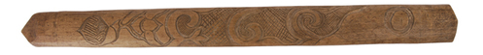

Adding an Alias to Wikipedia
Horniman has an object type "moustache lifters", e.g. 10.255.1 described as "Flat, light wooden libation stick (iku-pasuy), pointed at one end"
Wikipedia doesn't have this term, but finds it in the article enwiki:Ikupasuy "Ainu men occasionally used the ikupasuy as a mean to lift their moustaches, leading non Ainu observers of this habit to call them moustache lifters"
Notes:
Remember the red links are active and you can use them to explore.
Here we find such article, and only want to add an extra name (alt label or alias) for it.

Slide 9
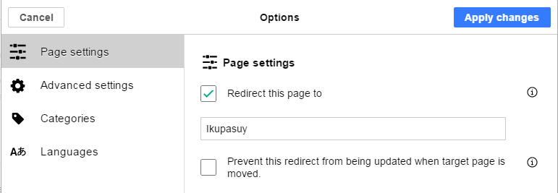
Adding an Alias to Wikipedia
Let's add a redirect (alias): Search for "Moustache lifter" (proper capitalization), click the red link
  Either enter #REDIRECT [[Ikupasuy]] in "Create Source"
  Or use Page Options in "Create"
  Easy!
Notes:
Wikipedia alias = Redirect page.
The Search turns up nothing, so Wikipedia allows you to add such a page.
For me it's faster to add the #REDIRECT code in the Create Source editor.
Or one could prefer to use the dedicated Options dialog in the Create visual editor

Slide 10
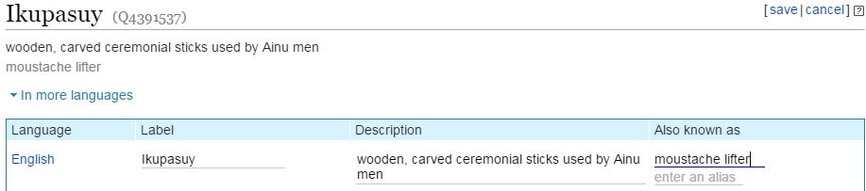
Adding an Alias to Wikidata
Click on Wikidata item in left nav
  Or find "Ikupasuy" (Q4391537) on Wikidata
  Click Edit, enter Also known as (maybe also Description), save
  Even easier!
Notes:
For basic tabular data, Wikidata is easier and faster to use than Wikipedia.
You can reach the Wikidata item either from the Wikipedia page, or by searching.
Adding a Description is always a good idea since it's indispensable when selecting an item through Auto-complete.

Slide 11
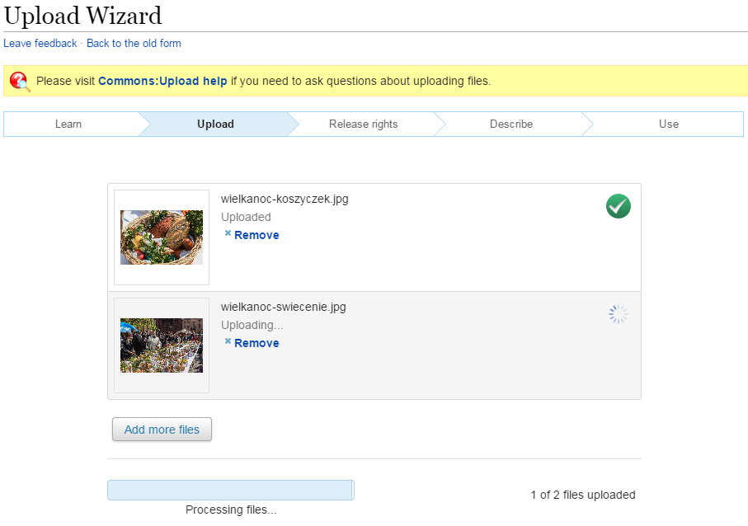
Uploading Photos to Commons
Maria Sliwinska posted 2 great photos of a colorful Polish Easter tradition "blessing of the baskets" ("swiecenie koszyczek"@pl)
Start the Wikimedia Commons Upload Wizard
  Upload both photos

Slide 12
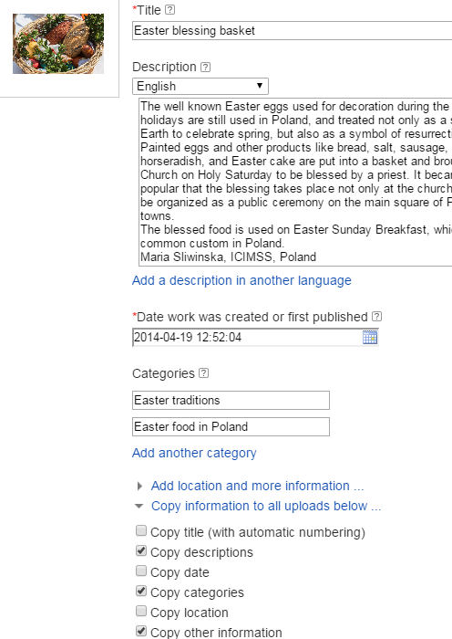
Uploading Photos to Commons
  State that I am the author (I hope Maria Sliwinska will forgive me)
  Use the default Creative Commons Attribution ShareAlike 4.0 license
  Enter a sensible title, description, categories (Easter traditions, Easter food in Poland)
  Checkboxes copy data from 1st to 2nd photo
Result:
  File:Easter_blessing_basket.jpg
  File:Blessing_of_the_baskets_Easter_tradition.jpg

Slide 13
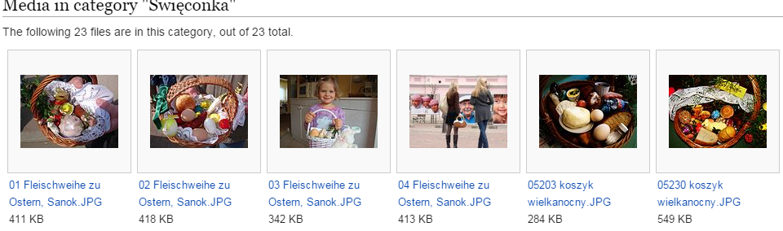
Adjusting Categories on Commons
Turns out that there are already more specific categories.
  Go to the bottom of the image pages
  Click down arrow (Subcategories), select more specific
Categories (+⁺): Święconka (−) (±) (↓) (↑) Blessing Easter Baskets (−) (±) (↓) (↑) (+)
  Commons Category:Święconka already has a number of images, but Maria's are definitely the nicest ones

Slide 14
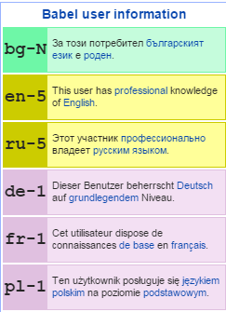
Adding Multilingual Aliases to Wikidata
I didn't know it but there are already Wikipedia articles: enwiki:Święconka, plwiki:Święconka, dewiki:Osterspeisensegnung_in_Polen
So let's just add multilingual aliases to Wikidata (English and Polish)
  Go to your user page and add babel, listing the languages you can work in. E.g. for me:
  {{#babel:bg|en-5|ru-5|de-1|fr-1|pl-1}}
  Go to Q877920 (or from Wikipedia)
  Enter EN "blessing of the baskets", PL "swiecenie koszyczek" (result is next)
Notes:
To enter multilingual info in Wikidata, you select the languages that you can work with at your user page.
List the languages using the {{#babel}} template.
It also can help other users of your language to discover you.

Slide 15
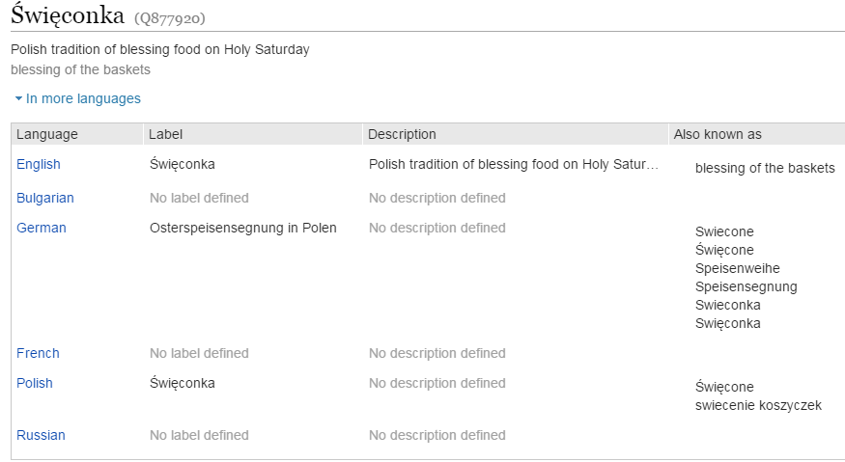
Wikidata Labels, Aliases

Slide 16
A Note on Wikimedia Logins
Getting a Wikipedia account is easy and free
  Thanks to single sign-on, that works across all Wikimedia sites and most additional tools
  You may have to give authorization to this and that tool to work on your behalf
  You are responsible for all your edits no matter what bots or bulk editing tools you use
Could even edit as anonymous user, but that's not recommended and some tools require a user

Slide 17
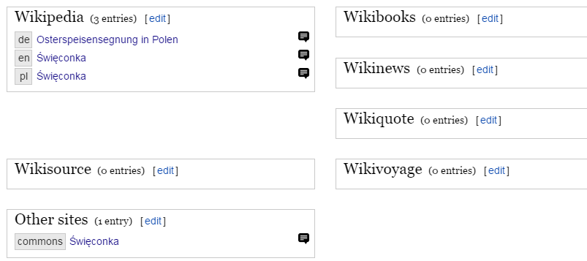
Wikidata→Wikimedia Site Links
  The inter-language links help to expand the EFD Categorization
  Critical for cross-language semantic enrichment and search

Slide 18
Wikipedia Categories
Look at the bottom of articles (plwiki & dewiki are translated):
  enwiki:Święconka: Easter traditions, Polish traditions
  plwiki:Święconka: Easter Traditions, Old Polish Traditions, German Cuisine (mistake?)
  dewiki:Osterspeisensegnung_in_Polen: Food and Beverages (Easter), Festivals and Customs (Poland), Roman Catholicism in Poland, Sacramental
When we merge the categories across languages, this gives us enough classification to:
  Discover this as a Food and drink topic
  Determine that it's about Easter
  Determine that it's a Polish tradition

Slide 19
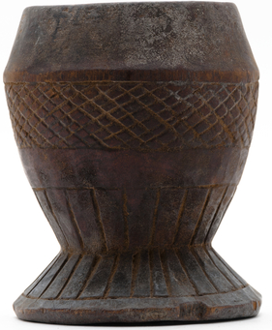
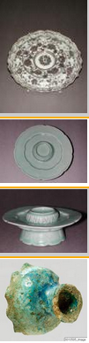
T'ala Cup
Horniman has another interesting object type "t'ala cups", used for drinking t'ala-beer: see object 19.4.66/90
Search Europeana for "t'ala cup" and you find object 19.4.66/90 (aggregated by CultureGrid UK)
  Proves the point that Europeana already has tons of FD objects
  Subjects: Health and Healing; Afar; t'ala cups (cups (narcotics & intoxicants: drinking)); wood
Google for "t'ala cup" and you find
  Horniman's
  An exhibit of "cups, standing" at Niall O'Leary library
So far so good!
Notes:
The first link is the object term from the Horniman thesaurus.
The second link is the (sole) object having that object type.
Then is a link to the object in Europeana (may be removed since Horniman wants to re-ingest it as part of the EFD project).

Slide 20
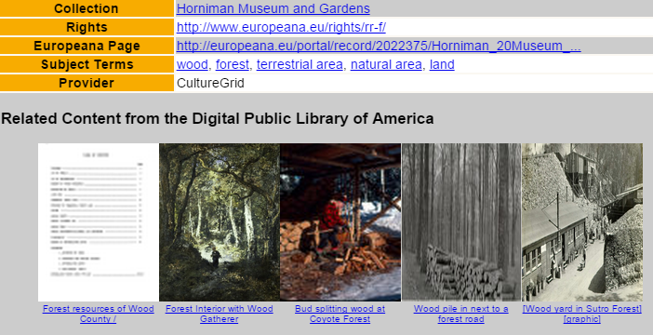
T'ala Cup in Europeana
Problems with 19.4.66/90 in Europeana:
  The image is missing
  Look at Auto-generated tags> What. Enrichment has added wood→forest, terrestrial area, natural area, land; and all their labels in tens of languages
  Came from parent concepts in GEMET (environmental thesaurus)
  No wonder Niall O'Leary shows forests and nature as "related content"
  This is how not to do enrichment

Slide 21
Adding an Item to Wikidata
Go to Wikidata and click "Create a new item"
  Enter title "t'ala cup" (lower-case since it's not a proper name; singular) and description "standing cup used to drink t'ala beer": Q19825902
  Statements> Add:
    topic's main category: "Category:Drinkware"
    Note: that’s not 100% the correct property, but there's no property "category", see Property proposal "category" wars
That's it! It ties up the new item (concept) to the Wikipedia categories and allows us to recognize it as related to FD
  You could add some optional statements too (see next)
  Even without this item, we could recognize "cup" (partial term)
Notes:
t'ala cup is not in Wikipedia nor Wikidata, so let's create it

Slide 22
Adding an Item to Wikidata (More Props)
Optional statements:
  subclass of: "cup" (drinking vessel)
  use: "beer"
  reference URL: http://www.horniman.ac.uk/collections/browse-our-collections/authority/term/identifier/term-505641
  Can't add image URL because "image" allows only Commons files
    If the Horniman decides to donate some images to Commons…
Not hard at all. But can we add items in bulk?
  First need to determine which items already exist (Thesaurus Alignment)
  Then use bulk tools as described below

Slide 23
Bulk Wikidata Item/Statement Addition
Tools
  Quick Statements: add items, labels, aliases, descriptions in bulk, from a text file
  Creator: add empty items for Wikipedia articles by category
  AutoList2: find items by WD Query and Wikipedia category, add missing statements
Notes:
How to add many items or statements at once?

Slide 24
Bulk Addition with Quick Statements
  No auto-completion, have to spell the P and Q numbers exactly. E.g.
  As it says: Please ensure you do not create duplicate items!
  Excel can be used profitably for lookup of P & Q numbers
  ONTO can help making such data exports
Command | Explanation
CREATE | Create new item
LAST Len "t'ala cup" | add Label in "en" to last created item
LAST Den "standing cup used to drink t'ala beer" | add Description in "en"
LAST P910 Q7440281 | topic's main category: Category:Drinkware
LAST P279 Q2100893 | subclass of: cup (drinking vessel)
LAST P366 Q44 | use: beer
LAST P854 "http://www.horniman.ac.uk/collections/browse-our-collections/authority/term/identifier/term-505641" | reference URL
Notes:
The Commands should be put in a text file, one per line, each part separated with tabs.
Can make many items with one text file.
Then paste the text file into the tool.

Slide 25
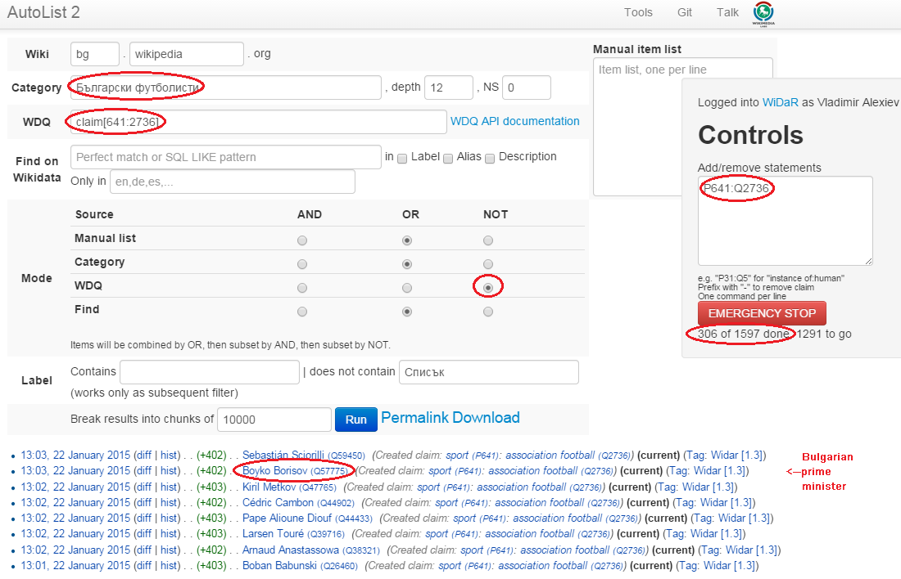
Bulk Addition with AutoList
If category is "Bulgarian footballer" and "occupation: footballer" is missing, then create it. (Even Bulgarian prime minister ☺)
Notes:
We start by specifying the wikipedia (bg.wikipedia.org) and Category "Bulgarian footballers".
We also specify a Wikidata Query (WDQ) claim[641:2736] ("occupation:footballer") in Mode NOT.
For those found, we add a statement P641:Q2736 ("occupation:footballer") using single-sign-on through the WIDaR tool.

Slide 26
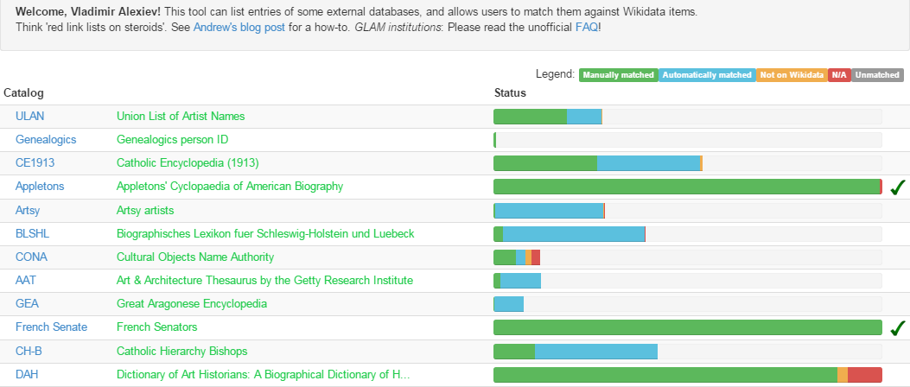
Thesaurus Alignment (Coreferencing)
How to ensure no duplicate items are created?
  Mix-n-Match. 54 thesauri/catalogs already loaded (including Getty AAT, TGN, ULAN, CONA; RKD-artists; BMT; etc)
  Decent auto-matching and excellent crowd-sourcing features

Slide 27
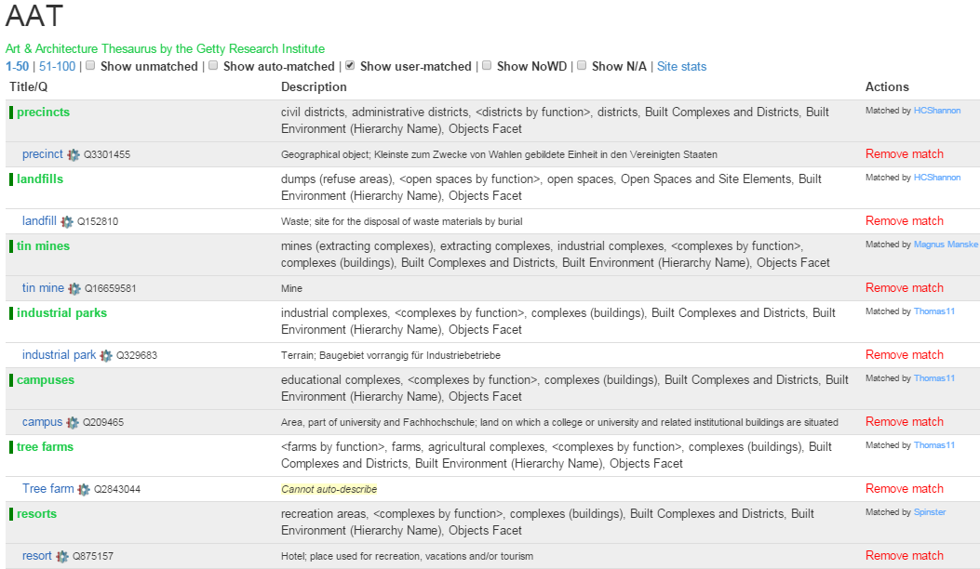
Coreferencing AAT to Wikidata
We'll do the same for Horniman but want to first do better auto-matching

Slide 28
Bulk Commons Upload with GWToolset
GLAMWikiToolset
  make batch uploads of GLAM content in Commons as easy as possible
  Commons materials can easily be integrated back into the collection of the original GLAM
  Easy tracking of reuse of content in pages, and view stats
  As of Jan 2015: 405k images uploaded by 59 people/orgs, 6253 images used in 1675 articles, pages viewed 4.8M times in Jan 2015 alone
Project
  Documentation, Wikimania 2012 slides, Wikimania 2014 flyer and pocket overview, GlamWiki2015 training
  Collaboration of Wikimedia NL, UK, FR, CH and Europeana

Slide 29
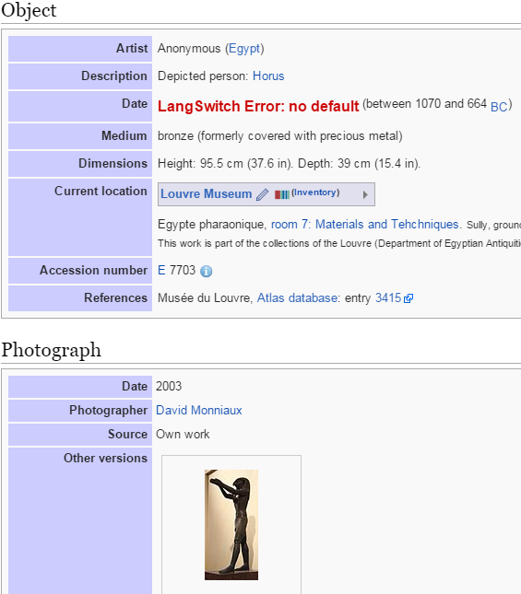
Metadata in Commons
Many Commons files from GLAMs have rich metadata
  Templates Art_Photo, Artwork, Book, Musical work, Map, Photograph, Specimen
  E.g. for Art_Photo:
    Artist, Author, Title, Object type, Description, Date, Medium, Dimensions, Current location, Accession number, Place of creation, Place of discovery, Object history, Exhibition history, Credit line, Inscriptions, Notes, References, Source, Permission, Other versions, Photographer

Slide 30
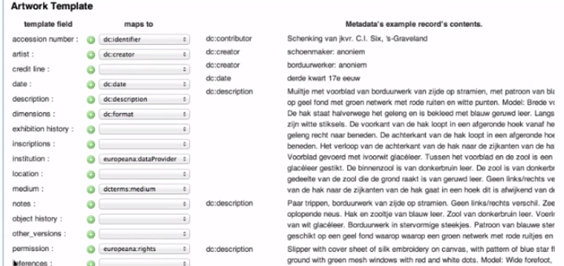
Mapping Metadata With GWToolset
Providing all this rich metadata by hand would be a lot of effort
  Most GLAMs already have it in collection management systems and can make XML exports (e.g. DCT, LIDO, EDM, Adlib)
  GWToolset includes metadata mapping functionality

Slide 31

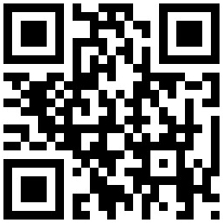

GLAMs Working With Wikidata
Vladimir Alexiev, Ontotext vladimir.alexiev@ontotext.com
Project co-funded by the European Union under the ICT Policy Support Programme

