Slide 1
University IT PM Education:
NBU and ESI/SEI Masters Programs
Vladimir Alexiev, PhD, PMP
Ontotext Lab, Sirma Group Holding
PMI BG Meeting, 11.11.2010

Slide 2
Outline
Sirma's Academic Tradition
MS SwEng programs at RU and VFU
MS IT PM program of NBU & BAS IMI
  Student Demographics, compare 2009 vs 2010
  Program Structure
  Base PM courses (PM 1 & 2, Workshop, PM3)
MS SEMP of ESI & SEI
Educational Needs of Industry
University IT PM Education
PMI BG Meeting, 11.11.2010

Slide 3
Sirma's Academic Tradition
Sirma Group: one of the largest private Bulgarian sw dev & IT consulting holdings
  18 years of history, 400 staff, 9 daughter companies, 5 Joint Ventures. Offices in 5 Bulgarian cities and 3 overseas. See www.sirma.bg (BG), www.sirma.com (EN)
Sirma has long academic traditions of collaboration with universities:
  Founder of BASSCOM Education group
  PM, OOP, C++, Agile courses at SU FMI
  Informatics courses at UNWE
  MS SwEng program at RU, VFU
  MS PM courses at NBU & BAS IMI
  SEMP of ESI & SEI
  Ontotext is BG's strongest participant in EU IST research (FP5, FP6, FP7)
University IT PM Education
PMI BG Meeting, 11.11.2010

Slide 4
MS SwEng programs at RU and VFU
Sirma Group sponsored two MS Software Engineering programs:
  Started in 2008, ongoing
  University of Ruse (through Sirma ITT Ruse)
  Varna Free University (through Sirma Solutions Varna)
  Most of the assistants and half of the lecturers are from Sirma
  Intensive internships and hiring of graduates
I led an IT PM course:
  Two threads throughout: theoretical PM (ala PMI) and IT PM (processes & practical aspects ala Steve McConnell)
  Based on "Principles of Software PM" (Q7503) by Columbia University
  Include a lot of extra material
  (Detailed description further on)
University IT PM Education
PMI BG Meeting, 11.11.2010

Slide 5
MS IT PM PROGRAM OF NBU & BAS IMI
University IT PM Education
PMI BG Meeting, 11.11.2010

Slide 6
MS IT PM program of NBU & BAS IMI
Started in 2009, first such program in BG
Partners:
  New Bulgarian University (NBU)
  Bulgarian Academy of Sciences, Institute of Mathematics and Informatics (BAS IMI)
  Lecturers from NBU, BAS IMI, SU FMI, Boston U (USA), companies
  Sirma prepared and runs the basic PM courses
Details in paper:
  "An Approach to Teaching IT Project Management in a Masters Program", 6th Annual International Conference on Education in Computer Science, 26-29 June 2010, (Fulda & Munich, Germany)
University IT PM Education
PMI BG Meeting, 11.11.2010

Slide 7
Student Demographics
2009/10: 29 students, 34% female (unusually high), age 25
2010/11: 45 students, 33% female, age 28 (a couple of industry veterans!)
Most work in IT companies, which is usual for both BS and MS students in BG. Some of the larger companies :
  2009: HP, SAP, Computer Sciences Corporation (CSC), Axway/Tumbleweed, Cisco/PostPath, Kozloduy NPP, InterConsult , SM Consulta, Bianor, DAIS, pharmaceutical, Proxiad, CompletIT, Bright Consulting, SEP Bulgaria
  2010: HP, Adecco, SAP, CSC, Software AG, MTel, Vivacom, Bulgartel (Bulgargaz), Coca Cola, Kaufland, BNP Paribas, UNIQA, Experian, Nove Holding, Gamma Consult, Stanga Solutions, Global Consulting, Musala, SoftConsultGroup, pharmaceutical, PlayTec , Sirma Mobile
Strong classes: include IT consultants, project managers, IT company owners, managers/supervisors, QA, devs, …
  Students are ambitious and aim at TL and PM positions
  A few joined PMI with the view of obtaining PMP certification
University IT PM Education
PMI BG Meeting, 11.11.2010

Slide 8
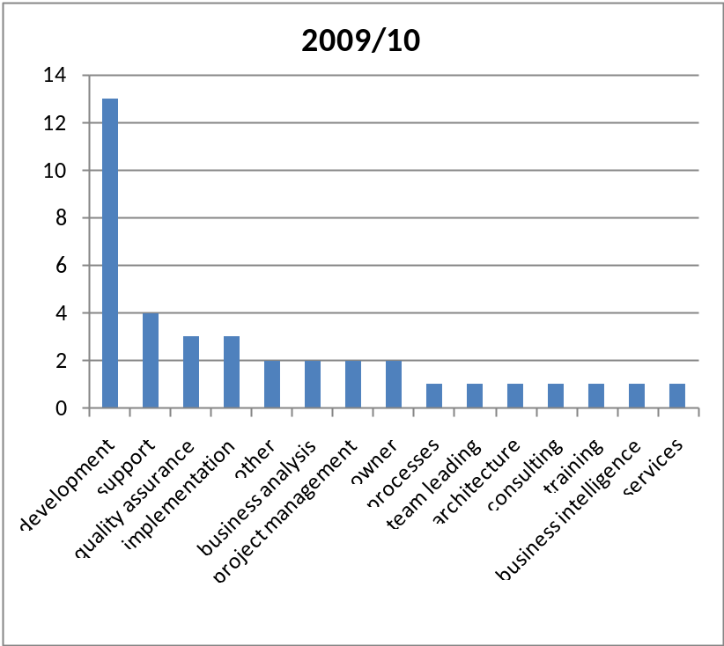
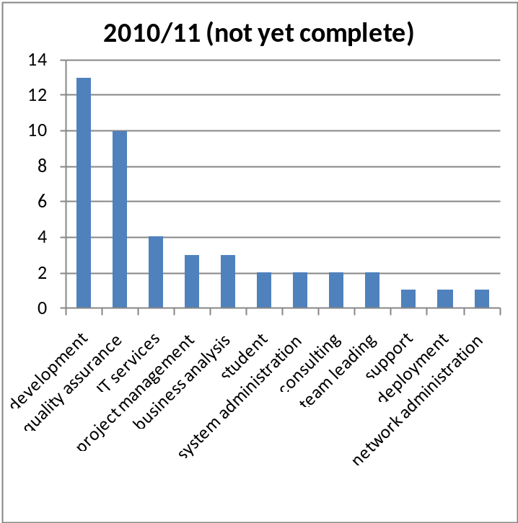
Professional Areas
software development, quality assurance, project management, deployment (incl. ERP), architecture, business analysis, business intelligence, IT training, end-user support, software process (including SCRUM), IT services, consulting, system or network administration
  (some gave >1 area)
University IT PM Education
PMI BG Meeting, 11.11.2010

Slide 9
Program Structure
4 terms (half year each)
  term1: 15 credits from courses
  term2: 15 credits from projects
  term3: 15 credits from practice
  term4: 15 credits from MS thesis
Standard course: 30 hours, provides 3 credits
The program currently comprises 21 courses
University IT PM Education
PMI BG Meeting, 11.11.2010

Slide 10
Program Courses
IT PM 1,2,3 (90h)
Workshop on IT PM, Course work
Law regulations of projects
Information Society Law
Management of Financial Resources
Leadership and Team
Analysis and Design of Information Systems
Managing Human Resources
Systems for Managing Business
Software Testing and Quality Assurance
Data Mining
Architectures of Software Systems
Data Warehouse
Modern Technologies for Managing IT Production
Software Estimation
Estimating Risk in IT Projects
Marketing Management
Statistical Methods
Writing European Projects
Practice in companies
University IT PM Education
PMI BG Meeting, 11.11.2010

Slide 11
Basic PM Courses
Designed to solve these problems:
  How to introduce a large set of new topics efficiently?
  How to impress the topics upon the students through practice activities?
Current base PM courses:
  IT PM 1 and 2 (Vladimir Alexiev, Ontotext)
  Practice and Course work (Nikolai Dushkov, Sirma Solutions)
  IT PM 3 (Vijay Kanabar, Boston U)
University IT PM Education
PMI BG Meeting, 11.11.2010

Slide 12
IT PM 1 & 2 Content
Intro to PM: PM Basics, PM amongst other SwEng disciplines. What is a project. Software vs project processes. Work and responsibility of the PM. People, process, technology, product. 36 classic mistakes in PM. PM process according to PMI and Project Management Body of Knowledge (PMBOK). 5 project areas, 43 processes, 10 knowledge areas. Software development phases. Project stakeholder analysis. Organizational structures. Project charter, Statement of Work (SOW)
Planning: Software Development Life Cycle (SDLC) models. Selecting appropriate SDLC. Project plans. Work Breakdown Structure (WBS)
Estimation and budgeting: Effort estimation, estimation methods, Function Points/ COCOMO/ parametric/ Use-case based. Budgeting, project portfolio selection. Return on investment models. NPV, ROI
Time management: Network planning. Critical path method. Gantt chart . Working with uncertainty: PERT, Monte Carlo analysis. Critical chain method, theory of constraints.
Microsoft Project: Intro, Tips & tricks, Hands-on lab using Microsoft Project
Risk & change management. Estimate uncertainty as a basic risk in software PM
University IT PM Education
PMI BG Meeting, 11.11.2010

Slide 13
IT PM 1 & 2 Content
Development management: Team models, working with people, managing the team, conflicts and motivation. SwEng disciplines. Requirements management as basic success factor. Configuration management. Software metrics, what are they useful for, how not to misuse. Programming languages and frameworks and their effect on productivity
Project control: Reporting progress and status. Partial milestones considered harmful. Project metrics. Earned value analysis/management. Communication management
Software quality management: test scenarios, blackbox/whitebox testing, unit and integration testing, acceptance testing and scenarios, test automation
Project closure, success factors. Project Recovery. Project documentation. Deployment and transition to production. Cutover/Migration. Project closure, Post Project Review. Defining and measuring success. Company politics, support from higher management. Expectation management
University IT PM Education
PMI BG Meeting, 11.11.2010

Slide 14
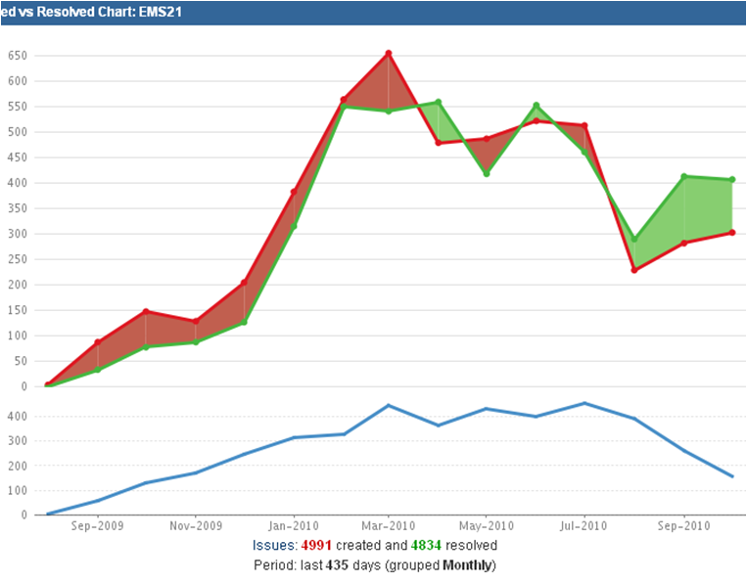
IT PM 1 & 2 Organization
Uses Moodle e-Learning system
Guest lecturers (2010):
  SCRUM and Agile planning: planning/task board,
  velocity, burndown
    Iliana Angelova, Sirma ITT process manager
    Deployed SCRUM in 45 person/year project (charts →)
  Continuous Integration, Hudson, Sonar, unit testing
    Deyan Atanasov, consultant
  Process Improvement, CMMI
    Ivo Georgiev, ESI Program Manager
Exam: completely electronic
  2 theoretical tasks involving calculations (EV and Network Diagram)
  50 multiple-choice questions (based on PMP material)
  Creating a project schedule with Microsoft Project
  Extracting descriptive and statistical information from the schedule
University IT PM Education
PMI BG Meeting, 11.11.2010

Slide 15
IT PM Course Work
Teams of 4 people each, allocated in a balanced way
Creation of complete project documentation based on RUP:
  Project charter
  Requirements specification (partial): functional and non-functional
  UML models, architecture (almost not scored, used as background only)
  Project plan
  Microsoft Project schedule, charts and reports from the schedule
  Quality plan
  Test plan
  Risk management plan
Projects: simplified real-world experience of Sirma Group
University IT PM Education
PMI BG Meeting, 11.11.2010

Slide 16
MS SEMP OF ESI & SEI
University IT PM Education
PMI BG Meeting, 11.11.2010

Slide 17
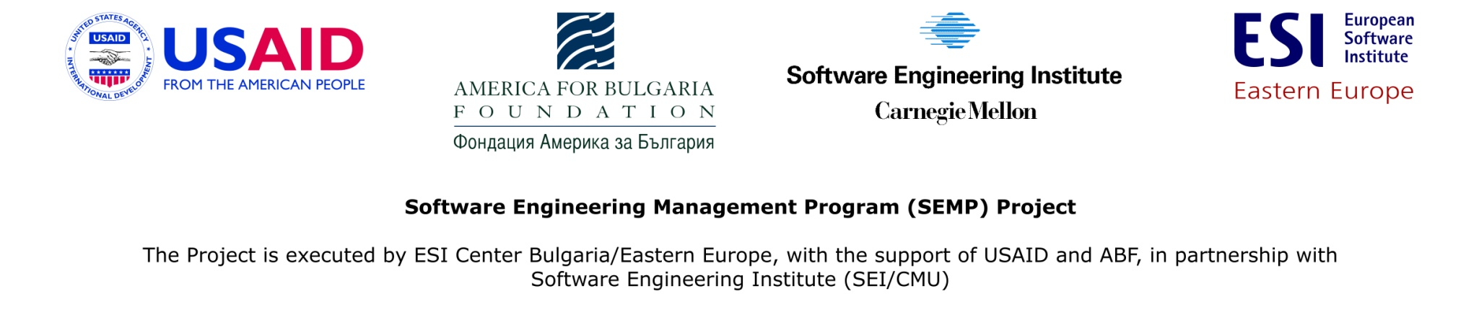
MS SEMP of ESI & SEI
Create MS Software Engineering Management Program for several BG universities:
  Sofia University
  Technical University of Sofia
  American University in Bulgaria
  New Bulgarian University
  University of Ruse
  Varna Free University
Emphasis on CMMI, personal/team software process, PM, BA, security, etc
Current phase: program formation, Teach the Teacher courses
I am one of NBU's lecturers, facilitated RU & VFU entry
University IT PM Education
PMI BG Meeting, 11.11.2010

Slide 18
SEMP PM Course Conception
Ideas:
  Initially 30h lectures plus 30h self-work
  Cover PM skills on personal level, but also how to document and use PM practices on organizational level
  Lots of practice, MS PM students could do actual PM of undergrad development projects
  Intermediate evaluations to verify students are learning the key concepts
Tentative timeline:
  30 Nov : create course objectives, framework, structure
  15 Dec: Present to SEMP, see who has interest & qualifications to work on the course (1 person per university), decide course structure and working group
  Jan-Apr: content creation
  mid-Feb: present short version of the course to SEMP lecturers (2d)
To be continued…
University IT PM Education
PMI BG Meeting, 11.11.2010

Slide 19
Educational Needs of Industry
PM & SE Management is highly practical and BG universities don't have such programs
Biggest higher education problems:
  obsolete programs, don't answer the needs of industry
  hard to retain good university lecturers
  sustainability of programs, need to be entrenched at universities
A comprehensive and focused program should be built by consensus
  Following CMU SEMP, but with BG additions/deletions (e.g. BA?, Reqs?, Arch?, QA?)
  Crucial: practical exercises, building competence (not just knowledge)
  Collaboration with professional associations (PMI BG, IPMA BG, IIBA BG, BASQ…)
  Collaboration with training providers
Real contribution to BG Knowledge Economy and competitiveness
Contacts: vladimir@sirma.bg, +359(888)568132, skype://valexiev1
University IT PM Education
PMI BG Meeting, 11.11.2010

