Slide 1
Computer Architecture and Operating Systems Lecture 3: Computer Architecture
Andrei Tatarnikov
atatarnikov@hse.ru
@andrewt0301

Slide 2
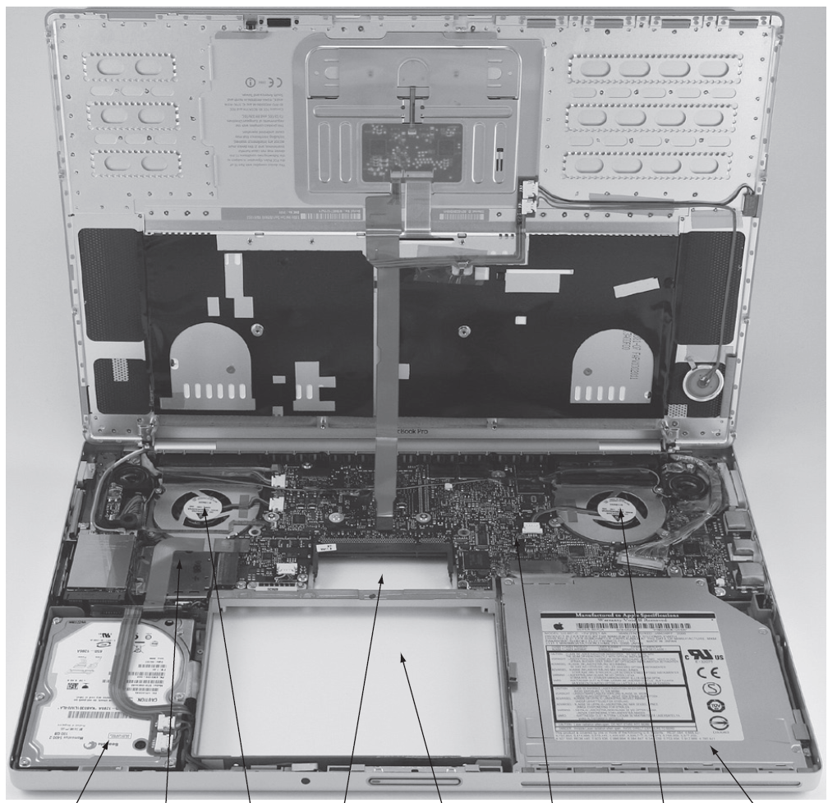
Computer Under Cover
Monitor
Hard drive
CPU (Processor)
Fan with cover
Spot for memory DIMMs
Spot for battery
Motherboard
Fan with cover
DVD drive
Keyboard
1 2 3 4 5 6 7 8 9 10

Slide 3
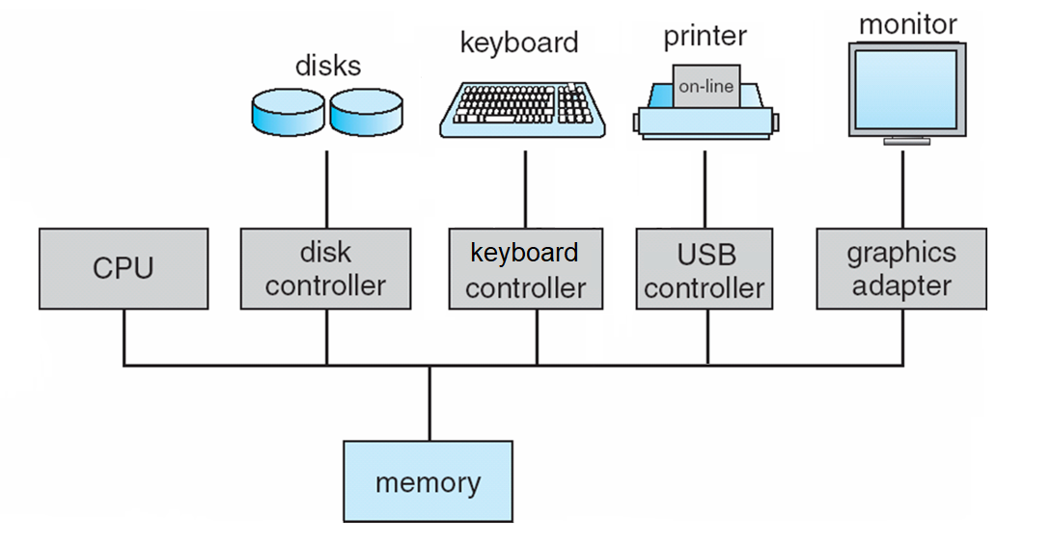
Computer Organization
One or more CPUs and device controllers connected through a bus providing access to shared memory

Slide 4
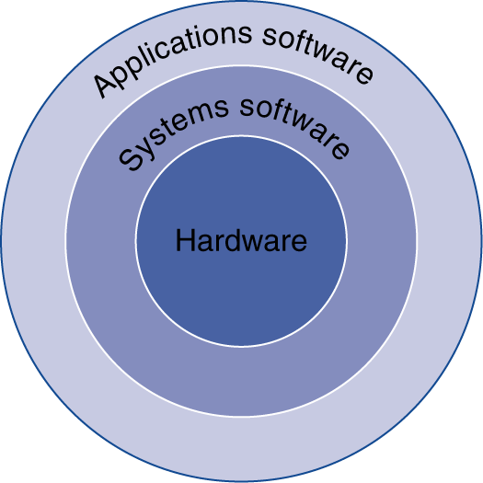
Program Under Hood
Application software
Written in high-level language
System software
Compiler: translates high-level language code to machine code
Operating System: service code
Handling input/output
Managing memory and storage
Scheduling tasks & sharing resources
Hardware
CPU, memory, I/O controllers

Slide 5
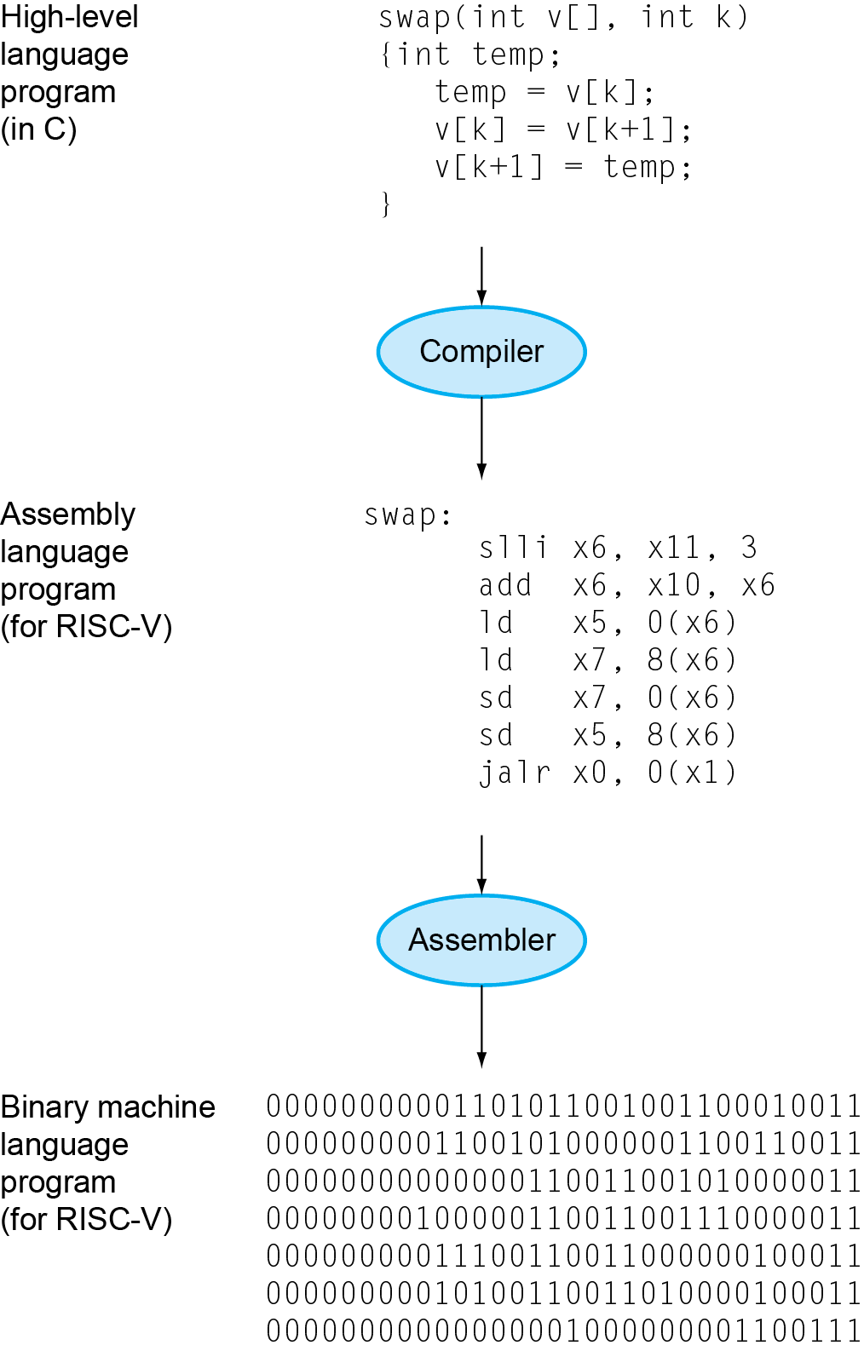
Levels of Program Code
High-level language
Level of abstraction closer to problem domain
Provides productivity and portability
Assembly language
Textual representation of instructions
Hardware representation
Binary digits (bits)
Encoded instructions and data

Slide 6
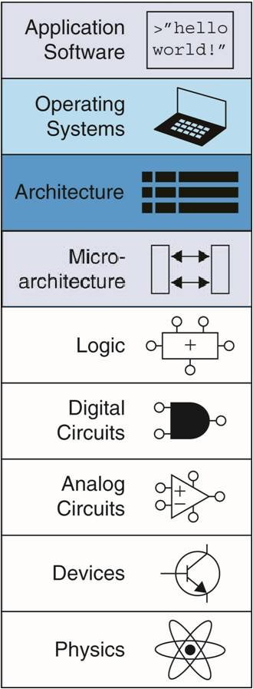
Abstractions
Abstraction helps us deal with complexity
Hide lower-level detail
Instruction set architecture (ISA)
The hardware/software interface
Application binary interface (ABI)
The ISA plus system software interface
Implementation (microarchitecture)
The details underlying the interface
Focus
of this course

Slide 7
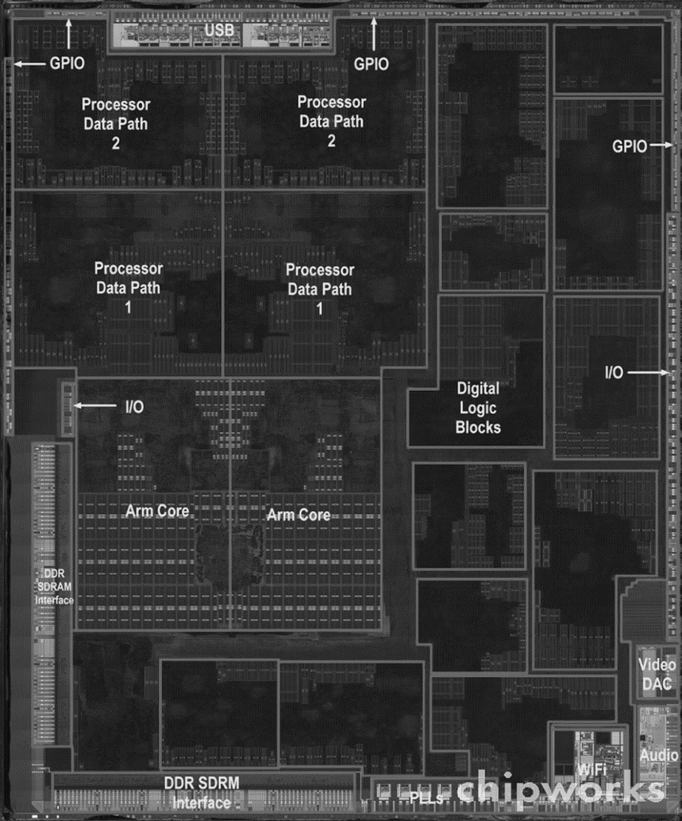
Inside the Processor (CPU)
Central Processing Unit (CPU) is the heart of any computer system.
Main components:
Register file: small fast memory for immediate access to data
Datapath: performs operations on data
Control unit: sequences datapath, memory, etc.

Slide 8
CPU Clocking
Clock period
Clock (cycles)
Data transfer and computation
Update state
Operation of digital hardware governed by a constant-rate clock
Clock period: duration of a clock cycle
e.g., 250 ps = 0.25 ns = 250×10^{–12} s
Clock frequency (rate): cycles per second
e.g., 4.0 GHz = 4000 MHz = 4.0×10⁹ Hz

Slide 9
CPU Time
Performance depends on
Algorithm: affects IC, possibly CPI
Programming language: affects IC, CPI
Compiler: affects IC, CPI
Instruction set architecture: affects IC, CPI, T_{c}

Slide 10
Instruction Set Architecture (ISA)
Instruction set architecture (ISA) is the interface between the hardware and the lowest-level software. This is one of the most important abstractions.
ISA Classification
Complex instruction set computer (CISC)
x86/x64 (Intel and AMD)
Reduced instruction set computer (RISC)
ARM, PowerPC, MIPS, RISC-V
Very long instruction word (VLIW)
Itanium, Elbrus

Slide 11
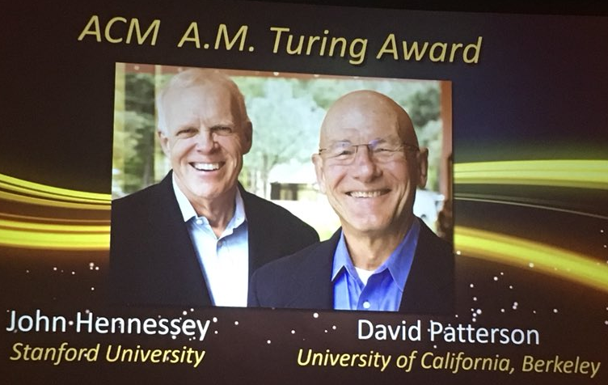
Reduced Instruction Set Computing (RISC)
Reduced Instruction Set Computing (RISC) concept was proposed by teams of researchers at Stanford University (John Hennessy) and University of California Berkeley (David Paterson) in early 1980s as an alternative of Complex Instruction Set Computing (CISC) dominating at that time.
RISC ISAs dominate – most mobile devices use ARM (RISC)
Modern CISC ISAs (x86/x64) are RISC-like underneath
2017 Turing Award to Patterson and Hennessy

Slide 12
RISC Principles
All instructions are executed by hardware
Maximize the rate at which instructions are issued
Instructions should be easy to decode
Only loads and stores should reference memory
Provide plenty of registers

Slide 13


RISC-V ISA
Simple ISA by UC Berkeley (2010)
Open and Free
Wide-Purpose Configurable ISA (from IoT to mainframes)
Maintained by RISC-V Foundation (moved to Switzerland)
Supported by many IT Companies and Universities
Industry
Innovation
Education
Research

Slide 14

RISC-V Community
Wide Support of IT Companies (except Intel and ARM) and Universities
and many others…

Slide 15
How CPU Works
Register File
Main Memory
x0
x1
x2
x3
…
x31
000000…000
0
4
8
12
16
20
Stores program and data
32-bit words
32 bit words
Machine language directly
reflects this structure
ALU
Arithmetic
Logic Unit

Slide 16
Instruction Execution
Fetch next instruction from memory into instruction register
Change program counter to point to next instruction
Determine type of instruction just fetched
If instructions uses word in memory, determine where Fetch word, if needed, into CPU register
Execute the instruction
Go to step 1 to begin executing following instruction

Slide 17
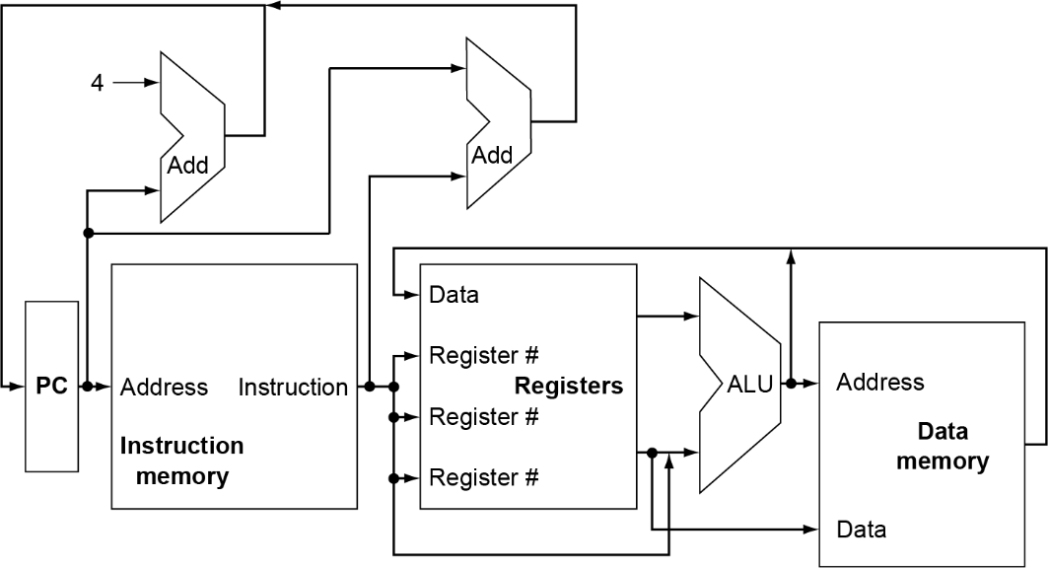
RISC-V CPU Scheme

Slide 18
RISC-V General-Purpose Registers
Register | Name | Use | Saver
x0 | zero | constant 0 | n/a
x1 | ra | return addr | caller
x2 | sp | stack ptr | callee
x3 | gp | gbl ptr
x4 | tp | thread ptr
x5-x7 | t0-t2 | temporaries | caller
x8 | s0/fp | saved/ frame ptr | callee
x9 | s1 | saved | callee
x10-x17 | a0-a7 | arguments | caller
x18-x27 | s2-s11 | saved | callee
x28-x31 | t3-t6 | temporaries | caller
32 Registers
32 (or 64) Bits Wide

Slide 19
RISC-V Instructions
Fixed-size 32 bit instructions
Always three operands: d -> op(s, t)
Instruction types
Computational instructions
Load-store instructions
Control-transfer instructions
System instructions
All operations done with registers

Slide 20
Assembly Programming
High Level Language vs Assembly Language
Primitive arithmetic and logical operations
Complex data types and data structures
Complex control structures – conditional statements, loops and procedures
Not suitable for direct implementation in hardware
Primitive arithmetic and logical operations
Primitive data structures – bits and integers
Control transfer instructions
Designed to be directly implementable in hardware
tedious programming!

Slide 21
Computational Instructions
Arithmetic, comparison, logical, and shift operations.
Register-Register Instructions:
2 source operand registers
1 destination register
Format: op dest, src1, src2
Arithmetic | Comparisons | Logical | Shifts
add, sub | slt, sltu | and, or, xor | sll, srl, sra
add x3, x1, x2
slt x3, x1, x2
and x3, x1, x2
sll x3, x1, x2
x3 <- x1 + x2
if x1 < x2 then x3 = 1 else x3 = 0
x3 <- x1 & x2
x3 <- x1 << x2

Slide 22
Register-Immediate Instructions
One operand comes from a register and the other is a small constant that is encoded into the instruction.
Format: op dest, src1, src2
Format | Arithmetic | Comparisons | Logical | Shifts
Register-Register | add, sub | slt, sltu | and, or, xor | sll, srl, sra
Register-Immediate | addi | slti, sltiu | andi, ori, xori | slli, srli, srai
addi x3, x1, 3
andi x3, x1, 3
slli x3, x1, 3
addi x3, x1, -3
x3 <- x1 + 3
x3 <- x1 & 3
x3 <- x1 << 3
x3 <- x1 - 3
No subi, instead use negative constant.

Slide 23
Compound Computations
Execute a = ((b+3) >> c) - 1;
Break up complex expression into basic computations.
Our instructions can only specify two source operands and one destination operand (also known as three address instruction).
Assume a, b, c are in registers x1, x2, and x3 respectively. Use x4 for t0, and x5 for t1.
addi x4, x2, 3
srl x5, x4, x3
addi x1, x5, -1
t0 = b + 3;
t1 = t0 >> c;
a = t1 - 1;

Slide 24
Control Flow Instructions
Need Conditional branch instructions:
Format: comp src1, src2, label
First performs comparison to determine if branch is taken or not: src1 comp src2
If comparison returns True, then branch is taken, else continue executing program in order.
bge x1, x2, else
addi x3, x1, 1
beq x0, x0, end
else:
addi x3, x2, 2
end:
if (a < b): c = a + 1
else: c = b + 2
assume
x1=a; x2=b; x3=c;

Slide 25
Unconditional Control Instructions: Jumps
jal: Unconditional jump and link
Example: jal x3, label
Jump target specified as label
label is encoded as an offset from current instruction
Link (to be discussed later): is stored in x3
jalr: Unconditional jump via register and link
Example: jalr x3, 4(x1)
Jump target specified as register value plus constant offset
Example: Jump target = x1 + 4
Can jump to any 32 bit address – supports long jumps

Slide 26
Constants and Instruction Encoding Limits
Instructions are encoded as 32 bits
Need to specify operation (10 bits)
Need to specify 2 source registers (10 bits) or 1 source register (5 bits) plus a small constant
Need to specify 1 destination register (5 bits)
The constant in register-immediate instructions has to be smaller than 12 bits; bigger constants have to be stored in the memory or a register and then used explicitly
The constant in a jal instruction is 20 bits wide (7 bits for operation, and 5 bits for register)

Slide 27
Computations on Values in Memory
a = b + c
x1 <- load(Mem[b])
x2 <- load(Mem[c])
x3 <- x1 + x2
store(Mem[a]) <- x3
x1 <- load(0x4)
x2 <- load(0x8)
x3 <- x1 + x2
store(0x10) <- x3
Main Memory
0x0
0x4
0x8
0xC
0x10
0x14
b
c
a
32 bit words

Slide 28
Load and Store Instructions
Address is specified as a <base address, offset> pair:
Base address is always stored in a register
Offset is specified as a small constant
Format: lw dest, offset(base) sw src, offset(base)
lw x1, 0x4(x0)
lw x2, 0x8(x0)
add x3, x1, x2
sw x3, 0x10(x0)
x1 <- load(Mem[x0 + 0x4])
x2 <- load(Mem[x0 + 0x8])
x3 <- x1 + x2
store(Mem[x0 + 0x10]) <- x3

Slide 29
Pseudoinstructions
Aliases to other actual instructions to simplify assembly programming.
Pseudoinstruction:
mv x2, x1
li x2, 3
ble x1, x2, label
beqz x1, label
bnez x1, label
j label
Equivalent Assembly Instruction:
addi x2, x1, 0
addi x2, x0, 3
bge x2, x1, label
beq x1, x0, label
bne x1, x0, label
jal x0, label

Slide 30
Example: Program to Sum Array Elements
Main Memory
sum = a[0] + a[1] + a[2] + ... + a[n-1]
(assume base address 100 is already in x10)
lw x1, 0x0(x10)
lw x2, 0x4(x10)
add x3, x0, x0
loop:
lw x4, 0x0(x1)
add x3, x3, x4
addi x1, x1, 4
addi x2, x2, -1
bnez x2, loop
sw x3, 0x8(x10)
Register File
0
4
100
104
108
a[0]
a[1]
x1
x2
x3
x10
Addr of a[i]
n
a[n-1]
sum
base
100
n
sum

Slide 31
Any Questions?
.text
__start: addi t1, zero, 0x18
addi t2, zero, 0x21
cycle: beq t1, t2, done
slt t0, t1, t2
bne t0, zero, if_less
nop
sub t1, t1, t2
j cycle
nop
if_less: sub t2, t2, t1
j cycle
done: add t3, t1, zero

