Slide 1
Computer Architecture and Operating Systems Lecture 4: Instruction Set Architecture
Andrei Tatarnikov
atatarnikov@hse.ru
@andrewt0301

Slide 2
How Computer Works
Main Parts:
Control
Datapath
Memory
Input
Output
Computer
CPU
Memory
Devices
Control
“Brain”
Input
Datapath
Registers
Output
Bus

Slide 3
Stored Program Concept
32-bit instructions and data stored in memory
Program is a sequence of instructions
To run a new program:
Simply load the new program into memory
Program Execution:
CPU fetches (reads) instructions from memory in sequence
CPU performs the specified operations

Slide 4
Stored Program Representation
Assembly Code
lw t0, 32 (t1)
add s1, s0, s2
addi t0, s3, -12
sub t0, t3, t5
Machine Code
0x02032283
0x012404B3
0xFF498293
0x41EE02B3
Stored Program
Memory
Address
…
0x00400000
0x00400004
0x00400008
0x0040000С
…
Instructions
…
0x02032283
0x012404B3
0xFF498293
0x41EE02B3
…
Program Counter (PC): keeps track of current instruction

Slide 5
Memory Layout
SP = 0x 7FFF EFFC
Text: program code
Static data: global variables
E.g., static variables in C, constant arrays and strings
Dynamic data: heap
E.g., malloc in C, new in Java
Stack: automatic storage
Stack
Dynamic Data
Static Data
GP = 0x 1000 8000
Text
PC = 0x 0040 0000
Reserved
0

Slide 6
RISC-V Instructions
Name | Description | Version | Status
Base
RVWMO | Weak Memory Ordering | 2.0 | Ratified
RV32I | Base Integer Instruction Set, 32-bit | 2.1 | Ratified
RV64I | Base Integer Instruction Set, 64-bit | 2.1 | Ratified
RV128I | Base Integer Instruction Set, 128-bit | 1.7 | Open
Extensions
M | Standard Extension for Integer Multiplication and Division | 2.0 | Ratified
A | Standard Extension for Atomic Instructions | 2.1 | Ratified
F | Standard Extension for Single-Precision Floating-Point | 2.2 | Ratified
D | Standard Extension for Double-Precision Floating-Point | 2.2 | Ratified
G | Shorthand for the base integer set (I) and above extensions (MAFD) | N/A | N/A
Q | Standard Extension for Quad-Precision Floating-Point | 2.2 | Ratified
C | Standard Extension for Compressed Instructions | 2.0 | Ratified
ZiCSR | Control and Status Register (CSR) | 2.0 | Ratified
Zifencei | Instruction-Fetch Fence | 2.0 | Ratified
And more standard and custom extensions…

Slide 7
Design Principles
Design Principle 1: Simplicity favors regularity
Regularity makes implementation simpler
Simplicity enables higher performance at lower cost
Design Principle 2: Make the common case fast
Most common cases affect the performance the most
Design Principle 3: Smaller is faster
32 registers, fewer instructions
Design Principle 4: Good design demands good compromises
Different formats complicate decoding, but allow 32-bit instructions uniformly
Keep formats as similar as possible

Slide 8
Six Instruction Formats
R-format: instructions using 3 register inputs
add, xor, mul - arithmetic/logical ops
I-format: instructions with immediates, loads
addi, lw, jalr, slli
S-format: store instructions
sw, sb
SB-format: branch instructions
beq, bge
U-format: instructions with upper immediates
lui, auipc - upper immediate is 20-bits
UJ-format: the jump instruction
jal

Slide 9
R-format Instructions
funct7
rs2
rs1
funct3
rd
opcode
7 bits
5 bits
5 bits
3 bits
5 bits
7 bits
add x9, x20, x21
0
21
20
0
9
51
0000000
10101
10100
000
01001
0110011
0000 0001 0101 1010 0000 0100 1011 0011_{two} = 015A04B3₁₆
Arithmetic Instructions
opcode: operation code
rd: destination register number
funct3: 3-bit function code (additional opcode)
rs1 and rs2: first and second source register 5-bit numbers
funct7: 7-bit function code (additional opcode)

Slide 10
I-format Instructions
immediate
rs1
funct3
rd
opcode
12 bits
5 bits
3 bits
5 bits
7 bits
addi t0, t1, 123
0x123
6
0
5
19
000100100011
00110
000
00101
0010011
0001 0010 0011 0011 0000 0010 1001 0011_{two} = 0x12330293₁₆
Immediate arithmetic and load instructions
rs1: source or base address register number
immediate: constant operand, or offset added to base address
2s-complement, sign extended

Slide 11
S-format Instructions
imm[11:5]
rs2
rs1
funct3
imm[4:0]
opcode
7 bits
5 bits
5 bits
3 bits
5 bits
7 bits
sw t0, 4(t1)
0
5
6
2
4
35
0000000
00101
00110
010
00100
100011
0000 0000 0101 0011 0010 0010 0010 0011_{two} = 0x00532223₁₆
Different immediate format for store instructions
rs1: base address register number
rs2: source operand register number
immediate: offset added to base address
Split so that rs1 and rs2 fields always in the same place

Slide 12
SB-format Instructions
imm[10:5]
rs2
rs1
funct3
imm[4:1]
opcode
6 bits
5 bits
5 bits
3 bits
5 bits
7 bits
imm[12]
beq x0, x1, 0x4
imm[11]
1 bit
1 bit
0
0
1
0
0
2
0
99
0
000000
00001
00000
000
0010
0
1100011
0000 0000 0001 0000 0000 0010 0110 0011 _{two} = 00100263 ₁₆
Branch instructions specify
Opcode, two registers, target address
Most branch targets are near branch
Branch range is +/- 4KB
PC-relative addressing
Target address = PC + immediate × 2

Slide 13
U-format Instructions
imm[31:12]
rd
opcode
20 bits
5 bits
lui x5, 0x12345
0x12345
5
55
0001 0010 0011 0100 0101
00101
0110111
0001 0010 0011 0100 0101 0010 1011 0111_{two} = 123452b7₁₆
Upper-immediate values: 20-bit values shifted left by 12 bits
opcode: operation code
rd: destination register number
imm: 20-bit immediate value

Slide 14
UJ-format Instructions
imm[10:1]
imm[19:12]
rd
opcode
imm[20]
10 bits
imm[11]
8 bits
5 bits
7 bits
1 bit
1 bit
jal x5, 0x4
0
2
0
0
5
111
0
0000000010
0
00000000
00101
1101111
0000 0000 0100 0000 0000 0010 1110 1111_{two} = 004002ef₁₆
Jump instructions
opcode: operation code
rd: destination link register
imm: signed offset in multiples of 2 bytes added to PC
Target address = PC + immediate × 2
Jump range is +/- 1MB

Slide 15
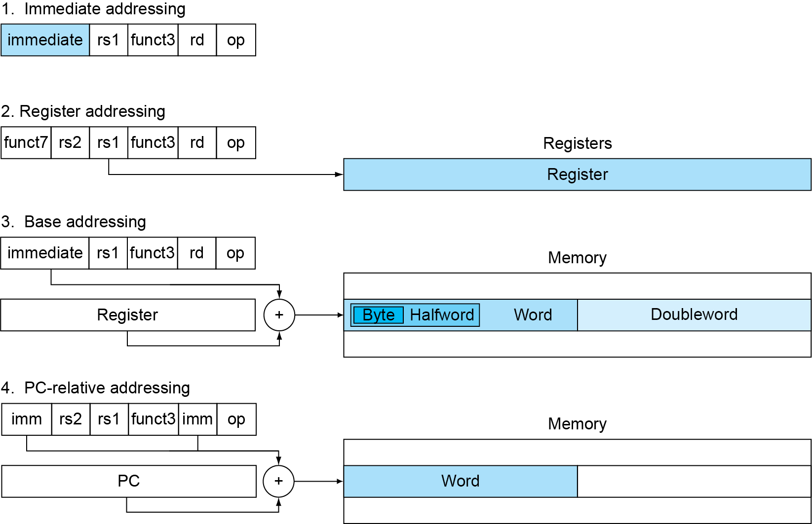
RISC-V Addressing Summary

Slide 16
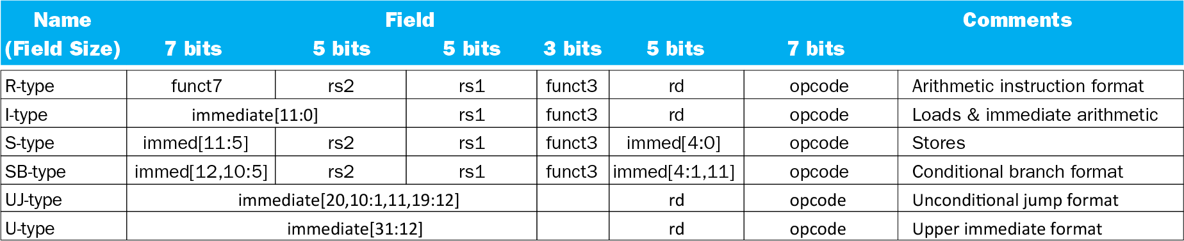
RISC-V Encoding Summary

Slide 17
Any Questions?
.text
__start: addi t1, zero, 0x18
addi t2, zero, 0x21
cycle: beq t1, t2, done
slt t0, t1, t2
bne t0, zero, if_less
nop
sub t1, t1, t2
j cycle
nop
if_less: sub t2, t2, t1
j cycle
done: add t3, t1, zero

