Slide 1
Computer Architecture and Operating Systems Lecture 5: Assembly Programming – Branches and Memory
Andrei Tatarnikov
atatarnikov@hse.ru
@andrewt0301

Slide 2
Program Structure and Memory Layout
0x 7FFF EFFC
Stack
Dynamic Data
.data
hello:
.string "Hello, world!"
.text
main:
li a7, 4
la a0, hello
ecall
0x1004 0000
.data
0x 1001 0000
.text
0x 0040 0000
Reserved
0x 0000 0000

Slide 3
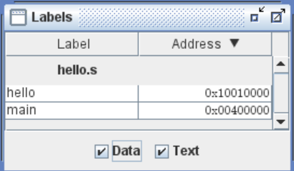
Labels
Labels are symbolic names for addresses (in the .data or .text segment).
Labels are used by control-flow instructions (branches and jumps).
Labels are used by load and store instructions.

Slide 4
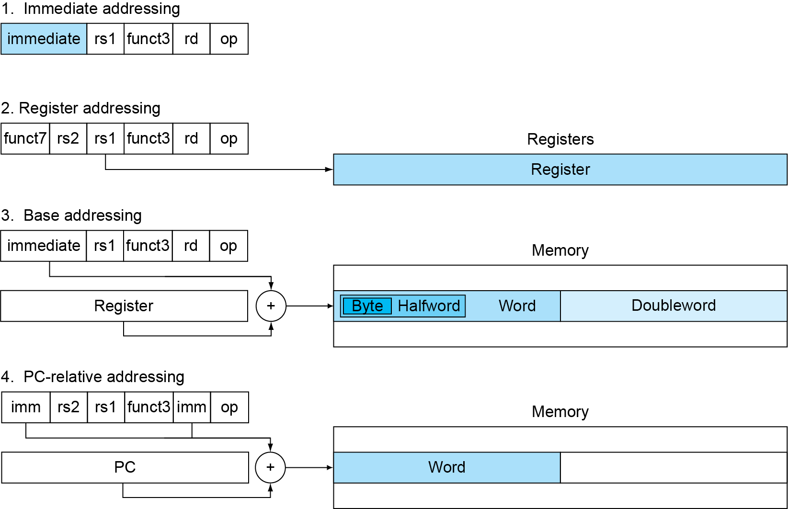
Addressing
Addresses can be represented in several ways

Slide 5
Program Counter
Program Counter (PC) is a special register that stores the address of the currently executed instruction.
When an instruction is executed, the PC is incremented by the size of the instruction (4 bytes) to point to the next instruction.
Branch and jump instructions assign to the PC new addresses to change the control flow.
Branch instructions use PC-relative addresses (increment or decrement current value by an offset).

Slide 6
Branch Instructions
Branch Instructions
Branch = beq rs1, rs2, label
Branch ≠ bne rs1, rs2, label
Branch < blt rs1, rs2, label
Branch ≥ bge rs1, rs2, label
Branch < Unsigned bltu rs1, rs2, label
Branch ≥ Unsigned bgeu rs1, rs2, label

Slide 7
Branch Pseudo Instructions
Branch Pseudo Instructions
Branch unconditionally j label
Branch = 0 beqz rs1, label
Branch ≥ 0 bgez rs1, label
Branch > bgt rs1, rs2, label
Branch > Unsigned bgtu rs1, rs2, label
Branch > 0 bgtz rs1, label
Branch ≤ ble rs1, rs2, label
Branch ≤ Unsigned bleu rs1, rs2, label
Branch ≤ 0 blez rs1, label
Branch < 0 bltz rs1, label
Branch ≠ 0 bnez rs1, label

Slide 8
Branches and Program Counter
Branch instructions are PC-relative
They add a 12-bit signed immediate to PC
The immediate is an offset from PC to the target label
The branch address range is ± 2¹² (4096 B = 4 KB)
PC can be read with the auipc instruction
main:
auipc a0, 0 # a0 = PC + 0
li a7, 34 # Print as hex
ecall # Print a0

Slide 9
Assembly Code for “If-Then-Else”
if_0:
bnez t0, if_less_0
li t1, 1
j end_if
if_less_0:
bgez t0, if_greater_10
li t1, 2
j end_if
if_greater_10:
li t3, 10
blt t0, t3, else
li t1, 3
j end_if
else:
li t1, 4
end_if:
if (t0 == 0) {
t1 = 1;
} else if (t0 < 0) {
t1 = 2;
} else if (t0 >= 10) {
t1 = 3;
} else {
t1 = 4;
}

Slide 10
Assembly Code for “While”
while:
li a7, 5
ecall
mv t0, a0
beqz a0, end_while
li a7, 1
ecall
li a7, 11
li a0, '\n'
ecall
j while
end_while:
while((t0 = read_int()) != 0) {
print_int(t0)
print_char('\n')
}

Slide 11
Assembly Code for “For”
for:
li a7, 5
ecall
mv t1, a0
mv t0, zero
next:
beq t0, t1, end_for
mv a0, t0
li a7, 1
ecall
li a7, 11
li a0, '\n'
ecall
addi t0, t0, 1
j next
end_for:
for (t0 = 0; t0 < t1; ++t0) {
print_int(t0)
print_char('\n')
}

Slide 12
Assembly Code for Nested “For”
mv t0, zero
next_t0:
beq t0, s0, end_for_t0
mv t1, zero
next_t1:
beq t1, s1, end_for_t1
print_int(t0)
print_char(':')
print_int(t1)
print_char(' ')
addi t1, t1, 1
j next_t1
end_for_t1:
print_char('\n')
addi t0, t0, 1
j next_t0
end_for_t0:
for (t0 = 0; t0 < s0; ++t0) {
for (t1 = 0; t0 < s1; ++t1) {
print_int(t0)
print_char(':')
print_int(t1)
print_int(' ')
}
print_char('\n')
}

Slide 13
Macros
Macro is a pattern-matching and replacement facility that provides a simple mechanism to name a frequently used sequence of instructions.
.macro print_int (%x)
li a7, 1
mv a0, %x
ecall
.end_macro
.macro read_int (%x)
li a7, 5
ecall
mv %x, a0
.end_macro
Use Macros to Simplify Your Code
main:
read_int(t0)
print_int(t0)

Slide 14
Including Macro Libraries
It is possible to place macros in a library file and include it in other assembly programs.
The read_int and print_int macros are defined in the macrolib.s file.
The file must be in the same directory as the program.
.include "macrolib.s"
main:
read_int(t0)
print_int(t0)

Slide 15
Macro Constants and Single-Line Macros
The .eqv directive can be used to define macro constants and single-line macros.
.eqv VAL 0x123
.eqv X t0
.eqv Y t1
.eqv SUM addi Y, X, VAL
main:
li X, 0x111
SUM

Slide 16
Data Segment
Segment .data stores static data (global variables and constants), which are described with the following directives:
.data
.word 0xDEADBEEF # 32-bit value
.half 0x1234, 0x4567 # 16-bit values
.byte 0x98, 0x76, 0x65, 0x43 # 8-bit values
.space 8 # 8 bytes of empty space
.ascii "Hello " # String
.asciz "World! " # Zero-terminated string

Slide 17
Data Alignment
Data items are aligned in memory by their size for convenience of access. This means address is multiple of size. Default alignment is as follows:
.byte # 1 byte
.half # 2 bytes
.word # 4 bytes
It is possible to specify a custom alignment by 2^{n} bytes for a next data item with the .align directive.
.align 0 # 1 byte
.align 1 # 2 bytes
.align 2 # 4 bytes
.align 3 # 8 bytes
etc.

Slide 18
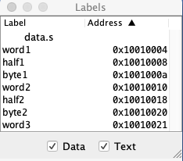
Data Alignment Example
.data
.space 3
word1:
.word 0x12345678
half1:
.half 0x1234
byte1:
.byte 0x12
.align 4
word2:
.word 0x12345678
.align 3
half2:
.half 0x1234
.align 3
byte2:
.byte 0x12
.align 0
word3:
.word 0x12345678
Default
Alignment
Custom
Alignment

Slide 19
Load and Store Instructions
Load Instructions
lb t1, offset(t2) # t1 <- sign-extended 8-bit value from address t2 + offset
lbu t1, offset(t2) # t1 <- zero-extended 8-bit value from address t2 + offset
lh t1, offset(t2) # t1 <- sign-extended 16-bit value from address t2 + offset
lhu t1, offset(t2) # t1 <- zero-extended 16-bit value from address t2 + offset
lw t1, offset(t2) # t1 <- contents of address t2 + offset
Store Instructions
sb t1, offset(t2) # Store low-order 8 bits (byte) of t1 to address t2 + offset
sh t1, offset(t2) # Store low-order 16 bits (half) of t1 to address t2 + offset
sw t1, offset(t2) # Store contents of t1 to address t2 + offset
Load Address Pseudo Instruction
la t2, label # t1 <- address of label

Slide 20
Load and Store Example
.data
x:
.word 0
y:
.word 0
z:
.word 0
.text
main:
read_int(t0)
la t2, x
sw t0, 0(t2)
read_int(t0)
la t2, y
sw t0, 0(t2)
la t2, x
lw t0, 0(t2)
la t2, y
lw t1, 0(t2)
add t3, t0, t1
la t2, z
sw t3, 0(t2)
# x, y, and z are static variables
int x, y, z;
x = read_int();
y = read_int();
z = x + y;

Slide 21
Load and Store With Offset Example
.data
data:
.word 0, 0, 0
.text
main:
la t2, data
read_int(t0)
sw t0, 0(t2)
read_int(t0)
sw t0, 4(t2)
lw t0, 0(t2)
lw t1, 4(t2)
add t3, t0, t1
sw t3, 8(t2)
# data[3] is a static array that stores three integer variables
int data[3]; # x, y, z
x = read_int();
y = read_int();
z = x + y;

Slide 22
Load and Store Pseudoinstruction Example
.data
x:
.word 0
y:
.word 0
z:
.word 0
.text
main:
read_int(t0)
sw t0, x, t2
read_int(t0)
sw t0, y, t2
lw t0, x
lw t1, y
add t3, t0, t1
sw t3, z, t2
# x, y, and z are static variables
int x, y, z;
x = read_int();
y = read_int();
z = x + y;

Slide 23
Load and Store Pseudo Instructions
Load Pseudo Instructions
lw t1, (t2) # t1 <- contents of memory at address t2
lw t1, imm # t1 <- contents of memory address in imm
lw t1, label # t1 <- contents of memory at label's address
Store Pseudo Instructions
sw t1,(t2) # Store t1 to address t2
sw t1, imm # Store t1 to address in imm
sw t1, imm, t2 # Store t1 in to address in imm using t2 as temp
sw t1, label, t2 # Store t1 to label's address using t2 as temp
For instructions lb, lbu, lh, lhu, sb, and sh similar pseudo instructions are provided.

Slide 24
Any Questions?
.text
__start: addi t1, zero, 0x18
addi t2, zero, 0x21
cycle: beq t1, t2, done
slt t0, t1, t2
bne t0, zero, if_less
nop
sub t1, t1, t2
j cycle
nop
if_less: sub t2, t2, t1
j cycle
done: add t3, t1, zero

