Slide 1
Computer Architecture and Operating Systems Lecture 7: Floating-Point Format
Andrei Tatarnikov
atatarnikov@hse.ru
@andrewt0301

Slide 2
Floating-Point Format
Representation for non-integral numbers
Including very small and very large numbers
Like scientific notation
–2.34 × 10⁵⁶
+0.002 × 10^{–4}
+987.02 × 10⁹
In binary
±1.xxxxxxx₂ × 2^{yyyy}
Types float and double in C
normalized
not normalized

Slide 3
Floating-Point Standard
Defined by IEEE Std 754-1985
Developed in response to divergence of representations
Portability issues for scientific code
Now almost universally adopted
Two representations
Single precision (32-bit)
Double precision (64-bit)

Slide 4
IEEE Floating-Point Format
single: 8 bits double: 11 bits
single: 23 bits double: 52 bits
S
Exponent
Fraction
S: sign bit (0 ⇒ non-negative, 1 ⇒ negative)
Normalized significand: 1.0 ≤ |significand| < 2.0
Always has a leading pre-binary-point 1 bit, so no need to represent it explicitly (hidden bit)
Significand is Fraction with the “1.” restored
Exponent: excess representation: actual exponent + Bias
Ensures exponent is unsigned
Single: Bias = 127; Double: Bias = 1203

Slide 5
Single-Precision Range
Exponents 00000000 and 11111111 reserved
Smallest value
Exponent: 00000001 ⇒ actual exponent = 1 – 127 = –126
Fraction: 000…00 ⇒ significand = 1.0
±1.0 × 2^{–126} ≈ ±1.2 × 10^{–38}
Largest value
exponent: 11111110 ⇒ actual exponent = 254 – 127 = +127
Fraction: 111…11 ⇒ significand ≈ 2.0
±2.0 × 2⁺¹²⁷ ≈ ±3.4 × 10⁺³⁸

Slide 6
Double-Precision Range
Exponents 0000…00 and 1111…11 reserved
Smallest value
Exponent: 00000000001 ⇒ actual exponent = 1 – 1023 = –1022
Fraction: 000…00 ⇒ significand = 1.0
±1.0 × 2^{–1022} ≈ ±2.2 × 10^{–308}
Largest value
Exponent: 11111111110 ⇒ actual exponent = 2046 – 1023 = +1023
Fraction: 111…11 ⇒ significand ≈ 2.0
±2.0 × 2⁺¹⁰²³ ≈ ±1.8 × 10⁺³⁰⁸

Slide 7
Floating-Point Precision
Relative precision
all fraction bits are significant
Single: approx 2^{–23}
Equivalent to 23 × log₁₀2 ≈ 23 × 0.3 ≈ 6 decimal digits of precision
Double: approx 2^{–52}
Equivalent to 52 × log₁₀2 ≈ 52 × 0.3 ≈ 16 decimal digits of precision

Slide 8
Floating-Point Example
Represent –0.75
–0.75 = (–1)¹ × 1.1₂ × 2^{–1}
S = 1
Fraction = 1000…00₂
Exponent = –1 + Bias
Single: –1 + 127 = 126 = 01111110₂
Double: –1 + 1023 = 1022 = 01111111110₂
Single: 1011111101000…00
Double: 1011111111101000…00

Slide 9
Floating-Point Example
What number is represented by the single-precision float 11000000101000…00
S = 1
Fraction = 01000…00₂
Fxponent = 10000001₂ = 129
x = (–1)¹ × (1 + 01₂) × 2^{(129 – 127)}
= (–1) × 1.25 × 2²
= –5.0

Slide 10
Denormal Numbers
Exponent = 000...0 ⇒ hidden bit is 0
Smaller than normal numbers
allow for gradual underflow, with diminishing precision
Denormal with fraction = 000...0
Two representations of 0.0!

Slide 11
Infinities and NaNs
Exponent = 111...1, Fraction = 000...0
±Infinity
Can be used in subsequent calculations, avoiding need for overflow check
Exponent = 111...1, Fraction ≠ 000...0
Not-a-Number (NaN)
Indicates illegal or undefined result
e.g., 0.0 / 0.0
Can be used in subsequent calculations

Slide 12
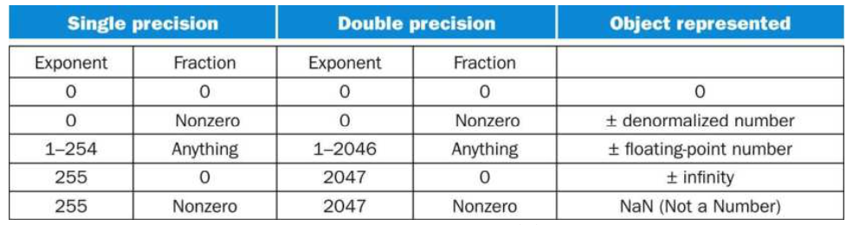
Special Values

Slide 13
Floating-Point Addition
Consider a 4-digit decimal example
9.999 × 10¹ + 1.610 × 10^{–1}
1. Align decimal points
Shift number with smaller exponent
9.999 × 10¹ + 0.016 × 10¹
2. Add significands
9.999 × 10¹ + 0.016 × 10¹ = 10.015 × 10¹
3. Normalize result & check for over/underflow
1.0015 × 10²
4. Round and renormalize if necessary
1.002 × 10²

Slide 14
Floating-Point Addition
Now consider a 4-digit binary example
1.000₂ × 2^{–1} + –1.110₂ × 2^{–2} (0.5 + –0.4375)
1. Align binary points
Shift number with smaller exponent
1.000₂ × 2^{–1} + –0.111₂ × 2^{–1}
2. Add significands
1.000₂ × 2^{–1} + –0.111₂ × 2^{–1} = 0.001₂ × 2^{–1}
3. Normalize result & check for over/underflow
1.000₂ × 2^{–4}, with no over/underflow
4. Round and renormalize if necessary
1.000₂ × 2^{–4} (no change) = 0.0625

Slide 15
FP Adder Hardware
Much more complex than integer adder
Doing it in one clock cycle would take too long
Much longer than integer operations
Slower clock would penalize all instructions
FP adder usually takes several cycles
Can be pipelined

Slide 16
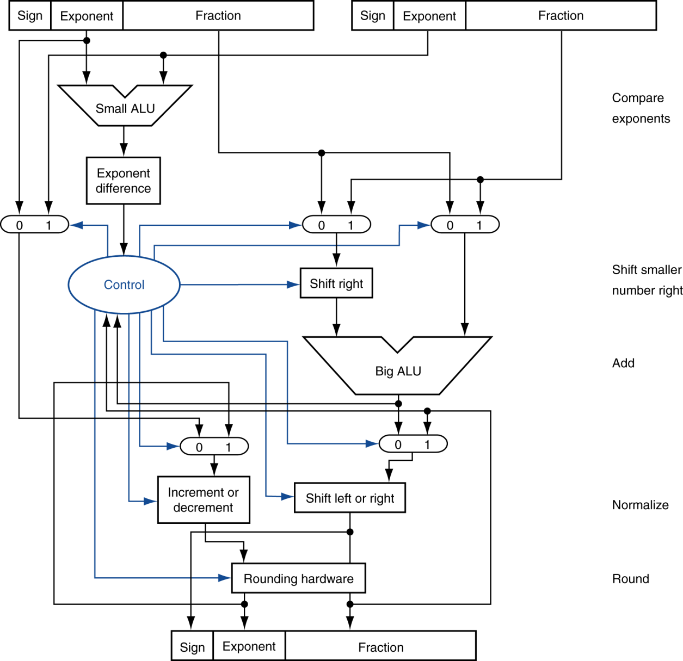
FP Adder Hardware
Step 1
Step 2
Step 3
Step 4

Slide 17
Floating-Point Multiplication
Consider a 4-digit decimal example
1.110 × 10¹⁰ × 9.200 × 10^{–5}
1. Add exponents
For biased exponents, subtract bias from sum
New exponent = 10 + –5 = 5
2. Multiply significands
1.110 × 9.200 = 10.212 ⇒ 10.212 × 10⁵
3. Normalize result & check for over/underflow
1.0212 × 10⁶
4. Round and renormalize if necessary
1.021 × 10⁶
5. Determine sign of result from signs of operands
+1.021 × 10⁶

Slide 18
Floating-Point Multiplication
Now consider a 4-digit binary example
1.000₂ × 2^{–1} × –1.110₂ × 2^{–2} (0.5 × –0.4375)
1. Add exponents
Unbiased: –1 + –2 = –3
Biased: (–1 + 127) + (–2 + 127) = –3 + 254 – 127 = –3 + 127
2. Multiply significands
1.000₂ × 1.110₂ = 1.1102 ⇒ 1.110₂ × 2^{–3}
3. Normalize result & check for over/underflow
1.110₂ × 2^{–3} (no change) with no over/underflow
4. Round and renormalize if necessary
1.110₂ × 2^{–3} (no change)
5. Determine sign: +ve × –ve ⇒ –ve
–1.110₂ × 2^{–3} = –0.21875

Slide 19
FP Arithmetic Hardware
FP multiplier is of similar complexity to FP adder
But uses a multiplier for significands instead of an adder
FP arithmetic hardware usually does
Addition, subtraction, multiplication, division, reciprocal, square-root
FP ↔ integer conversion
Operations usually takes several cycles
Can be pipelined

Slide 20
FP Instructions in RISC-V
Separate FP registers: f0, …, f31
double-precision
single-precision values stored in the lower 32 bits
FP instructions operate only on FP registers
Programs generally don’t do integer ops on FP data, or vice versa
More registers with minimal code-size impact
FP load and store instructions
flw, fld
fsw, fsd

Slide 21
FP Instructions in RISC-V
Single-precision arithmetic
fadd.s, fsub.s, fmul.s, fdiv.s, fsqrt.s
e.g., fadds.s f2, f4, f6
Double-precision arithmetic
fadd.d, fsub.d, fmul.d, fdiv.d, fsqrt.d
e.g., fadd.d f2, f4, f6
Single- and double-precision comparison
feq.s, flt.s, fle.s
feq.d, flt.d, fle.d
Result is 0 or 1 in integer destination register
Use beq, bne to branch on comparison result
Branch on FP condition code true or false
b.cond

Slide 22
FP Example: °F to °C
C code:
float f2c (float fahr) { return ((5.0/9.0)*(fahr - 32.0)); }
fahr in f10, result in f10, literals in global memory space
Compiled RISC-V code:
f2c:
flw f0,const5(x3) // f0 = 5.0f
flw f1,const9(x3) // f1 = 9.0f
fdiv.s f0, f0, f1 // f0 = 5.0f / 9.0f
flw f1,const32(x3) // f1 = 32.0f
fsub.s f10,f10,f1 // f10 = fahr – 32.0
fmul.s f10,f0,f10 // f10 = (5.0f/9.0f) * (fahr–32.0f)
jalr x0,0(x1) // return

Slide 23
FP Example: Array Multiplication
C = C + A × B
All 32 × 32 matrices, 64-bit double-precision elements
C code:
void mm (double c[][], double a[][], double b[][]) { size_t i, j, k; for (i = 0; i < 32; i = i + 1) for (j = 0; j < 32; j = j + 1) for (k = 0; k < 32; k = k + 1) c[i][j] = c[i][j] + a[i][k] * b[k][j]; }
Addresses of c, a, b in x10, x11, x12, and i, j, k in x5, x6, x7

Slide 24
FP Example: Array Multiplication
RISC-V code:
mm:...
li x28,32 // x28 = 32 (row size/loop end)
li x5,0 // i = 0; initialize 1st for loop
L1: li x6,0 // j = 0; initialize 2nd for loop
L2: li x7,0 // k = 0; initialize 3rd for loop
slli x30,x5,5 // x30 = i * 2**5 (size of row of c)
add x30,x30,x6 // x30 = i * size(row) + j
slli x30,x30,3 // x30 = byte offset of [i][j]
add x30,x10,x30 // x30 = byte address of c[i][j]
fld f0,0(x30) // f0 = c[i][j]
L3: slli x29,x7,5 // x29 = k * 2**5 (size of row of b)
add x29,x29,x6 // x29 = k * size(row) + j
slli x29,x29,3 // x29 = byte offset of [k][j]
add x29,x12,x29 // x29 = byte address of b[k][j]
fld f1,0(x29) // f1 = b[k][j]

Slide 25
FP Example: Array Multiplication
…
slli x29,x5,5 // x29 = i * 2**5 (size of row of a)
add x29,x29,x7 // x29 = i * size(row) + k
slli x29,x29,3 // x29 = byte offset of [i][k]
add x29,x11,x29 // x29 = byte address of a[i][k]
fld f2,0(x29) // f2 = a[i][k]
fmul.d f1, f2, f1 // f1 = a[i][k] * b[k][j]
fadd.d f0, f0, f1 // f0 = c[i][j] + a[i][k] * b[k][j]
addi x7,x7,1 // k = k + 1
bltu x7,x28,L3 // if (k < 32) go to L3
fsd f0,0(x30) // c[i][j] = f0
addi x6,x6,1 // j = j + 1
bltu x6,x28,L2 // if (j < 32) go to L2
addi x5,x5,1 // i = i + 1
bltu x5,x28,L1 // if (i < 32) go to L1

Slide 26
Accurate Arithmetic
IEEE Std 754 specifies additional rounding control
Extra bits of precision (guard, round, sticky)
Choice of rounding modes
Allows programmer to fine-tune numerical behavior of a computation
Not all FP units implement all options
Most programming languages and FP libraries just use defaults
Trade-off between hardware complexity, performance, and market requirements

Slide 27
Associativity
Parallel programs may interleave operations in unexpected orders
Assumptions of associativity may fail
Need to validate parallel programs under varying degrees of parallelism

Slide 28
Who Cares About FP Accuracy?
Important for scientific code
But for everyday consumer use?
“My bank balance is out by 0.0002¢!” ☹
The Intel Pentium FDIV bug
The market expects accuracy
See Colwell, The Pentium Chronicles

Slide 29
Concluding Remarks
Bits have no inherent meaning
Interpretation depends on the instructions applied
Computer representations of numbers
Finite range and precision
Need to account for this in programs

Slide 30
Concluding Remarks
ISAs support arithmetic
Signed and unsigned integers
Floating-point approximation to reals
Bounded range and precision
Operations can overflow and underflow

Slide 31
Any Questions?
.text
__start: addi t1, zero, 0x18
addi t2, zero, 0x21
cycle: beq t1, t2, done
slt t0, t1, t2
bne t0, zero, if_less
nop
sub t1, t1, t2
j cycle
nop
if_less: sub t2, t2, t1
j cycle
done: add t3, t1, zero

