Slide 1
Computer Architecture and Operating Systems Lecture 8: Memory and Caches
Andrei Tatarnikov
atatarnikov@hse.ru
@andrewt0301

Slide 2
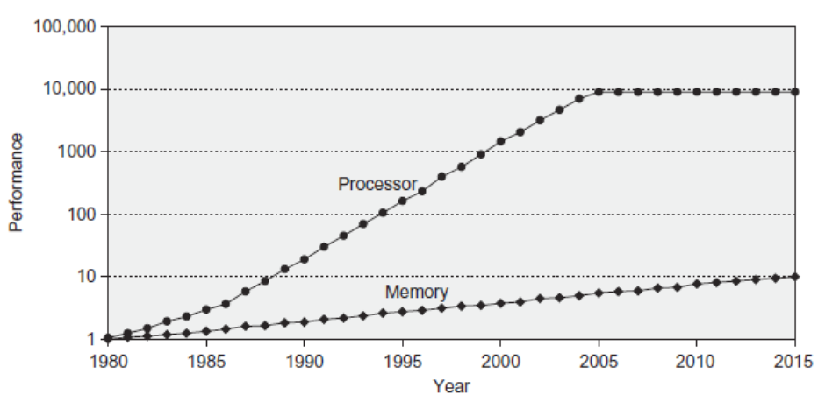
Processor-Memory Performance Gap
Computer performance depends on:
Processor performance
Memory performance

Slide 3
Memory Challenge
Make memory appear as fast as processor
Ideal memory:
Fast
Cheap (inexpensive)
Large (capacity)
But can only choose two!

Slide 4
Memory Technology
Static RAM (SRAM)
0.5 – 2.5 ns, $500 – $1000 per GB
Dynamic RAM (DRAM)
50 – 70 ns, $10 – $20 per GB
Flash Memory
5 000 – 50 000 ns, $0.75 – $1.00 per GB
Magnetic Disk
5 000 000 – 20 000 000 ns, $0.05 – $0.1 per GB
Ideal Memory
Access time of SRAM
Capacity and cost/GB of disk

Slide 5
Locality
No need for large memory to access it fast
Just exploit locality
Temporal Locality:
Locality in time
If data used recently, likely to use it again soon
How to exploit: keep recently accessed data in higher levels of memory hierarchy
Spatial Locality:
Locality in space
If data used recently, likely to use nearby data soon
How to exploit: when access data, bring nearby data into higher levels of memory hierarchy too

Slide 6
Taking Advantage of Locality
Memory hierarchy
Store everything on disk
Copy recently accessed (and nearby) items from disk to smaller DRAM memory
Main memory
Copy more recently accessed (and nearby) items from DRAM to smaller SRAM memory
Cache memory attached to CPU

Slide 7
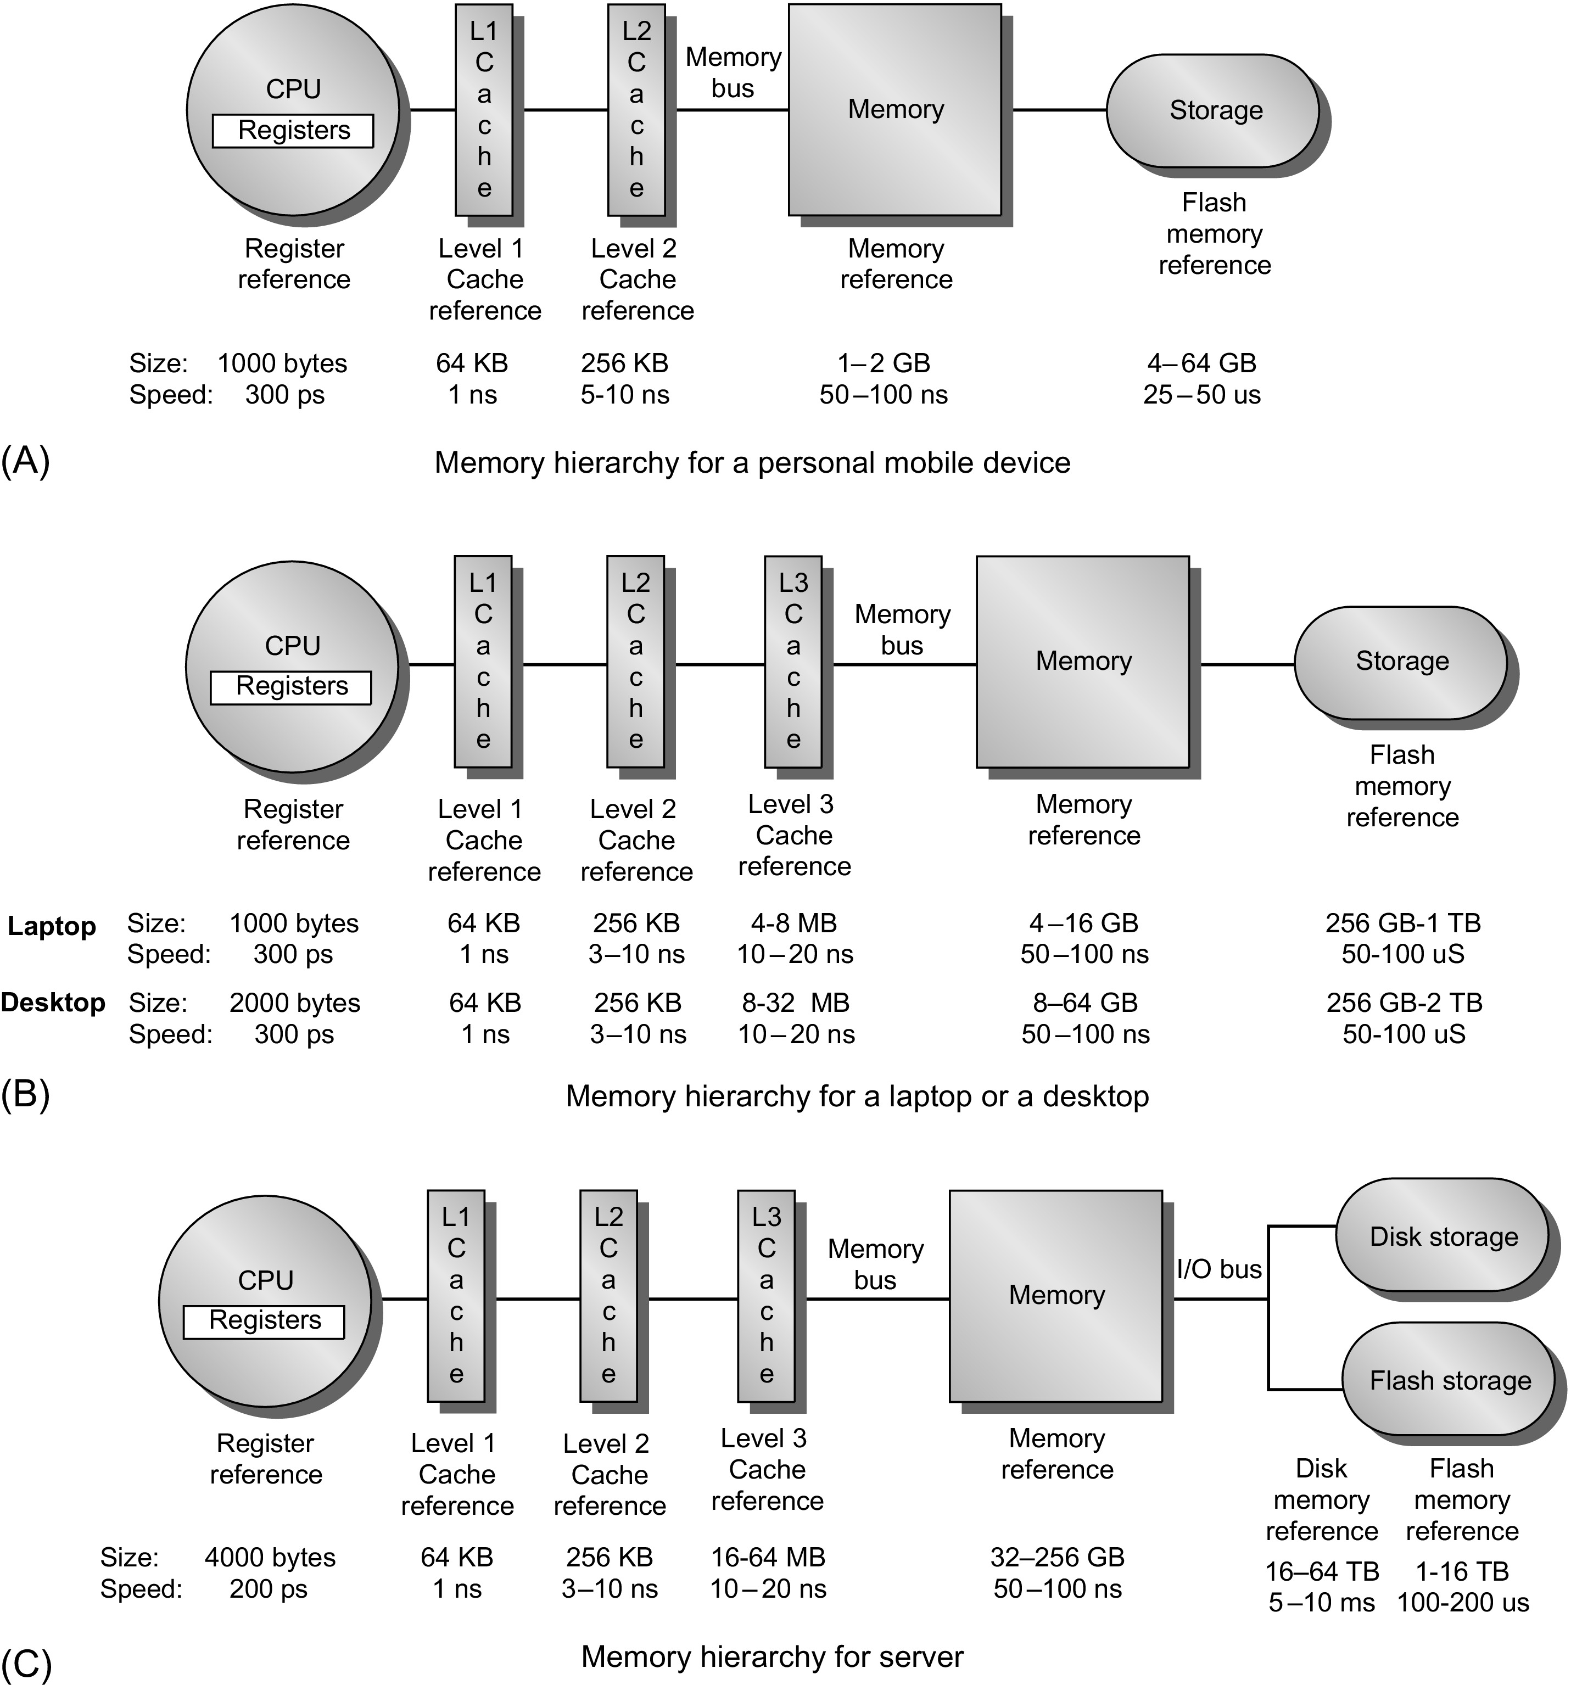
Memory Hierarchy
Personal mobile device
Laptop or desktop
Server

Slide 8
How It Works?
Block (aka line): unit of copying
May be multiple words
If accessed data is present in upper level
Hit: access satisfied by upper level
Hit ratio: hits/accesses
If accessed data is absent
Miss: block copied from lower level
Time taken: miss penalty
Miss ratio: misses/accesses = 1 – hit ratio
Then accessed data supplied from upper level
Processor
L1
L2
Memory

Slide 9
Hits and Misses
On cache hit, CPU proceeds normally
On cache miss
Stall the CPU pipeline
Fetch block from next level of hierarchy
Instruction cache miss
Restart instruction fetch
Data cache miss
Complete data access

Slide 10
Miss Types
Compulsory: first time data accessed
Capacity: cache too small to hold all data of interest
Conflict: data of interest maps to a location in cache mapped to different data

Slide 11
Memory Performance
Hit: data found in that level of memory hierarchy
Miss: data not found (must go to next level)
Hit Rate = # hits / # memory accesses = 1 – Miss Rate
Miss Rate = # misses / # memory accesses = 1 – Hit Rate
Average memory access time (AMAT): average time for processor to access data
AMAT = t_{cache} + MR_{cache}[t_{MM} + MR_{MM}(t_{VM})]

Slide 12
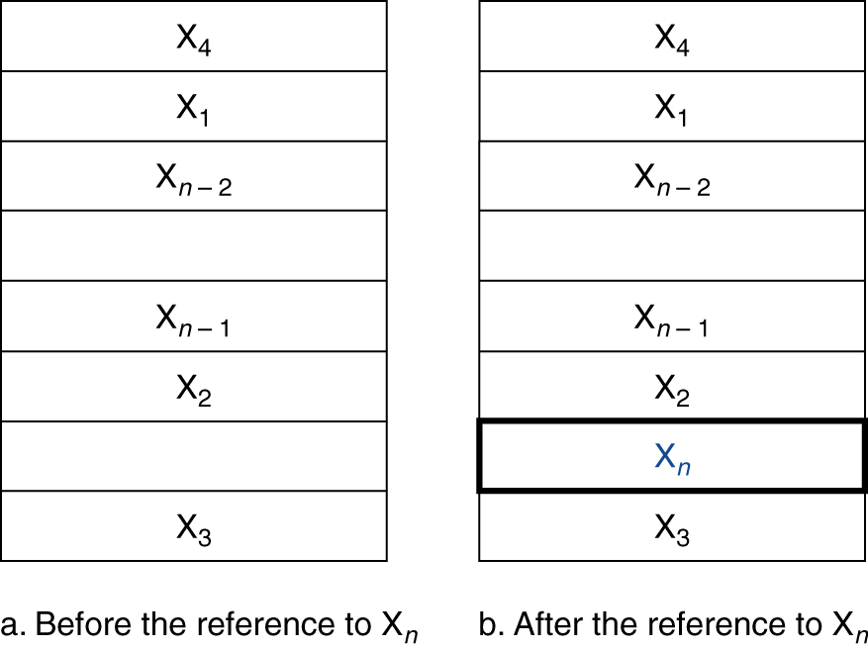
Cache Memory
Cache memory
The level of the memory hierarchy closest to the CPU
Given accesses X₁, …, X_{n–1}, X_{n}
How do we know if the data is present?
Where do we look?

Slide 13
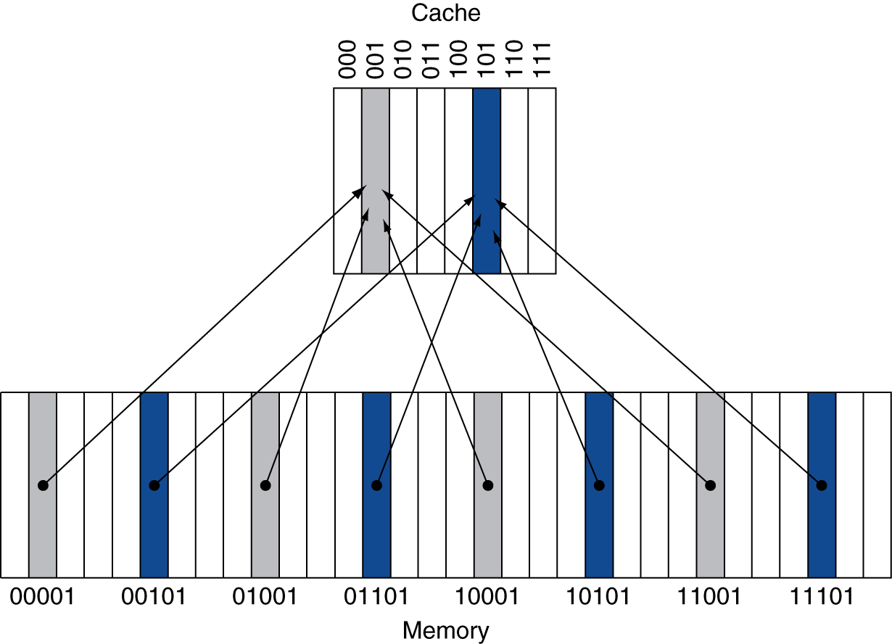
Direct Mapped Cache
Location determined by address
Direct mapped: only one choice
(Block address) modulo (#Blocks in cache)
Cache
#Blocks is a power of 2
Use low-order address bits
Memory

Slide 14
Tags and Valid Bits
How do we know which particular block is stored in a cache location?
Store block address as well as the data
Actually, only need the high-order bits
Called the tag
What if there is no data in a location?
Valid bit: 1 = present, 0 = not present
Initially 0

Slide 15
Direct Mapped Cache Example
8-blocks, 1 word/block, direct mapped
Initial state
Index | V | Tag | Data
000 | N
001 | N
010 | N
011 | N
100 | N
101 | N
110 | N
111 | N

Slide 16
Direct Mapped Cache Example
Word addr | Binary addr | Hit/miss | Cache block
22 | 10 110 | Miss | 110
Index | V | Tag | Data
000 | N
001 | N
010 | N
011 | N
100 | N
101 | N
110 | Y | 10 | Mem[10110]
111 | N

Slide 17
Direct Mapped Cache Example
Word addr | Binary addr | Hit/miss | Cache block
26 | 11 010 | Miss | 010
Index | V | Tag | Data
000 | N
001 | N
010 | Y | 11 | Mem[11010]
011 | N
100 | N
101 | N
110 | Y | 10 | Mem[10110]
111 | N

Slide 18
Direct Mapped Cache Example
Word addr | Binary addr | Hit/miss | Cache block
22 | 10 110 | Hit | 110
26 | 11 010 | Hit | 010
Index | V | Tag | Data
000 | N
001 | N
010 | Y | 11 | Mem[11010]
011 | N
100 | N
101 | N
110 | Y | 10 | Mem[10110]
111 | N

Slide 19
Direct Mapped Cache Example
Word addr | Binary addr | Hit/miss | Cache block
16 | 10 000 | Miss | 000
3 | 00 011 | Miss | 011
16 | 10 000 | Hit | 000
Index | V | Tag | Data
000 | Y | 10 | Mem[10000]
001 | N
010 | Y | 11 | Mem[11010]
011 | Y | 00 | Mem[00011]
100 | N
101 | N
110 | Y | 10 | Mem[10110]
111 | N

Slide 20
Direct Mapped Cache Example
Word addr | Binary addr | Hit/miss | Cache block
18 | 10 010 | Miss | 010
Index | V | Tag | Data
000 | Y | 10 | Mem[10000]
001 | N
010 | Y | 10 | Mem[10010]
011 | Y | 00 | Mem[00011]
100 | N
101 | N
110 | Y | 10 | Mem[10110]
111 | N

Slide 21
Associative Caches
Fully associative
Allow a given block to go in any cache entry
Requires all entries to be searched at once
Comparator per entry (expensive)
n-way set associative
Each set contains n entries
Block number determines which set
(Block number) modulo (#Sets in cache)
Search all entries in a given set at once
n comparators (less expensive)

Slide 22
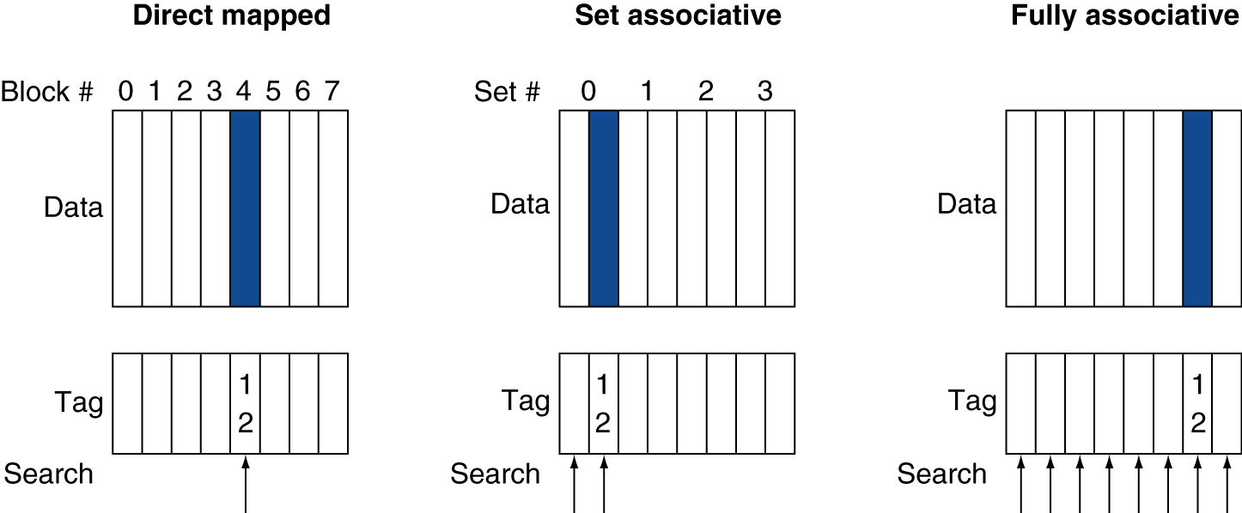
Associative Cache Examples

Slide 23
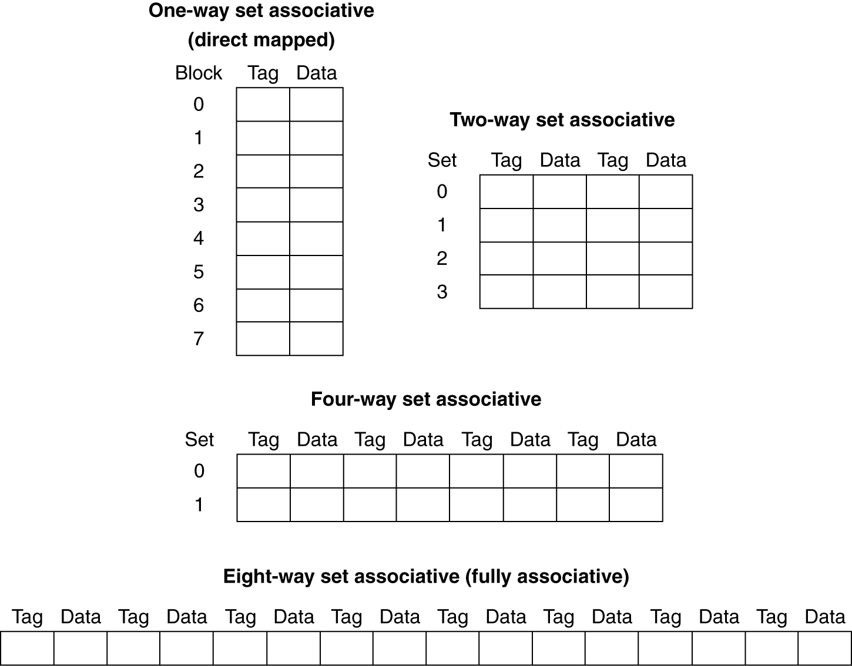
Spectrum of Associativity
For a cache with 8 entries

Slide 24
Associativity Example
Compare 4-block caches
Direct mapped, 2-way set associative, fully associative
Block access sequence: 0, 8, 0, 6, 8
Direct mapped
Block address | Cache index | Hit/miss | Cache content after access
 |  |  | 0 | 1 | 2 | 3
0 | 0 | miss | Mem[0]
8 | 0 | miss | Mem[8]
0 | 0 | miss | Mem[0]
6 | 2 | miss | Mem[0] |  | Mem[6]
8 | 0 | miss | Mem[8] |  | Mem[6]

Slide 25
Associativity Example
2-way set associative
Block address | Cache index | Hit/miss | Cache content after access
 |  |  | Set 0 |  | Set 1
0 | 0 | miss | Mem[0]
8 | 0 | miss | Mem[0] | Mem[8]
0 | 0 | hit | Mem[0] | Mem[8]
6 | 0 | miss | Mem[0] | Mem[6]
8 | 0 | miss | Mem[8] | Mem[6]
Fully associative
Block address |  | Hit/miss | Cache content after access
0 |  | miss | Mem[0]
8 |  | miss | Mem[0] | Mem[8]
0 |  | hit | Mem[0] | Mem[8]
6 |  | miss | Mem[0] | Mem[8] | Mem[6]
8 |  | hit | Mem[0] | Mem[8] | Mem[6]

Slide 26
How Much Associativity
Increased associativity decreases miss rate
But with diminishing returns
Simulation of a system with 64KB D-cache, 16-word blocks, SPEC2000
1-way: 10.3%
2-way: 8.6%
4-way: 8.3%
8-way: 8.1%

Slide 27
Replacement Policy
Direct mapped
No choice
Set associative
Prefer non-valid entry, if there is one
Otherwise, choose among entries in the set
Least-recently used (LRU)
Choose the one unused for the longest time
Simple for 2-way, manageable for 4-way, too hard beyond that
Random
Gives approximately the same performance as LRU for high associativity

Slide 28
Write-Through
On data-write hit, could just update the block in cache
But then cache and memory would be inconsistent
Write through: also update memory
But makes writes take longer
e.g., if base CPI = 1, 10% of instructions are stores, write to memory takes 100 cycles
Effective CPI = 1 + 0.1×100 = 11
Solution: write buffer
Holds data waiting to be written to memory
CPU continues immediately
Only stalls on write if write buffer is already full

Slide 29
Write-Back
Alternative: On data-write hit, just update the block in cache
Keep track of whether each block is dirty
When a dirty block is replaced
Write it back to memory
Can use a write buffer to allow replacing block to be read first

Slide 30
Write Allocation
What should happen on a write miss?
Alternatives for write-through
Allocate on miss: fetch the block
Write around: don’t fetch the block
Since programs often write a whole block before reading it (e.g., initialization)
For write-back
Usually fetch the block

Slide 31
Multilevel Caches
Primary cache attached to CPU
Small, but fast
Level-2 cache services misses from primary cache
Larger, slower, but still faster than main memory
Main memory services L-2 cache misses
Some high-end systems include L-3 cache

Slide 32
Measuring Cache Performance
Components of CPU time
Program execution cycles
Includes cache hit time
Memory stall cycles
Mainly from cache misses
With simplifying assumptions:
Memory Accesses
Program
Memory Stall Cycles =
× Miss Rate × Miss Penalty
Instructions
Program
Misses
Instructions
=
×
× Miss Penalty

Slide 33
Cache Performance Example
Given
I-cache miss rate = 2%
D-cache miss rate = 4%
Miss penalty = 100 cycles
Base CPI (ideal cache) = 2
Load & stores are 36% of instructions
Miss cycles per instruction
I-cache: 0.02 × 100 = 2
D-cache: 0.36 × 0.04 × 100 = 1.44
Actual CPI = 2 + 2 + 1.44 = 5.44
Ideal CPU is 5.44/2 =2.72 times faster

Slide 34
Average Access Time
Hit time is also important for performance
Average memory access time (AMAT)
AMAT = Hit time + Miss rate × Miss penalty
Example
CPU with 1ns clock, hit time = 1 cycle, miss penalty = 20 cycles, I-cache miss rate = 5%
AMAT = 1 + 0.05 × 20 = 2ns
2 cycles per instruction

Slide 35
Overal Performance Summary
When CPU performance increased
Miss penalty becomes more significant
Decreasing base CPI
Greater proportion of time spent on memory stalls
Increasing clock rate
Memory stalls account for more CPU cycles
Can’t neglect cache behavior when evaluating system performance

Slide 36
Example: How Caches Affect Performance
Matrix Multiplication
Loop order: i, j, k
for (int i= 0; i < n; i++) { for (int j= 0; j < n; j++) { for (int k= 0; k < n; k++) { C[i][j]+= A[i][k]*B[k][j]; } } }
Loop order: i, k, j
for (int i= 0; i < n; i++) { for (int k= 0; k < n; k++) { for (int j= 0; j < n; j++) { C[i][j]+= A[i][k]*B[k][j]; } } }
Loop order: j, k, i
for (int j= 0; j < n; j++) { for (int k= 0; k < n; k++) { for (int i= 0; i < n; i++) { C[i][j]+= A[i][k]*B[k][j]; } } }
Running time:
13.714264 sec.
Performance:
~ 153 MFLOPS
Running time:
2.739385 sec.
Performance:
~ 795 MFLOPS
Running time:
19.074106 sec.
Performance:
~ 113 MFLOPS

Slide 37
Memory Access Patterns
Loop order: i, j, k
Loop order: i, k, j
Loop order: j, k, i
A
A
A
B
B
B
C
C
C

Slide 38
Any Questions?
.text
__start: addi t1, zero, 0x18
addi t2, zero, 0x21
cycle: beq t1, t2, done
slt t0, t1, t2
bne t0, zero, if_less
nop
sub t1, t1, t2
j cycle
nop
if_less: sub t2, t2, t1
j cycle
done: add t3, t1, zero

