Slide 1
Computer Architecture and Operating Systems Lecture 12: Input/Output
Andrei Tatarnikov
atatarnikov@hse.ru
@andrewt0301

Slide 2
I/O Devices
Human readable
Suitable for communicating with users
Video displays, printers
Machine readable
Suitable for communicating with equipment
Magnetic disks, SSDs, sensors
Communication
Suitable for communicating with remote devices such as a terminal or another computer
Network interface card

Slide 3
I/O Module
Attach to the processor by a link to an I/O module
The link is used to exchange control, status, and data between the I/O module and the external device
Peripheral device
An external device connected to an I/O module
Address Lines
Data Lines
Systembus
Control Lines
I/O Module
Links to peripheral
devices

Slide 4
Signals
Control signals determine the function that the device will perform
Data are a set of bits to be sent to or received from the I/O module
Status signals indicate the state of the device

Slide 5
I/O Module Functions
Control and Timing
Coordinates the flow of traffic between internal resources and external devices
Processor Communication
Involves command decoding, data, status reporting, address recognition
Device Communication
Involves commands, status information, and data
Data Buffering
Performs the needed buffering operation to balance device and memory speeds
Error Detection
Detects and reports transmission errors

Slide 6
I/O Module Block Diagram

Slide 7
Three Techniques for I/O Operations
Programmed I/O
Data are exchanged between the processor and the I/O module
Processor executes a program that gives it direct control of the I/O operation
When the processor issues a command it must wait until the I/O operation is complete
If the processor is faster than the I/O module this is wasteful of processor time
Interrupt-driven I/O
Processor issues an I/O command, continues to execute other instructions, and is interrupted by the I/O module when the latter has completed its work
Direct memory access (DMA)
The I/O module and main memory exchange data directly without processor involvement

Slide 8
I/O Techniques

Slide 9
I/O Techniques

Slide 10
Direct Memory Access (DMA)
Processor
I/O
Main Memory
DMA
Controller
System Bus

Slide 11
Memory-Mapped I/O (MMIO)
Processor accesses I/O devices just like memory (like keyboards, monitors, printers)
Each I/O device assigned one or more address
When that address is detected, data read/written to I/O device instead of memory
A portion of the address space dedicated to I/O devices

Slide 12
Key Ideas
Memory-Mapped I/O is an I/O scheme in which portions of the address space are assigned to I/O devices, and reads and writes to those addresses are interpreted as commands to the I/O device
Direct Memory Access (DMA) is a mechanism that provides a device controller with the ability to transfer data directly to or from the memory without involving the processor

Slide 13
Key Ideas
Interrupt-Driven I/O is an I/O scheme that employs interrupts to indicate to the processor that an I/O device needs attention
Polling is the process of periodically checking the status of an I/O device to determine the need to service the device
Device Driver is a program that controls an I/O device that is attached to the computer

Slide 14
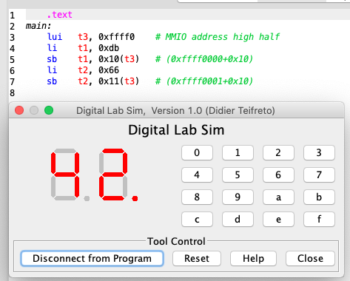
Example: RARS Digital Lab Sim
Seven segment display
Byte value at address 0xffff0010: command right segment display
Byte value at address 0xffff0011: command left segment display
Hexadecimal keyboard
Byte value at address 0xffff0012: command row number of hexadecimal keyboard (bit 0 to 3) and enable keyboard interrupt (bit 7)
Byte value at address 0xffff0014: receive row and column of the key pressed, 0 if not key pressed

Slide 15
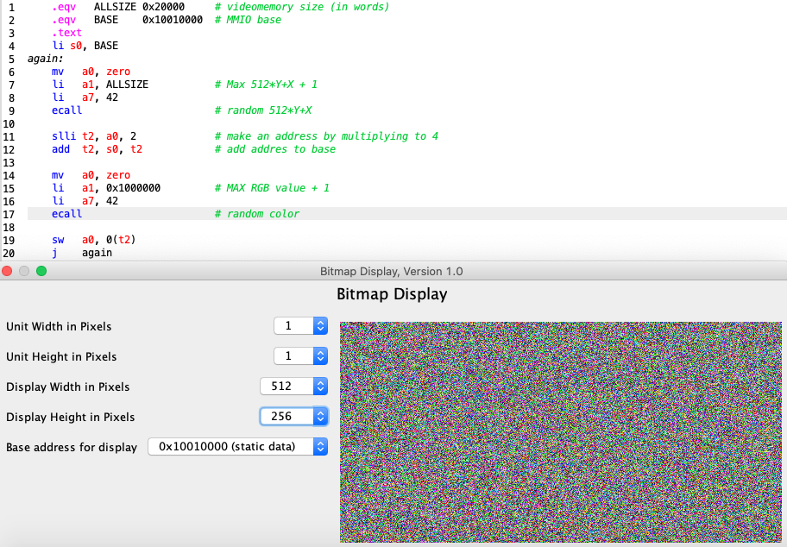
Example: RARS Bitmap Display

Slide 16
Any Questions?
.text
__start: addi t1, zero, 0x18
addi t2, zero, 0x21
cycle: beq t1, t2, done
slt t0, t1, t2
bne t0, zero, if_less
nop
sub t1, t1, t2
j cycle
nop
if_less: sub t2, t2, t1
j cycle
done: add t3, t1, zero

