Slide 1
Computer Architecture and Operating Systems Lecture 13: Data-level parallelism: Vector, SIMD, GPU
Andrei Tatarnikov
atatarnikov@hse.ru
@andrewt0301

Slide 2
Instruction-Level Parallelism (ILP)
Pipelining: executing multiple instructions in parallel
To increase ILP
Deeper pipeline
Less work per stage ⇒ shorter clock cycle
Multiple issue
Replicate pipeline stages ⇒ multiple pipelines
Start multiple instructions per clock cycle
CPI < 1, so use Instructions Per Cycle (IPC)
E.g., 4GHz 4-way multiple-issue
16 BIPS, peak CPI = 0.25, peak IPC = 4
But dependencies reduce this in practice

Slide 3
Multiple Issue
Static multiple issue
Compiler groups instructions to be issued together
Packages them into “issue slots”
Compiler detects and avoids hazards
Dynamic multiple issue
CPU examines instruction stream and chooses instructions to issue each cycle
Compiler can help by reordering instructions
CPU resolves hazards using advanced techniques at runtime

Slide 4
Speculation
“Guess” what to do with an instruction
Start operation as soon as possible
Check whether guess was right
If so, complete the operation
If not, roll-back and do the right thing
Common to static and dynamic multiple issue
Examples
Speculate on branch outcome
Roll back if path taken is different
Speculate on load
Roll back if location is updated

Slide 5
Compiler/Hardware Speculation
Compiler can reorder instructions
e.g., move load before branch
Can include “fix-up” instructions to recover from incorrect guess
Hardware can look ahead for instructions to execute
Buffer results until it determines they are actually needed
Flush buffers on incorrect speculation

Slide 6
Static Multiple Issue
Compiler groups instructions into “issue packets”
Group of instructions that can be issued on a single cycle
Determined by pipeline resources required
Think of an issue packet as a very long instruction
Specifies multiple concurrent operations
⇒ Very Long Instruction Word (VLIW)

Slide 7
Scheduling Static Multiple Issue
Compiler must remove some/all hazards
Reorder instructions into issue packets
No dependencies with a packet
Possibly some dependencies between packets
Varies between ISAs; compiler must know!
Pad with nop if necessary

Slide 8
RISC-V with Static Dual Issue
Two-issue packets
One ALU/branch instruction
One load/store instruction
64-bit aligned
ALU/branch, then load/store
Pad an unused instruction with nop
Address | Instruction type | Pipeline Stages
n | ALU/branch | IF | ID | EX | MEM | WB
n + 4 | Load/store | IF | ID | EX | MEM | WB
n + 8 | ALU/branch |  | IF | ID | EX | MEM | WB
n + 12 | Load/store |  | IF | ID | EX | MEM | WB
n + 16 | ALU/branch |  |  | IF | ID | EX | MEM | WB
n + 20 | Load/store |  |  | IF | ID | EX | MEM | WB

Slide 9
Dynamic Multiple Issue
“Superscalar” processors
CPU decides whether to issue 0, 1, 2, … each cycle
Avoiding structural and data hazards
Avoids the need for compiler scheduling
Though it may still help
Code semantics ensured by the CPU

Slide 10
Dynamic Pipeline Scheduling
Allow the CPU to execute instructions out of order to avoid stalls
But commit result to registers in order
Example
ld x31,20(x21) add x1,x31,x2 sub x23,x23,x3 andi x5,x23,20
Can start sub while add is waiting for ld

Slide 11
Why Do Dynamic Scheduling?
Why not just let the compiler schedule code?
Not all stalls are predicable
e.g., cache misses
Can’t always schedule around branches
Branch outcome is dynamically determined
Different implementations of an ISA have different latencies and hazards

Slide 12
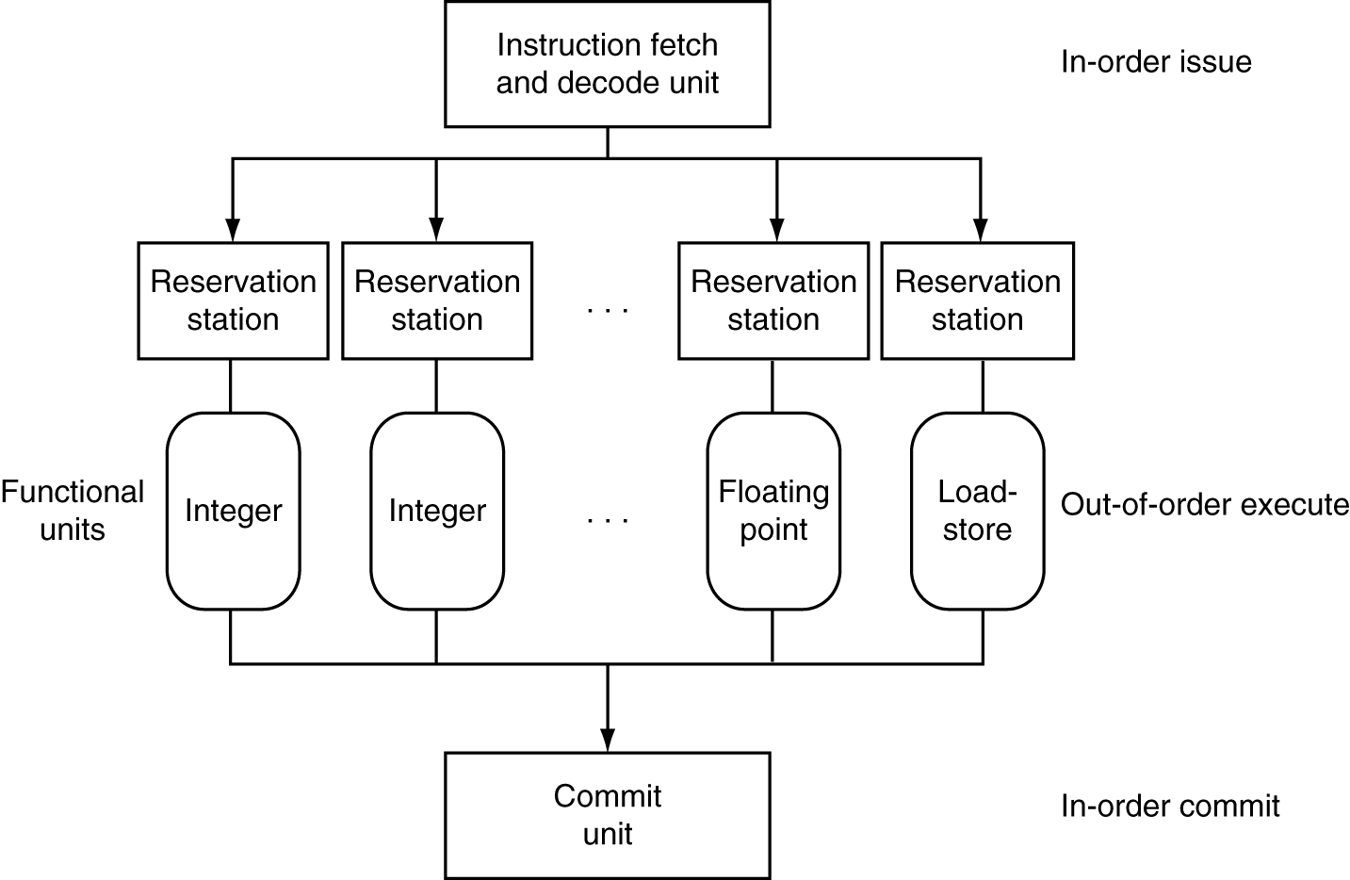
Dynamically Scheduled CPU
Preserves dependencies
Hold pending operands
Results also sent to any waiting reservation stations
Reorders buffer for register writes
Can supply operands for issued instructions

Slide 13
Does Multiple Issue Work?
Yes, but not as much as we’d like
Programs have real dependencies that limit ILP
Some dependencies are hard to eliminate
e.g., pointer aliasing
Some parallelism is hard to expose
Limited window size during instruction issue
Memory delays and limited bandwidth
Hard to keep pipelines full
Speculation can help if done well

Slide 14
Conclusion
ISA influences design of datapath and control
Datapath and control influence design of ISA
Pipelining improves instruction throughput using parallelism
More instructions completed per second
Latency for each instruction not reduced
Hazards: structural, data, control
Multiple issue and dynamic scheduling (ILP)
Dependencies limit achievable parallelism
Complexity leads to the power wall

Slide 15
Data-Level Parallelism
Data-level parallelism is parallelism achieved by performing the same operation on independent data
Best in dealing with arrays in for loops and processing other kinds of identically structured data
Unsuitable for control flow structures

Slide 16
Instruction and Data Streams
An alternate classification
SPMD: Single Program Multiple Data
A parallel program on a MIMD computer
Conditional code for different processors
 |  | Data Streams
 |  | Single | Multiple
Instruction Streams | Single | SISD: Intel Pentium 4 | SIMD: SSE instructions of x86
 | Multiple | MISD: No examples today | MIMD: Intel Xeon e5345

Slide 17
Types of Parallel Processing
Single instruction, single data (SISD) stream: A single processor executes a single instruction stream to operate on data stored in a single memory. Uniprocessors fall into this category.
Single instruction, multiple data (SIMD) stream: A single machine instruction controls the simultaneous execution of a number of processing elements on a lockstep basis. Each has an associated data memory, so that instructions are executed on different sets of data by different processors. Vector and array processors fall into this category.
Multiple instruction, single data (MISD) stream: A sequence of data is transmitted to a set of processors, each of which executes a different instruction sequence. Not commercially implemented.
Multiple instruction, multiple data (MIMD) stream: A set of processors simultaneously execute different instruction sequences on different data sets. SMPs, clusters, and NUMA systems fit into this category.

Slide 18
Vector Processors
Highly pipelined function units
Stream data from/to vector registers to units
Data collected from memory into registers
Results stored from registers to memory
Example: Vector extension to RISC-V
v0 to v31: 32 × 64-element registers, (64-bit elements)
Vector instructions
fld.v, fsd.v: load/store vector
fadd.d.v: add vectors of double
fadd.d.vs: add scalar to each element of vector of double
Significantly reduces instruction-fetch bandwidth

Slide 19
Example: DAXPY (Y = a × X + Y)
Conventional RISC-V code:
fld f0,a(x3) # load scalar a
addi x5,x19,512 # end of array X
loop: fld f1,0(x19) # load x[i]
fmul.d f1,f1,f0 # a * x[i]
fld f2,0(x20) # load y[i]
fadd.d f2,f2,f1 # a * x[i] + y[i]
fsd f2,0(x20) # store y[i]
addi x19,x19,8 # increment index to x
addi x20,x20,8 # increment index to y
bltu x19,x5,loop # repeat if not done
Vector RISC-V code:
fld f0,a(x3) # load scalar a
fld.v v0,0(x19) # load vector x
fmul.d.vs v0,v0,f0 # vector-scalar multiply
fld.v v1,0(x20) # load vector y
fadd.d.v v1,v1,v0 # vector-vector add
fsd.v v1,0(x20) # store vector y

Slide 20
Vector vs. Scalar
Vector architectures and compilers
Simplify data-parallel programming
Explicit statement of absence of loop-carried dependences
Reduced checking in hardware
Regular access patterns benefit from interleaved and burst memory
Avoid control hazards by avoiding loops
More general than ad-hoc media extensions (such as MMX, SSE)
Better match with compiler technology

Slide 21
SIMD
Operate elementwise on vectors of data
E.g., MMX and SSE instructions in x86
Multiple data elements in 128-bit wide registers
All processors execute the same instruction at the same time
Each with different data address, etc.
Simplifies synchronization
Reduced instruction control hardware
Works best for highly data-parallel applications

Slide 22
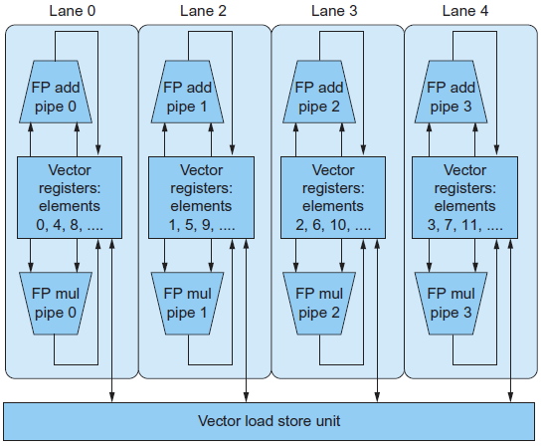
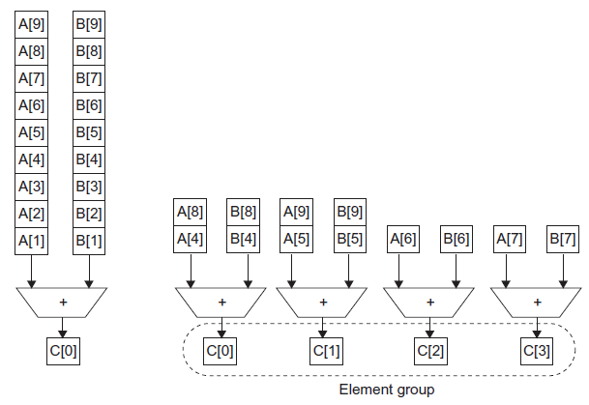
Vector vs. Multimedia Extensions
Vector instructions have a variable vector width, multimedia extensions have a fixed width
Vector instructions support strided access, multimedia extensions do not
Vector units can be combination of pipelined and arrayed functional units:

Slide 23
GPU Architectures
Processing is highly data-parallel
GPUs are highly multithreaded
Use thread switching to hide memory latency
Less reliance on multi-level caches
Graphics memory is wide and high-bandwidth
Trend toward general purpose GPUs
Heterogeneous CPU/GPU systems
CPU for sequential code, GPU for parallel code
Programming languages/APIs
DirectX, OpenGL
C for Graphics (Cg), High Level Shader Language (HLSL)
Compute Unified Device Architecture (CUDA)

Slide 24
History of GPUs
Early video cards
Frame buffer memory with address generation for video output
3D graphics processing
Originally high-end computers (e.g., SGI)
Moore’s Law ⇒ lower cost, higher density
3D graphics cards for PCs and game consoles
Graphics Processing Units
Processors oriented to 3D graphics tasks
Vertex/pixel processing, shading, texture mapping, rasterization

Slide 25
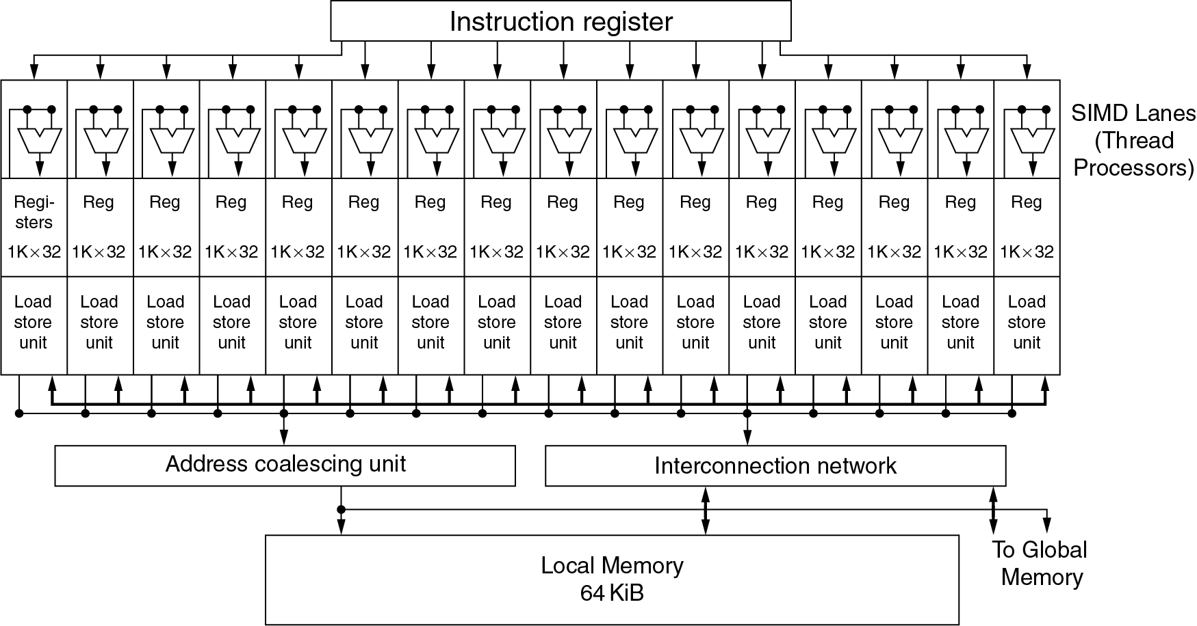
Example: NVIDIA Fermi
Multiple SIMD processors, each as shown:

Slide 26
Example: NVIDIA Fermi
SIMD Processor: 16 SIMD lanes
SIMD instruction
Operates on 32 element wide threads
Dynamically scheduled on 16-wide processor over 2 cycles
32K x 32-bit registers spread across lanes
64 registers per thread context

Slide 27
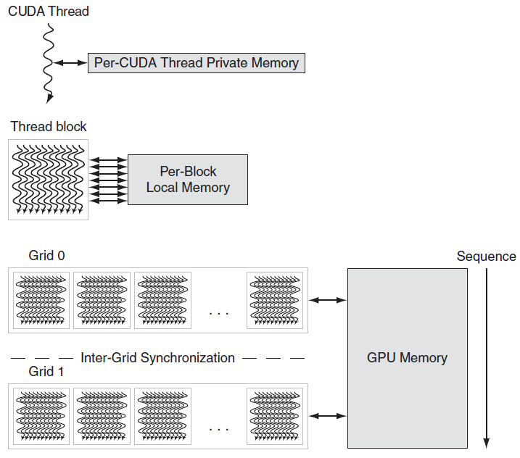
GPU Memory Structures

Slide 28
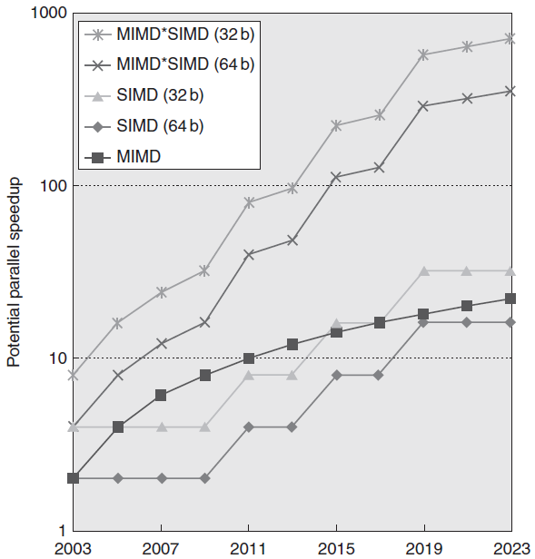
Concluding Remarks
SIMD and vector operations match multimedia applications and are easy to program

Slide 29
Any Questions?
.text
__start: addi t1, zero, 0x18
addi t2, zero, 0x21
cycle: beq t1, t2, done
slt t0, t1, t2
bne t0, zero, if_less
nop
sub t1, t1, t2
j cycle
nop
if_less: sub t2, t2, t1
j cycle
done: add t3, t1, zero

