Slide 1
Computer Architecture and Operating Systems Lecture 14: Thread-Level Parallelism
Andrei Tatarnikov
atatarnikov@hse.ru
@andrewt0301

Slide 2
Why We Need Thread-Level Parallelism
Goals
Task-level (process-level) parallelism
High throughput for independent jobs
Parallel processing program
Single program run on multiple processors
Implementations
Hardware multithreading
Multicore microprocessors
Chips with multiple processors (cores)
Multiprocessors
Connecting multiple computers to get higher performance
Scalability, availability, power efficiency

Slide 3
Challenge: Parallel Programming
Parallel hardware requires parallel software
Parallel software is the problem
Need to get significant performance improvement
Otherwise, just use a faster uniprocessor, since it is easier
Difficulties
Partitioning
Coordination
Communications overhead

Slide 4
Threading: Definitions
Process: program running on a computer
Multiple processes can run at once: e.g., surfing Web, playing music, writing a paper
Separate virtual memory, stack, registers
Thread: part of a program
Each process has multiple threads: e.g., a word processor may have threads for typing, spell checking, printing
Shared virtual memory, separate stack and registers

Slide 5
Threads in Conventional Uniprocessor (SISD)
One thread runs at once
When one thread stalls (for example, waiting for memory):
Architectural state of that thread stored
Architectural state of waiting thread loaded into processor and it runs
Called context switching (can take thousands of cycles)
Appears to user like all threads running simultaneously
Does not improve performance

Slide 6
Parallel Processing Challenge: Amdahl’s Law
Sequential part can limit speedup
Example: 100 processors, 90 × speedup?
T_{new} = T_{parallelizable}/100 + T_{sequential}
Speedup =
Solving: F_{parallelizable} = 0.999
Need sequential part to be 0.1% of original time

Slide 7
Scaling Example 1
Workload: sum of 10 scalars, and 10 × 10 matrix sum
Speed up from 10 to 100 processors
Single processor: Time = (10 + 100) × t_{add}
10 processors
Time = 10 × t_{add} + 100/10 × t_{add} = 20 × t_{add}
Speedup = 110/20 = 5.5 (55% of potential)
100 processors
Time = 10 × t_{add} + 100/100 × t_{add} = 11 × t_{add}
Speedup = 110/11 = 10 (10% of potential)
Assumes load can be balanced across processors

Slide 8
Scaling Example 2
What if matrix size is 100 × 100?
Single processor: Time = (10 + 10000) × t_{add}
10 processors
Time = 10 × t_{add} + 10000/10 × t_{add} = 1010 × t_{add}
Speedup = 10010/1010 = 9.9 (99% of potential)
100 processors
Time = 10 × t_{add} + 10000/100 × t_{add} = 110 × t_{add}
Speedup = 10010/110 = 91 (91% of potential)
Assuming load balanced

Slide 9
Strong vs Weak Scaling
Strong scaling: problem size fixed
As in the examples
Weak scaling: problem size proportional to number of processors
10 processors, 10 × 10 matrix
Time = 20 × t_{add}
100 processors, 32 × 32 matrix
Time = 10 × t_{add} + 1000/100 × t_{add} = 20 × t_{add}
Constant performance in this example

Slide 10
Hardware Multithreading
Multiple copies of architectural state
Multiple threads active at once:
When one thread stalls, another runs immediately
If one thread can’t keep all execution units busy, another thread can use them
Does not increase instruction-level parallelism (ILP) of single thread, but increases throughput
Intel calls this “hyperthreading”

Slide 11
Hardware Multithreading
Performing multiple threads of execution in parallel
Replicate registers, PC, etc.
Fast switching between threads
Fine-grained multithreading
Switch threads after each cycle
Interleave instruction execution
If one thread stalls, others are executed
Coarse-grained multithreading
Only switch on long stall (e.g., L2-cache miss)
Simplifies hardware, but doesn’t hide short stalls (eg, data hazards)
Simultaneous multithreading

Slide 12
Simultaneous Multithreading
In multiple-issue dynamically scheduled processor
Schedule instructions from multiple threads
Instructions from independent threads execute when function units are available
Within threads, dependencies handled by scheduling and register renaming
Example: Intel Pentium-4 HT
Two threads: duplicated registers, shared function units and caches

Slide 13
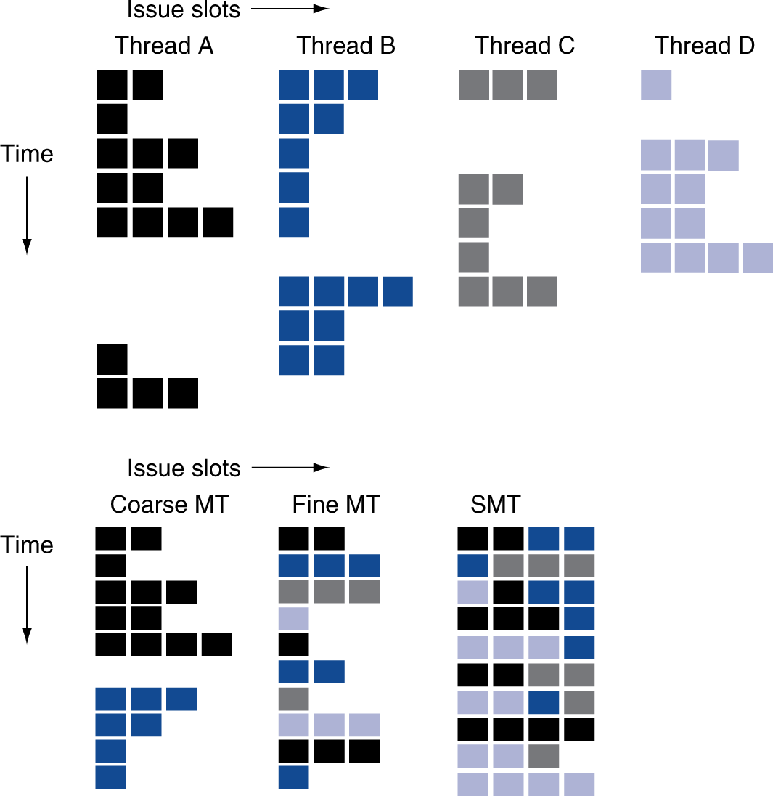
Multithreading Example

Slide 14
Multiprocessors (MIMD)
Multiple processors (cores) with a method of communication between them
Types:
Homogeneous: multiple cores with shared memory
Heterogeneous: separate cores for different tasks (for example, DSP and CPU in cell phone)
Clusters: each core has own memory system

Slide 15
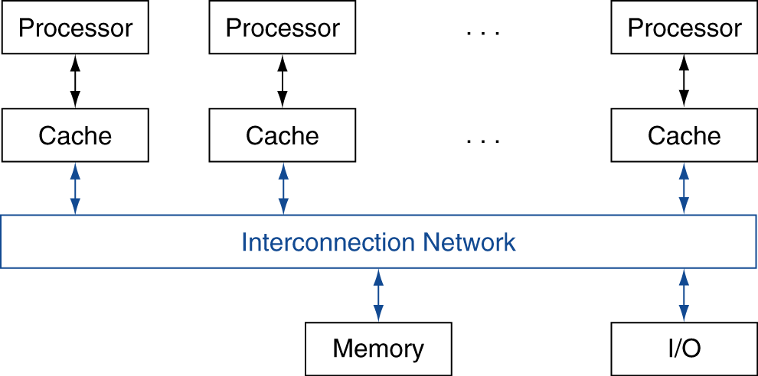
Multicores: Shared Memory
SMP: shared memory multiprocessor
Hardware provides single physical address space for all processors
Synchronize shared variables using locks
Memory access time
UMA (uniform) vs. NUMA (nonuniform)

Slide 16
Multicores and Cache Coherence
Suppose two CPU cores share a physical address space
Write-through caches
Time step | Event | CPU A’s cache | CPU B’s cache | Memory
0 |  |  |  | 0
1 | CPU A reads X | 0 |  | 0
2 | CPU B reads X | 0 | 0 | 0
3 | CPU A writes 1 to X | 1 | 0 | 1

Slide 17
Coherence Defined
Informally: Reads return most recently written value
Formally:
P writes X; P reads X (no intervening writes) ⇒ read returns written value
P₁ writes X; P₂ reads X (sufficiently later) ⇒ read returns written value
CPU B reading X after step 3 in example
P₁ writes X, P₂ writes X ⇒ all processors see writes in the same order
End up with the same final value for X

Slide 18
Cache Coherence Protocols
Operations performed by caches in multiprocessors to ensure coherence
Migration of data to local caches
Reduces bandwidth for shared memory
Replication of read-shared data
Reduces contention for access
Snooping protocols
Each cache monitors bus reads/writes
Directory-based protocols
Caches and memory record sharing status of blocks in a directory

Slide 19
Synchronization: Basic Building Blocks
Atomic exchange
Swaps register with memory location
Test-and-set
Sets under condition
Fetch-and-increment
Reads original value from memory and increments it in memory
Requires read and write in uninterruptable instruction
RISC-V: load reserved/store conditional
If the memory location specified by the load is changed before the store conditional to the same address, the store conditional fails

Slide 20
Implementing Locks
Atomic exchange (EXCH):
try: mov x3,x4 # mov exchange value
lr x2,x1 # load reserved from
sc x3,0(x1) # store conditional
bnez x3,try # branch store fails
mov x4,x2 # put load value in x4?
Atomic increment:
try: lr x2,x1 # load reserved 0(x1)
addi x3,x2,1 # increment
sc x3,0(x1) # store conditional
bnez x3,try # branch store fails

Slide 21
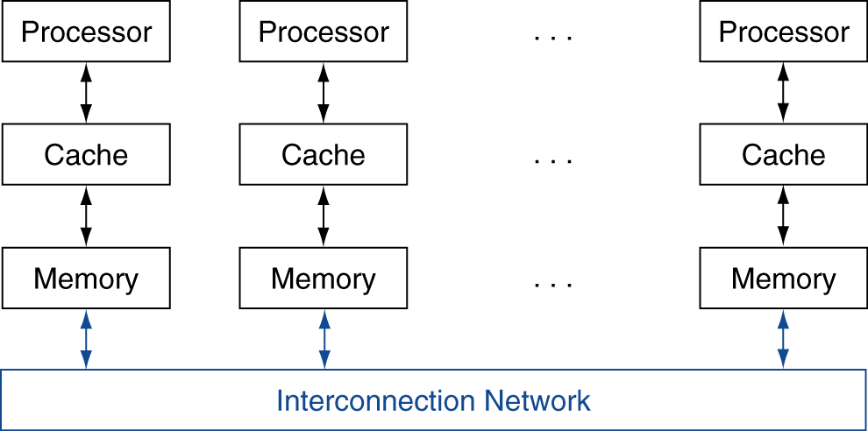
Multiprocessors: Message Passing
Each processor has private physical address space
Hardware sends/receives messages between processors

Slide 22
Any Questions?
.text
__start: addi t1, zero, 0x18
addi t2, zero, 0x21
cycle: beq t1, t2, done
slt t0, t1, t2
bne t0, zero, if_less
nop
sub t1, t1, t2
j cycle
nop
if_less: sub t2, t2, t1
j cycle
done: add t3, t1, zero

