Slide 1
Computer Architecture and Operating Systems Lecture 16: Domain-specific architectures. Tensor Processing Unit.
Andrei Tatarnikov
atatarnikov@hse.ru
@andrewt0301

Slide 2
Motivation
Modern performance tuning techniques:
Deep memory hierarchy
Wide SIMD units
Deep pipelines
Branch prediction
Out-of-order execution
Speculative prefetching
Multithreading
Multiprocessing
Further improvement:
Domain-specific architectures

Slide 3
Guidelines for DSAs
Use dedicated memories to minimize data movement
Invest resources into more arithmetic units or bigger memories
Use the easiest form of parallelism that matches the domain
Reduce data size and type to the simplest needed for the domain
Use a domain-specific programming language

Slide 4
Deep Neural Networks
Inpired by neuron of the brain
Computes non-linear “activation” function of the weighted sum of input values
Neurons arranged in layers
Most practitioners will choose an existing design
Topology
Data type
Training (learning):
Calculate weights using backpropagation algorithm
Supervised learning: stochastic graduate descent
Inference: use neural network for classification

Slide 5
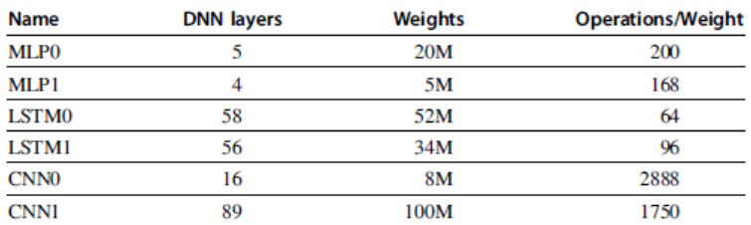
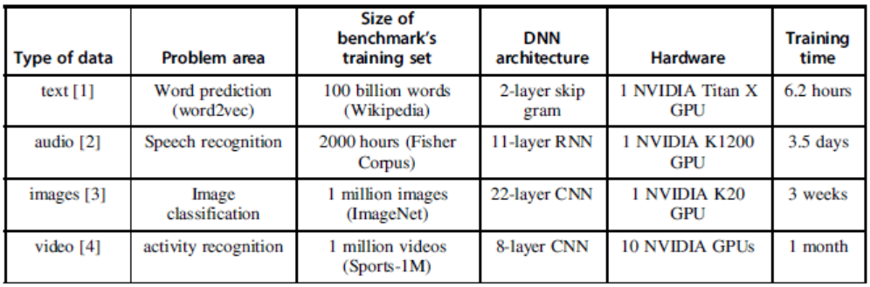
DNN Statistics

Slide 6
Most popular DNNs
Multilayer perceptron (MLP)
Recurrent neural network (RNN)
Speech recognition
Computer translation
Convolutional neural network (CNN)
Computer vision

Slide 7
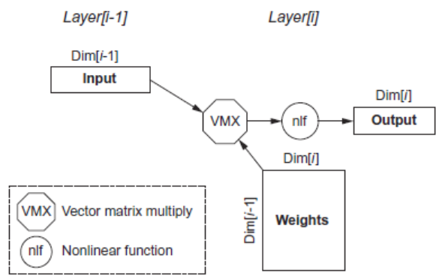
Multi-Layer Perceptron
Parameters:
Dim[i]: number of neurons
Dim[i-1]: dimension of input vector
Number of weights: Dim[i-1] x Dim[i]
Operations: 2 x Dim[i-1] x Dim[i]
Operations/weight: 2

Slide 8
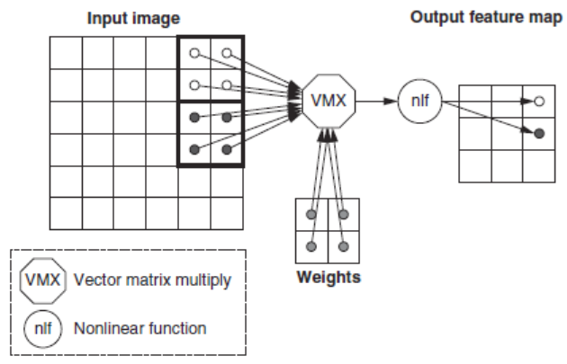
Convolutional Neural Network
Computer vision
Each layer raises the level of abstraction
First layer recognizes horizontal and vertical lines
Second layer recognizes corners
Third layer recognizes shapes
Fourth layer recognizes features, such as ears of a dog
Higher layers recognizes different breeds of dogs

Slide 9
DNN Summary
Batches
Reuse weights once fetched from memory across multiple inputs
Increases operational intensity
Quantization
Use 8- or 16-bit fixed point
Operations
Matrix-vector multiply
Matrix-matrix multiply
Stencil
ReLU
Sigmoid
Hyperbolic tangeant

Slide 10
Tensor Processing Unit
Google’s DNN ASIC
256 x 256 8-bit matrix multiply unit
Large software-managed scratchpad
Coprocessor on the PCIe bus

Slide 11
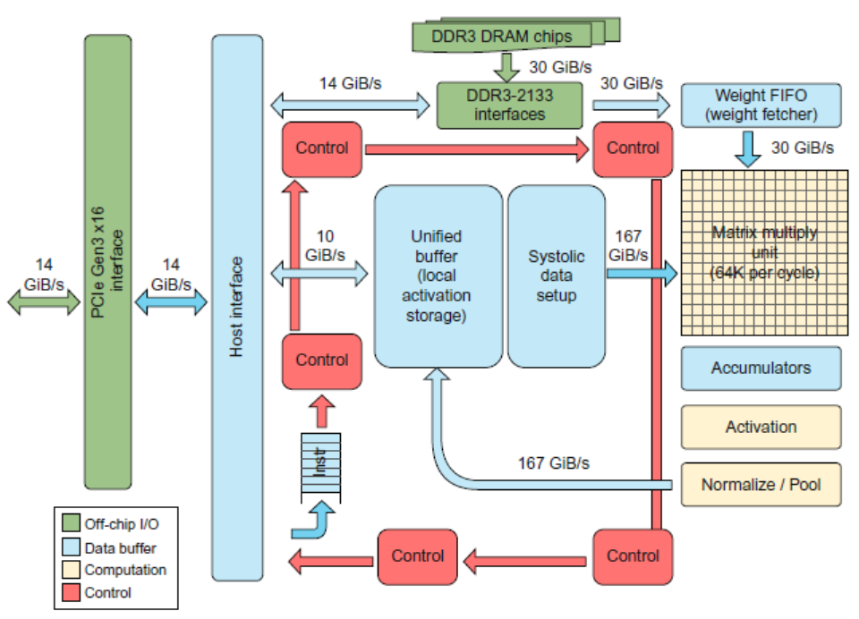
Tensor Processing Unit

Slide 12
TPU ISA
Read_Host_Memory
Reads memory from the CPU memory into the unified buffer
Read_Weights
Reads weights from the Weight Memory into the Weight FIFO as input to the Matrix Unit
MatrixMatrixMultiply/Convolve
Perform a matrix-matrix multiply, a vector-matrix multiply, an element-wise matrix multiply, an element-wise vector multiply, or a convolution from the Unified Buffer into the accumulators
takes a variable-sized B*256 input, multiplies it by a 256x256 constant input, and produces a B*256 output, taking B pipelined cycles to complete
Activate
Computes activation function
Write_Host_Memory
Writes data from unified buffer into host memory

Slide 13
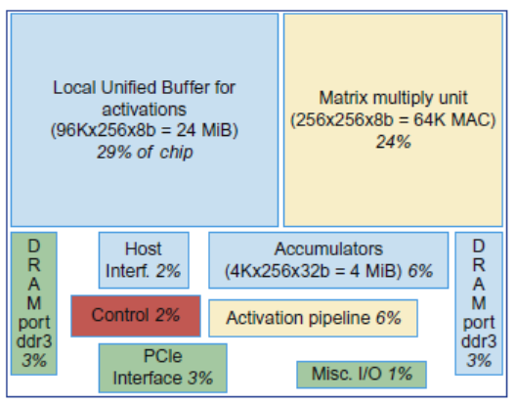
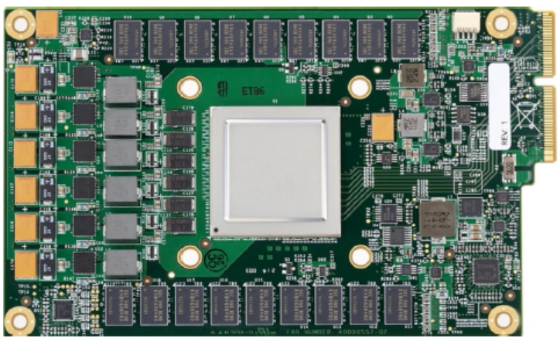
Tensor Processing Unit

Slide 14
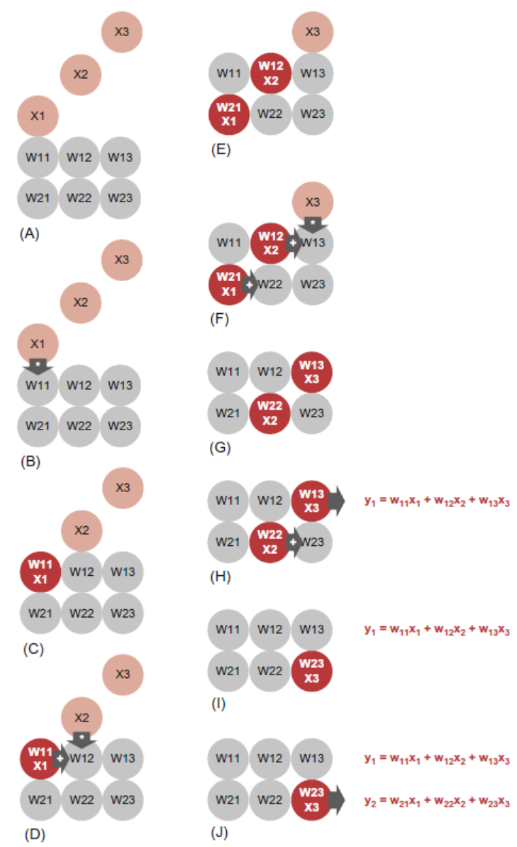
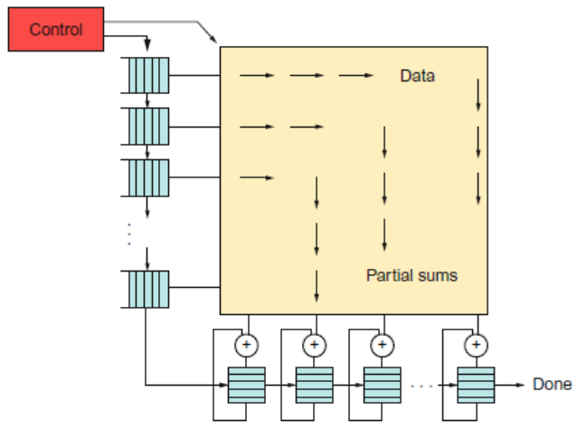
TPU ISA

Slide 15
The TPU and the Guidelines
Use dedicated memories
24 MiB dedicated buffer, 4 MiB accumulator buffers
Invest resources in arithmetic units and dedicated memories
60% of the memory and 250X the arithmetic units of a server-class CPU
Use the easiest form of parallelism that matches the domain
Exploits 2D SIMD parallelism
Reduce the data size and type needed for the domain
Primarily uses 8-bit integers
Use a domain-specific programming language
Uses TensorFlow

Slide 16
Any Questions?
.text
__start: addi t1, zero, 0x18
addi t2, zero, 0x21
cycle: beq t1, t2, done
slt t0, t1, t2
bne t0, zero, if_less
nop
sub t1, t1, t2
j cycle
nop
if_less: sub t2, t2, t1
j cycle
done: add t3, t1, zero

