Slide 1
Computer Architecture and Operating Systems Lecture 16: Domain-specific architectures. Tensor Processing Unit.
Alexey Kanakhin
akanakhin@hse.ru

Slide 2
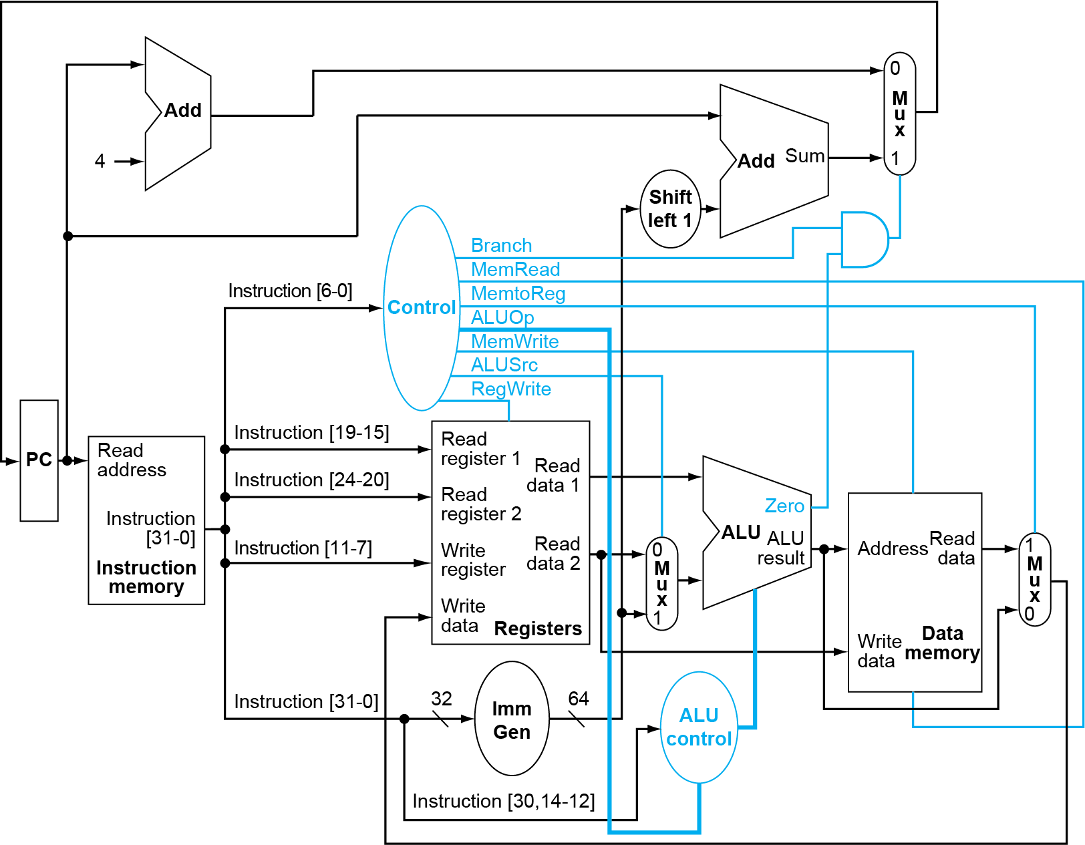
Conventional 5-stages pipeline

Slide 3
Possible improvements
Modern performance tuning techniques:
Deep memory hierarchy
Wide SIMD units
Deep pipelines
Branch prediction
Out-of-order execution
Speculative prefetching
Multithreading
Multiprocessing
Further improvement:
Domain-specific architectures

Slide 4
Guidelines for DSAs
Use dedicated memories to minimise data movement
Invest resources into more arithmetic units or bigger memories
Use the easiest form of parallelism that matches the domain
Reduce data size and type to the simplest needed for the domain
Use a domain-specific programming language

Slide 5
DNN Summary
Batches
Reuse weights once fetched from memory across multiple inputs
Increases operational intensity
Quantisation
Use 8- or 16-bit fixed point or integer numbers
Operations
Matrix-vector multiply
Matrix-matrix multiply
Stencil
ReLU
Sigmoid
Hyperbolic tangent

Slide 6
Matrix-Matrix multiplication

Slide 7
Systolic array (2D pipeline)
Different from pipelining
Nonlinear array structure, multi-direction data flow, each PE may have (small) local instruction and data memory
Different from SIMD
each PE may do something different

Slide 8
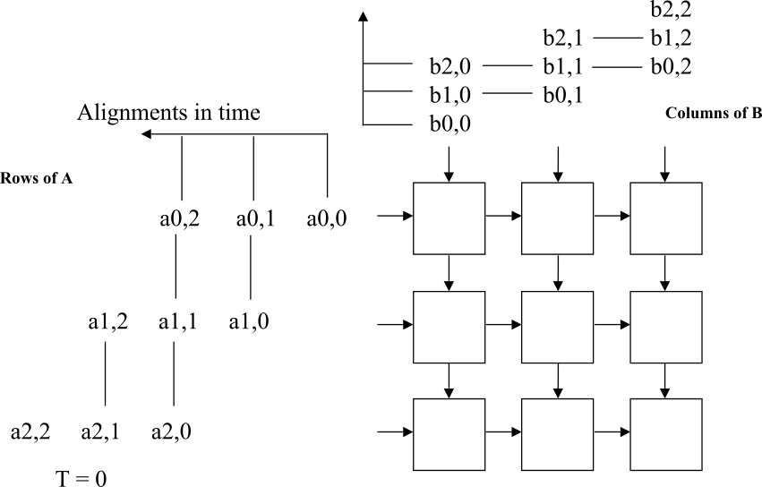
Computation example
Processing units arranged in a 2D grid
Each PU accumulates one element of the product

Slide 9
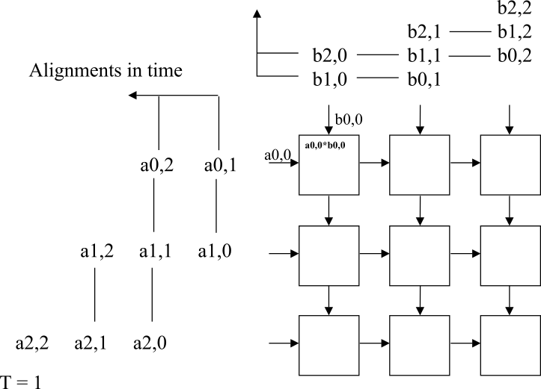
Computation example
Processing units arranged in a 2D grid
Each PU accumulates one element of the product

Slide 10
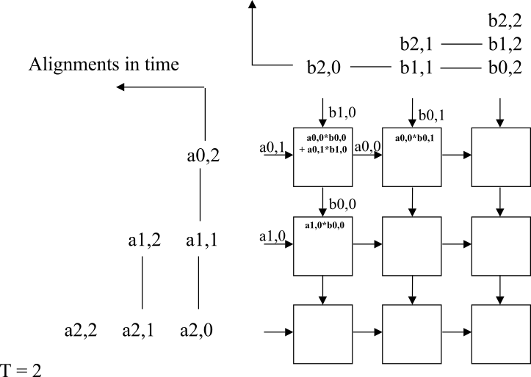
Computation example
Processing units arranged in a 2D grid
Each PU accumulates one element of the product

Slide 11
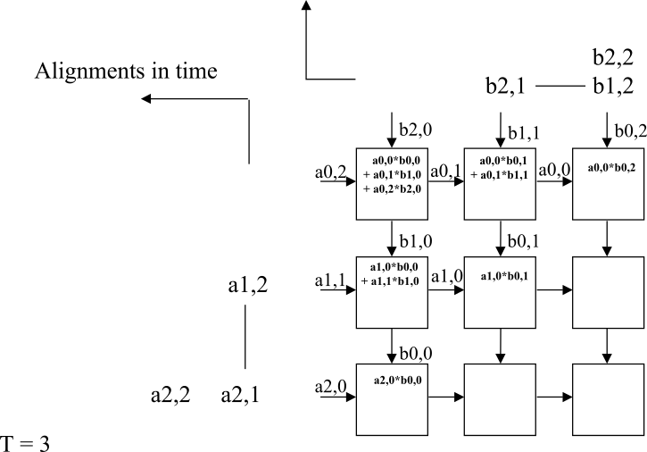
Computation example
Processing units arranged in a 2D grid
Each PU accumulates one element of the product

Slide 12
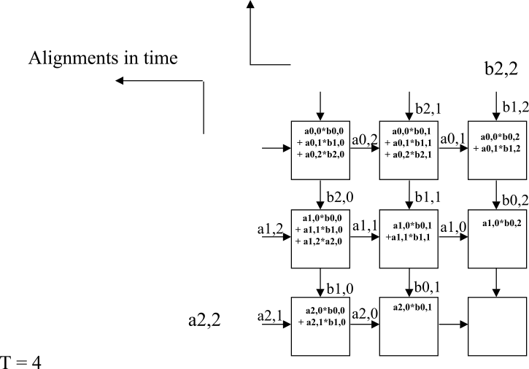
Computation example
Processing units arranged in a 2D grid
Each PU accumulates one element of the product

Slide 13
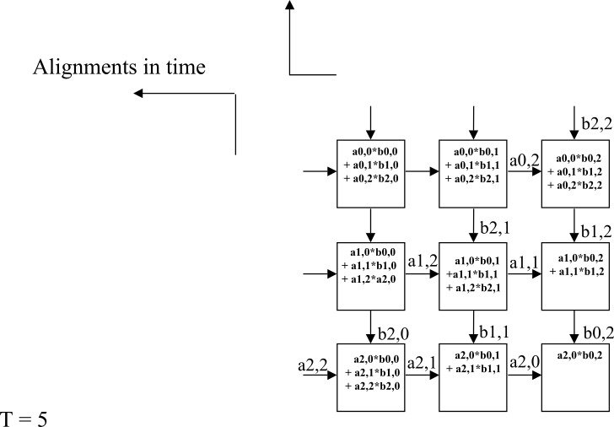
Computation example
Processing units arranged in a 2D grid
Each PU accumulates one element of the product

Slide 14
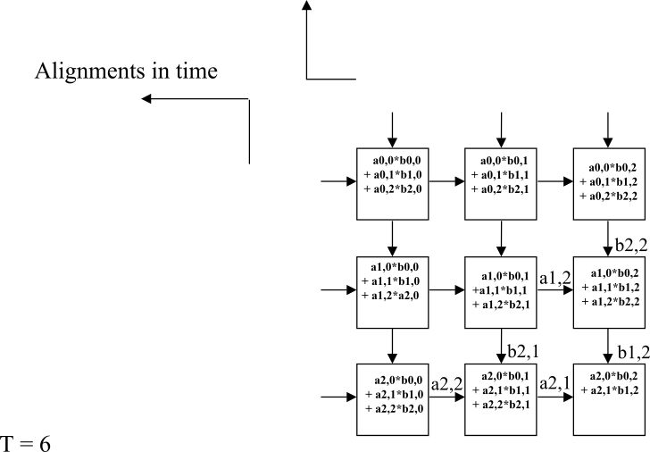
Computation example
Processing units arranged in a 2D grid
Each PU accumulates one element of the product

Slide 15
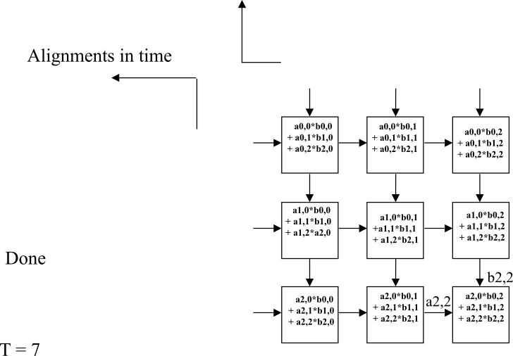
Computation example
Processing units arranged in a 2D grid
Each PU accumulates one element of the product

Slide 16
Tensor Processing Unit
Google’s DNN ASIC
256 x 256 8-bit matrix multiply unit
Large software-managed scratchpad
Coprocessor on the PCIe bus

Slide 17
TPU ISA
Read_Host_Memory
Reads memory from the CPU memory into the unified buffer
Read_Weights
Reads weights from the Weight Memory into the Weight FIFO as input to the Matrix Unit
MatrixMatrixMultiply/Convolve
Perform a matrix-matrix multiply, a vector-matrix multiply, an element-wise matrix multiply, an element-wise vector multiply, or a convolution from the Unified Buffer into the accumulators
takes a variable-sized B*256 input, multiplies it by a 256x256 constant input, and produces a B*256 output, taking B pipelined cycles to complete
Activate
Computes activation function
Write_Host_Memory
Writes data from unified buffer into host memory

Slide 18
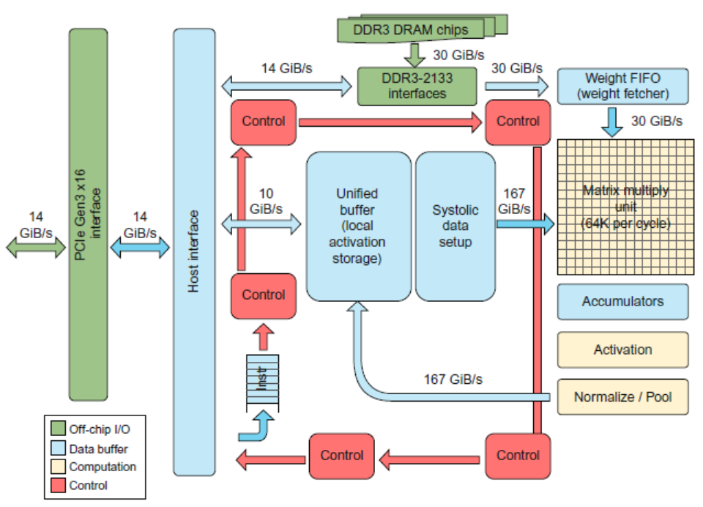
Tensor Processing Unit

Slide 19
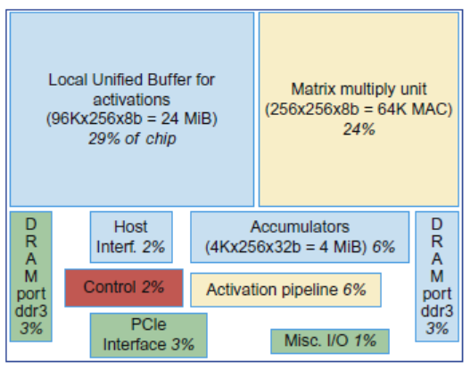
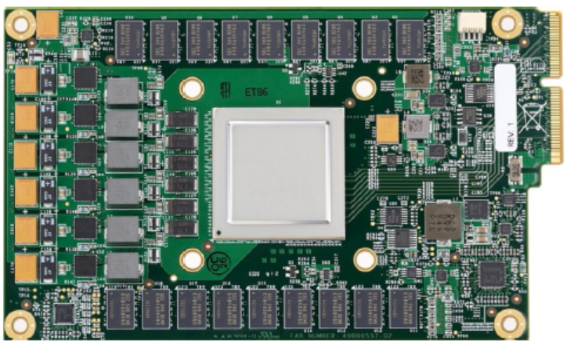
Tensor Processing Unit

Slide 20
The TPU and the Guidelines
Use dedicated memories
24 MiB dedicated buffer, 4 MiB accumulator buffers
Invest resources in arithmetic units and dedicated memories
60% of the memory and 250X the arithmetic units of a server-class CPU
Use the easiest form of parallelism that matches the domain
Exploits 2D SIMD parallelism
Reduce the data size and type needed for the domain
Primarily uses 8-bit integers
Use a domain-specific programming language
Uses TensorFlow

Slide 21
FPGA vs ASIC

Slide 22
FPGA vs ASIC

Slide 23
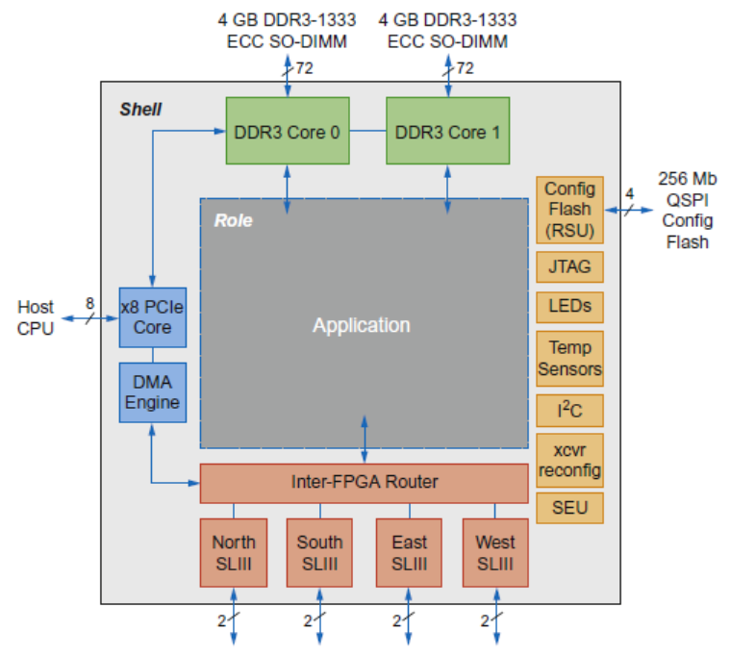
Microsoft Catapult
Needed to be general purpose and power efficient
Uses FPGA PCIe board with dedicated 20 Gbps network in 6 x 8 torus
Each of the 48 servers in half the rack has a Catapult board
Limited to 25 watts
32 MiB Flash memory
Two banks of DDR3-1600 (11 GB/s) and 8 GiB DRAM
FPGA (unconfigured) has 3962 18-bit ALUs and 5 MiB of on-chip memory
Programmed in Verilog RTL
Shell is 23% of the FPGA

Slide 24
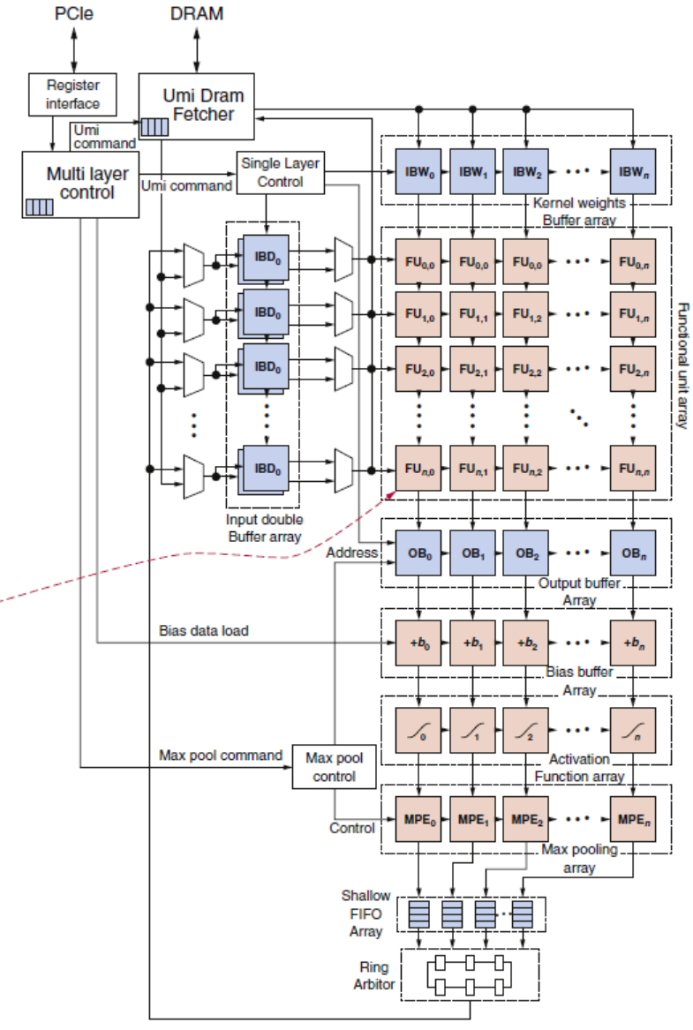
Microsoft Catapult: CNN configuration

Slide 25
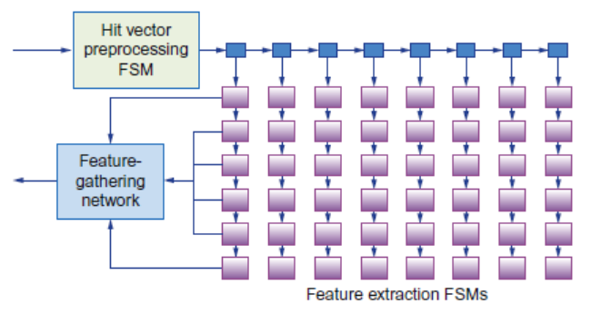
Microsoft Catapult: Search Ranking Configuration
Feature extraction (1 FPGA)
Extracts 4500 features for every document-query pair, e.g. frequency in which the query appears in the page
Systolic array of FSMs
Free-form expressions (2 FPGAs)
Calculates feature combinations
Machine-learned Scoring (1 FPGA for compression, 3 FPGAs calculate score)
Uses results of previous two stages to calculate floating-point score

Slide 26
FSM Example

Slide 27
Microsoft Catapult and Guidelines
Use dedicated memories
5 MiB dedicated memory
Invest resources in arithmetic units and dedicated memories
3926 ALUs
Use the easiest form of parallelism that matches the domain
2D SIMD for CNN, MISD parallelism for search scoring
Reduce the data size and type needed for the domain
Uses mixture of 8-bit integers and 64-bit floating-point
Use a domain-specific programming language
Uses Verilog RTL; Microsoft did not follow this guideline

Slide 28
Any Questions?
.text
__start: addi t1, zero, 0x18
addi t2, zero, 0x21
cycle: beq t1, t2, done
slt t0, t1, t2
bne t0, zero, if_less
nop
sub t1, t1, t2
j cycle
nop
if_less: sub t2, t2, t1
j cycle
done: add t3, t1, zero

