Slide 1
Computer Architecture and Operating Systems Lecture 6: Processes and Threads
Andrei Tatarnikov
atatarnikov@hse.ru
@andrewt0301

Slide 2
Process Concept
An operating system executes a variety of programs:
Batch system – jobs
Time-shared systems – user programs or tasks
Textbook uses the terms job and process almost interchangeably
Process – a program in execution; process execution must progress in sequential fashion
Multiple parts
The program code, also called text section
Current activity including program counter, processor registers
Stack containing temporary data
Function parameters, return addresses, local variables
Data section containing global variables
Heap containing memory dynamically allocated during run time

Slide 3
Process Concept (Cont.)
Program is passive entity stored on disk (executable file), process is active
Program becomes process when executable file loaded into memory
Execution of program started via GUI mouse clicks, command line entry of its name, etc
One program can be several processes
Consider multiple users executing the same program

Slide 4
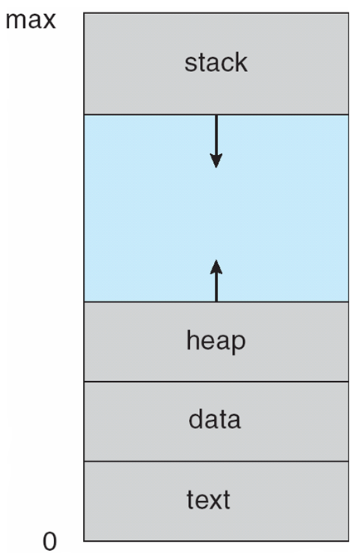
Process in Memory

Slide 5
Process State
As a process executes, it changes state
new: The process is being created
running: Instructions are being executed
waiting: The process is waiting for some event to occur
ready: The process is waiting to be assigned to a processor
terminated: The process has finished execution

Slide 6
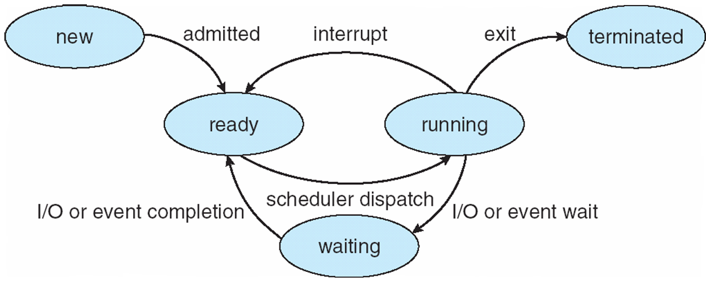
Diagram of Process State

Slide 7
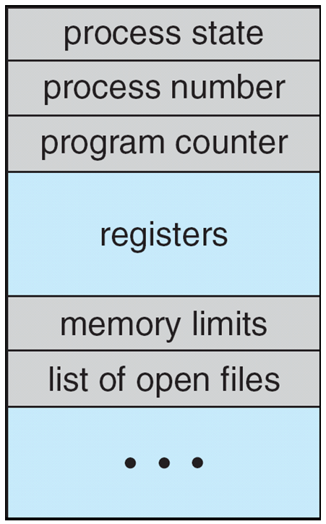
Process Control Block (PCB)
Information associated with each process
(also called task control block)
Process state – running, waiting, etc
Program counter – location of instruction to next execute
CPU registers – contents of all process-centric registers
CPU scheduling information- priorities, scheduling queue pointers
Memory-management information – memory allocated to the process
Accounting information – CPU used, clock time elapsed since start, time limits
I/O status information – I/O devices allocated to process, list of open files

Slide 8
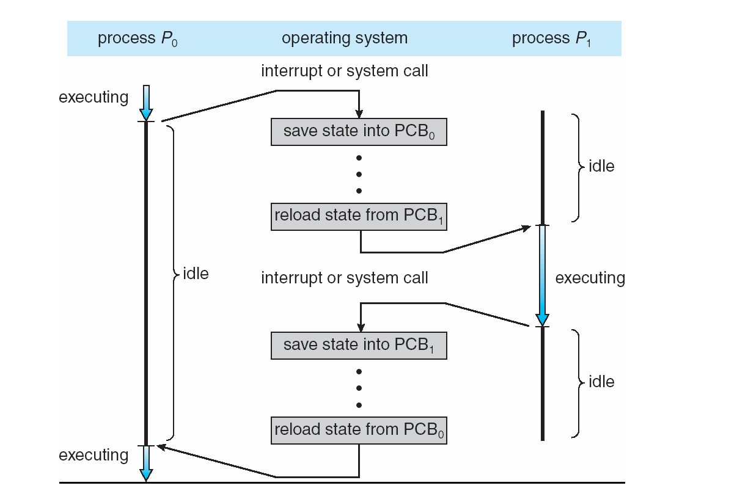
CPU Switch From Process to Process

Slide 9
Threads
So far, process has a single thread of execution
Consider having multiple program counters per process
Multiple locations can execute at once
Multiple threads of control -> threads
Must then have storage for thread details, multiple program counters in PCB
See next chapter

Slide 10
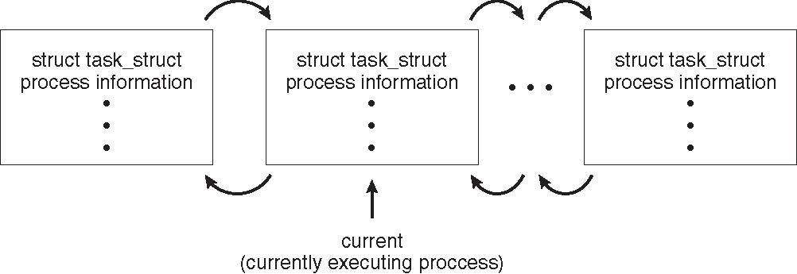
Process Representation in Linux
Represented by the C structure task_struct
pid t_pid; /* process identifier */
long state; /* state of the process */
unsigned int time_slice /* scheduling information */
struct task_struct *parent; /* this process’s parent */
struct list_head children; /* this process’s children */
struct files_struct *files; /* list of open files */
struct mm_struct *mm; /* address space of this process */

Slide 11
Process Scheduling
Maximize CPU use, quickly switch processes onto CPU for time sharing
Process scheduler selects among available processes for next execution on CPU
Maintains scheduling queues of processes
Job queue – set of all processes in the system
Ready queue – set of all processes residing in main memory, ready and waiting to execute
Device queues – set of processes waiting for an I/O device
Processes migrate among the various queues

Slide 12
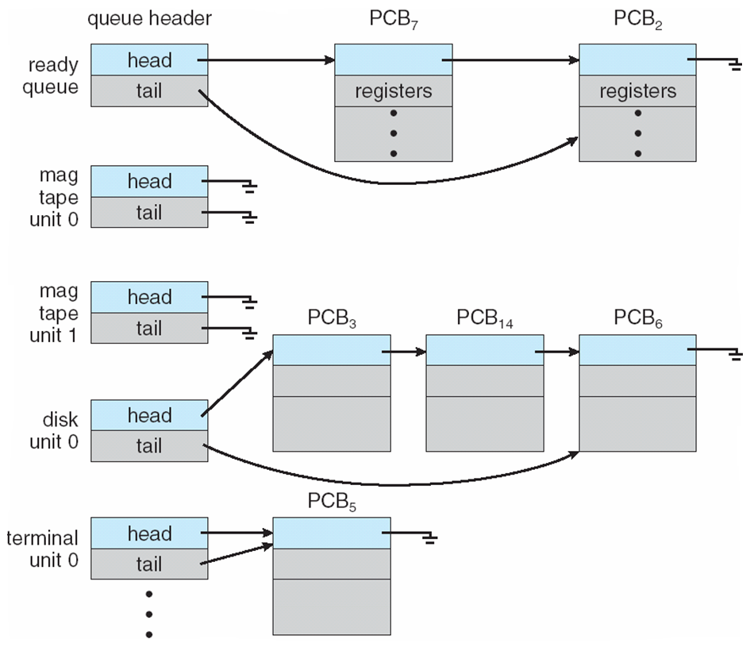
Ready Queue And Various I/O Device Queues

Slide 13
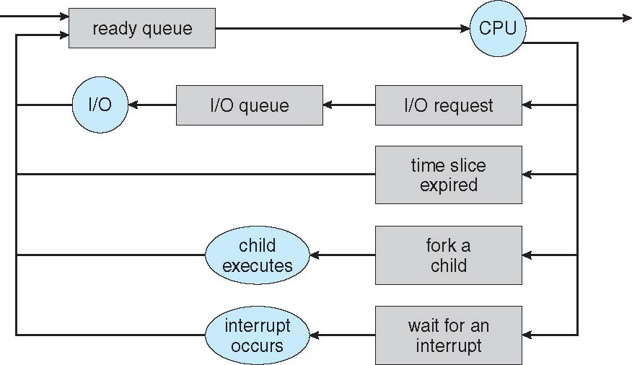
Representation of Process Scheduling
Queueing diagram represents queues, resources, flows

Slide 14
Schedulers
Short-term scheduler (or CPU scheduler) – selects which process should be executed next and allocates CPU
Sometimes the only scheduler in a system
Short-term scheduler is invoked frequently (milliseconds) ⇒ (must be fast)
Long-term scheduler (or job scheduler) – selects which processes should be brought into the ready queue
Long-term scheduler is invoked infrequently (seconds, minutes) ⇒ (may be slow)
The long-term scheduler controls the degree of multiprogramming
Processes can be described as either:
I/O-bound process – spends more time doing I/O than computations, many short CPU bursts
CPU-bound process – spends more time doing computations; few very long CPU bursts
Long-term scheduler strives for good process mix

Slide 15
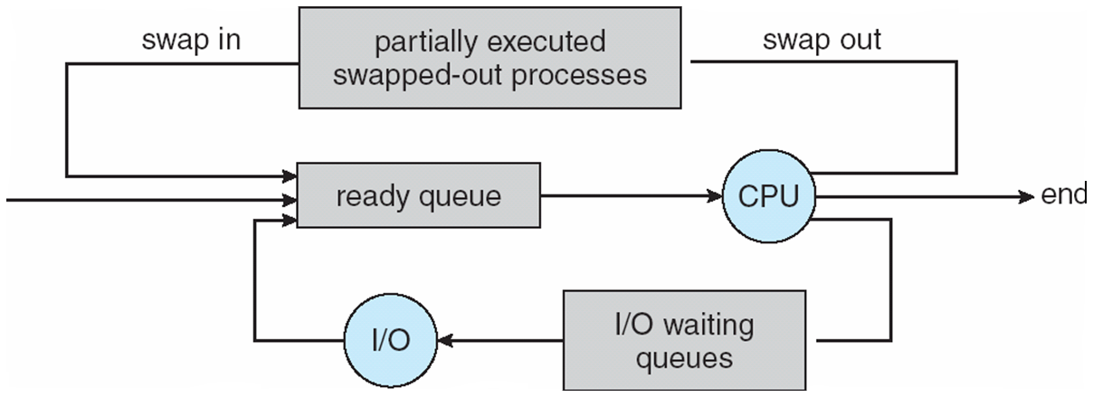
Addition of Medium Term Scheduling
Medium-term scheduler can be added if degree of multiple programming needs to decrease
Remove process from memory, store on disk, bring back in from disk to continue execution: swapping

Slide 16
Context Switch
When CPU switches to another process, the system must save the state of the old process and load the saved state for the new process via a context switch
Context of a process represented in the PCB
Context-switch time is overhead; the system does no useful work while switching
The more complex the OS and the PCB ➔ the longer the context switch
Time dependent on hardware support
Some hardware provides multiple sets of registers per CPU ➔ multiple contexts loaded at once

Slide 17
Operations on Processes
System must provide mechanisms for:
process creation,
process termination,
and so on as detailed next

Slide 18
Process Creation
Parent process create children processes, which, in turn create other processes, forming a tree of processes
Generally, process identified and managed via a process identifier (pid)
Resource sharing options
Parent and children share all resources
Children share subset of parent’s resources
Parent and child share no resources
Execution options
Parent and children execute concurrently
Parent waits until children terminate

Slide 19
A Tree of Processes in Linux

Slide 20
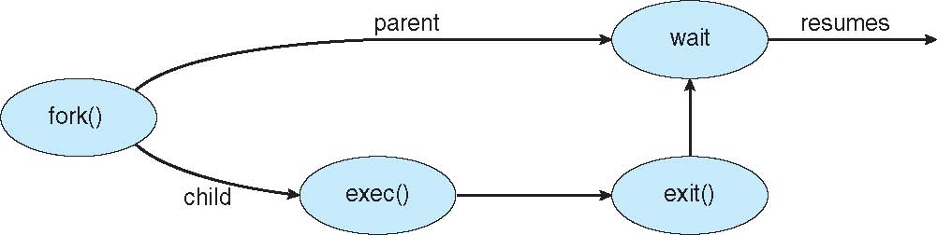
Process Creation (Cont.)
Address space
Child duplicate of parent
Child has a program loaded into it
UNIX examples
fork() system call creates new process
exec() system call used after a fork() to replace the process’ memory space with a new program

Slide 21
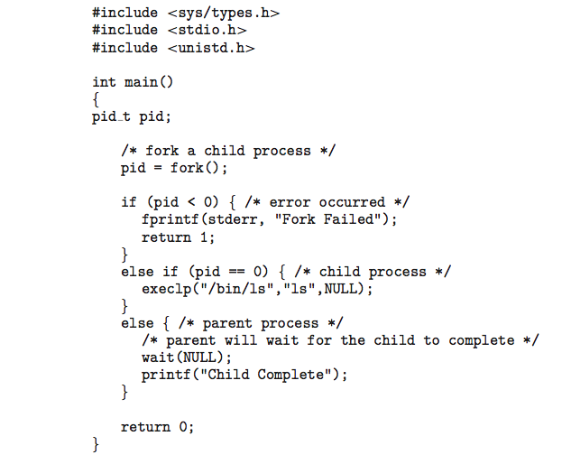
C Program Forking Separate Process

Slide 22
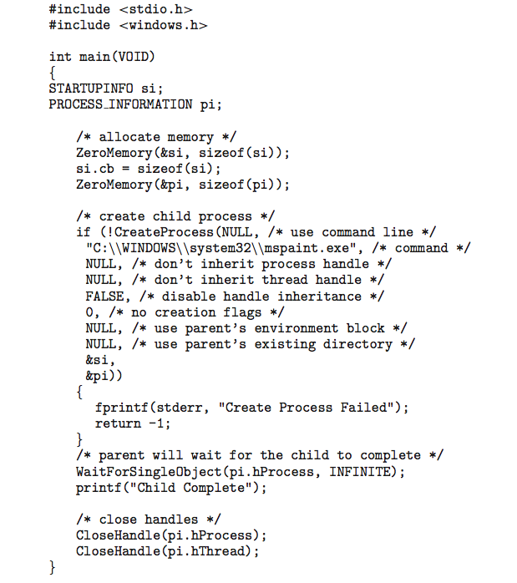
Creating a Separate Process via Windows API

Slide 23
Process Termination
Process executes last statement and then asks the operating system to delete it using the exit() system call.
Returns status data from child to parent (via wait())
Process’ resources are deallocated by operating system
Parent may terminate the execution of children processes using the abort() system call. Some reasons for doing so:
Child has exceeded allocated resources
Task assigned to child is no longer required
The parent is exiting and the operating systems does not allow a child to continue if its parent terminates

Slide 24
Process Termination
Some operating systems do not allow child to exists if its parent has terminated. If a process terminates, then all its children must also be terminated.
cascading termination. All children, grandchildren, etc. are terminated.
The termination is initiated by the operating system.
The parent process may wait for termination of a child process by using the wait()system call. The call returns status information and the pid of the terminated process
pid = wait(&status);
If no parent waiting (did not invoke wait()) process is a zombie
If parent terminated without invoking wait , process is an orphan

Slide 25
Interprocess Communication
Processes within a system may be independent or cooperating
Cooperating process can affect or be affected by other processes, including sharing data
Reasons for cooperating processes:
Information sharing
Computation speedup
Modularity
Convenience
Cooperating processes need interprocess communication (IPC)
Two models of IPC
Shared memory
Message passing

Slide 26
Communications Models
(a) Message passing.
(b) Shared memory.

Slide 27
Cooperating Processes
Independent process cannot affect or be affected by the execution of another process
Cooperating process can affect or be affected by the execution of another process
Advantages of process cooperation
Information sharing
Computation speed-up
Modularity
Convenience

Slide 28
Producer-Consumer Problem
Paradigm for cooperating processes, producer process produces information that is consumed by a consumer process
unbounded-buffer places no practical limit on the size of the buffer
bounded-buffer assumes that there is a fixed buffer size

Slide 29
Interprocess Communication – Shared Memory
An area of memory shared among the processes that wish to communicate
The communication is under the control of the users processes not the operating system.
Major issues is to provide mechanism that will allow the user processes to synchronize their actions when they access shared memory.
Synchronization is discussed in great details in Chapter 5.

Slide 30
Interprocess Communication – Message Passing
Mechanism for processes to communicate and to synchronize their actions
Message system – processes communicate with each other without resorting to shared variables
IPC facility provides two operations:
send(message)
receive(message)
The message size is either fixed or variable

Slide 31
User Threads and Kernel Threads
User threads - management done by user-level threads library
Three primary thread libraries:
POSIX Pthreads
Windows threads
Java threads
Kernel threads - Supported by the Kernel
Examples – virtually all general purpose operating systems, including:
Windows
Solaris
Linux
Tru64 UNIX
Mac OS X

Slide 32
Pthreads
May be provided either as user-level or kernel-level
A POSIX standard (IEEE 1003.1c) API for thread creation and synchronization
Specification, not implementation
API specifies behavior of the thread library, implementation is up to development of the library
Common in UNIX operating systems (Solaris, Linux, Mac OS X)

Slide 33
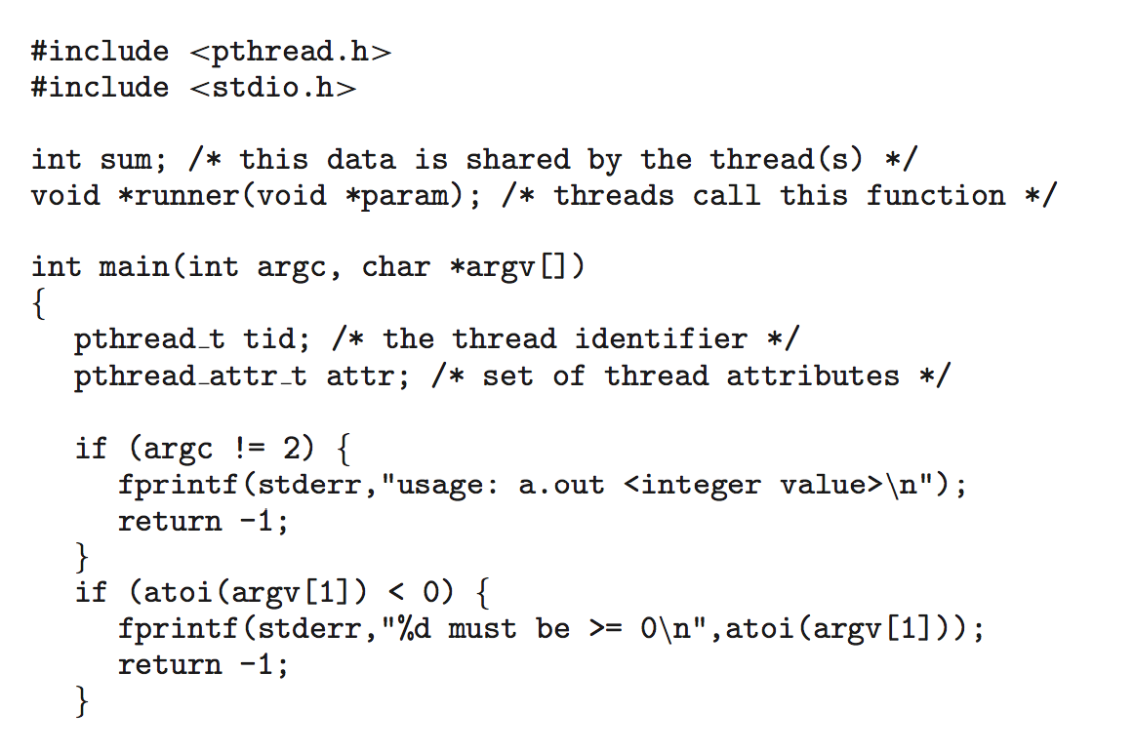
Pthreads Example

Slide 34
Pthreads Example (Cont.)

Slide 35
Pthreads Code for Joining 10 Threads

Slide 36
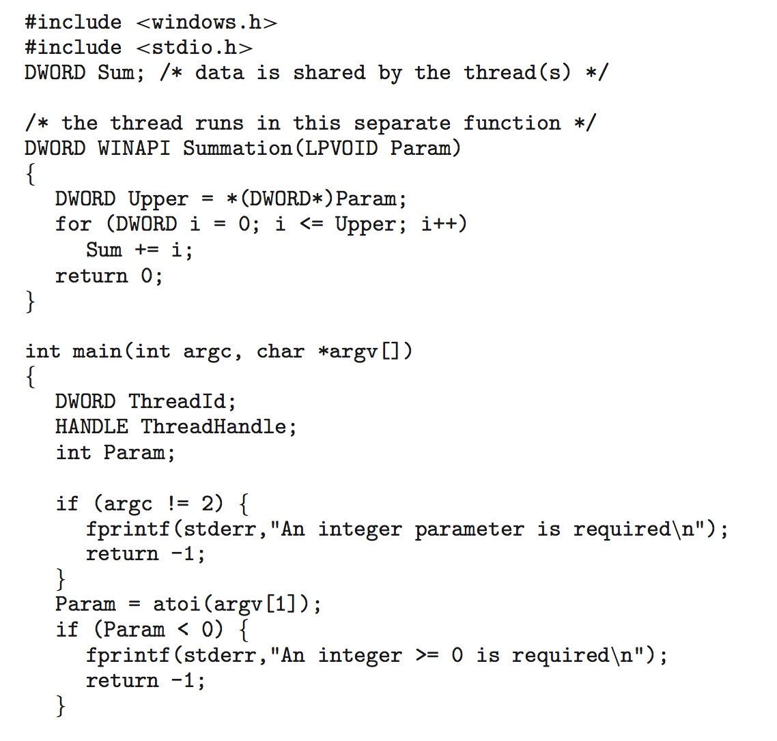
Windows Multithreaded C Program

Slide 37
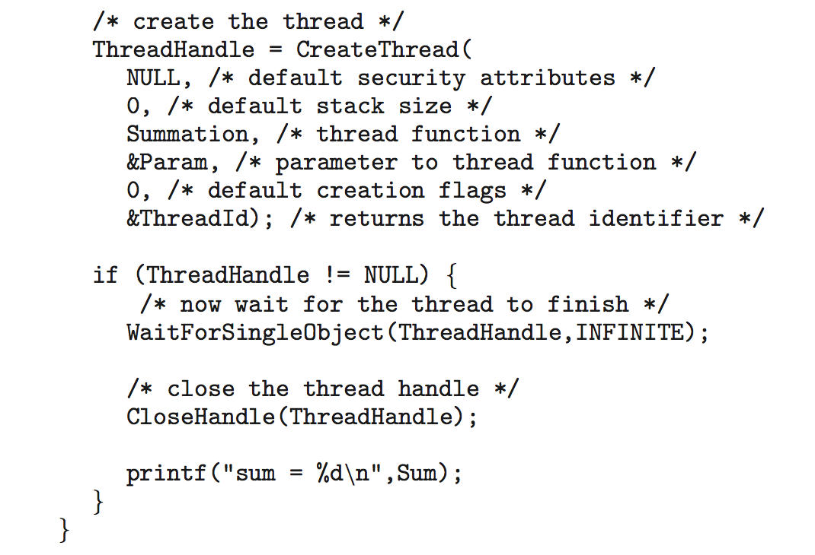
Windows Multithreaded C Program (Cont.)

Slide 38
Any Questions?
.text
__start: addi t1, zero, 0x18
addi t2, zero, 0x21
cycle: beq t1, t2, done
slt t0, t1, t2
bne t0, zero, if_less
nop
sub t1, t1, t2
j cycle
nop
if_less: sub t2, t2, t1
j cycle
done: add t3, t1, zero

