Slide 1
Computer Architecture and Operating Systems Lecture 7: I/O and Files
Andrei Tatarnikov
atatarnikov@hse.ru
@andrewt0301

Slide 2
Unix I/O Overview
A Linux file is a sequence of m bytes:
B₀ , B₁ , .... , B_{k} , .... , B_{m-1}
All I/O devices are represented as files:
/dev/sda2 (/usr disk partition)
/dev/tty2 (terminal)
Even the kernel is represented as a file:
/boot/vmlinuz-3.13.0-55-generic (kernel image)
/proc (kernel data structures)

Slide 3
Unix I/O Overview
Elegant mapping of files to devices allows kernel to export simple interface called Unix I/O:
Opening and closing files
open()and close()
Reading and writing a file
read() and write()
Changing the current file position (seek)
indicates next offset into file to read or write
lseek()
B₀
B₁
• • •
B_{k-1}
B_{k}
B_{k+1}
• • •
Current file position = k

Slide 4
File Types
Each file has a type indicating its role in the system
Regular file: Contains arbitrary data
Directory: Index for a related group of files
Other file types
Named pipes (FIFOs)
Symbolic links
Character and block devices
Sockets for communicating with a process on another machine

Slide 5
Regular Files
A regular file contains arbitrary data
Applications often distinguish between text files and binary files
Text files are regular files with only ASCII or Unicode characters
Binary files are everything else
e.g., object files, JPEG images
Kernel does not know the difference!
Text file is sequence of text lines
Text line is sequence of chars terminated by newline char (‘\n’)
Newline is 0xa, same as ASCII line feed character (LF)
End of line (EOL) indicators in other systems
Linux and Mac OS: ‘\n’ (0xa)
line feed (LF)
Windows and Internet protocols: ‘\r\n’ (0xd 0xa)
Carriage return (CR) followed by line feed (LF)

Slide 6
Directories
Directory consists of an array of links
Each link maps a filename to a file
Each directory contains at least two entries
. (dot) is a link to itself
.. (dot dot) is a link to the parent directory in the directory hierarchy (next slide)
Commands for manipulating directories
mkdir: create empty directory
ls: view directory contents
rmdir: delete empty directory

Slide 7
Directory Hierarchy
All files are organized as a hierarchy anchored by root directory named / (slash)
Kernel maintains current working directory (cwd) for each process
Modified using the cd command
/
bin/
dev/
etc/
home/
usr/
bash
tty1
group
passwd
acos/
andrewt/
include/
bin/
hello.c
stdio.h
sys/
vim
unistd.h

Slide 8
Pathnames
Locations of files in the hierarchy denoted by pathnames
Absolute pathname starts with ‘/’ and denotes path from root
/home/acos/hello.c
Relative pathname denotes path from current working directory
../home/acos/hello.c
/
cwd: /home/andrewt
bin/
dev/
etc/
home/
usr/
bash
tty1
group
passwd
acos/
andrewt/
include/
bin/
hello.c
stdio.h
sys/
vim
unistd.h

Slide 9
Linux Filesystem Hierarchy Standard
/bin – Essential user command binaries (for use by all users)
/boot – Static files of the boot loader
/dev – Device files
/etc – Host-specific system configuration
/home – User home directories (optional)
/lib – Essential shared libraries and kernel modules
/lib<qual> – Alternate format essential shared libraries (optional)
/media – Mount point for removable media
/mnt – Mount point for a temporarily mounted filesystem
/opt – Add-on application software packages
/root – Home directory for the root user
/proc – Virtual filesystem providing process and kernel information as files
/run – Run-time variable data
/sbin – System binaries
/srv – Data for services provided by this system
/sys – Kernel and system information virtual filesystem
/tmp – Temporary files
/usr – Secondary hierarchy for read-only user data; contains the majority of (multi-) user tools
/var – Variable files: files whose content is expected to change during normal operation of the system

Slide 10
Virtual File Systems
Virtual File Systems (VFS) on Unix provide an object-oriented way of implementing file systems
VFS allows the same system call interface (the API) to be used for different types of file systems
Separates file-system generic operations from implementation details
Implementation can be one of many file systems types, or network file system
Implements vnodes which hold inodes or network file details
Then dispatches operation to appropriate file system implementation routines

Slide 11
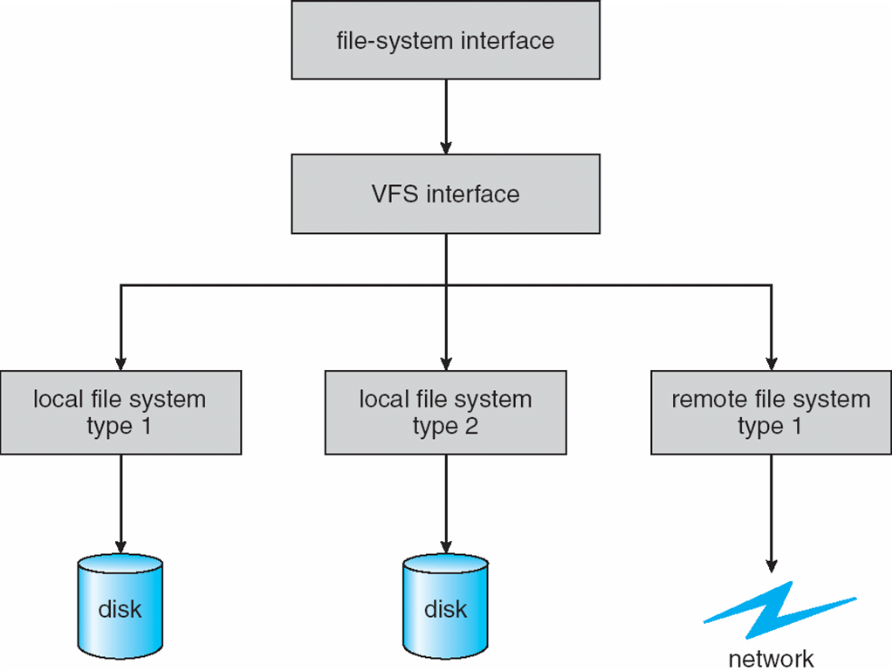
Virtual File Systems (Cont.)
The API is to the VFS interface, rather than any specific type of file system

Slide 12
Virtual File System Implementation
For example, Linux has four object types:
inode, file, superblock, dentry
VFS defines set of operations on the objects that must be implemented
Every object has a pointer to a function table
Function table has addresses of routines to implement that function on that object
For example:
• int open(...)— Open a file
• int close(...)— Close an already-open file
• ssize t read(...)— Read from a file
• ssize t write(...)— Write to a file
• int mmap(...)— Memory-map a file

Slide 13
5 parts of a Linux Disk
Boot Block
Contains boot loader
Superblock
The file systems “header”
Specifies location of file system data structures
inode area
Contains descriptors (inodes) for each file on the disk
All inodes are the same size
Head of the inode free list is stored in superblock
File contents area
Fixed size blocks containing data
Head of freelist stored in superblock
Swap area
Part of disk given to virtual memory system

Slide 14
Inode Format
User and group IDs
Protection bits
Access times
File Type
Directory, normal file, symbolic link, etc
Size
Length in bytes
Block list
Location of data blocks in file contents area
Link Count
Number of directories (hard links) referencing this inode

Slide 15
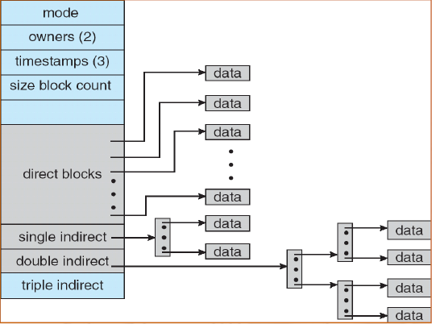
Unix Filesystem (Inodes)
Metadata
Ownership, permissions
Access/Modification times
etc…
Direct blocks:
Array of consecutive data blocks
Block size = 512 bytes
Inlined in the inode
Indirect blocks:
i-node only holds a small number of data block pointers (direct pointers)
For larger files, i-node points to an indirect block containing 1024 4-byte entries in a 4K block
Each indirect block entry points to a data block
Can have multiple levels of indirect blocks for even larger files

Slide 16
Opening Files
Opening a file informs the kernel that you are getting ready to access that file
Returns a small identifying integer file descriptor
fd == -1 indicates that an error occurred
Each process created by a Linux shell begins life with three open files associated with a terminal:
0: standard input (stdin)
1: standard output (stdout)
2: standard error (stderr)
int fd; /* file descriptor */
if ((fd = open("/etc/hosts", O_RDONLY)) < 0) {
perror("open");
exit(1);
}

Slide 17
Closing Files
Closing a file informs the kernel that you are finished accessing that file
Closing an already closed file is a recipe for disaster in threaded programs (more on this later)
Moral: Always check return codes, even for seemingly benign functions such as close()
int fd; /* file descriptor */
int retval; /* return value */
if ((retval = close(fd)) < 0) {
perror("close");
exit(1);
}

Slide 18
Reading Files
Reading a file copies bytes from the current file position to memory, and then updates file position
Returns number of bytes read from file fd into buf
Return type ssize_t is signed integer
nbytes < 0 indicates that an error occurred
Short counts (nbytes < sizeof(buf) ) are possible and are not errors!
char buf[512];
int fd; /* file descriptor */
int nbytes; /* number of bytes read */
/* Open file fd ... */
/* Then read up to 512 bytes from file fd */
if ((nbytes = read(fd, buf, sizeof(buf))) < 0) {
perror("read");
exit(1);
}

Slide 19
Writing Files
Writing a file copies bytes from memory to the current file position, and then updates current file position
Returns number of bytes written from buf to file fd
nbytes < 0 indicates that an error occurred
As with reads, short counts are possible and are not errors!
char buf[512];
int fd; /* file descriptor */
int nbytes; /* number of bytes read */
/* Open the file fd ... */
/* Then write up to 512 bytes from buf to file fd */
if ((nbytes = write(fd, buf, sizeof(buf)) < 0) {
perror("write");
exit(1);
}

Slide 20
Simple Unix I/O example
Copying stdin to stdout, one byte at a time
#include <unistd.h>
int main(void)
{
char c;
while(read(STDIN_FILENO, &c, 1) != 0)
write(STDOUT_FILENO, &c, 1);
exit(0);
}

Slide 21
On Short Counts
Short counts can occur in these situations:
Encountering (end-of-file) EOF on reads
Reading text lines from a terminal
Reading and writing network sockets
Short counts never occur in these situations:
Reading from disk files (except for EOF)
Writing to disk files
Best practice is to always allow for short counts.

Slide 22
File Metadata
Metadata is data about data, in this case file data
Per-file metadata maintained by kernel
accessed by users with the stat and fstat functions
/* Metadata returned by the stat and fstat functions */
struct stat {
dev_t st_dev; /* Device */
ino_t st_ino; /* inode */
mode_t st_mode; /* Protection and file type */
nlink_t st_nlink; /* Number of hard links */
uid_t st_uid; /* User ID of owner */
gid_t st_gid; /* Group ID of owner */
dev_t st_rdev; /* Device type (if inode device) */
off_t st_size; /* Total size, in bytes */
unsigned long st_blksize; /* Blocksize for filesystem I/O */
unsigned long st_blocks; /* Number of blocks allocated */
time_t st_atime; /* Time of last access */
time_t st_mtime; /* Time of last modification */
time_t st_ctime; /* Time of last change */
};

Slide 23
Example of Accessing File Metadata
statcheck.c
linux> ./statcheck statcheck.c
type: regular, read: yes
linux> chmod 000 statcheck.c
linux> ./statcheck statcheck.c
type: regular, read: no
linux> ./statcheck ..
type: directory, read: yes
int main (int argc, char **argv)
{
struct stat stat;
char *type, *readok;
Stat(argv[1], &stat);
if (S_ISREG(stat.st_mode)) /* Determine file type */
type = "regular";
else if (S_ISDIR(stat.st_mode))
type = "directory";
else
type = "other";
if ((stat.st_mode & S_IRUSR)) /* Check read access */
readok = "yes";
else
readok = "no";
printf("type: %s, read: %s\n", type, readok);
exit(0);
}

Slide 24
How the Unix Kernel Represents Open Files
Two descriptors referencing two distinct open files. Descriptor 1 (stdout) points to terminal, and descriptor 4 points to open disk file
Descriptor table
[one table per process]
Open file table
[shared by all processes]
v-node table
[shared by all processes]
File A (terminal)
stdin
fd 0
File access
stdout
fd 1
File pos
File size
Info in
stat struct
stderr
fd 2
fd 3
refcnt=1
File type
fd 4
...
...
File B (disk)
File access
File pos
File size
refcnt=1
File type
...
...

Slide 25
File Sharing
Two distinct descriptors sharing the same disk file through two distinct open file table entries
E.g., Calling open twice with the same filename argument
Descriptor table
[one table per process]
Open file table
[shared by all processes]
v-node table
[shared by all processes]
File A (disk)
stdin
fd 0
File access
stdout
fd 1
File pos
File size
stderr
fd 2
fd 3
refcnt=1
File type
fd 4
...
...
File B (disk)
File pos
refcnt=1
...

Slide 26
How Processes Share Files: fork
A child process inherits its parent’s open files
Note: situation unchanged by exec functions (use fcntl to change)
Before fork call:
Descriptor table
[one table per process]
Open file table
[shared by all processes]
v-node table
[shared by all processes]
File A (terminal)
stdin
fd 0
File access
stdout
fd 1
File pos
File size
stderr
fd 2
fd 3
refcnt=1
File type
fd 4
...
...
File B (disk)
File access
File pos
File size
refcnt=1
File type
...
...

Slide 27
How Processes Share Files: fork
A child process inherits its parent’s open files
After fork:
Child’s table same as parent’s, and +1 to each refcnt
Descriptor table
[one table per process]
Open file table
[shared by all processes]
v-node table
[shared by all processes]
Parent
File A (terminal)
fd 0
File access
fd 1
File pos
File size
fd 2
File type
fd 3
refcnt=2
fd 4
...
...
Child
File B (disk)
File access
fd 0
File size
fd 1
File pos
fd 2
refcnt=2
File type
fd 3
...
fd 4
...

Slide 28
I/O Redirection
Question: How does a shell implement I/O redirection?
linux> ls > foo.txt
Answer: By calling the dup2(oldfd, newfd) function
Copies (per-process) descriptor table entry oldfd to entry newfd
Descriptor table
before dup2(4,1)
Descriptor table
after dup2(4,1)
fd 0
fd 0
fd 1
a
fd 1
b
fd 2
fd 2
fd 3
fd 3
fd 4
b
fd 4
b

Slide 29
I/O Redirection Example
Step #1: open file to which stdout should be redirected
Happens in child executing shell code, before exec
Descriptor table
[one table per process]
Open file table
[shared by all processes]
v-node table
[shared by all processes]
File A
stdin
fd 0
File access
stdout
fd 1
File pos
File size
stderr
fd 2
fd 3
refcnt=1
File type
fd 4
...
...
File B
File access
File pos
File size
refcnt=1
File type
...
...

Slide 30
I/O Redirection Example (cont.)
Step #2: call dup2(4,1)
cause fd=1 (stdout) to refer to disk file pointed at by fd=4
Descriptor table
[one table per process]
Open file table
[shared by all processes]
v-node table
[shared by all processes]
File A
stdin
fd 0
File access
stdout
fd 1
File pos
File size
stderr
fd 2
fd 3
refcnt=0
File type
fd 4
...
...
File B
File access
File pos
File size
refcnt=2
File type
...
...

Slide 31
Standard I/O Functions
The C standard library (libc.so) contains a collection of higher-level standard I/O functions
Documented in Appendix B of K&R
Examples of standard I/O functions:
Opening and closing files (fopen and fclose)
Reading and writing bytes (fread and fwrite)
Reading and writing text lines (fgets and fputs)
Formatted reading and writing (fscanf and fprintf)

Slide 32
Standard I/O Streams
Standard I/O models open files as streams
Abstraction for a file descriptor and a buffer in memory
C programs begin life with three open streams (defined in stdio.h)
stdin (standard input)
stdout (standard output)
stderr (standard error)
#include <stdio.h>
extern FILE *stdin; /* standard input (descriptor 0) */
extern FILE *stdout; /* standard output (descriptor 1) */
extern FILE *stderr; /* standard error (descriptor 2) */
int main() {
fprintf(stdout, "Hello, world\n");
}

Slide 33
Buffered I/O: Motivation
Applications often read/write one character at a time
getc, putc, ungetc
gets, fgets
Read line of text one character at a time, stopping at newline
Implementing as Unix I/O calls expensive
read and write require Unix kernel calls
> 10,000 clock cycles
Solution: Buffered read
Use Unix read to grab block of bytes
User input functions take one byte at a time from buffer
Refill buffer when empty
Buffer
already read
unread

Slide 34
Buffering in Standard I/O
Standard I/O functions use buffered I/O
Buffer flushed to output fd on “\n”, call to fflush or exit, or return from main.
printf("h");
printf("e");
printf("l");
printf("l");
printf("o");
buf
printf("\n");
h
e
l
l
o
\n
.
.
fflush(stdout);
write(1, buf, 6);

Slide 35
Standard I/O Buffering in Action
You can see this buffering in action for yourself, using the always fascinating Linux strace program:
#include <stdio.h>
int main()
{
printf("h");
printf("e");
printf("l");
printf("l");
printf("o");
printf("\n");
fflush(stdout);
exit(0);
}
linux> strace ./hello
execve("./hello", ["hello"], [/* ... */]).
...
write(1, "hello\n", 6) = 6
...
exit_group(0) = ?

Slide 36
Unix I/O vs. Standard I/O
Standard I/O are implemented using low-level Unix I/O
Which ones should you use in your programs?
fopen fdopen
fread fwrite fscanf fprintf sscanf sprintf fgets fputs fflush fseek
fclose
C application program
Standard I/O
functions
open read
write lseek
stat close
Unix I/O functions
(accessed via system calls)

Slide 37
Pros and Cons of Unix I/O
Pros
Unix I/O is the most general and lowest overhead form of I/O
All other I/O packages are implemented using Unix I/O functions
Unix I/O provides functions for accessing file metadata
Unix I/O functions are async-signal-safe and can be used safely in signal handlers
Cons
Dealing with short counts is tricky and error prone
Efficient reading of text lines requires some form of buffering, also tricky and error prone
Both of these issues are addressed by the standard I/O and RIO packages

Slide 38
Pros and Cons of Standard I/O
Pros:
Buffering increases efficiency by decreasing the number of read and write system calls
Short counts are handled automatically
Cons:
Provides no function for accessing file metadata
Standard I/O functions are not async-signal-safe, and not appropriate for signal handlers
Standard I/O is not appropriate for input and output on network sockets

Slide 39
Choosing I/O Functions
General rule: use the highest-level I/O functions you can
Many C programmers are able to do all of their work using the standard I/O functions
But, be sure to understand the functions you use!
When to use standard I/O
When working with disk or terminal files
When to use raw Unix I/O
Inside signal handlers, because Unix I/O is async-signal-safe
In rare cases when you need absolute highest performance
When to use RIO
When you are reading and writing network sockets
Avoid using standard I/O on sockets

Slide 40
Aside: Working with Binary Files
Functions you should never use on binary files
Text-oriented I/O such as fgets, scanf
Interpret EOL characters
String functions
strlen, strcpy, strcat
Interprets byte value 0 (end of string) as special

Slide 41
Fun with File Descriptors (1)
#include <unistd.h>
int main(int argc, char *argv[])
{
int fd1, fd2, fd3;
char c1, c2, c3;
char *fname = argv[1];
fd1 = open(fname, O_RDONLY, 0);
fd2 = open(fname, O_RDONLY, 0);
fd3 = open(fname, O_RDONLY, 0);
dup2(fd2, fd3);
read(fd1, &c1, 1);
read(fd2, &c2, 1);
read(fd3, &c3, 1);
printf("c1 = %c, c2 = %c, c3 = %c\n", c1, c2, c3);
return 0;
}
ffiles1.c
What would this program print for file containing “abcde”?

Slide 42
Fun with File Descriptors (2)
#include <unistd.h>
int main(int argc, char *argv[])
{
int fd1;
int s = getpid() & 0x1;
char c1, c2;
char *fname = argv[1];
fd1 = open(fname, O_RDONLY, 0);
Read(fd1, &c1, 1);
if (fork()) { /* Parent */
sleep(s);
read(fd1, &c2, 1);
printf("Parent: c1 = %c, c2 = %c\n", c1, c2);
} else { /* Child */
sleep(1-s);
read(fd1, &c2, 1);
printf("Child: c1 = %c, c2 = %c\n", c1, c2);
}
return 0;
}
ffiles2.c
What would this program print for file containing “abcde”?

Slide 43
Fun with File Descriptors (3)
#include <unistd.h>
int main(int argc, char *argv[])
{
int fd1, fd2, fd3;
char *fname = argv[1];
fd1 = open(fname, O_CREAT|O_TRUNC|O_RDWR, S_IRUSR|S_IWUSR);
write(fd1, "pqrs", 4);
fd3 = open(fname, O_APPEND|O_WRONLY, 0);
write(fd3, "jklmn", 5);
fd2 = dup(fd1); /* Allocates descriptor */
write(fd2, "wxyz", 4);
write(fd3, "ef", 2);
return 0;
}
ffiles3.c
What would be the contents of the resulting file?

Slide 44
Accessing Directories
Only recommended operation on a directory: read its entries
dirent structure contains information about a directory entry
DIR structure contains information about directory while stepping through its entries
#include <sys/types.h>
#include <dirent.h>
{
DIR *directory;
struct dirent *de;
...
if (!(directory = opendir(dir_name)))
error("Failed to open directory");
...
while (0 != (de = readdir(directory))) {
printf("Found file: %s\n", de->d_name);
}
...
closedir(directory);
}

Slide 45
Any Questions?
.text
__start: addi t1, zero, 0x18
addi t2, zero, 0x21
cycle: beq t1, t2, done
slt t0, t1, t2
bne t0, zero, if_less
nop
sub t1, t1, t2
j cycle
nop
if_less: sub t2, t2, t1
j cycle
done: add t3, t1, zero

