Slide 1
Computer Architecture and Operating Systems Lecture 13: Sockets
Andrei Tatarnikov
atatarnikov@hse.ru
@andrewt0301

Slide 2
Communication Protocol
Layer 1: Physical layer – handles the mechanical and electrical details of the physical transmission of a bit stream
Layer 2: Data-link layer – handles the frames, or fixed-length parts of packets, including any error detection and recovery that occurred in the physical layer
Layer 3: Network layer – provides connections and routes packets in the communication network, including handling the address of outgoing packets, decoding the address of incoming packets, and maintaining routing information for proper response to changing load levels

Slide 3
Communication Protocol (Cont.)
Layer 4: Transport layer – responsible for low-level network access and for message transfer between clients, including partitioning messages into packets, maintaining packet order, controlling flow, and generating physical addresses
Layer 5: Session layer – implements sessions, or process-to-process communications protocols
Layer 6: Presentation layer – resolves the differences in formats among the various sites in the network, including character conversions, and half duplex/full duplex (echoing)
Layer 7: Application layer – interacts directly with the users, deals with file transfer, remote-login protocols and electronic mail, as well as schemas for distributed databases

Slide 4
OSI Network Model
Logical communication between two computers, with the three lowest-level layers implemented in hardware

Slide 5
OSI Protocol Stack

Slide 6
OSI Network Message

Slide 7
OSI Model
The OSI model formalizes some of the earlier work done in network protocols but was developed in the late 1970s and is currently not in widespread use
The most widely adopted protocol stack is the TCP/IP model, which has been adopted by virtually all Internet sites
The TCP/IP protocol stack has fewer layers than the OSI model. Theoretically, because it combines several functions in each layer, it is more difficult to implement but more efficient than OSI networking
The relationship between the OSI and TCP/IP models is shown in the next slide

Slide 8
The OSI and TCP/IP Protocol Stacks

Slide 9
TCP/IP Example
Every host has a name and an associated IP address (host-id)
Hierarchical and segmented
Sending system checks routing tables and locates a router to send packet
Router uses segmented network part of host-id to determine where to transfer packet
This may repeat among multiple routers
Destination system receives the packet
Packet may be complete message, or it may need to be reassembled into larger message spanning multiple packets

Slide 10
TCP/IP Example (Cont.)
Within a network, how does a packet move from sender (host or router) to receiver?
Every Ethernet/WiFi device has a medium access control (MAC) address
Two devices on same LAN communicate via MAC address
If a system needs to send data to another system, it needs to discover the IP to MAC address mapping
Uses address resolution protocol (ARP)
A broadcast uses a special network address to signal that all hosts should receive and process the packet
Not forwarded by routers to different networks

Slide 11
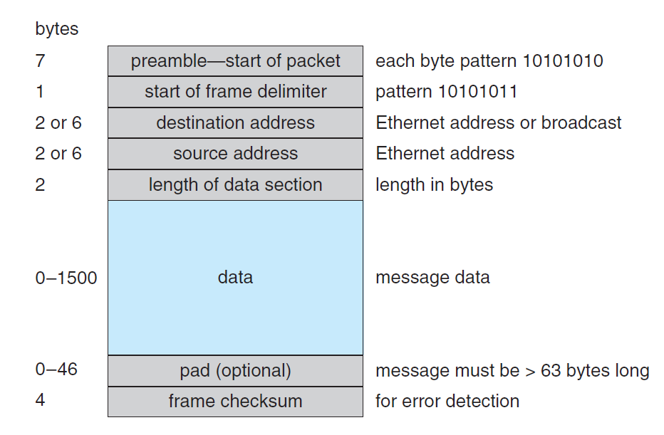
Ethernet Packet

Slide 12
Transport Protocols UDP and TCP
Once a host with a specific IP address receives a packet, it must somehow pass it to the correct waiting process
Transport protocols TCP and UDP identify receiving and sending processes through the use of a port number
Allows host with single IP address to have multiple server/client processes sending/receiving packets
Well-known port numbers are used for many services
FTP – port 21
ssh – port 22
SMTP – port 25
HTTP – port 80
Transport protocol can be simple or can add reliability to network packet stream

Slide 13
User Datagram Protocol
UDP is unreliable – bare-bones extension to IP with addition of port number
Since there are no guarantees of delivery in the lower network (IP) layer, packets may become lost
Packets may also be received out-out-order
UDP is also connectionless – no connection setup at the beginning of the transmission to set up state
Also no connection tear-down at the end of transmission
UDP packets are also called datagrams

Slide 14
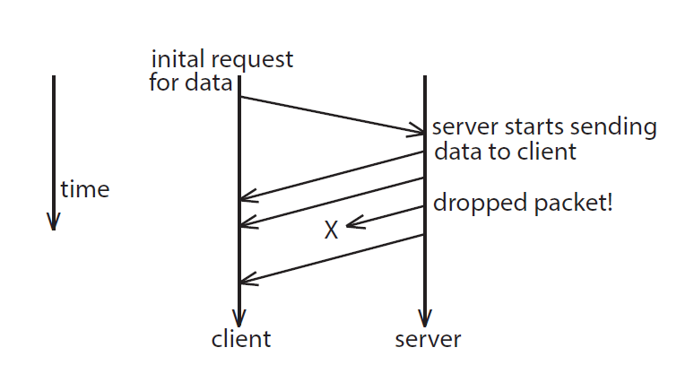
UDP Dropped Packet Example

Slide 15
Transmission Control Protocol
TCP is both reliable and connection-oriented
In addition to port number, TCP provides abstraction to allow in-order, uninterrupted byte-stream across an unreliable network
Whenever host sends packet, the receiver must send an acknowledgement packet (ACK). If ACK not received before a timer expires, sender will resend.
Sequence numbers in TCP header allow receiver to put packets in order and notice missing packets
Connections are initiated with series of control packets called a three-way handshake
Connections also closed with series of control packets

Slide 16
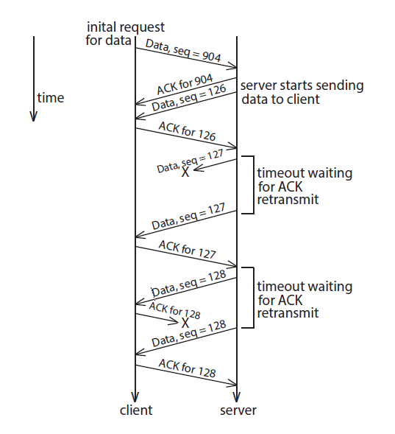
TCP Data Transfer Scenario

Slide 17
Sockets Interface
Client
2. Start client
1. Start server
Server
getaddrinfo
getaddrinfo
socket
socket
open_clientfd
open_listenfd
bind
Connection
request
listen
connect
accept
3. Exchange
data
Client / Server
Session
write
read
Await connection
request from
next client
read
write
4. Disconnect client
EOF
5. Drop client
close
read
close

Slide 18
Recall: Socket Address Structures
Generic socket address:
For address arguments to connect, bind, and accept
Necessary only because C did not have generic (void *) pointers when the sockets interface was designed
For casting convenience, we adopt the Stevens convention:
typedef struct sockaddr SA;
struct sockaddr {
uint16_t sa_family; /* Protocol family */
char sa_data[14]; /* Address data. */
};
sa_family
Family Specific

Slide 19
Socket Address Structures
Internet-specific socket address:
Must cast (struct sockaddr_in *) to (struct sockaddr *) for functions that take socket address arguments.
struct sockaddr_in {
uint16_t sin_family; /* Protocol family (always AF_INET) */
uint16_t sin_port; /* Port num in network byte order */
struct in_addr sin_addr; /* IP addr in network byte order */
unsigned char sin_zero[8]; /* Pad to sizeof(struct sockaddr) */
};
sin_port
sin_addr
AF_INET
0
0
0
0
0
0
0
0
sa_family
sin_family
Family Specific

Slide 20
Sockets Interface: socket
Clients and servers use the socket function to create a socket descriptor:
Example:
Protocol specific! Best practice is to use getaddrinfo to generate the parameters automatically, so that code is protocol independent.
int socket(int domain, int type, int protocol)
int clientfd = Socket(AF_INET, SOCK_STREAM, 0);
Indicates that we are using 32-bit IPV4 addresses
Indicates that the socket will be the end point of a connection

Slide 21
Sockets Interface: bind
int bind(int sockfd, SA *addr, socklen_t addrlen);
A server uses bind to ask the kernel to associate the server’s socket address with a socket descriptor:
The process can read bytes that arrive on the connection whose endpoint is addr by reading from descriptor sockfd.
Similarly, writes to sockfd are transferred along connection whose endpoint is addr.
Best practice is to use getaddrinfo to supply the arguments addr and addrlen.

Slide 22
Sockets Interface: listen
By default, kernel assumes that descriptor from socket function is an active socket that will be on the client end of a connection.
A server calls the listen function to tell the kernel that a descriptor will be used by a server rather than a client:
Converts sockfd from an active socket to a listening socket that can accept connection requests from clients.
backlog is a hint about the number of outstanding connection requests that the kernel should queue up before starting to refuse requests.
int listen(int sockfd, int backlog);

Slide 23
Sockets Interface: accept
Servers wait for connection requests from clients by calling accept:
Waits for connection request to arrive on the connection bound to listenfd, then fills in client’s socket address in addr and size of the socket address in addrlen.
Returns a connected descriptor that can be used to communicate with the client via Unix I/O routines.
int accept(int listenfd, SA *addr, int *addrlen);

Slide 24
Sockets Interface: connect
A client establishes a connection with a server by calling connect:
Attempts to establish a connection with server at socket address addr
If successful, then clientfd is now ready for reading and writing.
Resulting connection is characterized by socket pair
(x:y, addr.sin_addr:addr.sin_port)
x is client address
y is ephemeral port that uniquely identifies client process on client host
Best practice is to use getaddrinfo to supply the arguments addr and addrlen.
int connect(int clientfd, SA *addr, socklen_t addrlen);

Slide 25
accept Illustrated
listenfd(3)
Client
Server
1. Server blocks in accept, waiting for connection request on listening descriptor listenfd
clientfd
Connection
request
listenfd(3)
Client
Server
2. Client makes connection request by calling and blocking in connect
clientfd
listenfd(3)
Client
Server
3. Server returns connfd from accept. Client returns from connect. Connection is now established between clientfd and connfd
clientfd
connfd(4)

Slide 26
Connected vs. Listening Descriptors
Listening descriptor
End point for client connection requests
Created once and exists for lifetime of the server
Connected descriptor
End point of the connection between client and server
A new descriptor is created each time the server accepts a connection request from a client
Exists only as long as it takes to service client
Why the distinction?
Allows for concurrent servers that can communicate over many client connections simultaneously
E.g., Each time we receive a new request, we fork a child to handle the request

Slide 27
Testing Servers Using telnet
The telnet program is invaluable for testing servers that transmit ASCII strings over Internet connections
Our simple echo server
Web servers
Mail servers
Usage:
linux> telnet <host> <portnumber>
Creates a connection with a server running on <host> and listening on port <portnumber>

Slide 28
Any Questions?
.text
__start: addi t1, zero, 0x18
addi t2, zero, 0x21
cycle: beq t1, t2, done
slt t0, t1, t2
bne t0, zero, if_less
nop
sub t1, t1, t2
j cycle
nop
if_less: sub t2, t2, t1
j cycle
done: add t3, t1, zero

