Slide 1
Computer Architecture and Operating Systems Lecture 1: Operating System Architecture
Andrei Tatarnikov
atatarnikov@hse.ru
@andrewt0301

Slide 2
Operating System
A program that controls the execution of application programs
An interface between applications and hardware
Main Objectives of an OS
Convenience
Efficiency
Ability to evolve

Slide 3
Operating System Definition
OS is a resource allocator
Manages all resources
Decides between conflicting requests for efficient and fair resource use
OS is a control program
Controls execution of programs to prevent errors and improper use of the computer
No universally accepted definition
“Everything a vendor ships when you order an operating system” is a good approximation
But varies wildly
“The one program running at all times on the computer” is the kernel
Everything else is either
a system program (ships with the operating system) , or
an application program

Slide 4
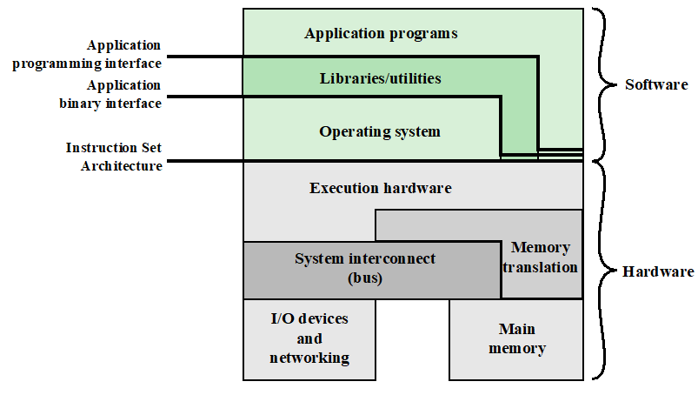
Computer Hardware and Software Structure

Slide 5
Operating System Services
Program development
Program execution
Access I/O devices
Controlled access to files
System access
Error detection and response
Accounting

Slide 6
Key Interfaces
Instruction set architecture (ISA)
Application binary interface (ABI)
Application programming interface (API)

Slide 7
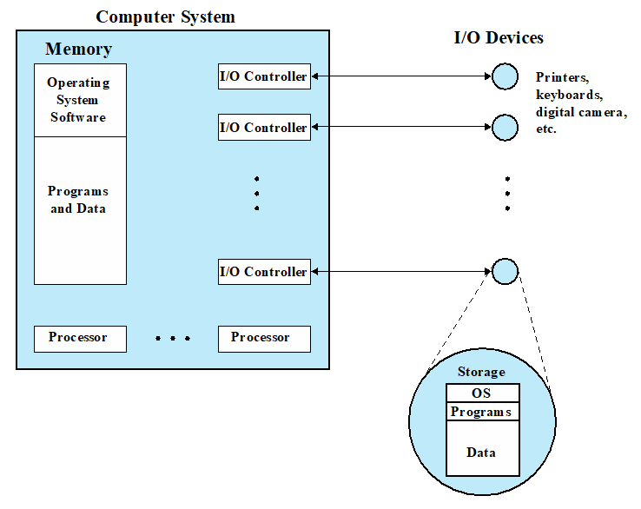
Operating System as Resource Manager

Slide 8
Operating System Structure
Multiprogramming (Batch system) needed for efficiency
Single user cannot keep CPU and I/O devices busy at all times
Multiprogramming organizes jobs (code and data) so CPU always has one to execute
A subset of total jobs in system is kept in memory
One job selected and run via job scheduling
When it has to wait (for I/O for example), OS switches to another job
Timesharing (multitasking) is logical extension in which CPU switches jobs so frequently that users can interact with each job while it is running, creating interactive computing
Response time should be < 1 second
Each user has at least one program executing in memory process
If several jobs ready to run at the same time  CPU scheduling
If processes don’t fit in memory, swapping moves them in and out to run
Virtual memory allows execution of processes not completely in memory

Slide 9
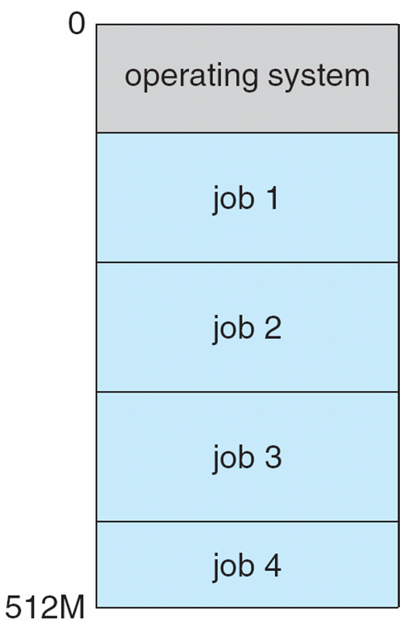
Memory Layout for Multiprogrammed System

Slide 10
Kernel Data Structures
Singly linked list
Doubly linked list
Circular linked list
Binary search tree
Hash function and hash map
Bitmap

Slide 11
Operating-System Operations
Interrupt driven (hardware and software)
Hardware interrupt by one of the devices
Software interrupt (exception or trap):
Software error (e.g., division by zero)
Request for operating system service
Other process problems include infinite loop, processes modifying each other or the operating system
Dual-mode operation allows OS to protect itself and other system components
User mode and kernel mode
Mode bit provided by hardware
Provides ability to distinguish when system is running user code or kernel code
Some instructions designated as privileged, only executable in kernel mode
System call changes mode to kernel, return from call resets it to user
Increasingly CPUs support multi-mode operations
i.e. virtual machine manager (VMM) mode for guest VMs

Slide 12
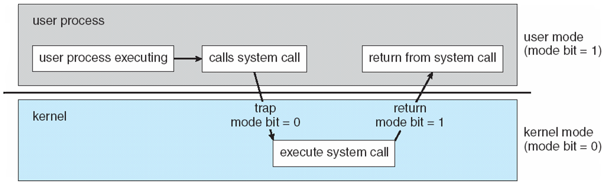
Transition from User to Kernel Mode
Timer to prevent infinite loop / process hogging resources
Timer is set to interrupt the computer after some time period
Keep a counter that is decremented by the physical clock.
Operating system set the counter (privileged instruction)
When counter zero generate an interrupt
Set up before scheduling process to regain control or terminate program that exceeds allotted time

Slide 13
Process Management
A process is a program in execution. It is a unit of work within the system. Program is a passive entity, process is an active entity.
Process needs resources to accomplish its task
CPU, memory, I/O, files
Initialization data
Process termination requires reclaim of any reusable resources
Single-threaded process has one program counter specifying location of next instruction to execute
Process executes instructions sequentially, one at a time, until completion
Multi-threaded process has one program counter per thread
Typically system has many processes, some user, some operating system running concurrently on one or more CPUs
Concurrency by multiplexing the CPUs among the processes / threads

Slide 14
Process Management Activities
The operating system is responsible for the following activities in connection with process management:
Creating and deleting both user and system processes
Suspending and resuming processes
Providing mechanisms for process synchronization
Providing mechanisms for process communication
Providing mechanisms for deadlock handling

Slide 15
Memory Management
To execute a program all (or part) of the instructions must be in memory
All (or part) of the data that is needed by the program must be in memory
Memory management determines what is in memory and when
Optimizing CPU utilization and computer response to users
Memory management activities
Keeping track of which parts of memory are currently being used and by whom
Deciding which processes (or parts thereof) and data to move into and out of memory
Allocating and deallocating memory space as needed

Slide 16
Storage Management
OS provides uniform, logical view of information storage
Abstracts physical properties to logical storage unit - file
Each medium is controlled by device (i.e., disk drive, tape drive)
Varying properties include access speed, capacity, data-transfer rate, access method (sequential or random)
File-System management
Files usually organized into directories
Access control on most systems to determine who can access what
OS activities include
Creating and deleting files and directories
Primitives to manipulate files and directories
Mapping files onto secondary storage
Backup files onto stable (non-volatile) storage media

Slide 17
Mass-Storage Management
Usually disks used to store data that does not fit in main memory or data that must be kept for a “long” period of time
Proper management is of central importance
Entire speed of computer operation hinges on disk subsystem and its algorithms
OS activities
Free-space management
Storage allocation
Disk scheduling
Some storage need not be fast
Tertiary storage includes optical storage, magnetic tape
Still must be managed – by OS or applications
Varies between WORM (write-once, read-many-times)
and RW (read-write)

Slide 18
I/O Subsystem
One purpose of OS is to hide peculiarities of hardware devices from the user
I/O subsystem responsible for
Memory management of I/O including buffering (storing data temporarily while it is being transferred), caching (storing parts of data in faster storage for performance), spooling (the overlapping of output of one job with input of other jobs)
General device-driver interface
Drivers for specific hardware devices

Slide 19
Protection and Security
Protection – any mechanism for controlling access of processes or users to resources defined by the OS
Security – defense of the system against internal and external attacks
Huge range, including denial-of-service, worms, viruses, identity theft, theft of service
Systems generally first distinguish among users, to determine who can do what
User identities (user IDs, security IDs) include name and associated number, one per user
User ID then associated with all files, processes of that user to determine access control
Group identifier (group ID) allows set of users to be defined and controls managed, then also associated with each process, file
Privilege escalation allows user to change to effective ID with more rights

Slide 20
Virtualization
Allows operating systems to run applications within other OSes
Vast and growing industry
Emulation used when source CPU type different from target type (i.e. RISC-V to Intel x86)
Generally slowest method
When computer language not compiled to native code – Interpretation
Virtualization – OS natively compiled for CPU, running guest OSes also natively compiled
Consider VirtualBox running Windows 7 guests, each running applications, all on native Windows 7 host OS
VMM (virtual machine Manager) provides virtualization services

Slide 21
Virtualization
Use cases involve laptops and desktops running multiple OSes for exploration or compatibility
Apple laptop running Mac OS X host, Windows as a guest
Developing apps for multiple OSes without having multiple systems
QA testing applications without having multiple systems
Executing and managing compute environments within data centers
VMM can run natively, in which case they are also the host
There is no general purpose host then (VMware ESX and Citrix XenServer)

Slide 22
Virtualization

Slide 23
Different Architectural Approaches
Demands on operating systems require new ways of organizing the OS
Different approaches and design elements have been tried:
microkernel architecture
multithreading
symmetric multiprocessing
distributed operating systems
object-oriented design

Slide 24
Any Questions?
.text
__start: addi t1, zero, 0x18
addi t2, zero, 0x21
cycle: beq t1, t2, done
slt t0, t1, t2
bne t0, zero, if_less
nop
sub t1, t1, t2
j cycle
nop
if_less: sub t2, t2, t1
j cycle
done: add t3, t1, zero

