Slide 1
Computer Architecture and Operating Systems Lecture 2: The C Programming Language
Andrei Tatarnikov
atatarnikov@hse.ru
@andrewt0301

Slide 2
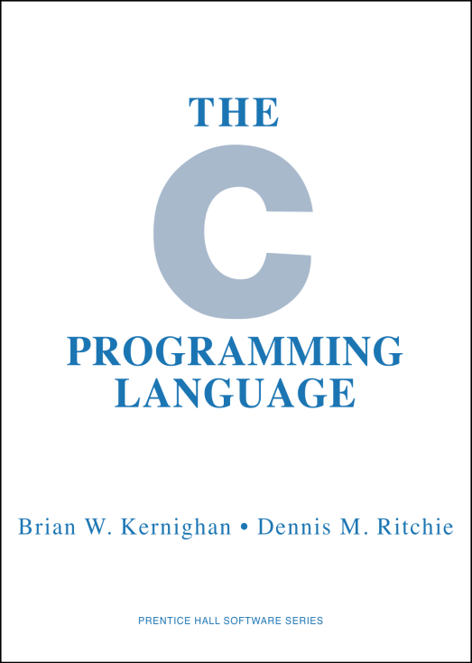
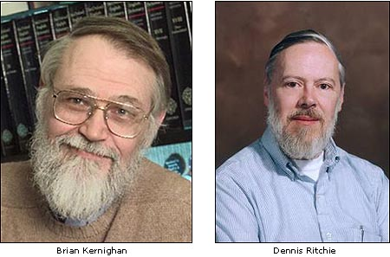
The C Programming Language
1972-1973: Developed at Bell Labs by Dennis Ritchie to create utilities for Unix
1973: Unix was re-implemented in C
1978: Brian Kernighan and Dennis Ritchie published The C Programming Language
1989/1990: ANSI C and ISO C; 1999: C99; 2011: C11; 2017: C17

Slide 3
The Application of C Language
C is not a “very high level” language, nor a “big” one, and is not specialized to any particular area of application. But its absence of restrictions and its generality make it more convenient and effective for many tasks than supposedly more powerful languages.
Kernighan and Ritchie
With C we can write programs that allow us to exploit underlying features of the architecture

Slide 4
C Concepts
Compiler | Creates usable programs from C source code
Typed variables | Must declare the kind of data the variable will contain
Typed functions | Must declare the kind of data returned from the function
Header files (.h) | Allows declaring functions and variables in separate files
Structs | Groups of related values
Enums | Lists of predefined values
Pointers | Aliases to other variables

Slide 5
C Memory Layout
0x FFFF FFFF
Program’s address space contains 4 regions:
Stack: local variables, grows downward
Heap: space requested via malloc() and used with pointers; resizes dynamically, grows upward
Static Data: global and static variables, does not grow or shrink
Code: loaded when program starts, does not change
Stack
Heap
Static Data
Code
Reserved
0x 0000 0000
OS prevents accesses between stack and heap (via virtual memory)

Slide 6
Where Do the Variables Go?
Declared outside a function:
Static Data
Declared inside a function:
Stack
main() is a function
freed when the function returns
Dynamically allocated:
Heap
i.e. malloc (will be covered shortly)
#include <stdio.h>
int varGlobal;
int main() {
int varLocal;
int *varDyn =
malloc(sizeof(int));
}

Slide 7
Stack
Each stack frame is a contiguous block of memory holding the local variables of a single function
A stack frame includes:
Location of caller function
Function arguments
Space for local variables
Stack pointer (SP) tells where lowest (current) stack frame is
When function ends, stack pointer is moved back (but data remains (garbage!)); frees memory for future stack frames

Slide 8
Stack
Last In, First Out (LIFO) data structure
int main() {
a(0);
return 1;
}
void a(int m) {
b(1);
}
void b(int n) {
c(2);
d(4);
}
void c(int o) {
printf(“c”);
}
void d(int p) {
printf(“d”);
}
main
Stack Pointer
a
Stack Pointer
b
Stack Pointer
d
Stack Pointer

Slide 9
Stack Misuse
int *getPtr() {
int y;
y = 3;
return &y;
}
int main () {
int *stackAddr, content;
stackAddr = getPtr();
content = *stackAddr;
printf("%d", content); /* 3 */
content = *stackAddr;
printf("%d", content); /* ? */
}
Never return pointers to local variable from functions!
Your compiler will warn you about this.
Do not ignore such warnings!
printf overwrites stack frames.

Slide 10
Static Data
Place for variables that persist
Data not subject to comings and goings like function calls
Examples: string literals, global variables
String literal example: char * str = “hi”;
Do not be mistaken with: char str[] = “hi”;
This will put str on the stack!
Size does not change, but sometimes data can
Notably string literals cannot

Slide 11
Code
Copy of your code goes there
C code becomes data too!
Does (should) not change
Typically read-only

Slide 12
Dynamic Memory Allocation
Want persisting memory (like static) even when we do not know size at compile time?
e.g. input files, user interaction
Stack will not work because stack frames are not persistent
Dynamically allocated memory goes on the Heap
more permanent than Stack
Need as much space as possible without interfering with Stack
Start at opposite end and grow towards Stack

Slide 13
The sizeof Operator
If integer sizes are machine dependent, how do we tell?
Use sizeof() operator
Returns size in number of char-sized units of a variable or data type name
Examples: int x; sizeof(x); sizeof(int);
sizeof(char) is always 1
Can we use sizeof to determine a length of an array?
Generally no but there is an exception:
int a[61];
sizeof(a) gets the total number of bytes stored in the array a.
To get the number of elements, use: sizeof(a) / sizeof(int)
This ONLY works for arrays defined on the stack IN THE SAME FUNCTION
It is not recommended to do this. A preferred way is to keep track of an array size elsewhere.

Slide 14
Allocating Memory
Functions for requesting memory: malloc(), calloc(), and realloc()
malloc(n)
Allocates a continuous block of n bytes of uninitialized memory (contains garbage!)
Returns a pointer to the beginning of the allocated block; NULL indicates failed request (check for this!)
Different blocks not necessarily adjacent

Slide 15
Any Questions?
.text
__start: addi t1, zero, 0x18
addi t2, zero, 0x21
cycle: beq t1, t2, done
slt t0, t1, t2
bne t0, zero, if_less
nop
sub t1, t1, t2
j cycle
nop
if_less: sub t2, t2, t1
j cycle
done: add t3, t1, zero

