Slide 1
Incredibles Engineering Practices

Slide 2
Request Lifecycle
The client sends HTTP request
The router inspects the request and sends it to the right controller and the right action
The action processes the data that needs to be returned to the client
This data is passed to the view that renders the response, which is sent back to the browser.

Slide 3
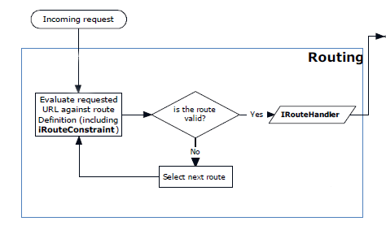
ASP NET MVC Pipeline

Slide 4
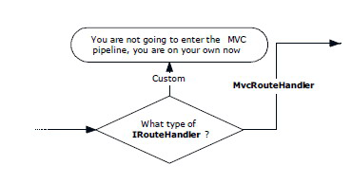
ASP NET MVC Pipeline

Slide 5
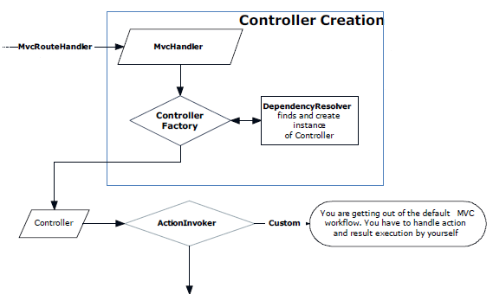
ASP NET MVC Pipeline

Slide 6
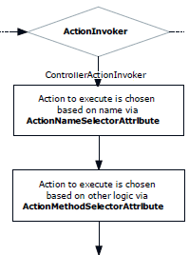
ASP NET MVC Pipeline
http://www.tugberkugurlu.com/archive/involving-action-selection-process-in-asp-net-mvc-with-actionnameselectorattribute

Slide 7
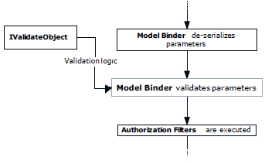
ASP NET MVC Pipeline

Slide 8

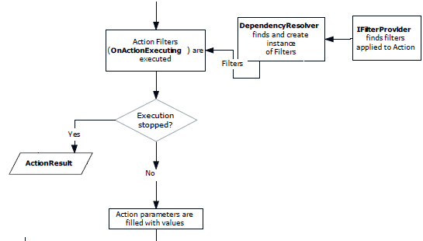
ASP NET MVC Pipeline

Slide 9
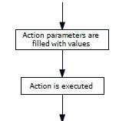
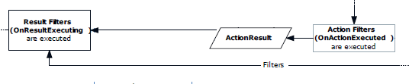
ASP NET MVC Pipeline

Slide 10
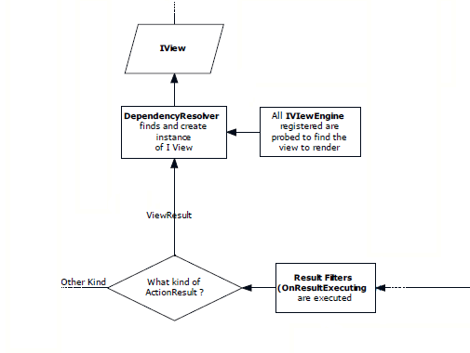
ASP NET MVC Pipeline

Slide 11
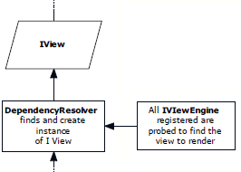
ASP NET MVC Pipeline

Slide 12
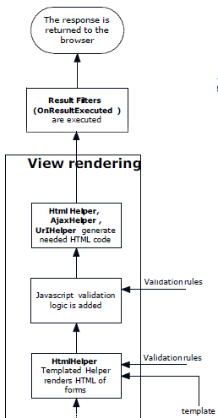
ASP NET MVC Pipeline

Slide 13
ASP NET MVC Pipeline

Slide 14
ASP NET MVC Pipeline

Slide 15
ASP NET MVC Pipeline

Slide 16
Purpose of this talk
Resources
https://www.simple-talk.com/dotnet/net-framework/an-introduction-to-asp-net-mvc-extensibility/
https://www.simple-talk.com/wp-content/uploads/imported/1358-ASP.NET%20MVC%20Pipeline.pdf

