Slide 1

Haptic Glove
INTERACTION WITH VIRTUAL REALITY
Anton Lechanka
Stanislav Podshivalov
Vladimir Eremin

Slide 2
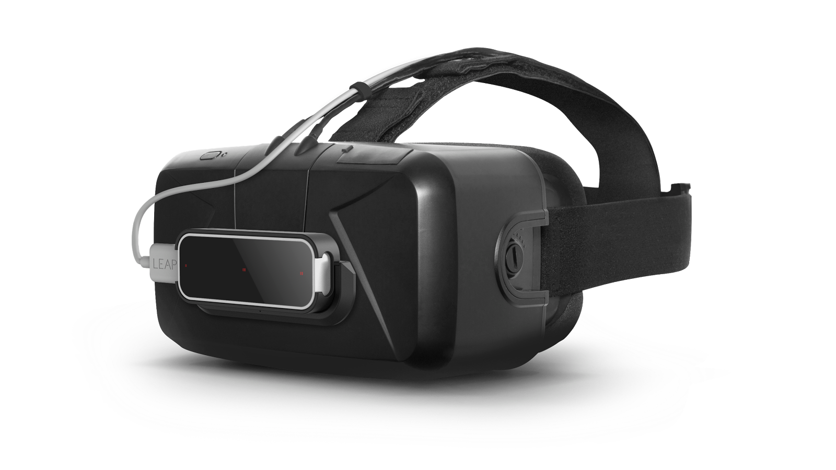
Instruments
Oculus Rift
LeapMotion

Slide 3
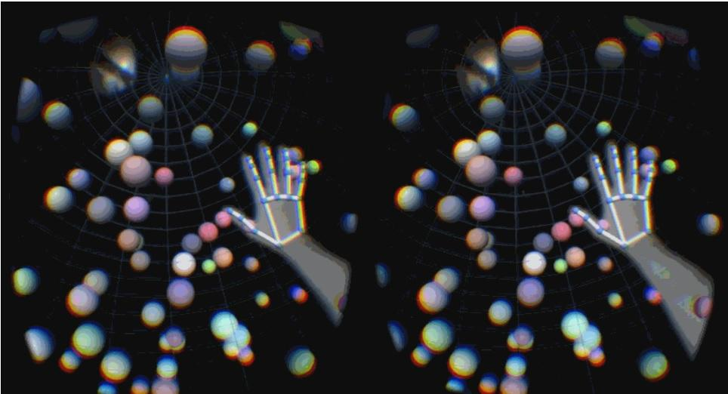
Visual part

Slide 4
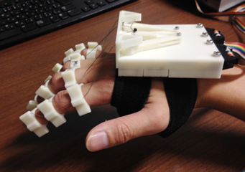
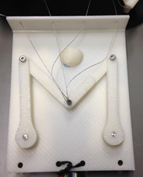
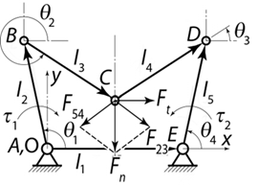
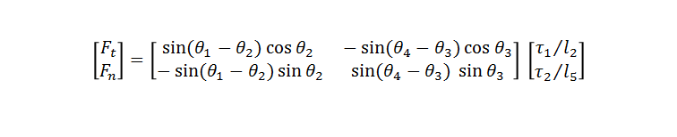
Kinematics of the arm
Vector linkage diagram of a 5-bar linkage
WearLinkGlove
WearLinkGlove actuator

Slide 5
Applications
Medical: remote surgery
Robotics: e.g. Shadow Hand
Art and Design: sound synthesis or graphic design and animation

Slide 6
Individual contribution
Anton - one idea generator
Stanislav - bought pizza =)
Vladimir - unpaid employer

Slide 7
Thank you for attention!

Slide 8
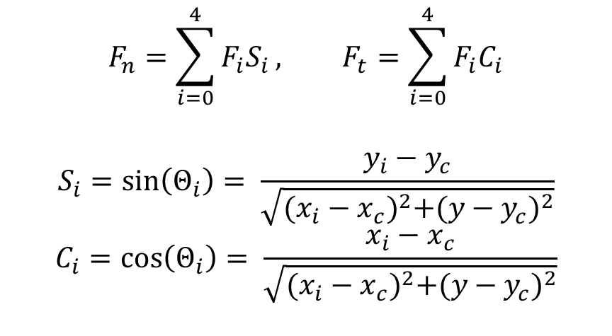
More math

