Slide 1
Hospital Quality Analysis
CMS Hospital Compare — 5,400+ U.S. Hospitals
Three questions. A bronze-silver-gold pipeline. Surprising answers.
Built with PostgreSQL 14 · SQL · Tableau | Portfolio Project by Vladimir Mickic

Slide 2

EXECUTIVE SUMMARY
Three Hypotheses Tested. All Three Were Wrong.
Every initial assumption was overturned by the data — revealing that hospital quality problems are more fragmented, and more nuanced, than conventional wisdom suggests.
r = −0.020
221 min
83% → 5 "Worse"
Imaging overuse and ED wait times are statistically independent. R² = 0.0004 across 3,589 hospitals. They are entirely separate problems.
Non-Profits have the highest star ratings (3.18 avg) but the slowest EDs (221 min). Clinical quality ≠ operational speed.
A hospital scored 83% on process compliance and still earned 5 "Worse" complication ratings. Checklists ≠ safety.
Imaging overuse and ED throughput are separate problems. They need separate interventions and separate budgets.

Slide 3
THE PROBLEM
Why This Analysis Exists
CMS publishes quality data on 5,400+ hospitals — but it arrives in 5 separate files with inconsistent formats, suppressed scores, and mixed data types in the same columns. The raw data is rich but unusable without a structured pipeline.
1
Imaging vs. ED Waits
This analysis builds that pipeline and uses it to answer three high-stakes questions about how hospital quality actually works.
Do hospitals that over-order imaging also have longer ED wait times?
2
Ownership Type
Does ownership structure predict quality patterns? Do incentive structures matter?
3
Compliance vs. Safety
Can a hospital follow every protocol and still be unsafe for patients?

Slide 4



METHODOLOGY
Bronze → Silver → Gold Pipeline
A three-tier architecture transforms 430K+ raw rows from 5 CMS CSV files into clean, analytical views that directly answer each business question.
🥉 Bronze — Raw Landing
🥈 Silver — Cleaned & Typed
🥇 Gold — Analytical
All columns stored as TEXT. No casting, no transforms. 5 tables, 430K+ rows. Per-table exception handling with row-count logging.
Type casting, NULL standardization, tiered score usability flags. 12 ownership values collapsed to 4 canonical groups. Multi-code footnote parsing via array overlap.
3 focused views answering the 3 questions. 1 hospital dimension view with Census regions. No monolithic fact table — each view joins only what it needs.
Table
Rows
Domain
cms_hospital_general
5,426
Ratings, ownership, location
cms_timely_care
138,129
ED waits, vaccination, timing
cms_complications
95,780
Mortality & complications
cms_outpatient_imaging
18,500
CT/MRI ordering efficiency
cms_infections
172,404
HAI rates

Slide 5

FINDING 1
No Link Between Imaging Overuse & ED Wait Times
−0.020
0.0004
Pearson r
R² Value
Near-zero correlation across 3,589 hospitals
Imaging explains 0.04% of ED wait time variance
What Was Tested
Imaging composite: AVG of OP-10, OP-13, OP-39 (lower % = better). OP-8 excluded — its mean (36.9%) is 5× higher than peers and would dominate the composite.
ED wait: AVG of OP_18a–d in minutes, capped at 1,440
Sample: n = 3,589 hospitals with usable scores in both domains
Insight: Imaging overuse is a clinical ordering decision. ED throughput is an operational flow problem. Different root causes → different interventions required.

Slide 6
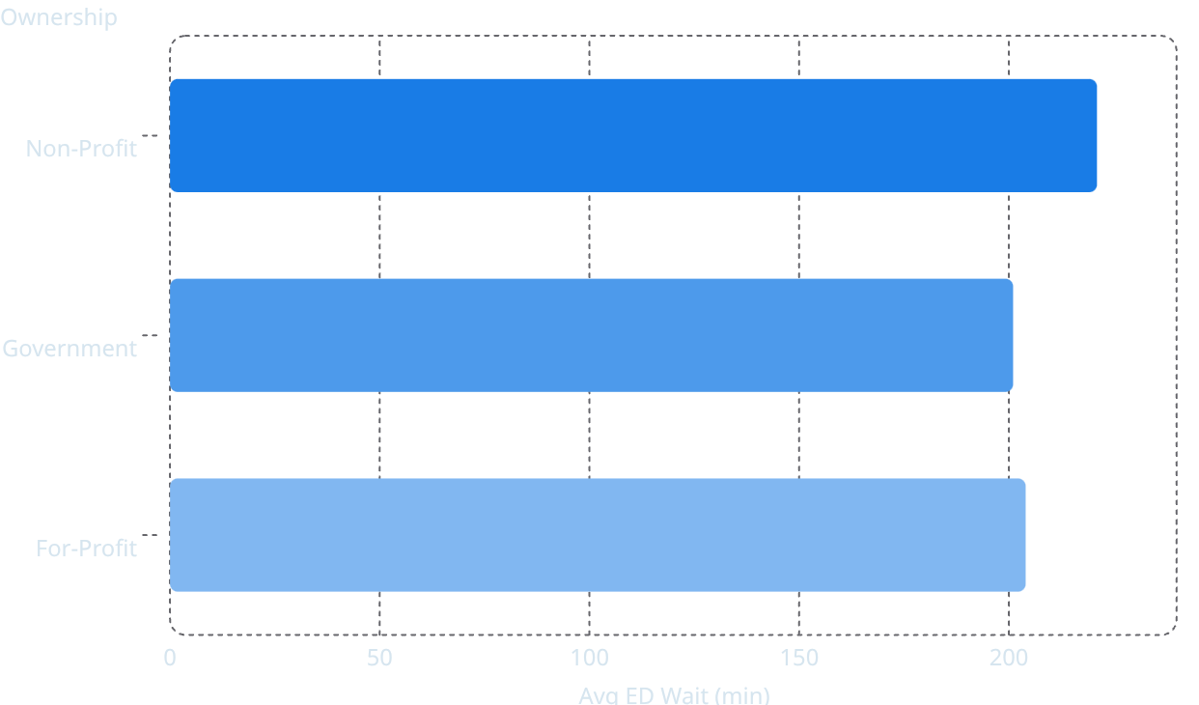
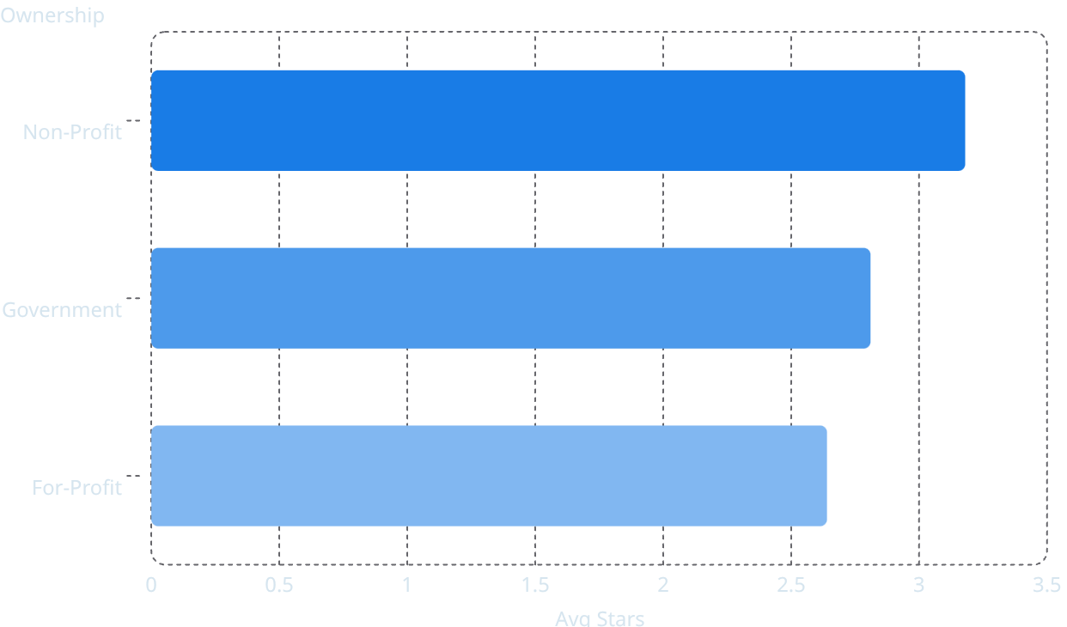
FINDING 2
The Non-Profit Paradox
Non-Profits lead on clinical star ratings — but run the slowest emergency departments of any ownership group. The correlation between imaging and ED waits stays near zero in every group.
Avg ED Wait Time (min)
Avg Star Rating (out of 5)
221
3.18
201
2.81
204
2.64
The Core Paradox
Methodology Caveat
Non-Profits optimize for clinical quality metrics — mortality, readmissions, patient experience. This may come at the cost of operational throughput. Star ratings and ED speed measure fundamentally different things.
Non-Profit share rises from 54% → 64% in the joined sample due to higher reporting rates — a form of survivorship bias. Tribal hospitals (collapsed to 1 entity) were excluded from group analysis.

Slide 7

FINDING 3
Compliance Does Not Equal Safety
Among the 30 worst-complication hospitals (3+ "Worse" ratings), compliance scores range from 42%–84% with no clear pattern.
Correlation Test
r value
Relationship
Process compliance vs. Complications
≈ 0
None
Process compliance vs. Mortality
≈ 0
None
Process compliance vs. Patient Safety (PSI)
0.08
Barely detectable
Hospital 1800445 "Worse" complication ratings
Process compliance: 83.55% — High compliance, still deeply unsafe.
Hospital 0501454 "Worse" complication ratings
Process compliance: 42.17% — Low compliance AND unsafe, a different failure mode entirely.
Process measures track narrow boxes — colonoscopy care, staff vaccination. Clinical outcomes depend on staffing, communication, equipment, and patient acuity. Checklists don't capture these factors.

Slide 8


STRATEGIC RECOMMENDATIONS
Two Interventions. Separate Budgets. Measurable Targets.
The data points to two structurally independent problems — each requiring its own roadmap, ownership, and success metrics.
Imaging Utilization Reform
ED Throughput Optimization
Target OP-10 ordering rates. Implement radiologist-led pre-authorization protocols for contrast CT. Benchmark against the 4–5% rate seen in 5-star hospitals. Expected impact: 30–50% reduction in unnecessary contrast orders within 12 months.
ED wait times are operationally driven — staffing models, triage protocols, and bed management. Treat as a separate workstream from imaging. Expected impact: 15–25 min reduction in median wait time with lean process redesign.
CLINICAL ORDERING · LOW COST · HIGH SIGNAL
OPERATIONAL · SEPARATE BUDGET · QUICK WIN
These are not the same problem. Conflating them wastes resources. Each intervention has a distinct owner, timeline, and KPI.

Slide 9
DEEP DIVE
Ownership Is Not a Monolith
Ownership Subtype
Avg Stars
Notable Pattern
The 1.5-Star Gap
Lumping VA hospitals with local government hospitals under "Government" masks a 1.5-star quality gap — one of the largest differences in the entire dataset.
VA Hospitals
4.2
77% are high performers
Reporting ≠ Quality
Non-Profit (all subtypes)
~3.2
~40% high performers
Reporting completeness vs. star ratings: r = −0.041 (R² = 0.0017). Hospitals that report on more measures do not score better. Transparency and quality are independent dimensions.
Physician-Owned (For-Profit)
3.32
Outperforms its sector
Local/State Government
2.7–2.8
Disproportionate low performers
Proprietary (For-Profit)
2.55
~49% low performers

Slide 10

CASE STUDY
UPMC Presbyterian Shadyside — Gap to 5 Stars
Benchmarked against Pennsylvania non-profit acute care peers (facility 390164, current 4-star rating). UPMC excels in high-acuity ED pathways — 133–149 min faster than PA average on OP_18c/d — but two specific gaps prevent a 5-star rating.
Measure
UPMC
5-Star Avg
Gap
PSI_03 — Pressure Ulcers
1.84
0.50
+1.34 — nearly 4× worse
OP-10 — CT Contrast Overuse
12.2%
~4–5%
Nearly double PA rate
HAI_1_SIR — Central Line Infections
Above benchmark
Below benchmark
Gap exists
PSI_90 — Safety Composite
Elevated
Lower
Driven by PSI_03
No UPMC hospital achieved 5 stars in PA. The 5-star group is dominated by smaller regional systems: WellSpan, St. Luke's, AHN Wexford. Two actionable problems — pressure ulcer protocols and CT contrast ordering are specific, measurable, and addressable.

Slide 11
PIPELINE QUALITY & WRAP-UP
Bugs Fixed, Limitations Acknowledged
Bug
Impact
Fix Applied
Footnote matching used exact strings
Missed multi-code values like '5, 23'
Switched to array overlap (&&)
Score exclusion priority reversed
Footnoted rows misclassified
Footnotes evaluated before NULL scores
Zero-infection hospitals not flagged
Code 8 rows treated as valid scores
Added to usability blacklist
birthing_friendly conflated unknown/no
Unknown hospitals marked as "No"
NULL for unknowns
Data Quality Realities
Rural suppression: MT, SD, WY → 65–80% unusable vs. 15–30% for NJ, CT, RI
58% of timely_care scores = "Not Available"
47% of hospitals have no star rating
Only 11.9% have usable scores across all 6 HAI measures

