Slide 1
How Much Financial Flexibility Is Optimal?
A Closed-Form Capital Structure Model for Investment-Grade Firms
Research summary.
Vladimir Manaev, CQF, PRM | Quant Research | Barcelona
Notes:
[Sources]
- (Model + results) Author manuscript PDF provided in repository.
[/Sources]

Slide 2
Research Question
How much financial flexibility is optimal?
Flexibility dominates leverage targets
CFOs prioritize financial flexibility and rating resilience when setting financing policy [Graham 2022].
Investment-grade defaults are genuinely rare
Only ~0.5% of historical defaults started as investment grade; in 2024, just two issuers were IG one year before default [S&P Global Ratings 2025].
Constraints bite before “default”
For IG firms, pricing grids and covenant triggers reprice debt and shift control rights long before default is relevant [Asquith, Beatty & Weber 2005; Roberts & Sufi 2009].
Notes:
[Sources]
- Graham (2022), *Corporate Finance and Reality* (AFA presidential address / NBER working paper): https://www.nber.org/papers/w29841
- S&P Global Ratings (2024), *Annual Global Corporate Default and Rating Transition Study* (S&P): https://maalot.co.il/Publications/FTS20250331162126.pdf
- Asquith, Beatty & Weber (2005), performance pricing in bank debt: https://www.sciencedirect.com/science/article/abs/pii/S0165410105000583
- Chava & Roberts (2008), covenant violations and investment: https://finance.wharton.upenn.edu/~mrrobert/resources/Publications/CovenantInvestmentJF2008.pdf
[/Sources]

Slide 3
Model Setup
Object | Assumption
State | Firm value follows GBM under Q: dV/V = r dt + σ dW.
Control | Choose trigger Vg (contractual headroom / flexibility buffer).
Debt | Perpetual coupon C; reprices to C(1+s) when V ≤ Vg; reverts on recovery.
Taxes | Corporate tax rate τ; tax shield on coupon payments.
Ex‑ante cost | Up‑front cost of weaker trigger protection: k / Vg.
Goal | Maximize equity value; closed-form interior solution for Vg*.
V
Above Vg: coupon C
Vg
repricing
Below Vg: coupon C·(1+s) (step-up)
Notes:
[Sources]
- (Model contribution + schematic) Author manuscript PDF provided in repository.
[/Sources]

Slide 4
Baseline scenario
Output: baseline Vg*/V ≈ 0.86 (≈14% headroom); implied leverage ≈ 35%
Item | Model parameter | Baseline value | Meaning (plain English)
Risk‑free rate | r | 4% | Discount rate under risk‑neutral pricing.
Asset volatility | σ | 22% | Diffusion (market) risk of firm value.
Corporate tax rate | τ | 21% | Tax shield on interest payments.
Coupon rate (base) | C | 5% | Base debt service while V > Vg.
Step‑up severity | s | 0.12 | Coupon multiplier below trigger: C·(1+s).
Ex‑ante flexibility cost | k | 0.05 | Up‑front cost of buying headroom: k / Vg.
EBITDA ratio (mapping) | α | 0.10 | EBITDA ≈ α·V (translation layer only).
Debt/EBITDA ratio | K | 4× | Most common covenant trigger.
Notes:
[Sources]
- (Model setup) Author manuscript PDF provided in repository.
[/Sources]

Slide 5

Closed-form optimal headroom rule
Optimal headroom (closed form)
• V : firm asset value (state variable)
• Vg* : optimal trigger threshold
• C : coupon before trigger
• s : step‑up severity (coupon ×(1+s))
• τ : corporate tax rate
• k : ex‑ante concession parameter (cost of looser trigger)
• r : risk‑free rate
• σ : asset volatility
• x = 2r/σ² : trigger‑hitting sensitivity
Notes:
[Sources]
- (Closed-form expressions) Author manuscript PDF provided in repository.
[/Sources]

Slide 6
Comparative Statics: directional impact on optimal headroom (Vg*/V)
Parameter | Change | Optimal Vg*/V | Intuition
Repricing severity s | ↑ | ↓ | More expensive step‑up ⇒ stay further from trigger (more headroom).
Tax rate τ | ↑ | ↑ | Tax shield more valuable ⇒ tighter trigger and higher implied leverage.
Coupon level C | ↑ | ↓ | Higher debt service makes repricing region costlier ⇒ more headroom.
Ex‑ante cost k | ↑ | ↑ | Costlier to buy slack (k/Vg) ⇒ tighter headroom.
Also depends on r and σ² via x = 2r/σ²; the net effect can be non‑monotone (↕). For partial derivatives and details, see Appendix E.
Notes:
[Sources]
- (Optimal policy + statics) Author manuscript PDF provided in repository.
[/Sources]

Slide 7
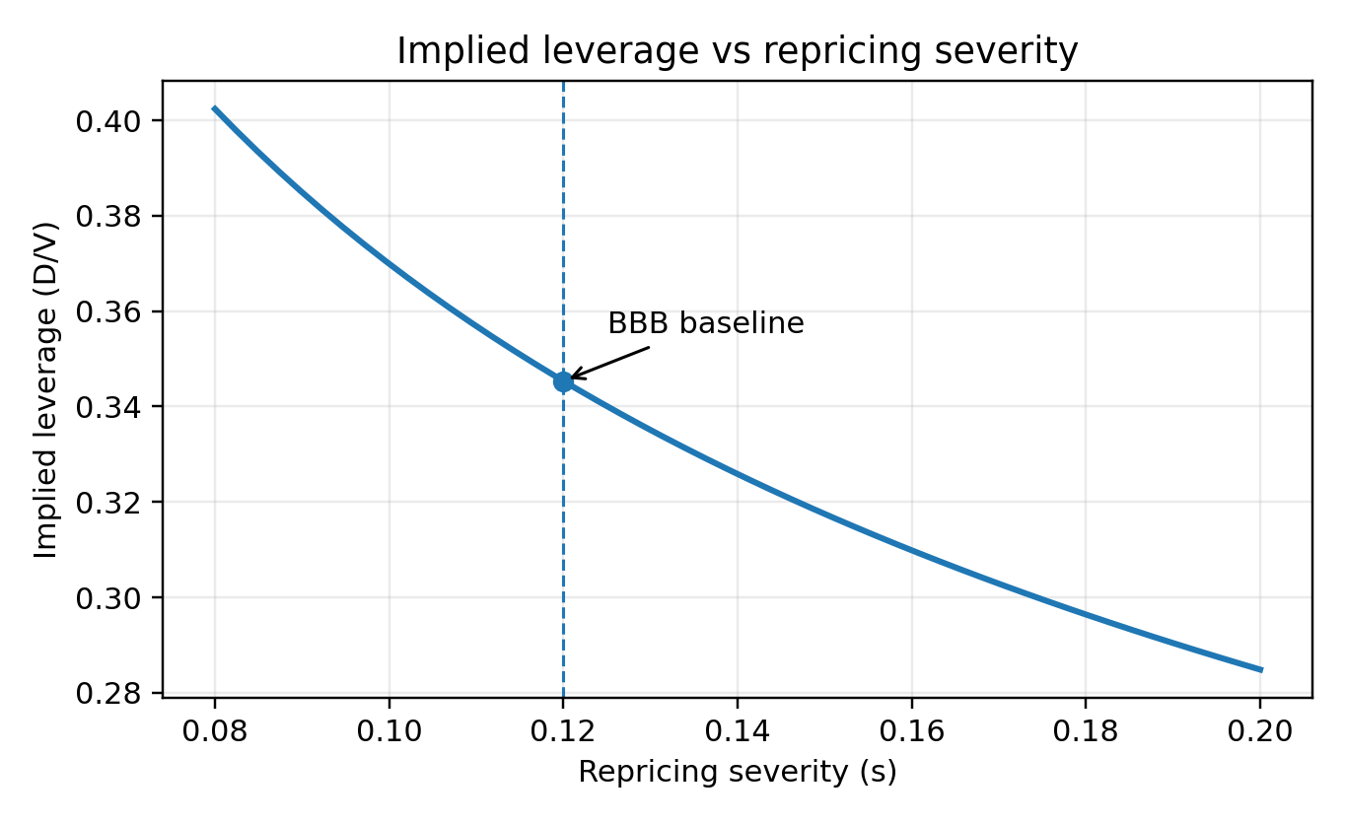
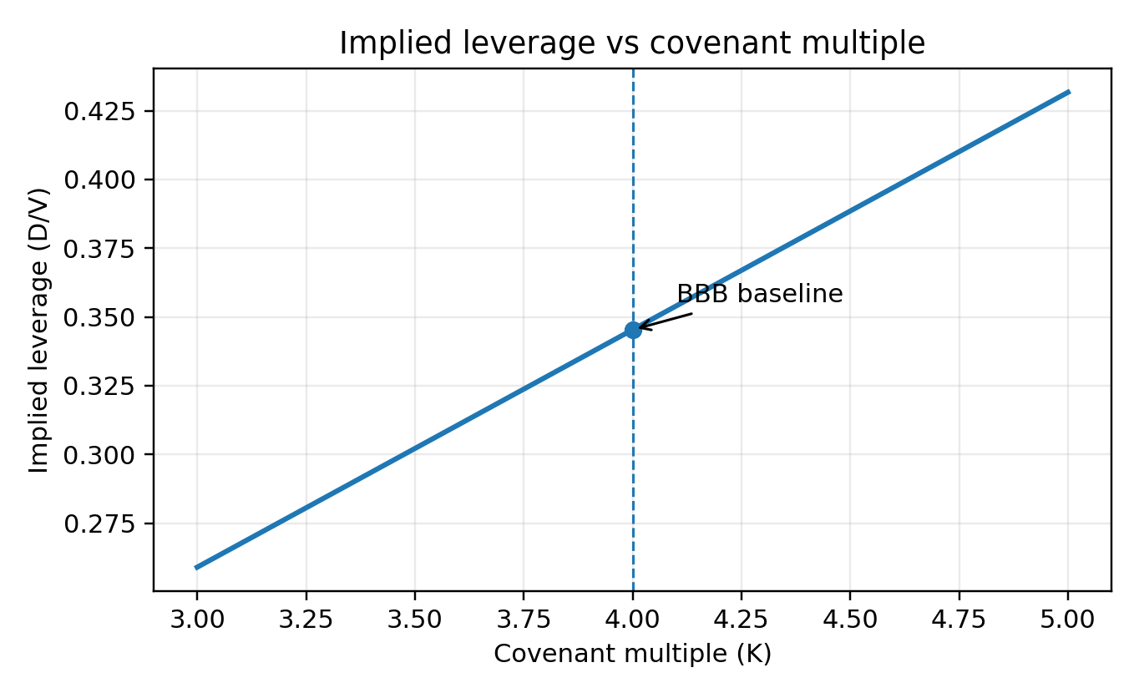
Selected results
Figure 1. Implied leverage vs repricing severity (s) — BBB baseline.
Figure 2. Implied leverage vs covenant multiple (K) — BBB baseline.
Higher repricing severity (s↑) lowers implied leverage: optimal headroom rises (Vg*/V↓).
Holding optimal headroom fixed, implied leverage scales linearly with the covenant multiple (K).
Notes:
[Sources]
- (Option interpretation) Author manuscript PDF provided in repository.
[/Sources]

Slide 8
Main results
1) Policy object: optimal headroom (trigger ratio)
Headroom is chosen directly as the trigger ratio Vg*/V (or buffer 1 − Vg*/V), which is economically interpretable and easy to communicate.
2) Endogenous debt capacity (leverage is an output)
Debt is priced at break-even given the policy. The model maps the headroom choice into implied debt capacity via Dcap = α·K·Vg* (and implied leverage D/V).
3) Transparent drivers and decomposition
Two channels are separated: (i) contract frictions (e.g., repricing severity s and flexibility cost k) shift optimal headroom, and (ii) the Debt/EBITDA mapping (α) and covenant choice (K) scales debt capacity mechanically.
Notes:
[Sources]
- (Baseline parameters + outputs) Supplementary Appendix, Tables 4–5 in author PDF.
- Anchoring s with rating-yield differences: FRED (e.g., Moody’s Aaa yield series AAA): https://fred.stlouisfed.org/series/AAA
[/Sources]

Slide 9
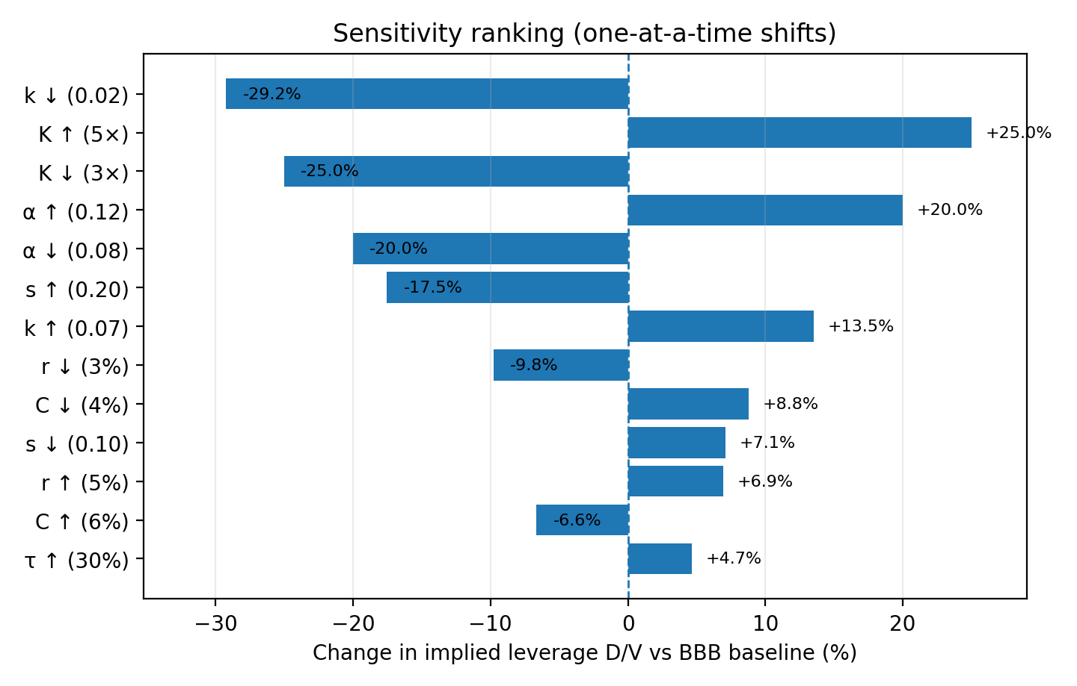
Sensitivity highlights
Change in implied D/V vs BBB baseline from one-at-a-time parameter shifts (Supplement Table 6).
Notes:
[Sources]
- (Scenario numbers) Supplementary Appendix Table 6 in author PDF.
[/Sources]

Slide 10
Limitations
Pre-default IG benchmark
No explicit default, bankruptcy, or strategic renegotiation.
Stationary policy
Single trigger threshold (Vg) without repeated re-optimization over time.
Parsimonious frictions
Contract frictions summarized by repricing severity (s) and issuance-time concession (k/Vg).
Notes:
[Sources]
- (All results) Author manuscript PDF + Supplementary Appendix in repository.
[/Sources]

Slide 11
Use cases
USER | DECISION | OUTPUT
CFO / Treasury | Set headroom policy (Vg) | Implied buffer and debt capacity
Credit analyst | Stress repricing terms (s) or coupon cost of debt (C) | Δ implied leverage (D/V) from sensitivity
Loan structuring | Choose covenant multiple (K) and estimate profitability proxy (α) | Implied debt capacity via Dcap = α·K·Vg

Slide 12
Thank you
Happy to share the full paper, appendix, and reproducible code outputs upon request.
Author:
Vladimir Manaev
Email:
Vladimir.manaev@gmail.com
LinkedIn:
https://www.linkedin.com/in/vladimir-manaev-0025405/
GitHub:
https://github.com/VladimirNM/
Paper / preprint:
available on request

