Slide 1
Retail forecasting and clustering
Vladimir Nikiforov

Slide 2
1. Forecasting
Goal is to calculate sale forecasts for next 28 days:
1. Region (all shops) / ware / day
2. Store / ware / day
Metric: WAPE
Goal metric values:
1. Region / ware / day less than 30%
2. Store / ware/ day less than 50%
It is desirable to apply several different techniques of forecasting and data analysis (ARIMA, random forest, …).

Slide 3
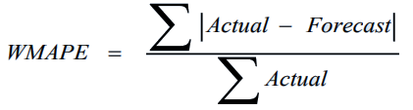
1. Forecasting. WAPE – what is it?
Weighted Absolute Percent Error (WAPE or WMAPE) is the Sum of Absolute errors divided by the Sum of the Actuals
WAPE gives you a true picture of forecast quality in an organization and how this will impact the business performance in both Sales and profits.
WAPE can also be construed as the Average Absolute Error divided by the Average Actual quantity

Slide 4
1. Forecasting. Data info
86916 rows * 7 columns:
Store_id 86916 non-null int64
SKU_id 86916 non-null int64
Date 86916 non-null datetime64[ns]
Promo 15349 non-null float64
Demand 86916 non-null int64
Regular_Price 86916 non-null float64
Promo_Price 15349 non-null float64
There are missing values in Promo/Promo_Price.
Let’s use them to modify Regular_Price.

Slide 5
1. Forecasting. Features
Let’s create new features
WEEKDAY – weekday number from Date
YEARDAY – cos of day number in year from Date
PRICE – Promo_Price if >0, else Regular_Price
Demand_lag1_day – Demand value from yesterday
Demand_lag1_week – Demand value from the same weekday week ago

Slide 6
1. Forecasting. ARIMA
ARIMA stands for Autoregressive Integrated Moving Average models.
Univariate (single vector) ARIMA is a forecasting technique that projects the future values of a series based entirely on its own inertia.
Its main application is in the area of short term forecasting requiring at least 40 historical data points.
It works best when your data exhibits a stable or consistent pattern over time with a minimum amount of outliers.

Slide 7
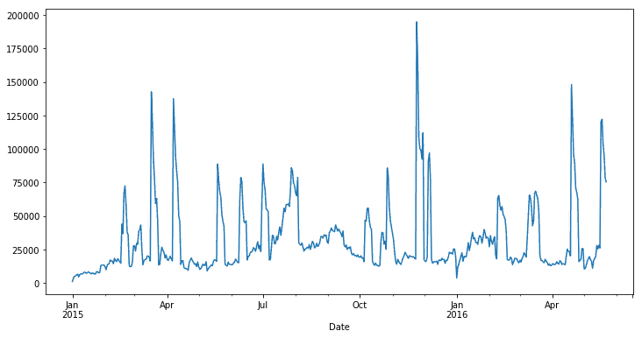
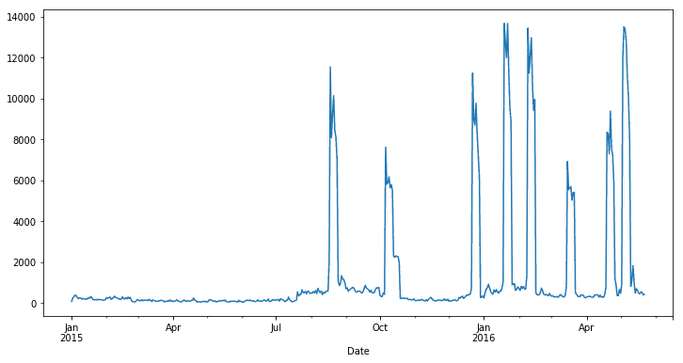
1. Forecasting. ARIMA
SKU_id = 1 SKU_id = 2
WAPE = 21.65% WAPE = 29.85%
* Forecast for each next day made from previous fact-data

Slide 8
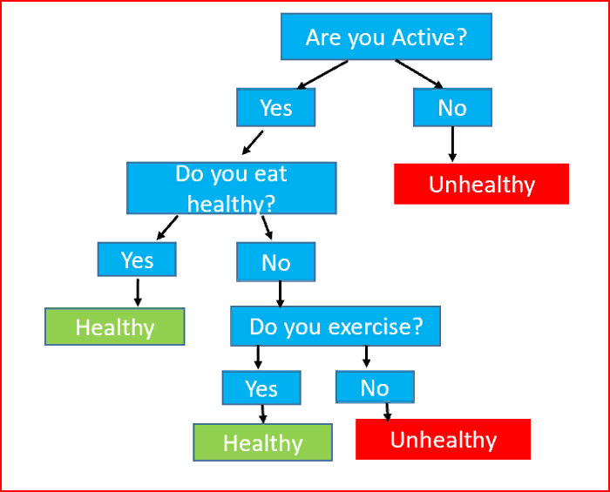
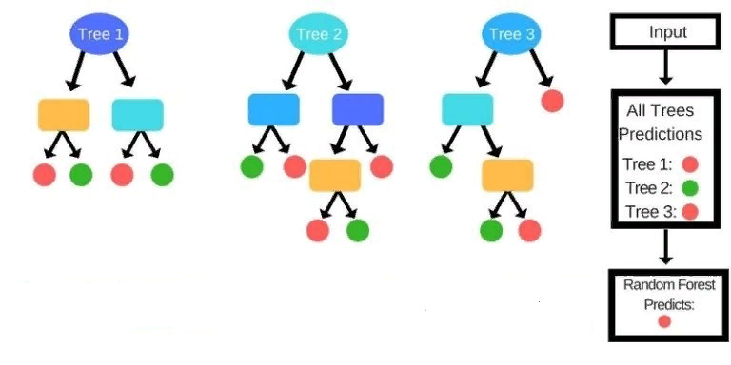
1. Forecasting. Random Forest
Random Forest is an ensemble of randomized decision trees.
Each decision tree gives a vote for the prediction of target variable.
Random forest chooses the prediction that gets the most vote.
An ensemble learning model aggregates multiple machine learning models to give a better performance.
In random forest we use multiple random decision trees for a better accuracy.

Slide 9
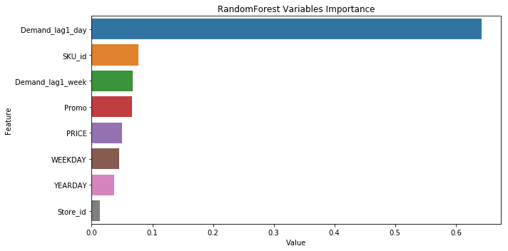
1. Forecasting. Random Forest
Detailed forecast: Store / ware / day
WAPE = 39.83%

Slide 10
2. Clustering
Goal is to find clusters in stores data
Clustering helps divide data into a number of subsets. Each of these subsets contain data that is similar to one another. These subsets are known as clusters.
We have stores sale data and stores attributes

Slide 11
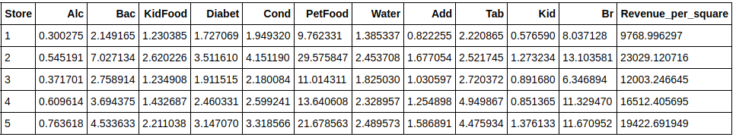
2. Clustering. Features
We want to find cluster of stores with the same power of sales:
Let’s create features for each category (level 2 of wares) and calculate average monthly percent of sold quantity per “number of SKU in category” from daily sales for each category and “revenue per 1 square feet” for each store.

Slide 12
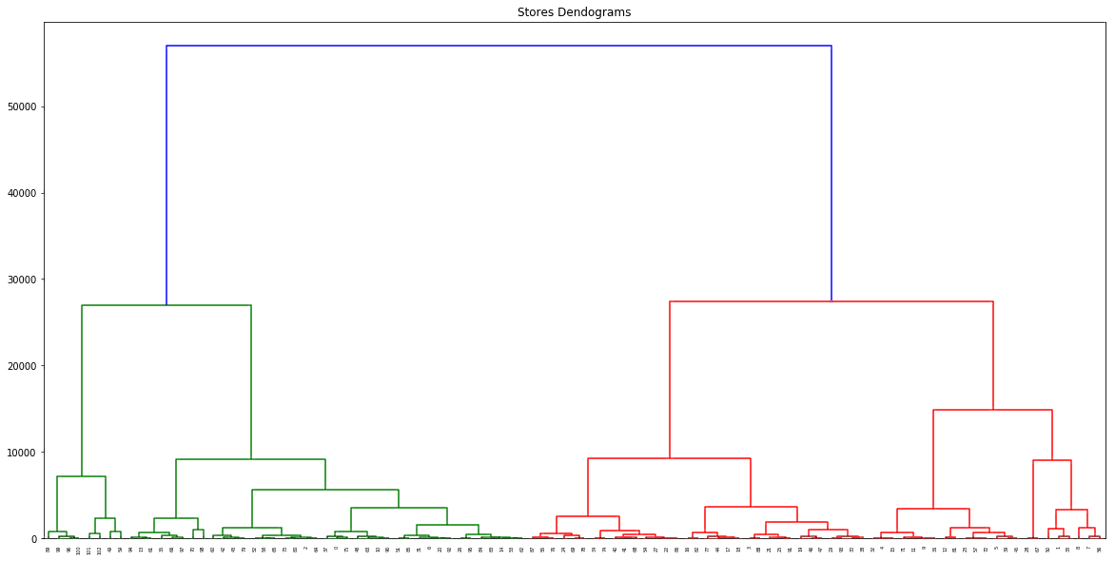
2. Clustering. Results
Hierarchical clustering method provide us clusters’ power

Slide 13
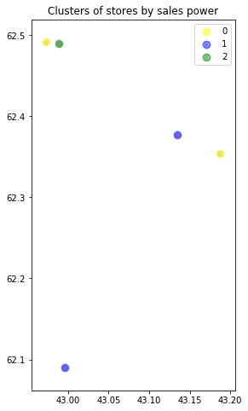
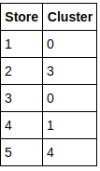
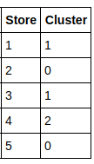
2. Clustering. Results
Based on dendrogram we can split our stores to 4 big clusters or 9 small clusters.
We can provide cluster label to each store.
4 clusters 9 clusters

