Slide 1
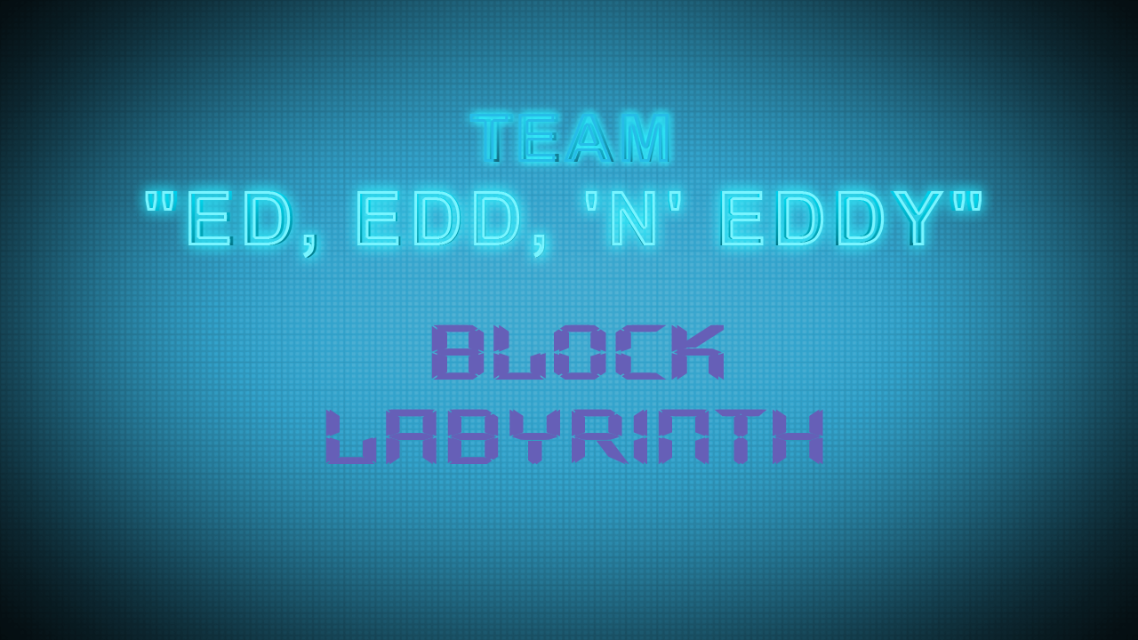

Slide 2
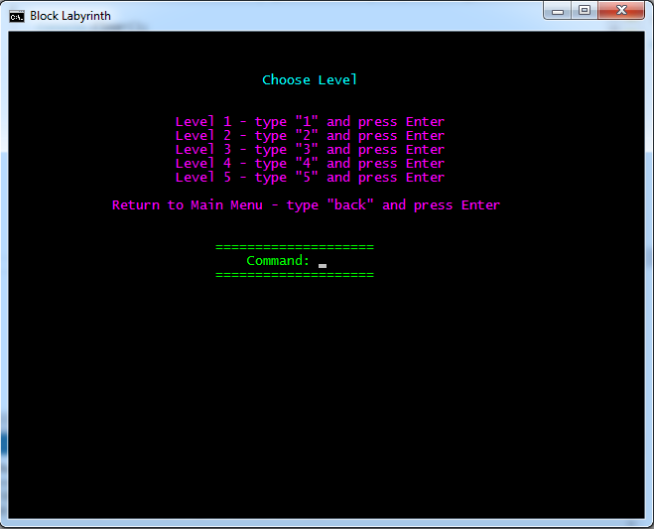
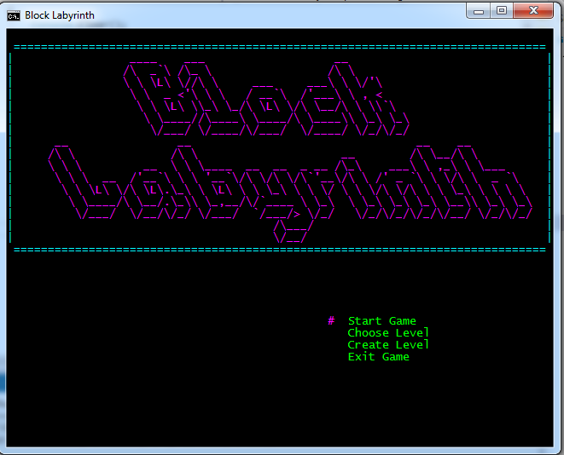
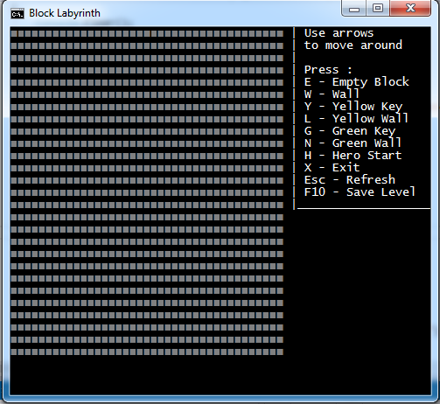
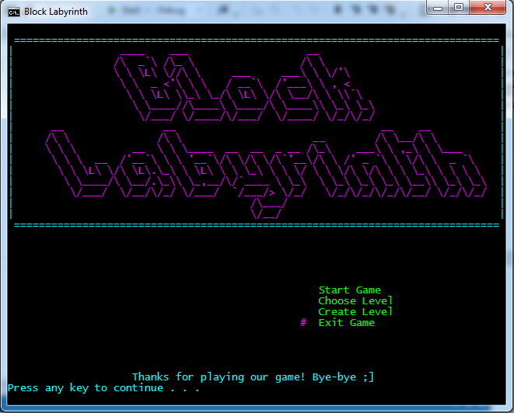
Beginning: Start Game
Loading Game Menu
Choosing a level
Create your level
Exit Game

Slide 3
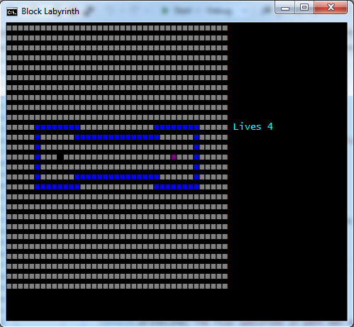
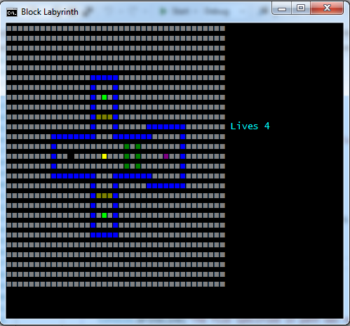
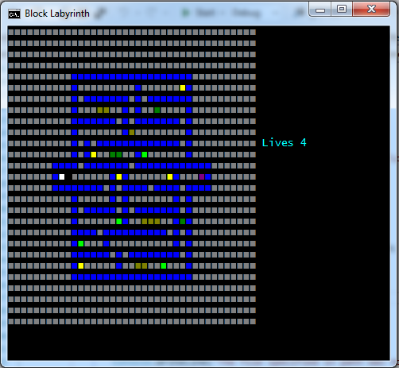
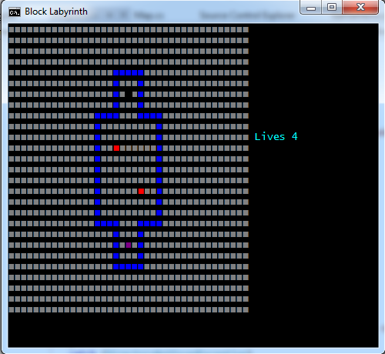
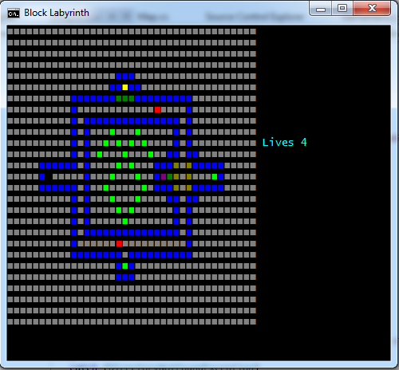
Levels
Level 1
Level 2
Level 3
Level 4
Level 5

Slide 4
structure and gameplay
BlockLabyrinth.cs
Engine.cs
Hero.cs
GameMenu.cs
Map.cs
Zombie.cs
MapMaker.cs
Hero
Zombie
End
‘\u25a0’
enemy
exit
Yellow Key
Green Key
Yellow Wall
Green Wall
Levels
Logo Game
Hero avoids Zombie
Hero hits Yellow Key to
break Yellow Wall
Hero reaches End to exit level

Slide 5
